Slide 1
Clicker Questions
Chapter 14
Matter & Interactions 4e
2015-02-21

Slide 2
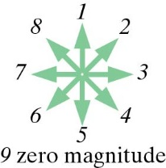
Q14.3.a
What is the direction of the electric field at the location of the point charge, due to the dipole?
Matter & Interactions 4e

Slide 3
Q14.3.b
What is the direction of the electric force on the point charge, due to the dipole?
Matter & Interactions 4e

Slide 4
Q14.3.c
A positive point charge causes a neutral molecule to polarize, as shown below. What is the direction of the electric field at the location of the point charge, due to the induced dipole?
Matter & Interactions 4e

Slide 5
Q14.3.d
A positive point charge causes a neutral molecule to polarize, as shown below. What is the direction of the electric force on the point charge, due to the induced dipole?
Matter & Interactions 4e

Slide 6
Q14.3.e
A negatively charged ion is located to the left of a neutral molecule. Which diagram correctly shows the polarization of the neutral molecule?
Matter & Interactions 4e

Slide 7

Q14.3.f
A negative point charge causes a neutral molecule to polarize, as shown below. What is the direction of the electric force on the point charge, due to the induced dipole?
Matter & Interactions 4e

Slide 8
Q14.3.g
A point charge is brought near a neutral molecule. (There is nothing else nearby).
Is it possible for the point charge and the neutral molecule to repel each other?
Yes. The molecule can polarize so that it repels the point charge.
No. The molecule can only polarize in a way that will attract the point charge.
Matter & Interactions 4e

Slide 9
Q14.3.h
You observe that a tape is attracted to a negatively charged plastic pen.
What can you conclude?
The tape is positively charged.
The tape is negatively charged.
The tape is neutral.
The tape could be positive or neutral.
The tape could be positive, negative, or neutral.
Matter & Interactions 4e

Slide 10
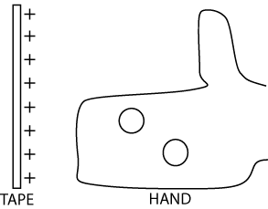

Q14.3.i
A positively charged tape is held near your hand.
Which diagram best shows the polarization of a molecule in your hand?
Matter & Interactions 4e

Slide 11
Q14.3.j
What is the direction of the force on the tape, due to the polarized molecules in your hand?
Matter & Interactions 4e

Slide 12
Q14.4.a
A solid plastic ball has negative charge spread over a small patch of surface.
Which diagram best shows the polarization of molecules inside the ball?
1.
2.
3.
Matter & Interactions 4e

Slide 13
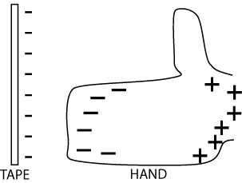
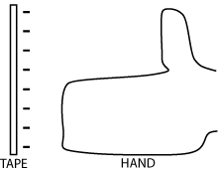
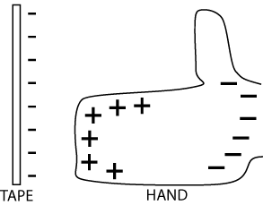
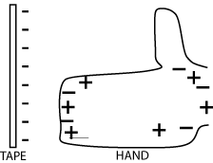
Q14.5.a
Which diagram best shows the polarization of your blood by a negative tape?
1.
3.
2.
4.
Matter & Interactions 4e

Slide 14
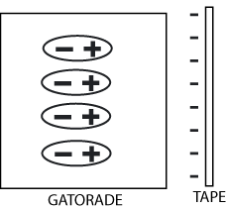
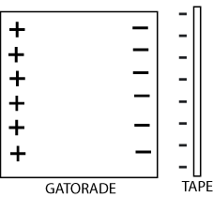
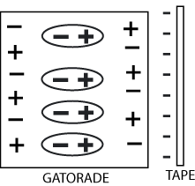
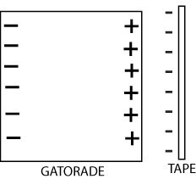
Q14.5.b
A glass of Gatorade is placed near a charged tape. Which diagram best shows the polarization of the Gatorade (which contains K⁺, Na⁺, Cl–, and other ions)?
1.
3.
2.
4.
Matter & Interactions 4e

Slide 15
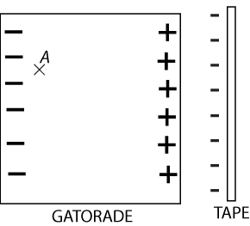
Q14.5.c
In equilibrium, what is the direction of the net electric field at location A, inside the Gatorade?
Matter & Interactions 4e

Slide 16
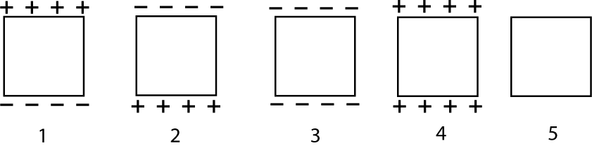
Q14.6.a
In a region of space there is an electric field upward (in the +y direction), due to charges not shown in the diagram. A neutral copper block is placed in the region. Which diagram best describes the charge distribution on the block?
Matter & Interactions 4e

Slide 17
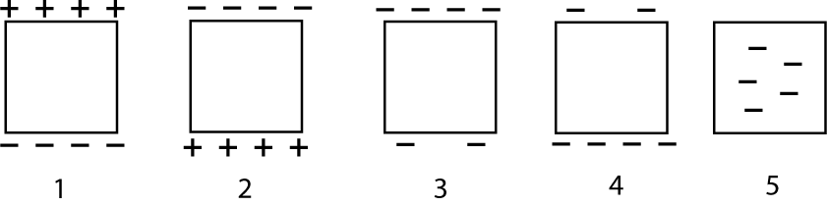
Q14.6.b
A negatively charged iron block is placed in a region where there is an electric field downward (in the –y direction) due to charges not shown. Which diagram best describes the charge distribution in and/or on the iron block?
Matter & Interactions 4e

Slide 18
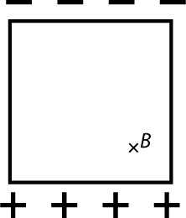
Q14.6.c
A neutral copper block is polarized as shown, due to an electric field made by external charges (not shown). What is the direction of the net electric field at location B, which is inside the copper block?
Matter & Interactions 4e

Slide 19
Location A lies within a neutral, solid piece of metal, which has been placed near two point charges.
• A
+
-
q₁
q₂
Draw and label the following electric field vectors:
The electric field at point A due to the charge q₁.
The electric field at point A due to the charge q₂.
The electric field at point A due to the surface charge on the metal.
Matter & Interactions 4e

Slide 20
Now vote:
E₂
E₂
E₁
1)
2)
E₁
E_{metal}
E_{metal}
3) Not enough information to determine E_{metal}.
E₂
E₂
4)
5)
E₁
E_{metal}
E_{metal}
E₁
Matter & Interactions 4e

Slide 21
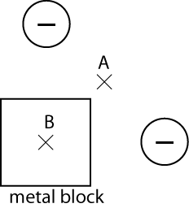
Q14.6.d
A neutral copper block is located near two balls which have equal negative charges, as shown in the diagram. What is the direction of the net electric field at location A?
Think carefully.
Matter & Interactions 4e

Slide 22
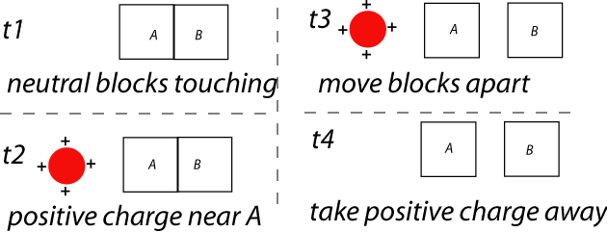
Q14.7.d Two aluminum blocks, A and B, are initially neutral. They have insulating handles, which are not shown. This sequence occurs:
At a time after t4, what is the net charge of A?
positive
negative
neutral
Matter & Interactions 4e

Slide 23
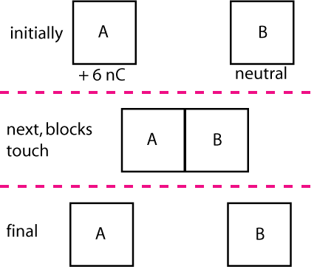
Q14.7.a
A and B are identical metal blocks. What is the final charge of block B?
+6 nC
+3 nC
0 nC
–3 nC
–6 nC
Matter & Interactions 4e

Slide 24
Q14.7.b
A and B are identical metal blocks.
What happens?
protons move from A to B
positrons move from A to B
electrons move from B to A
both protons and electrons move
no charges move
Matter & Interactions 4e

Slide 25
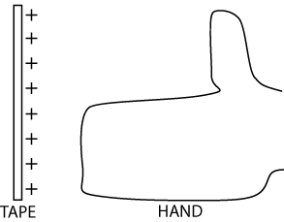
Q14.7.b
You neutralize a positively charged tape by running your finger across it.
What happens?
mobile electrons move from skin to tape
Cl⁻ ions move from skin to tape
protons move from tape to skin
+ ions move from tape to skin
no charges move
Matter & Interactions 4e

Slide 26
Q14.7.d Two aluminum blocks, A and B, are initially neutral. They have insulating handles, which are not shown. This sequence occurs:
At a time after t4, what is the net charge of A?
positive
negative
neutral
Matter & Interactions 4e

