Slide 1
Electric forces and fields
PHYS 2250 L1
2020-09-01

Slide 2
Electric Charge

Slide 3

What is charge?
Like mass, charge is a fundamental property of matter
Unlike mass, there are two types of charge
We call them “positive” and “negative”
SI unit of charge is the Coulomb (C)
Charge of 1 proton = e = $1.6 × {10}^{−19}$ C

Slide 4
Units of charge
What is the smallest possible charge?

Slide 5

Units of charge
What is the smallest possible charge?
e = proton/electron charge = $1.6 × {10}^{−19}$ C
All larger measured charges are multiples of e

Slide 6
Electric Force

Slide 7
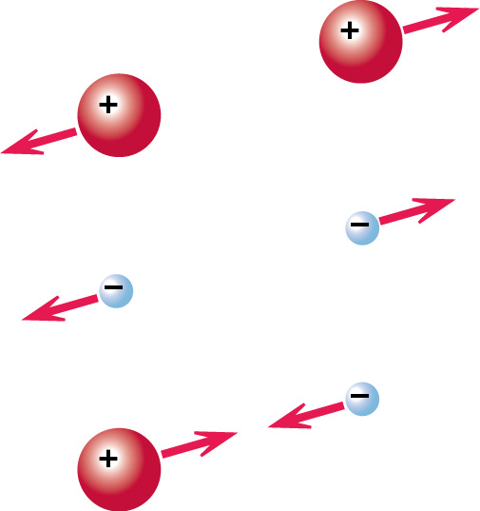
Electric Force
Just like with mass, two electric charges will experience a force
Unlike mass, force can be attractive or repulsive

Slide 8
Electric Force
How do we quantify this?

Slide 9

Coulomb Force Law
$\left|\vec{F}\right|=\frac{1}{4πε_{0}}\frac{|Q_{1}Q_{2}|}{r^{2}}$
$ε_{0}=8.85×{10}^{−12}\frac{C^{2}}{N∙m}$

Slide 10
A thought Experiment
Suppose I release a proton and it falls down at 9.8 m/s2
What do you think the proton was interacting with?

Slide 11
A thought Experiment
Suppose I try this again, and I observe the proton accelerates to the right with an acceleration of 1x10^11 m/s2
Is this likely to be caused by gravity? Why?
What could cause such an interaction?

Slide 12
A thought Experiment
What if I take away the proton (while marking it’s position) and replace it with an electron?

Slide 13
A thought Experiment
Clearly there is something going on at this point in space. Any charge we place there will experience a force!
The “property” of space we are interested in is what we will call the electric field
“Virtual Force” waiting for a charge

Slide 14
Electric Field
F2 = q2 E1
The force that particle 1 experiences due to the field of particle 2
E1 = F2/q2

Slide 15
Properties of electric field
Vector
Property of a location in space ( E(x,y,z) )
Exists even if no charge placed at location x,y,z
Created by other charged particles (at a different location)

Slide 16
Field of a point charge
We can rewrite the force of a point charge in terms of electric field
Clearly, the field of a point charge

Slide 17
Announcements
Read: M&I 13.1-13.5 for Wednesday’s lecture
Lab: Come to your lab section on Thursday to make sure you have the appropriate software installed. I’ll also be available for help with homework during this time.
HW 0 (on Canvas) due Friday
Quiz 0 (covering HW 0) on Friday

