Slide 1
Electric forces and fields
PHYS 2250 L1
2020-09-01

Slide 2
E field ring

Slide 3
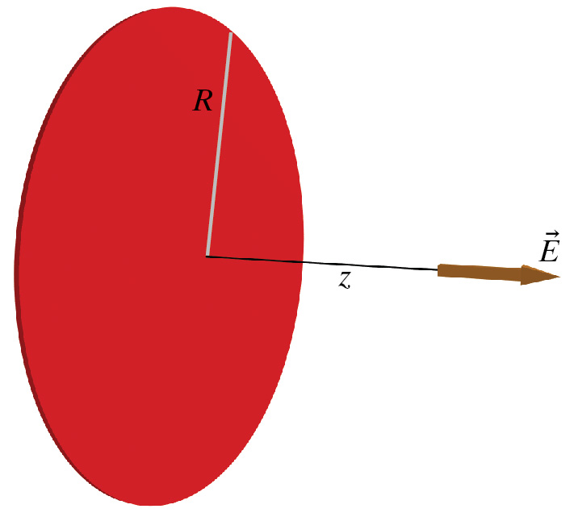
Charged Disk

Slide 4
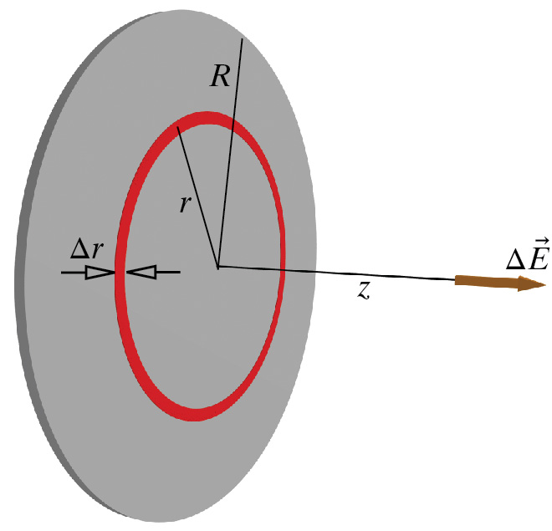
E field disk

Slide 5
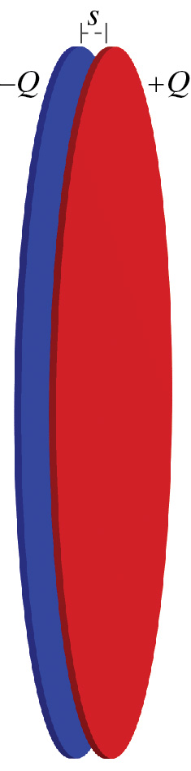
Capacitor

