Slide 1
Introduction To Electromagnetism
PHYS 2250 L0
2020-08-31

Slide 2
Four fundamental interactions
What are they?

Slide 3
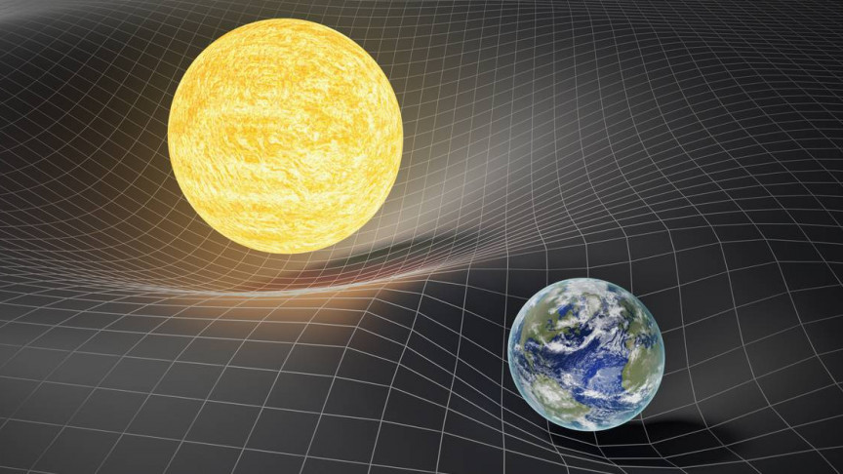
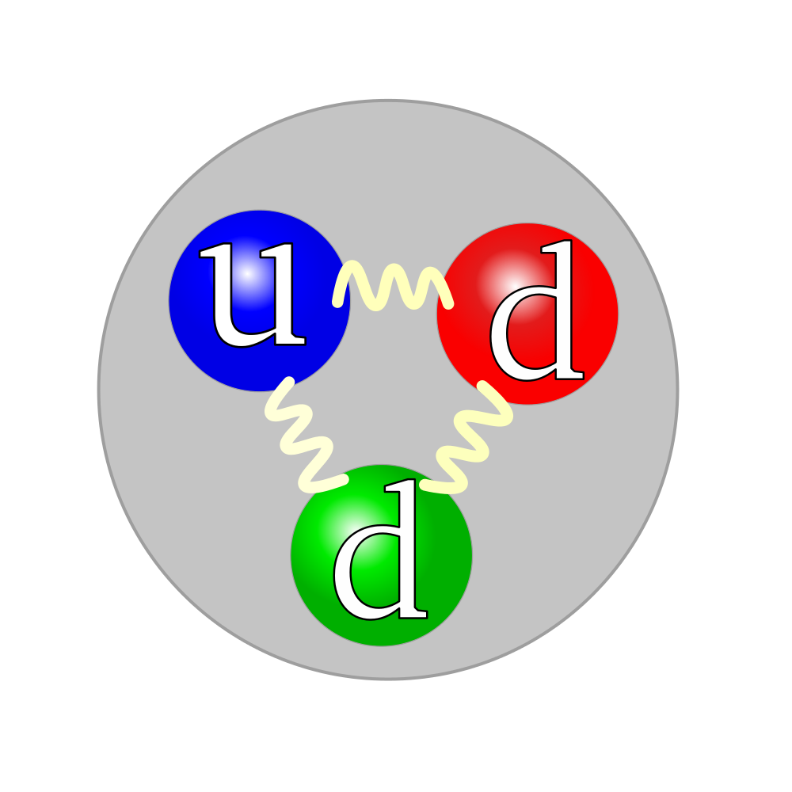
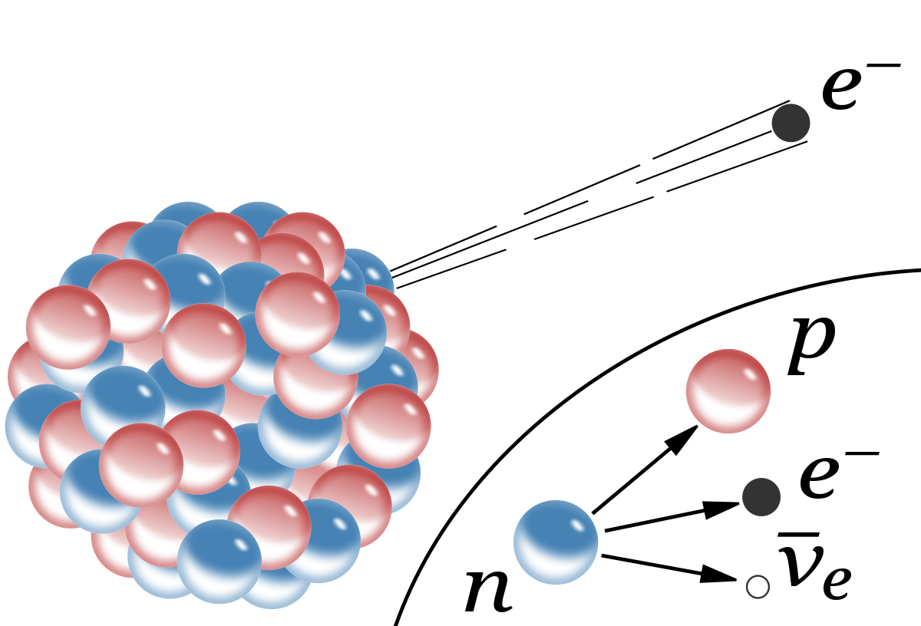
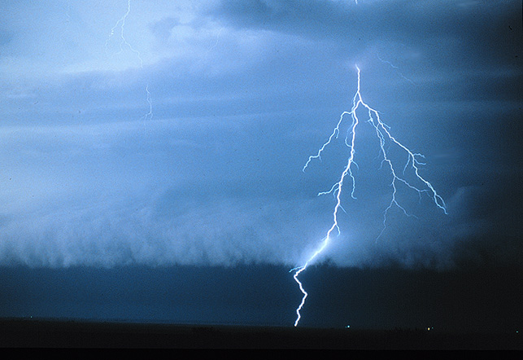
Four fundamental interactions
Gravity
Strong force
Weak force
Electromagnetic force

Slide 4
Four fundamental interactions
Relatively weak, infinite range, important over large distances
Gravity
Strong force
Weak force
Electromagnetic force
Strong, but only important within the atom
Strong with infinite range

Slide 5
Four fundamental interactions
Relatively weak, infinite range, important over large distances
Gravity
Strong force
Weak force
Electromagnetic force
Strong, but only important within the atom
Strong with infinite range
Responsible for most macroscopic phenomena

Slide 6
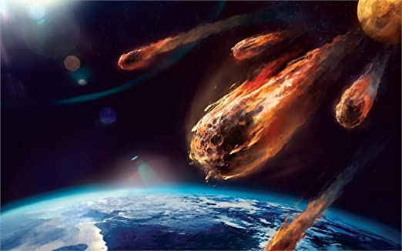

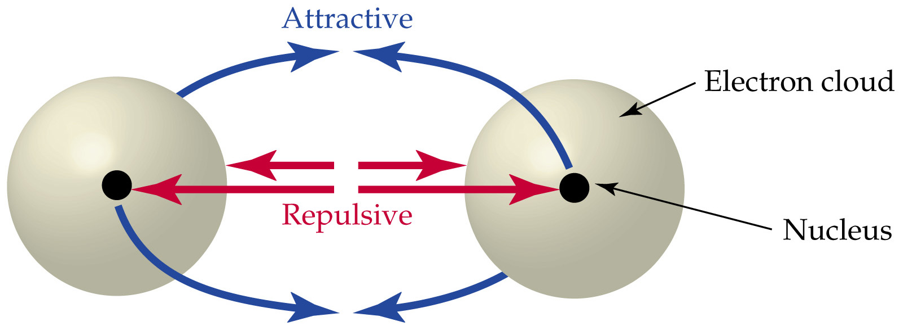
Electromagnetic Force
Responsible for:
Friction
Lightning
Rainbows
Computers
Lasers
Chemistry
…

Slide 7
What We Will Learn This Semester
How do charges create fields?
How do fields affect charges?

Slide 8
What We Will Learn This Semester
How do charges create fields?
How do fields affect charges?
Our job is to quantify this process

Slide 10
Announcements
Read: M&I 13.1-13.5 for Wednesday’s lecture
Lab: Come to your lab section on Thursday to make sure you have the appropriate software installed. I’ll also be available for help with homework during this time.
HW 0 (on Canvas) due Friday
Quiz 0 (covering HW 0) on Friday

