Slide 1






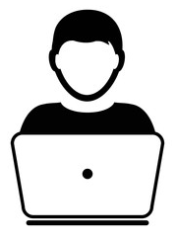









Web Server
Database Server
Front
User
Data Model Server
Data Collection

