Slide 1
Capstone Project The battle of neighborhoods
Presentation
By
Francesco Salpietro

Slide 2
Introduction
Data Science is an exciting and innovative scientific field which allows us to research and embrace many different sectors including: engineering, finance, insurance, real estate, statistical and historical data
Business Understanding entails identifying the requirements and outcomes for the specified project – in this case - we would like to perform market research for Restaurants in the city of Munich, Germany
Data Mining / Data Lifecycle is the core (80%) of Data Science and its applications – Data is collected, prepared, modelled and evaluated
Deployment – After results are presented a so-called business decision can be implemented by stakeholders
In this project Data Scientist are a consultancy that implement market analysis on behalf of stakeholders – startup investors that would invest in a new restaurant in the city of Munich
After performing a market scan using Yelp API, we collect store and prepare data to identify market opportunities: neighborhoods with a high demand for a particular restaurant type

Slide 3
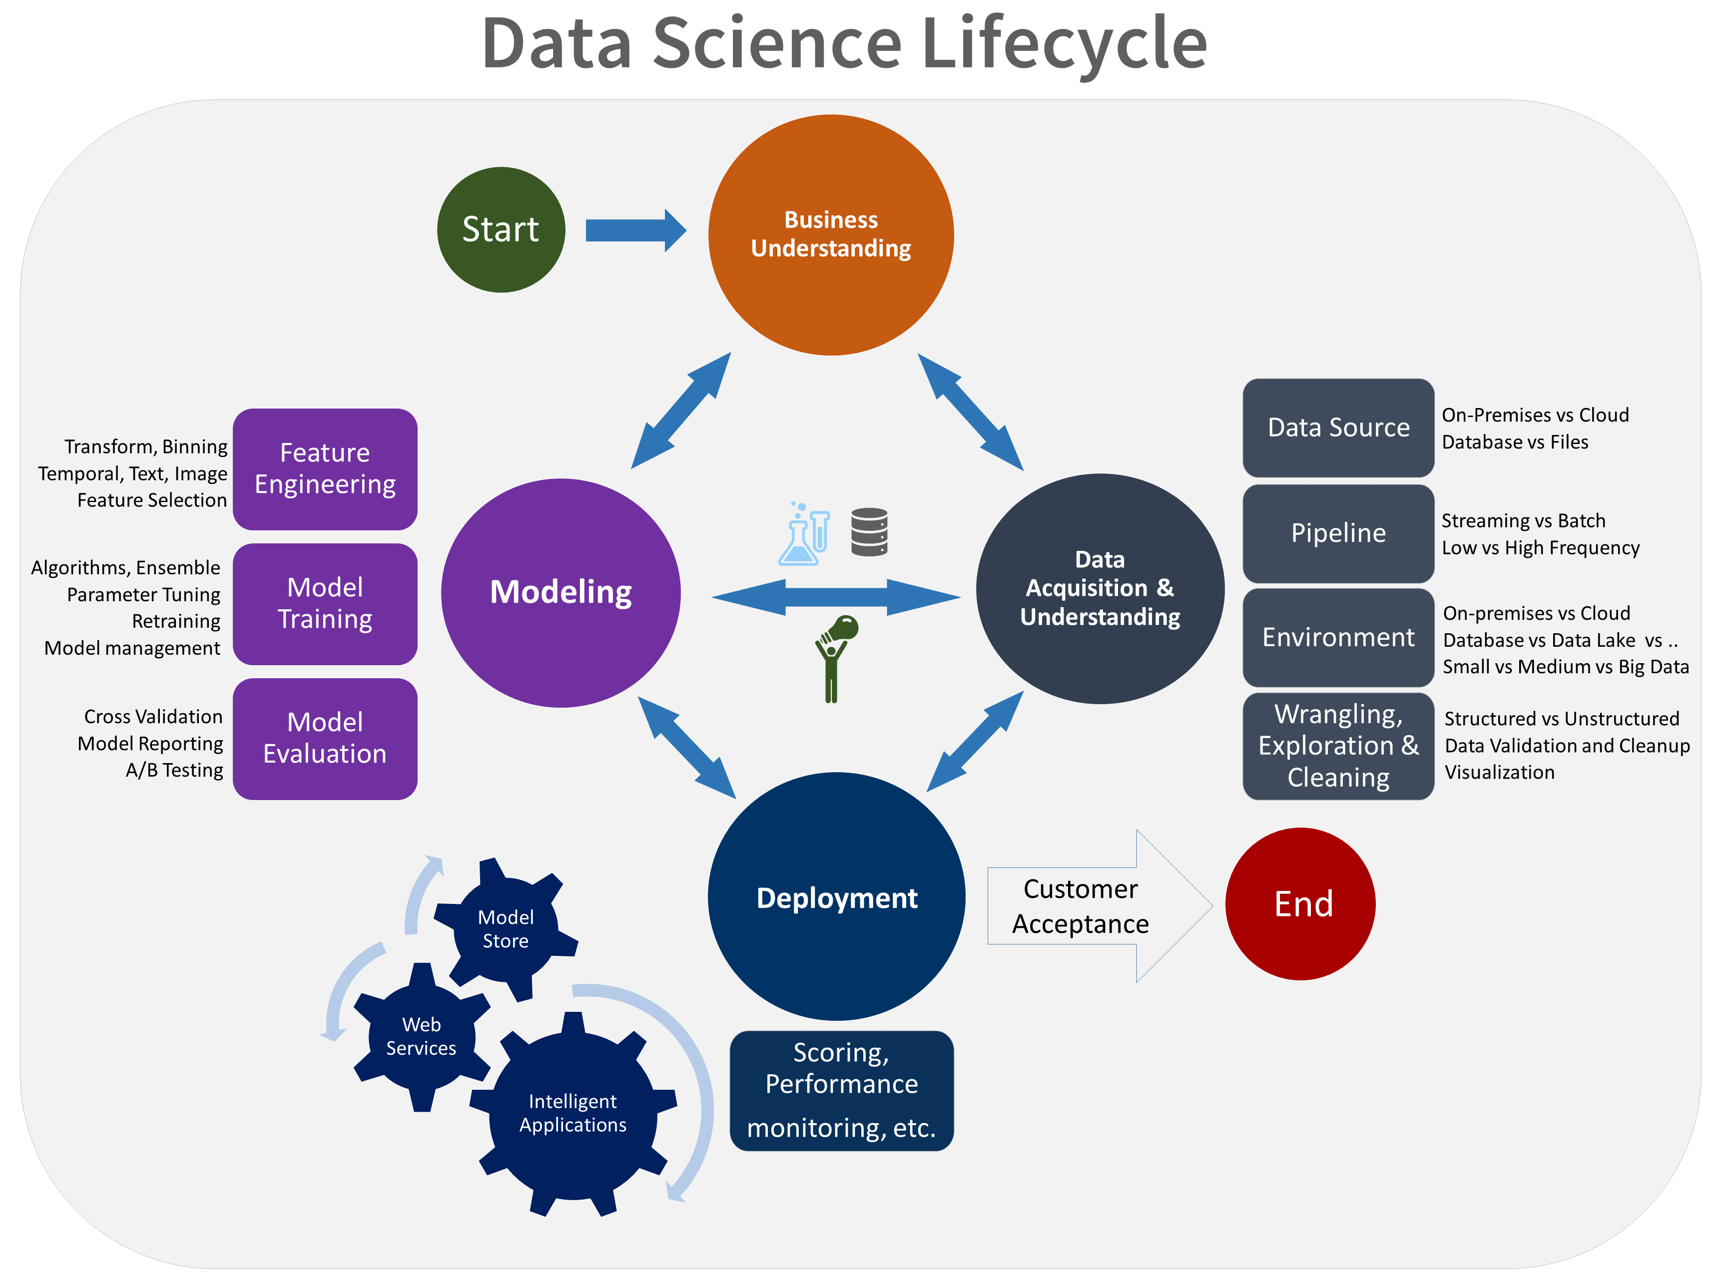

Slide 4
Data Collection
Data is streamed and saved via Yelp API – max 50 entries
Initially we have to install Yelp - Python libraries:
! pip install yelp
! pip install yelpapi # install yelp api
After that we request business search specifying “restaurant” and “Munich”
# define yelp api key, authorization data
api_key=‘YOUR KEY’ = {'Authorization': 'Bearer %s' % api_key}
url='https://api.yelp.com/v3/businesses/search'
# yelp api, businesses search - params, specifies relevant parameters - term, location, limit
# params term - restaurant, bars, cafes, italian, japan, china, location city, limit 5, 10, 20 max 50
# limit is 50 restaurant entries, specified by yelp api
params = {'term':'restaurant','location':'Munich', 'limit':'50’}
Many other parameters can be specified – attributes, id, url more can be found
https://www.yelp.com/developers/documentation/v3/business

Slide 5
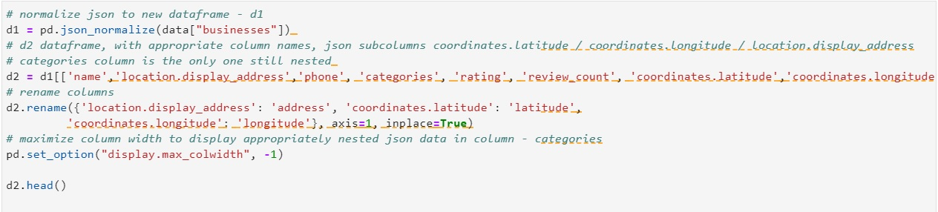
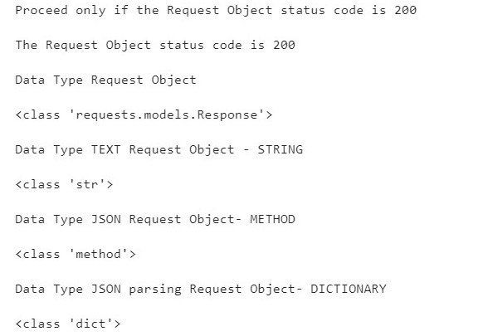
Data Preparation
Data is initially streamed as a Request Objects from the URL via the Yelp API – req = request.get(url, params=params, headers=headers)
req is then parsed as Text data to JSON Data Type data = json.loads(req.text)
d2 is the first DataFrame containing most data

Slide 6
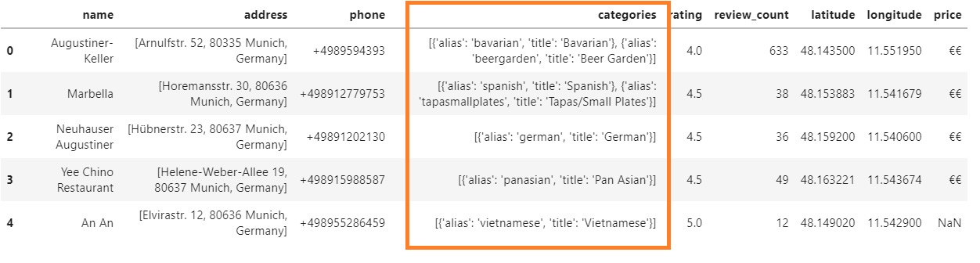
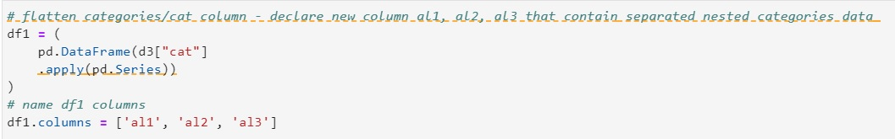
We notice that data is still JSON Multi-Nested – ‘categories’ column
More flattening is required

Slide 7
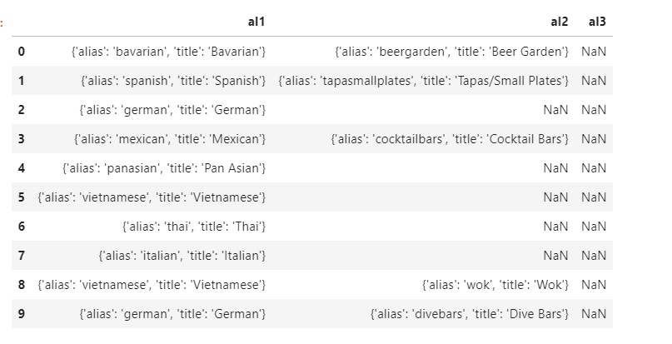
We declare df with 3 categories columns al1-al3
More JSON normalization is required
df = pd.json_normalize(data[‘businesses’])

Slide 8
Every single Restaurant Entry needs to be categorized – we declare dff1 as df containing categorization columns: cat1 / cat2 / cat3 – we notice that some entries have multi categorization, that is cat1: German cat2: Bavarian cat3: Gastropubs, others have just 2 categorization terms: cat1: Spanish cat2: Tapas/Small Plates
# Extract from dff1 - cat 1/2/3 Columns all relevant categorization information
df_flat4['fl1'] = dff1.cat1.str.extract(r'\b(\w+)$', expand=True)
df_flat4['fl2'] = dff1.cat2.str.extract(r'\b(\w+)$', expand=True)
df_flat4['fl3'] = dff1.cat3.str.extract(r'\b(\w+)$', expand=True)
df_flat4 = dff1.fillna('')
# New CAT Column to store all previously extracted - relevant categorization information
df_flat4['CAT'] = df_flat4['cat1'] +' - '+ df_flat4['cat2']+' - ‘+ df_flat4['cat3']
df_flat4.head(50)
Finally, the DataFrame satisfying our data requirements is constructed and displayed

Slide 9
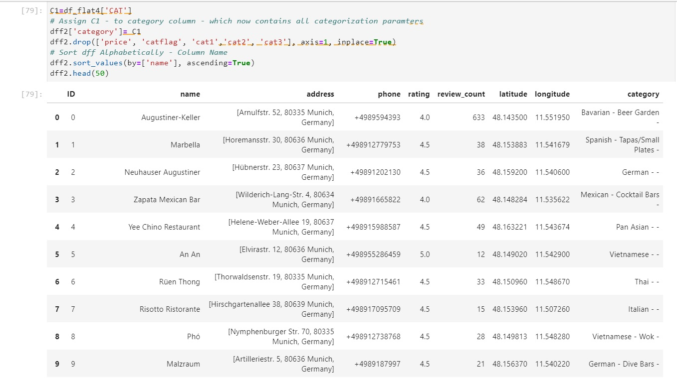

Slide 10
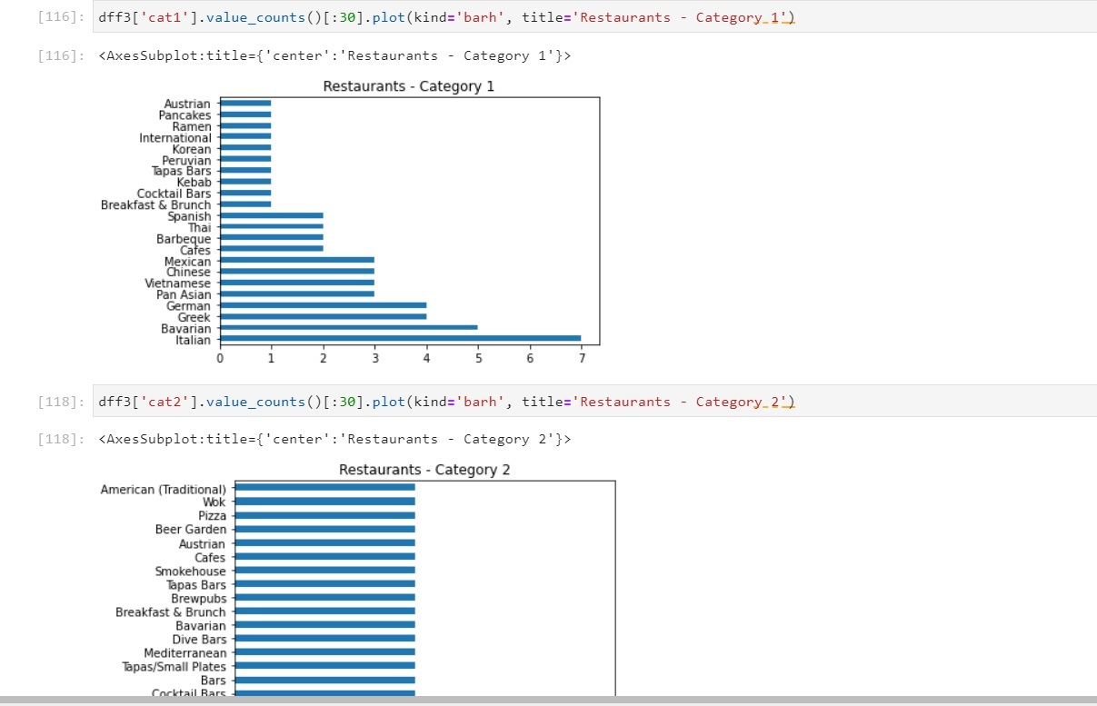
We can display categories VS frequency of occurrence

