Slide 1
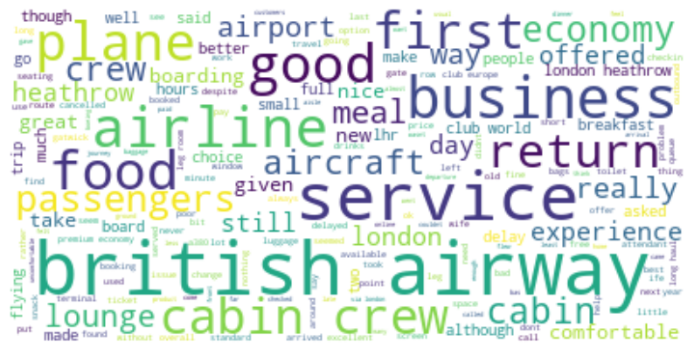
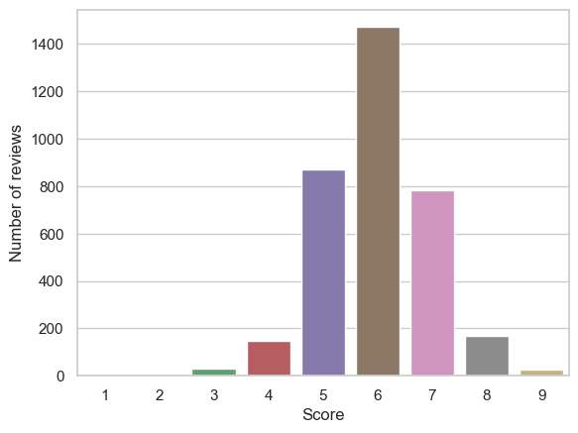
3500 surveys scraped and analysed from Skytrax
Average word count: 160 words, Average word length: 4 characters
Reviews contained an average of 73 stopwords at an average rate of 44%
Sentiment analysis performed on the reviews :
Polarity of reviews ranged from -0.83 to 0.8 on a scale of -1 – 1 where a higher value reflects a more positive review
Subjectivity (0 - 1) varied between the two extrema.
Overall, the reviews leaned towards a more positive outlook of British Airways.
Calculated score for the positivity of each review
Wordcloud of key words and phrases found in the reviews

