Slide 1

Task 2: Predicting customer buying behaviour
July 2023

Slide 2
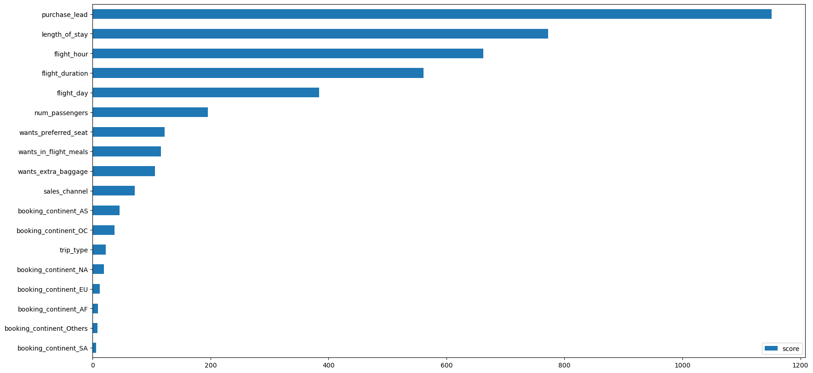
predictive model to understand factors that influence buying behaviour
Key Findings:
Using the features importance of the model, the most important factors influencing customers in completing their bookings were ‘purchase_lead’ and ‘length_of_stay’: the time gap between the order time and flight, and how long the customer intends to stay at their destination, respectively.
For ‘purchase_lead’, unfinished bookings have a higher ‘purchase_lead’ value than completed ones.
Similarly, the average value for ‘length_of_stay’ is higher for bookings that are not finished.
On the other hand, the location the customer is making their booking from does not affect whether they will complete the booking or not.
Possible Solutions:
Introducing attractive offers for completing bookings such as larger discounts if a booking is completed more than 30 days before the scheduled flight.
Implementing options for customers to reschedule their flights with a deadline of at least 3 days before the flight.

