Slide 1

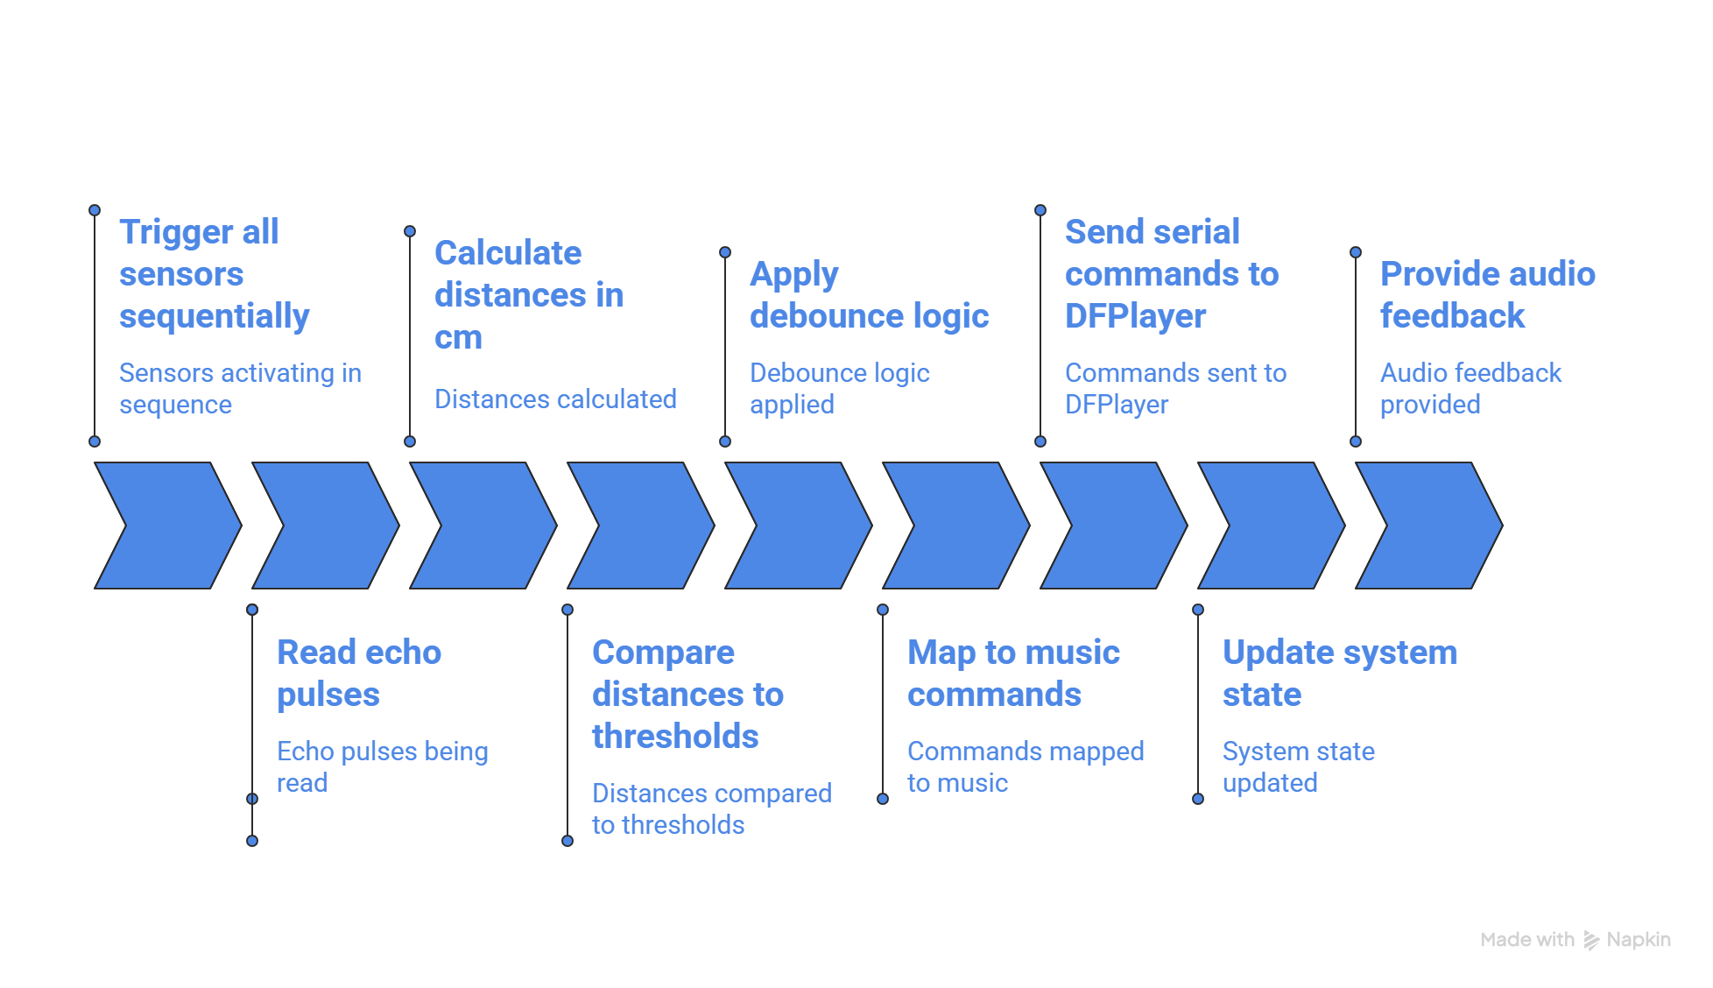
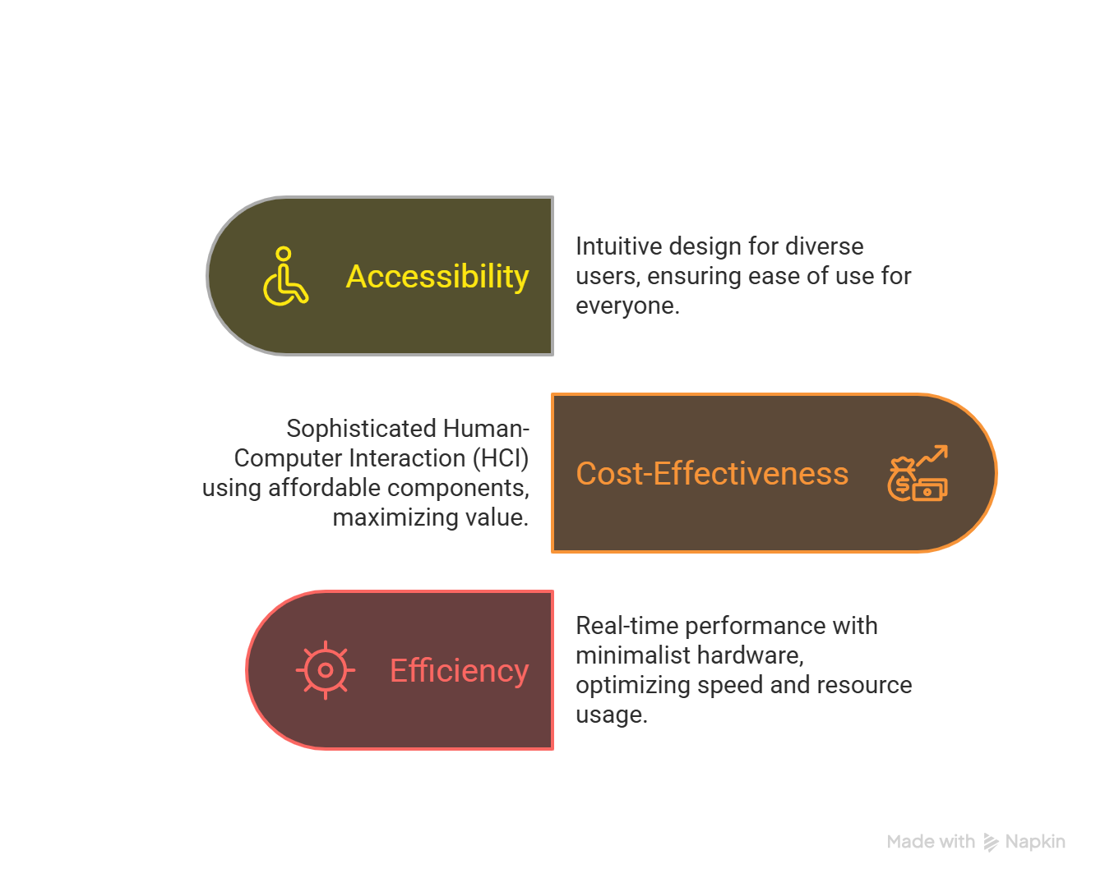
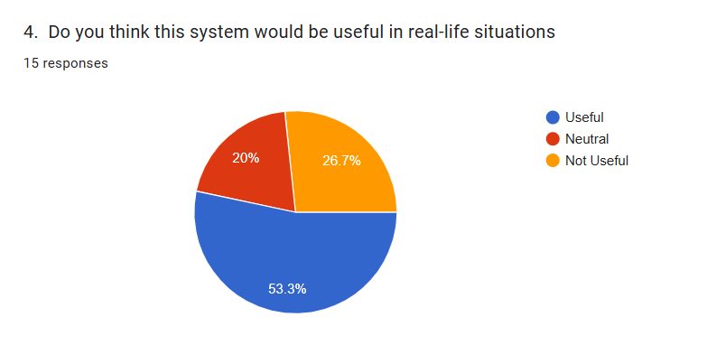
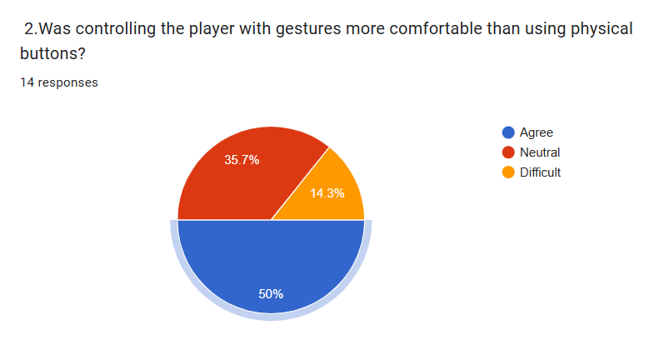
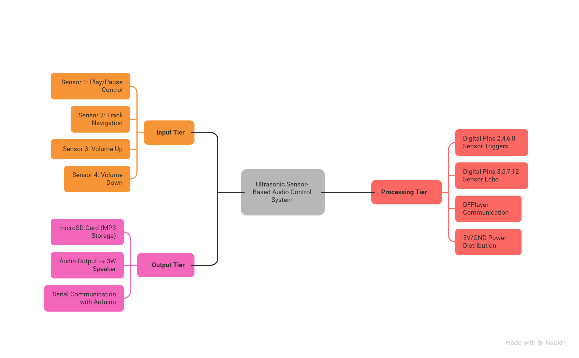
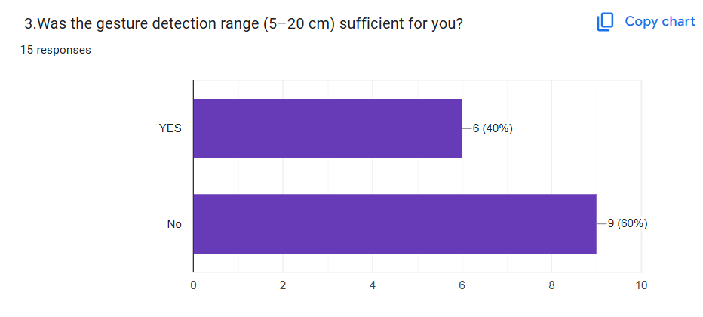
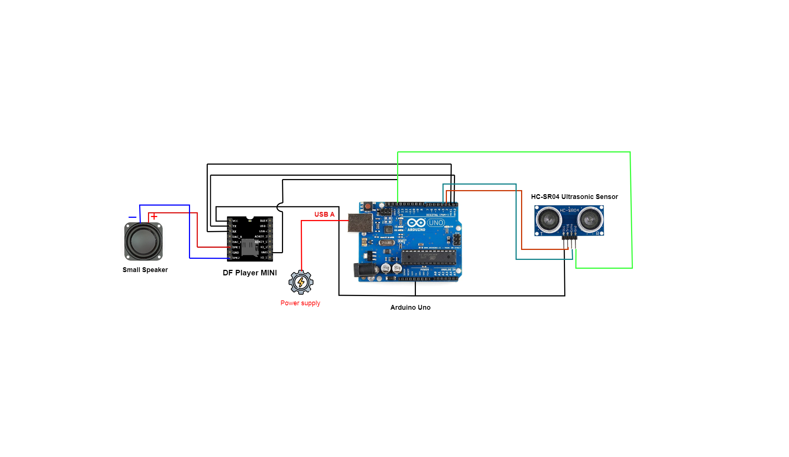
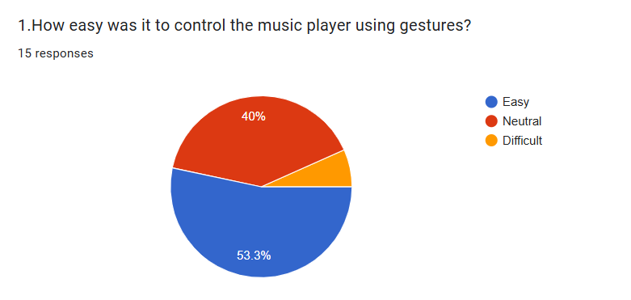
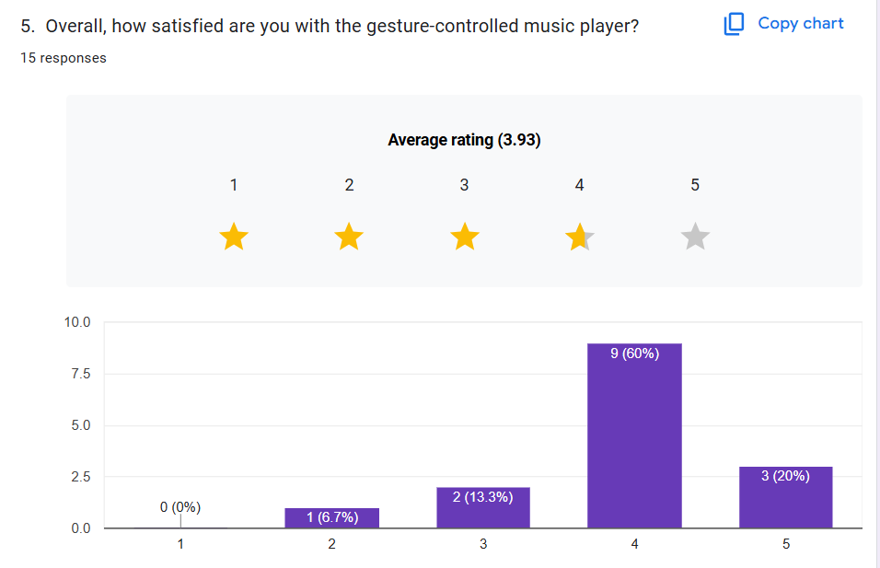
Touchless Music Controller
TUTUL KUMAR GHOSH
ID : 22-47813-2
P.M TASRIFUL ISLAM
ID : 22-47885-2
ANANYA DUTTA
ID : 22-47966-2
MD.SAIF AHMED SOURAV
ID : 22-46790-2
ABSTRACT
This project develops a gesture-controlled music player using Arduino UNO, DFPlayer Mini, ultrasonic sensors, and a speaker. Hand gestures replace physical buttons to control play/pause, track navigation, and volume, demonstrating a practical Human-Computer Interaction (HCI) system that enhances touchless accessibility and user experience.
INTRODUCTION
Problem
Solution
Key Findings
Traditional music players require physical contact (buttons or touchscreens), which is inconvenient when hands are occupied, dirty, or in environments demanding hygiene.
GestureTune utilizes affordable ultrasonic sensors to detect hand gestures, translating them into commands for an Arduino-based music player, eliminating the need for physical contact.
Ultrasonic Gesture Recognition: Low-cost, real-time hand detection without complex hardware.
Arduino UNO & DFPlayer Mini: A simple, robust, and portable hardware core.
Intuitive HCI Mapping: Natural gestures directly mapped to music controls
BACKGROUND AND MOTIVATION
Structure
of Algorithm Model
Result and Future Improvements
Hands-free control for kitchens, labs, medical settings, exhibits, accessibility, and automotive systems.
.
All core functions were executed correctly upon gesture input. User-Friendly .. The entire system was built using affordable, off-the-shelf components.Majority found gestures intuitive (53%) and rated satisfaction highly (3.93/5).60% confirmed detection range sufficiency, supporting design choices. Over half of users saw practical application, indicating strong adoption promise.
Extend detection range beyond 20cm
Add LED feedback for gesture confirmation
Implement Bluetooth for wireless audio
User Data Survey Report
survey was conducted to evaluate the usability and effectiveness of the gesture-controlled music player.. Participants were asked about ease of use, accuracy, comfort, and satisfaction with the system.
Structure of Hardware Model
Conclusion
The gesture-controlled music player successfully demonstrates a functional and accessible HCI system. User feedback confirms its intuitive operation and real-world applicability. Future work will focus on expanding gesture complexity and enhancing user customization features.
References
Norman, D. A. (2013). The Design of Everyday Things. Revised Edition. Basic Books.
Arduino LLC. (2022). Arduino UNO Technical Specifications. https://www.arduino.cc/
DFRobot. (2021). DFPlayer Mini User Manual. https://www.dfrobot.com/
Department of Computer Science, Faculty of Science and Technology.
American International University-Bangladesh (AIUB)

