Slide 1
Automate Your Quality of Life With PowerShell
With Active Directory heavy examples, and some other tips

Slide 2
Tim Fox
Automation Engineer
20 Years in IT
15 Years wearing a combination of System, Network, Infrastructure, + Administrator, Engineer, Architect, Developer hat
Command Line Fool since 1994
Lazy Windows Administrator since 2006
PowerShell Enthusiast since 2013
Loves all things mechanical & electrical (Bonus Points for Jeeps)
Obsessed with finding the perfect ink pen
/

Slide 3
Why I love PowerShell…
PowerShell is Awesome
Because I’m Lazy

Slide 4
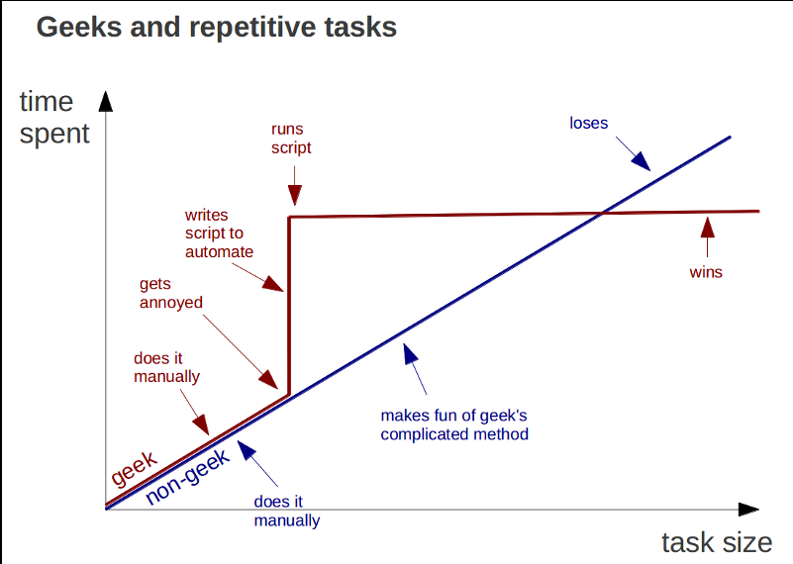
Why you should learn automation tools…

Slide 5
What We Will Cover
Comments
Profiles
Logging
Pipeline Output
Functions
Aliases
Session Variables
Parameters
For-Each loops
If statements
Optimizing Best Practices in your Scripting
Bonus Facts
* This will be mostly Demo Focused
** This is not intended to be exhaustive, just a sample of what is possible

Slide 6
Things to Remember…
Most of my examples are Active Directory Related, but PowerShell Cmdlets are agnostic
Select-Object
Sort-Object
Group-Object
Where-Object
Measure-Object
Filter-Table
Export-CSV
Add-Content

Slide 7
Comments
# This is a single line comment
<#
This is a multiline comment
#>
Write-Host "Hello World" # This is an inline comment
Comment your code when you have the chance. You don’t want to be woken up at 3 am with something broke while you try to figure out what you were thinking 9 months ago when you wrote the code.

Slide 8
Profiles
4 – 6 Locations for your PowerShell Profile *
Description | Path
Current User, Current Host – console | $Home\[My ]Documents\WindowsPowerShell\Profile.ps1
Current User, All Hosts | $Home\[My ]Documents\Profile.ps1
All Users, Current Host – console | $PsHome\Microsoft.PowerShell_profile.ps1
All Users, All Hosts | $PsHome\Profile.ps1
Current user, Current Host – ISE | $Home\[My ]Documents\WindowsPowerShell\Microsoft.PowerShellISE_profile.ps1
All users, Current Host – ISE | $PsHome\Microsoft.PowerShellISE_profile.ps1
https://devblogs.microsoft.com/scripting/understanding-the-six-powershell-profiles/
* Windows 11 has a slightly different folder structure; Windows XP - 10 uses this structure

Slide 9
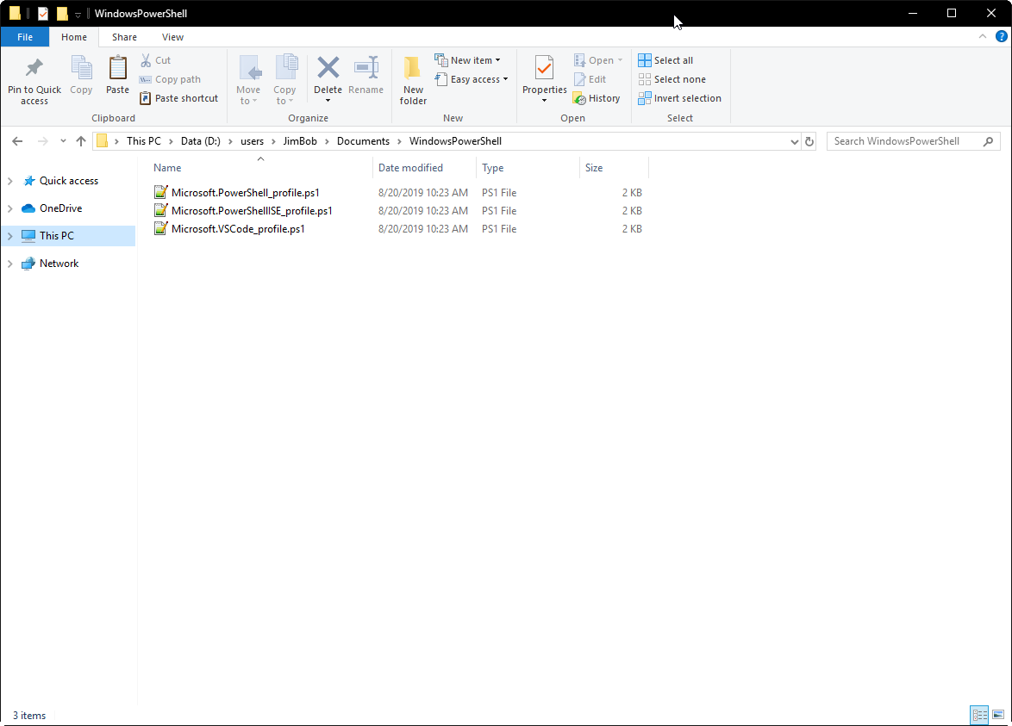
My Personal Profile Preference
\user\Documents\WindowsPowerShell

Slide 10
My Personal Profile Preference
\$user\Documents\WindowsPowerShell
3 Profile Files
One for PowerShell
One for PowerShell ISE
One for VS Code
All 3 files are identical so that all interpreters load the same things
These 3 files also exist in the user folders for multiple users for a consistent user experience across user accounts
You can use this trick to have a consistent user experience across different accounts that you run PowerShell under
Windows 11 users a slightly different folder structure
PowerShell 7 also has a config file you can set

Slide 11
My Personal PowerShell Profile File
# Clears Console Window
Clear-Host
# Sets Domain/Username variable
$user = whoami
# directory where my scripts are stored
$autoload="C:\Users\gtfox\OneDrive - columbusairports.com\Documents\GitHub\GTFox\Powershell\Autoload"
# load all scripts in autoload folder
Get-ChildItem "${autoload}\*.ps1" | ForEach-Object{.$_}
# Turns On Transcription - Functionality moved to Transcription.ps1
start-transcript -path "C:\Users\gtfox\OneDrive - columbusairports.com\Documents\Code\Transcripts\$env:username\$(get-date -f yyyy-MM-dd)-ISE.txt" -Append
#Insprational Saying
Inspirational-Sayings
Set-Location "C:\Users\gtfox\OneDrive - columbusairports.com\Documents\GitHub\GTFox\Powershell"
# Welcome message
Write-Host "`nYou are now entering a custom PowerShell Environment:"$user -foregroundcolor "black" -backgroundcolor "yellow"`n

Slide 12
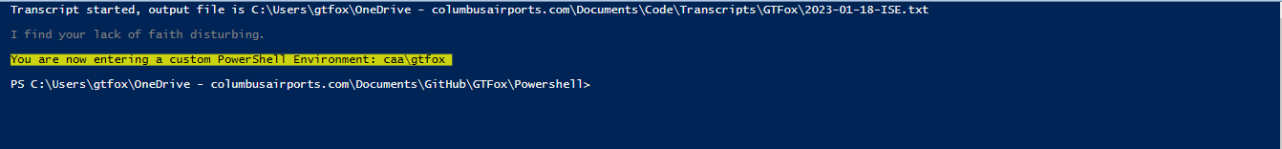
My Personal PowerShell Profile File in Action

Slide 13
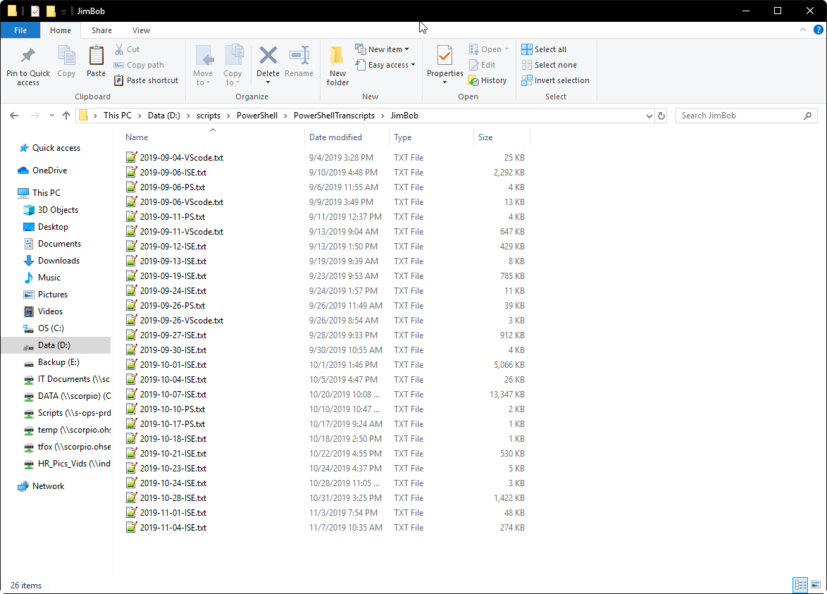
My Personal Logging Scheme
There is no undo in PowerShell!!!
Transcription Logs can Establish what you (or somebody else) did in order fix it.

Slide 14
Using the PowerShell Pipeline
Pipelines act like a series of connected segments of pipe. Items moving along the pipeline pass through each segment. To create a pipeline in PowerShell, you connect commands together with the pipe operator "|". The output of each command is used as input to the next command.
* https://docs.microsoft.com/en-us/powershell/scripting/learn/understanding-the-powershell-pipeline?view=powershell-6
Feeding the output from one command into another command. More on this Later.
Ex:
Get-AdUser gtfox
Lists select attributes for user
Get-ADUser -Filter *
Lists select attributes for all users in AD
Get-ADUser -filter * | Select-Object Name, UserPrincipalName, SID
Only Lists Name, UPN, & SID
Get-ADUser -filter * | select Name, UserPrincipalName, SID | Sort-Object Name
Lists Name, UPM, SID; Sorted by Name
Get-ADComputer -filter * -searchbase "OU=computers,DC=contoso,DC=com" -server contoso.com -properties comment |
Where-Object { $_.comment -ne "noreboot" } |
Select-Object name |
Sort-Object Name

Slide 15
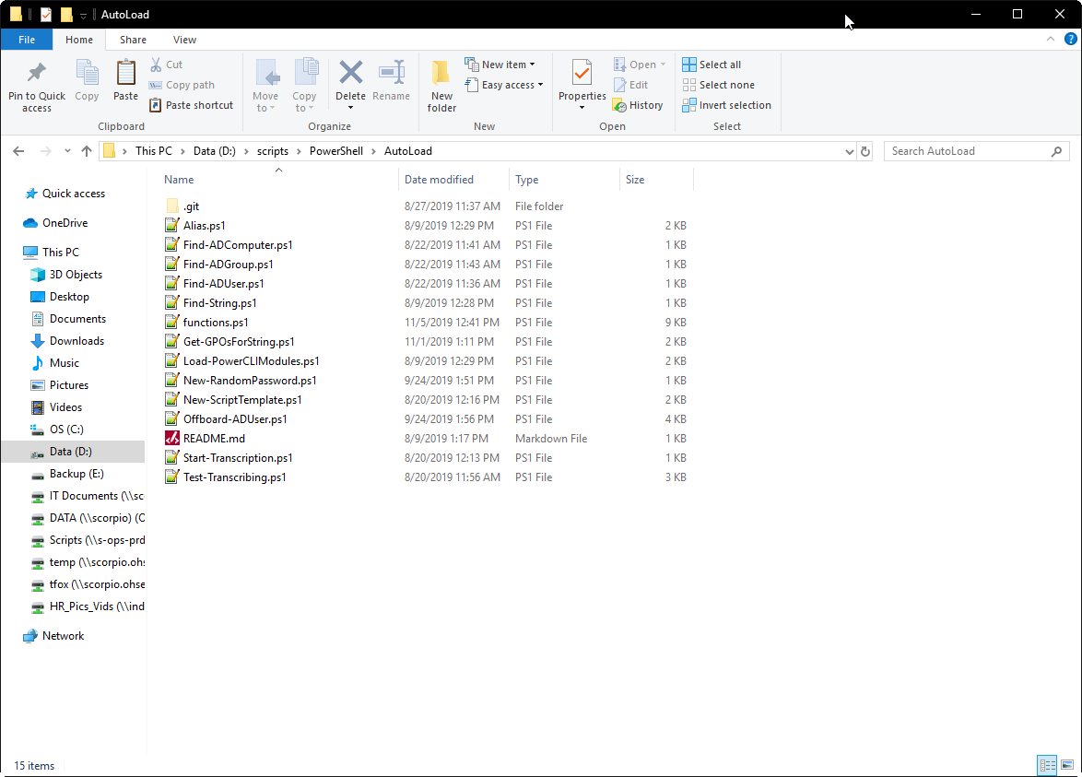
PowerShell Functions
… a way of collecting up a bunch of code to perform one or many different times by just pointing to it instead of duplicating that code repeatedly.
* https://www.business.com/articles/functions-in-powershell/
AKA – A Way to Improve Your Quality Of Life and save you from mundane repeatable tasks.

Slide 16
PowerShell Functions part 2
Quick and easy way to cough up a QOTD
Illustrates how you can obtain a random line of text (or value from a file and use it)
Function Get-QTOD
{
$color = @('Gray','Red', 'Yellow', 'Green', 'Cyan', 'Magenta', 'DarkYellow', 'DarkGray')
$QTOD = Get-Content "C:\Users\gtfox\OneDrive - columbusairports.com\Documents\GitHub\GTFox\Powershell\QTOD.txt" | get-random
Write-host `n$QTOD -ForegroundColor (Get-random $color)
}

Slide 17
PowerShell Aliases
A PowerShell alias is a shortcut to a command that can save you some keystrokes and help you remember commands.
* https://4sysops.com/archives/how-to-create-a-powershell-alias/
dir = Get-ChildItem
ipconfig = Get-NetIPConfiguration
ping = Test-NetConnection
nslookup = Resolve-DnsName
Get-Alias – Lists all Aliases loaded on your session
You can create your own Aliases to suit your needs and load them with your PowerShell Profile.
set-alias ifconfig ipconfig
# Type "edit <filename.ext>" and the file will open with Notepad
set-alias edit Notepad
# Exchange Remote PowerShell Console
set-alias Exchange-Console D:\scripts\Powershell\Exchange\ExchangeShell.ps1

Slide 18
PowerShell Session Variables
You can create and store variables for the life of your session. This may be a commonly used value that you use across multiple scripts.
$ver = $psversiontable.PSVersion
Could have been done with an Alias
$scriptsotput = “d:\scripts\output\”
$DesktopPath = [System.Environment]::GetFolderPath([System.Environment+SpecialFolder]::Desktop)
Returns \Users\JimBob\Desktop
$DesktopWorkingPath = “$desktopPath\working”
Returns \Users\JimBob\Desktop\Working
$PowerShellPath = “d:\scripts\”

Slide 19
PowerShell Parameters
You can write scripts that take an input (parameter) to do work. You can also use multiple parameters.
Simple dice rolling script I wrote as a personal challenge years ago.
Function roll ($Dice, $Sides)
{
[int]$counter = 0
If (!($dice)) {$dice = 2}
If (!($sides)) {$sides = 20}
Write-Host `n
Do {
$counter++
$num = get-random -min 1 -max $($sides + 1)
Write-Host "Dice "$counter": "$num -ForegroundColor "magenta"
} until ($counter -eq $dice)
}

Slide 20
PowerShell For-Each
You can write scripts that take an input (parameter) to do work. You can also use multiple parameters.
#Read group members from CSV file
$Import = Import-CSV "C:\Users\gtfox\OneDrive - columbusairports.com\Documents\Projects\RBAC\users.csv"
# Could incorporate the $Group into CSV
#Iterate members one by one and add to group
Foreach($Item in $Import)
{
Write-host $Item
}

Slide 21
PowerShell If statements
You can write scripts that can produce two different outputs based on a condition.
$condition = $true
if ( $condition )
# This statement could have been written as "If ($condition -eq $true)”
{
Write-Output "The condition was true"
}
else
{
Write-Output "The condition was false"
}

Slide 22
PowerShell Optimization
There are multiple ways to get the same information, with some being faster than others.
Get-ADUser -Filter {UserPrincipalName -ne “$Null"} -Properties UserPrincipalName |
Sort-Object name |
Format-Table Name, SAMAccountName, UserPrincipalName -auto
Get-ADUser -Filter {UserPrincipalName -ne “$Null"} -Properties UserPrincipalName |
Select-Object Name, SAMAccountName, UserPrincipalName |
Sort-Object name |
Format-Table Name, SAMAccountName, UserPrincipalName -auto
Get-ADUser -Filter * -Properties UserPrincipalName |
Where-Object { $_.UserPrincipalName -ne $null } |
Sort-Object name |
Format-Table Name, SAMAccountName, UserPrincipalName -auto
Get-ADUser -Filter * -Properties UserPrincipalName |
Where-Object { $_.UserPrincipalName -ne $null } |
Select-Object Name, SAMAccountName, UserPrincipalName |
Sort-Object name |
Format-Table Name, SAMAccountName, UserPrincipalName -auto

Slide 23
PowerShell Optimization
There are multiple ways to get the same information, with some being faster than others.
Method 1
11.8 Seconds *
Method 2
0.57 Seconds *
Method 3
11.25 Seconds *
Method 4
0.98 Seconds *
* There are many variables that can change the speed that a script takes. These include resources on the DC, resources on the local PC, and network bandwidth. These numbers are also based on an Active Directory Domain with ~ 500 Active Directory User Accounts.

Slide 24
PowerShell Optimization
There are multiple ways to get the same information, with some being faster than others.
Because Active Directory is just a database you can shape your query to filter unnecessary data as quickly as possible to speed up subsequent commands.
-Filter reduces the amount of data you are requesting
-Filter * is a wild card to pull everything
- Properties only requests the extend properties you need, and not the full subset
-Properties * is a wild card to pull all extended properties
By Default PowerShell only pulls about 10 user properties for Get-ADUser
Select-Object selects the objects you actually want and discards the rest.
-Filter performs the filter on the server side, Where-Object performs the filter on the client side
There are NO magic bullets to optimize your queries, you will need to explore what works best for your environment.

Slide 25
PowerShell Optimization
But where did you get your numbers?
PowerShell has a measure command that will tell you the time your action took. Wrap your action in curly brackets and add “measure-command” before the leading curly bracket. This will give you elapsed time information in formats that are not necessary for our need.
You can cut down that information by wrapping the whole command in parentheses, and adding “.totalseconds”, or the time measurement of your choice to the end of the command.
(measure-command {Get-ADUser -Filter {UserPrincipalName -ne "$Null"} -Properties UserPrincipalName |
Select-Object Name, SAMAccountName, UserPrincipalName |
Sort-Object name |
Format-Table Name, SAMAccountName, UserPrincipalName -auto}).totalseconds *
* Elapsed Time will vary based on many variables, and should not be used as a hard and fast timing of your script. You can run the measure-command process multiple times and generate an average for a baseline.

Slide 26
PowerShell Bonus Facts:
Get a list of AD users who’s city attribute is “Boston” and then piplining that list into a command to reset the user’s password.
get-aduser -filter {city -eq 'Boston'} | Set-ADAccountPassword -NewPassword (ConvertTo-SecureString -String “Pass#1234" -AsPlainText -Force) -Reset
You can repeat a task a specific number of times. QA Called & needs 500 generic AD users to do performance testing.
1..500 | ForEach-Object {new-aduser -name "Minion$PSItem" -AccountPassword (ConvertTo-SecureString -AsPlainText "Welcome#$PSItem!" -force) -Enabled:True}
This can be to create accounts for a new branch office, or a big hiring push. You can leave the password part off and the accounts will be created as disabled with no password.
get-service <Service> -ComputerName s-ads-prd-dc1.contoso.com
Remotely Check a Service on a Remote Computer
You can load other non Microsoft modules into PowerShell and use your favorite interpreter.
&"C:\Program Files (x86)\VMware\Infrastructure\PowerCLI\Scripts\Initialize-PowerCLIEnvironment.ps1“
This loads the VMWare PowerCLI module and allows you to use manage VMWare VM’s in a native PowerShell interpreter rather than being locked into the PowerCLI console. Assuming you have PowerCLI installed.
You Can Manage HyperV the same way with PowerShell, but because they use some of the same commands (Get-VM), you cannot manage both at the same time.
PowerShell v5.1 is the last Windows Only version of PowerShell
PowerShell v6+ allows you to install on OSX, Linux, Windows, & Raspberry Pi.
Yes you can now use the dir command on OSX or Linux.

Slide 27
PowerShell Bonus Facts Part Deux:
get-service -ComputerName s-ads-prd-dc1.contoso.com
Lists all Services on a Remote Computer
get-service -ComputerName s-ads-prd-dc1.contoso.com | Where-Object {$_.Status –eq “Running”}
Lists all Running Services on a Remote Computer
You can also add the Sort-Object & Select-Objects to better target or slice & dice the data results

Slide 28
Thank You for Attending
Automate your Quality of Life with PowerShell
Slides & Script Examples will be posted at the following URL
https://github.com/tk427/PS_LL

