Slide 1
ChurnLens: Customer Risk Intelligence
Predictive Analytics & NLP Review Integrity Dashboard
Generated automatically from the Data Engineering Pipeline

Slide 2
Project Overview & Architecture
ChurnLens is an end-to-end Machine Learning pipeline that predicts customer churn and evaluates review integrity.
1. Data Engineering: 100k+ rows merged and cleaned.
2. Feature Engineering: RFM metrics (Recency, Frequency, Monetary) extracted.
3. Predictive Modeling: XGBoost model handles imbalanced churn data using SMOTE.
4. NLP Integrity: VADER + TF-IDF Logistic Regression detects mismatching reviews.

Slide 3
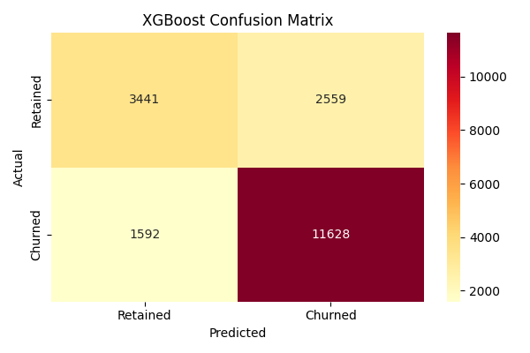
XGBoost Churn Prediction Performance

Slide 4
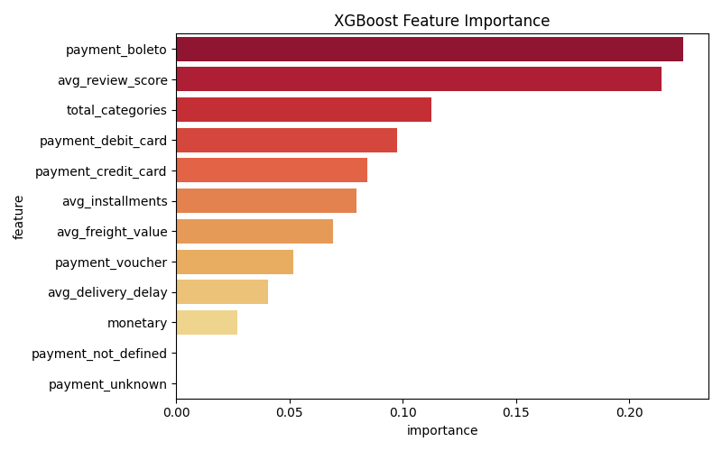
Key Drivers of Customer Churn

Slide 5
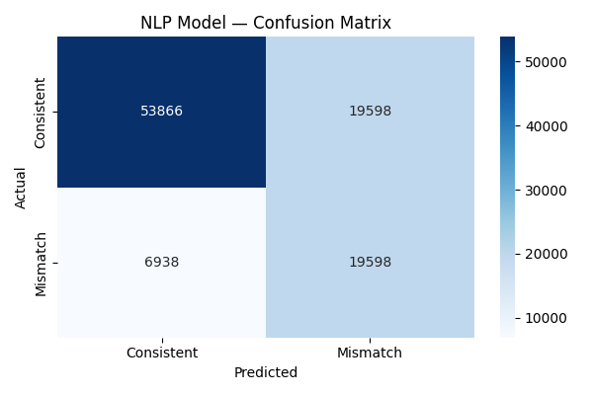
NLP Review Integrity Detection
Model successfully identifies cases where the text sentiment contradicts the 5-star or 1-star rating.

Slide 6
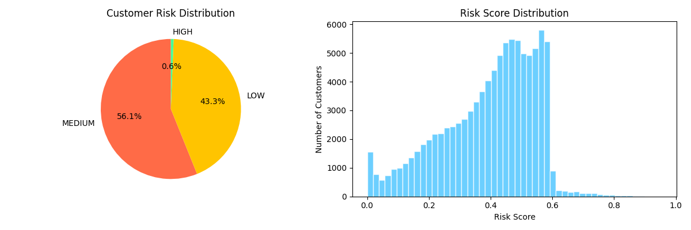
Overall Customer Risk Distribution
Final Ensembled Risk Score combining XGBoost Churn Probability and NLP Integrity anomalies.

