Slide 1
Cache Design Exploration
What is this project?
A RISC-V cache simulator visually comparing user-defined cache organizations.
by Tara K.
Topics Covered:
Cache Associativity
Conflict Misses
Performance Tradeoffs

Slide 2
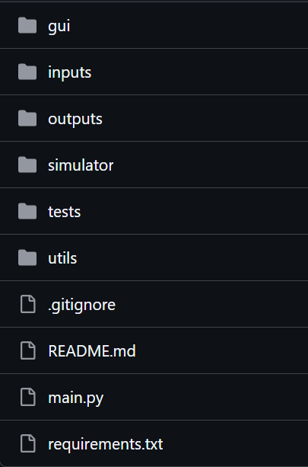
Project Structure
GUI
hex_inst.txt
All log files
Actual function (decoder/cache/pipeline/etc)
Used before GUI was created, also useful for debugging
Loader and Logger
Entry Point

Slide 3
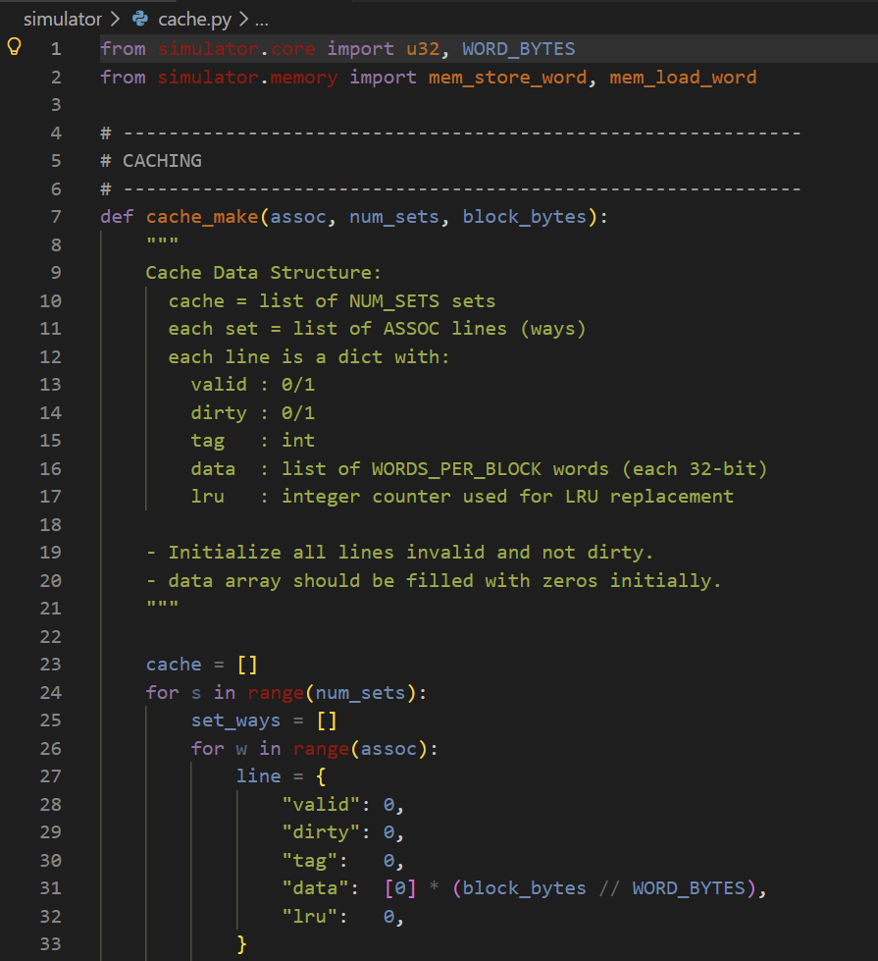
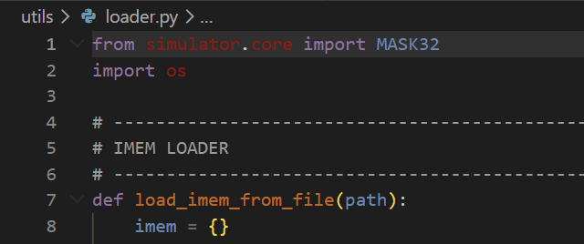
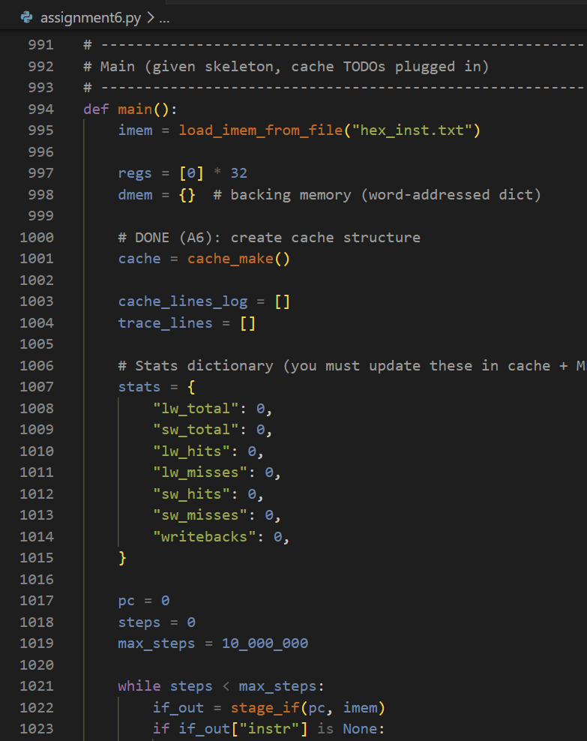
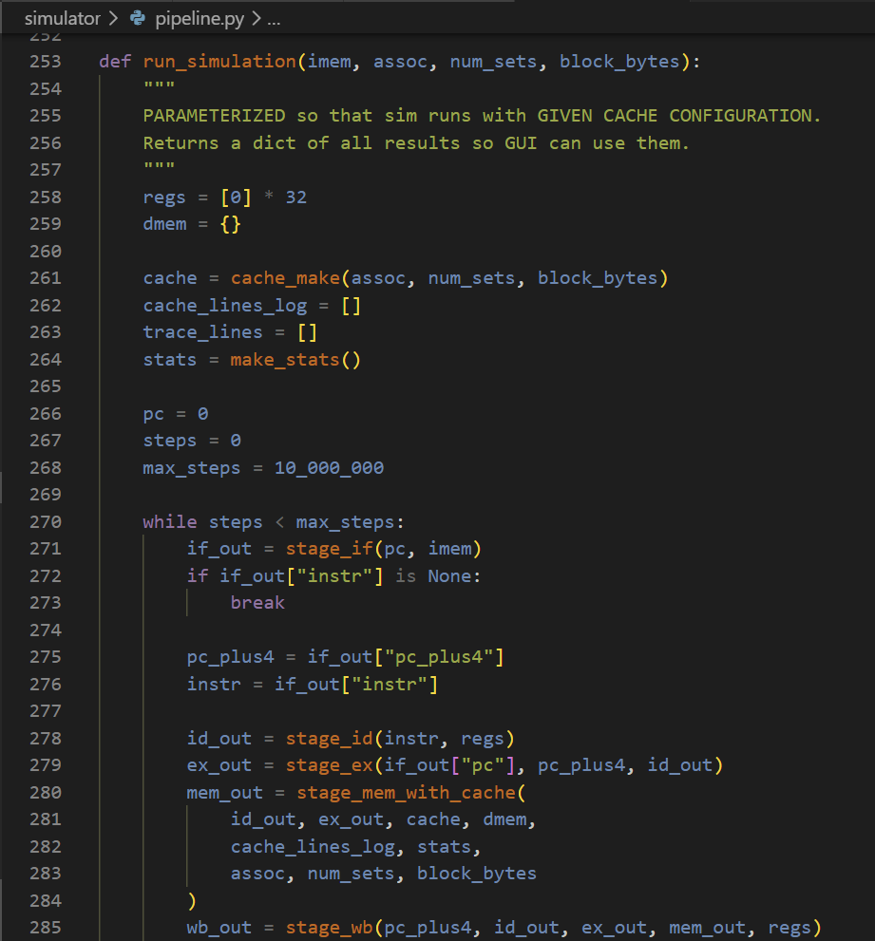
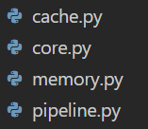
simulator/
Core of the project
Built from the CPU simulator developed through class assignments
Primarily Assignment 6 parameterizing
refactored to handle multiple cache configurations
RISC-V decoder
All stages, stage helpers/traces, and “pseudo-main”
DMEM lw/sw: ensures cache usage

Slide 4
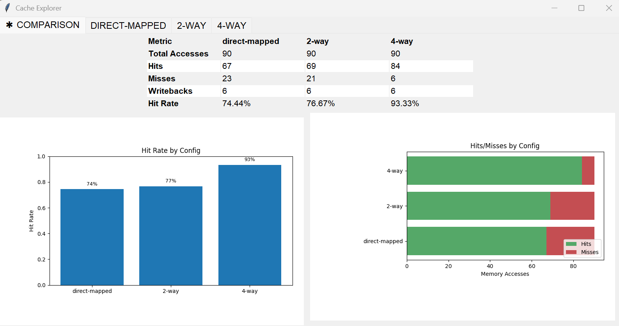
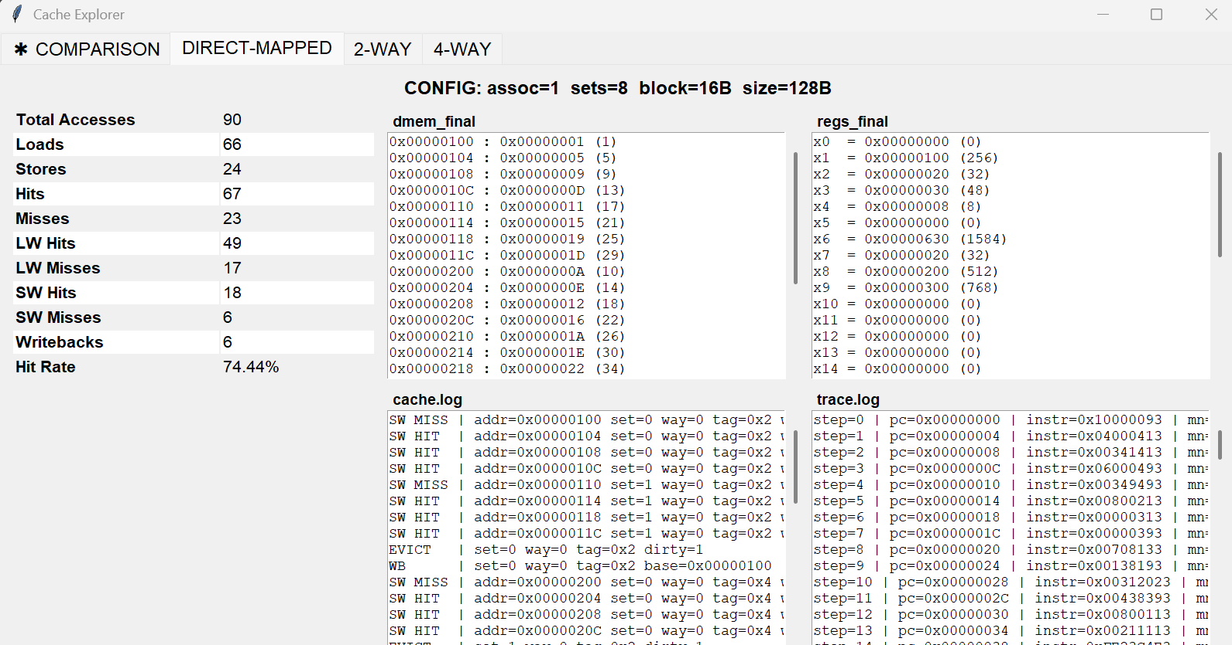
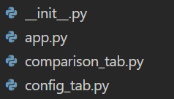
gui/
New, simple tkinter GUI for visual analysis
CONFIG TAB: Stats for individual configs, and easily visible log files
COMPARISON TAB: Directly compares all provided configs in table/graphs
Check hit rate & hits/misses
Each is its own class

Slide 5
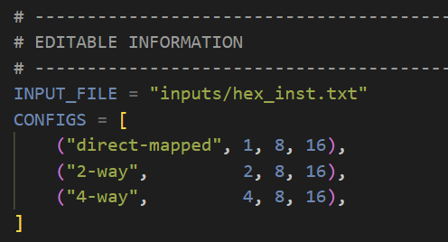
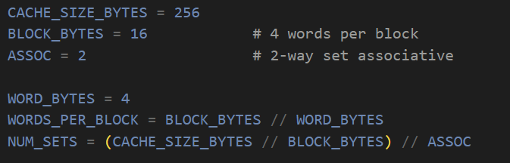
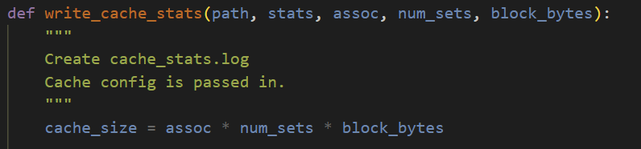
User Configuration
Designed to be easily configured by user
INPUT_FILE: Custom input path/file
CONFIGS: Cache settings
Design choice: list[tuple[str, int, int, int]]
In Assignment 6: NUM_SETS is derived
In project: cache size is derived
size = assoc * num_sets * block_bytes
Easier to get different behavior by specifying assoc and num_sets
NAME
ASSOC:
Number of ways per set – N different blocks occupying the same set
NUM_SETS:
Number of sets in cache – defines how addresses are mapped to cache
BLOCK_BYTES: Data size transferred in one operation

Slide 6
Demo

Slide 7
Insights
Conflict Misses
Compulsory
first time accessing an address
Capacity
cache size too small, system must evict data
Conflict/Collisions
addresses mapping to the same set are evicting each other
Direct-mapped: one address, one cache location
N-way: addresses get multiple slots before eviction
Performance Tradeoffs
Higher ASSOC:
Less conflict misses, higher hit rate
Requires checking more ways
Performance improvements level off
Direct-Mapped:
Only one way, only one search
High costs for conflict misses, bad hit rate
 | Direct-Mapped | 2-Way | 4-Way
Conflict Miss Cost | High | Medium | Low
Lookup Speed | Fast | Medium | Slow
Hardware Cost | Least | Medium | Most
Hit Rate | Worst | Medium | Best

