Slide 1
Lung Transplant
Analytics Report · October 2026 Update
National Insights · ALUA Program Analysis · Policy Impact · Forecasts
PART 1 — NATIONAL ANALYSIS
PART 2 — ALUA PROGRAM
▸ National volume 2005–2026 (Jan–Sep)
▸ Volume history & Southeast peers
▸ DSA & CAS policy impact
▸ SRTR PSR Jul 2026 & UNOS benchmarks
▸ Program quadrant analysis
▸ Rolling HR surveillance (Oct 4, 2026)
▸ Equity & access metrics
▸ Offer acceptance, regression & Monte Carlo
OPTN 2005–Sep 30, 2026 (as of Oct 25, 2026) · SRTR PSR July 7, 2026 · Rolling reports Oct 4, 2026 · Offer acceptance Jan–Aug 2026
Notes:
October 2026 update of the April 2026 report. All OPTN volume figures now run through September 30, 2026 (HRSA data as of October 25, 2026). Part 1 covers national trends and policy impact; Part 2 covers ALUA, now including a Southeast peer comparison. Outcomes use the SRTR program-specific report released July 7, 2026 (data through April 30, 2026), the center's rolling graft-survival and waitlist-mortality reports updated October 4, 2026, and the January–August 2026 offer-acceptance subgroup report.

Slide 2
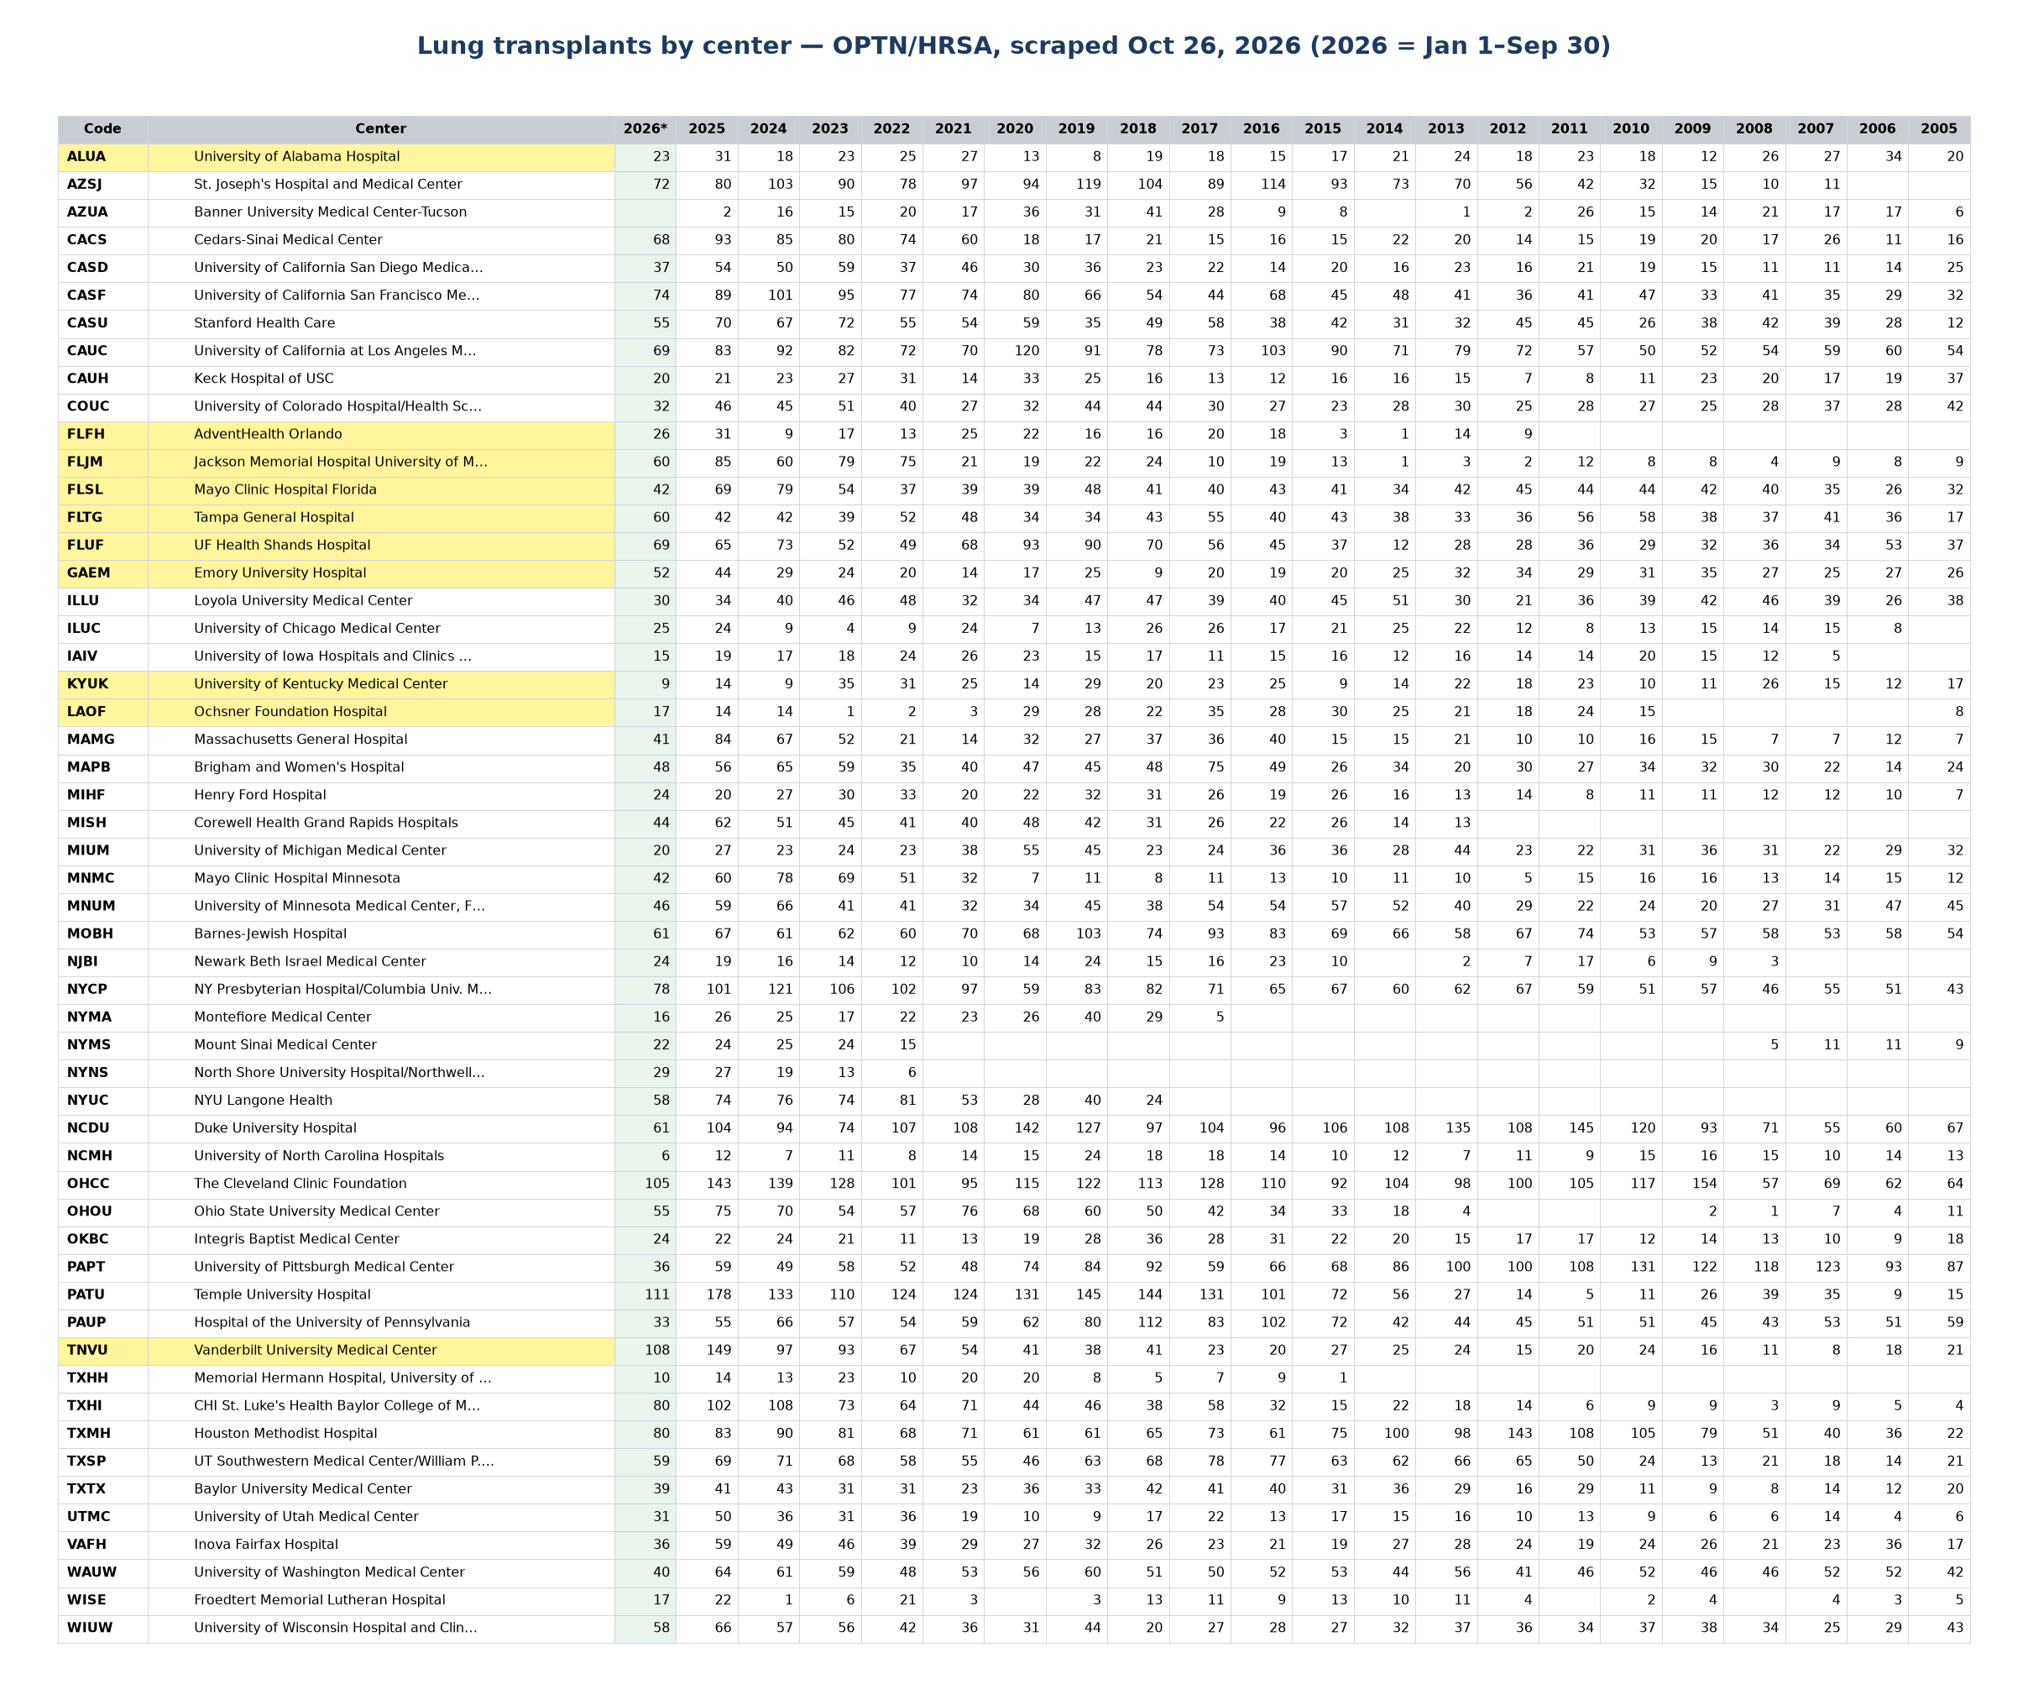
Web-scraped data
Personal project to apply text /data mining tools with AI help
OPTN-HRSA website:
Used AI-assisted coding to web-scrape lung transplant data for 54 US centers (active adult programs > 3 years)
Period 2005 – Sep 30, 2026 (OPTN data as of Oct 25, 2026)
Key Questions:
How has the U.S. lung transplant system changed over the past 20 years?
How did major allocation policy reforms — DSA removal and CAS implementation — redistribute volume and access across centers?
Where does ALUA stand now — nationally and against Southeast peers — and what are the major surveillance risks for 2026–2028?
Notes:
Personal data science project applying web scraping and AI-assisted analysis to public OPTN-HRSA data. The scraper captures annual lung transplant counts for 54 active adult programs. HRSA's 2026 column covers transplants performed January 1 – September 30, 2026; the data were pulled October 26, 2026. Highlighted rows are ALUA and its Southeast peers. Key questions: how has national volume changed, what did the DSA and CAS reforms do to individual programs, and where does ALUA stand nationally and regionally?

Slide 3
US Lung Transplant
At a Glance · October 2026 Update
National Insights · ALUA Program Analysis · Policy Impact · Forecasts
3,083
2,397
31
23
90.5%
2025 National Volume
2026 Jan–Sep (US)
ALUA 2025 Volume
ALUA 2026 Jan–Sep
ALUA 1-yr Survival (PSR Jul '26)
OPTN 2005–Sep 30, 2026 (as of Oct 25, 2026) · SRTR PSR July 7, 2026 · Rolling reports Oct 4, 2026 · Offer acceptance Jan–Aug 2026
Notes:
Top-line numbers. The 54 centers performed 3,083 lung transplants in 2025 and 2,397 in January–September 2026, an annualized pace of about 3,196 (+4%). ALUA performed 31 in 2025 and 23 in January–September 2026 — a pace of about 31, the same as 2025. One-year patient survival in the July 2026 PSR is 90.5% (expected 91.7%, national 90.3%), down from 95.7% in the January report.

Slide 4
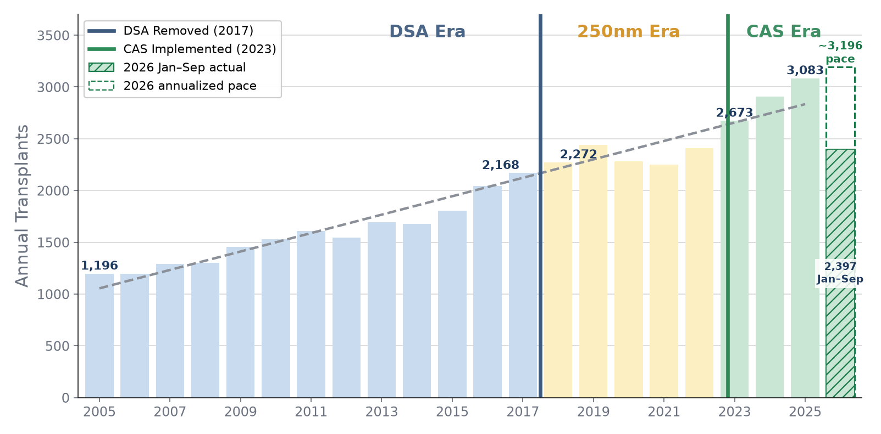
Part 1 — National Market
US Lung Transplant Volume 2005–2026 (Jan–Sep) with Policy Inflection Points
Era Averages
Pre-DSA (2015–17): 2,006/yr
250 NM Era (2018–22): 2,332/yr (+16%)
CAS Era (2023–25): 2,888/yr (+24%)
▸ 158% growth: 1,196 → 3,083 transplants over 20 years
▸ 2023: largest single-year jump (+10.9%) — CAS effect
▸ COVID 2020 dip (−6.5%) recovered fully by 2022
▸ Post-CAS slope: +216/yr vs long-run +89/yr
▸ 2026 Jan–Sep: 2,397 → ~3,196/yr pace (+4% vs 2025) — growth slowing after post-CAS surge
US Lung Transplant Analytics | National Volume Trend
4
Notes:
National volume grew from 1,196 in 2005 to 3,083 in 2025 — 158% growth. Era averages: pre-DSA (2015–17) 2,006 per year; the 250-nautical-mile era 2,332 (+16%); the CAS era 2,888 (+24%). Note the pre-DSA average uses the last three pre-DSA years, matching the three-year CAS window (the April deck labelled it 2010–17). COVID produced a 6.5% dip in 2020, recovered by 2022. CAS in March 2023 produced the largest single-year jump (+10.9%). 2026: 2,397 transplants January–September, an annualized pace of about 3,196 — about 4% above 2025, so growth is slowing from the post-CAS surge.

Slide 5
Competitive landscape: concentration is moderate, but leaders matter
National market
36.6%
Top 10 share of 2025 national volume
Largest center
Top three combined
Temple
178
470
Market is not monopolistic, but center-specific capability matters.
Leaders combine referral depth, high-acuity candidate management, donor acceptance, and surgical throughput.
ALUA competes in a system where the benchmark is no longer only local geography.
US Lung Transplant Analytics | ALUA Program Assessment
Sources: OPTN/HRSA center data (scraped Oct 26, 2026), SRTR PSR Jan 2026, Rolling SRTR Apr 2026, project analysis.
5
Notes:
Speaker notes: This slide gives the national competitive context. The top ten centers perform about 36.6 percent of national volume, so the market is moderately concentrated. The dominant centers - Temple, Vanderbilt, and Cleveland Clinic - are not simply large by chance. Their volumes likely reflect a combination of referral networks, operational scale, acuity management, donor acceptance behavior, and surgical capacity. For ALUA, the relevant message is that sustaining volume requires competing on these capabilities, not just relying on regional donor geography.

Slide 6
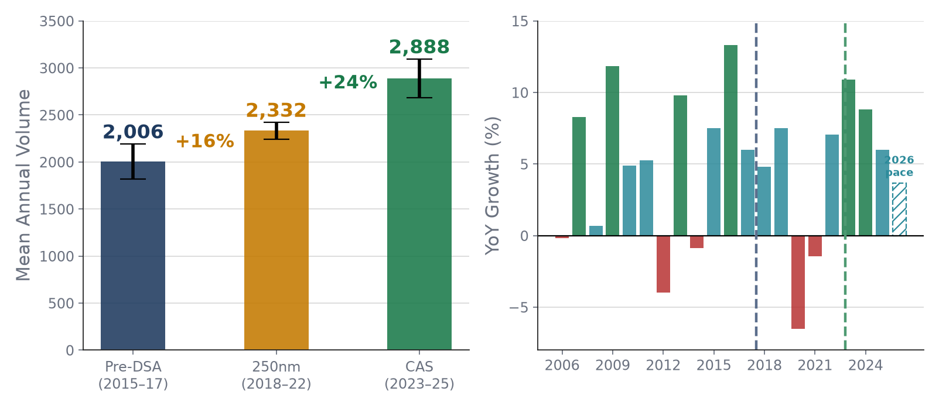
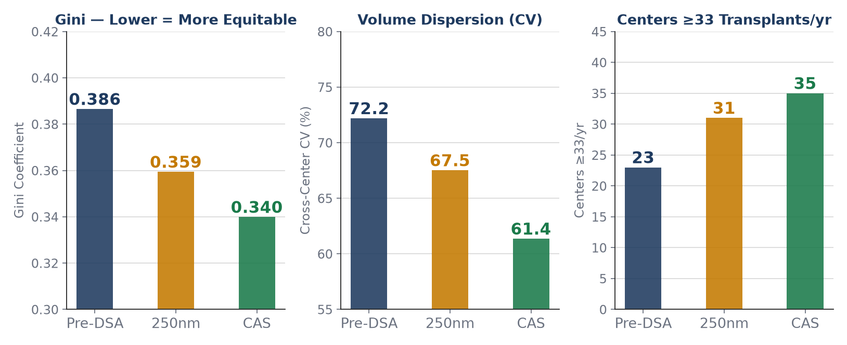
Policy Era Comparison & Equity Impact
DSA Removal (Nov 2017) · CAS Implementation (Mar 2023)
Key Policy Findings
▸ DSA removal: median waitlist time fell 9 days; transplant rate rose nationally; LOS increased 2 days (transport distance)
▸ CAS (Mar 2023): acuity-first composite scoring. Waitlist mortality: 11.2% → 8.4% → 4.1%. Largest YoY volume jump on record.
▸ Gini: 0.386→0.359→0.340. CV: 72.2%→67.5%→61.4%. Centers ≥33/yr: 23→31→35 (recomputed, Oct 2026 data). System measurably more equitable under CAS.
▸ Both reforms market-expanding: only 4 of 51 centers declined under BOTH policies (the Double Losers).
US Lung Transplant Analytics | Policy Era Analysis
6
Notes:
Two allocation reforms reshaped the landscape. DSA removal (November 2017) eliminated donation service area geography as the first distribution level: median waitlist time fell 9 days and transplant rates rose, but length of stay rose about 2 days because of longer transport. CAS (March 2023) replaced the Lung Allocation Score with a composite acuity-first score and produced the largest year-on-year jump on record; waitlist mortality fell from 11.2% to 8.4% to 4.1% across the three eras.
Equity metrics were recomputed on the October 2026 data, using each center's average annual volume within each era (pre-DSA 2015–17, 250nm 2018–22, CAS 2023–25). The Gini coefficient fell 0.386 → 0.359 → 0.340 and the cross-center CV fell 72.2% → 67.5% → 61.4%, so volume is spread more evenly across programs. Centers averaging at least 33 transplants a year — the empirical volume-quality floor — rose from 23 of 51 to 31 of 54 to 35 of 54. The 250nm-era values differ slightly from the April deck (0.364, 69.5%, 28) because HRSA revises historical counts. ALUA's 2015–2025 CV of 34.0% is close to the peer median of 35.1%.

Slide 7
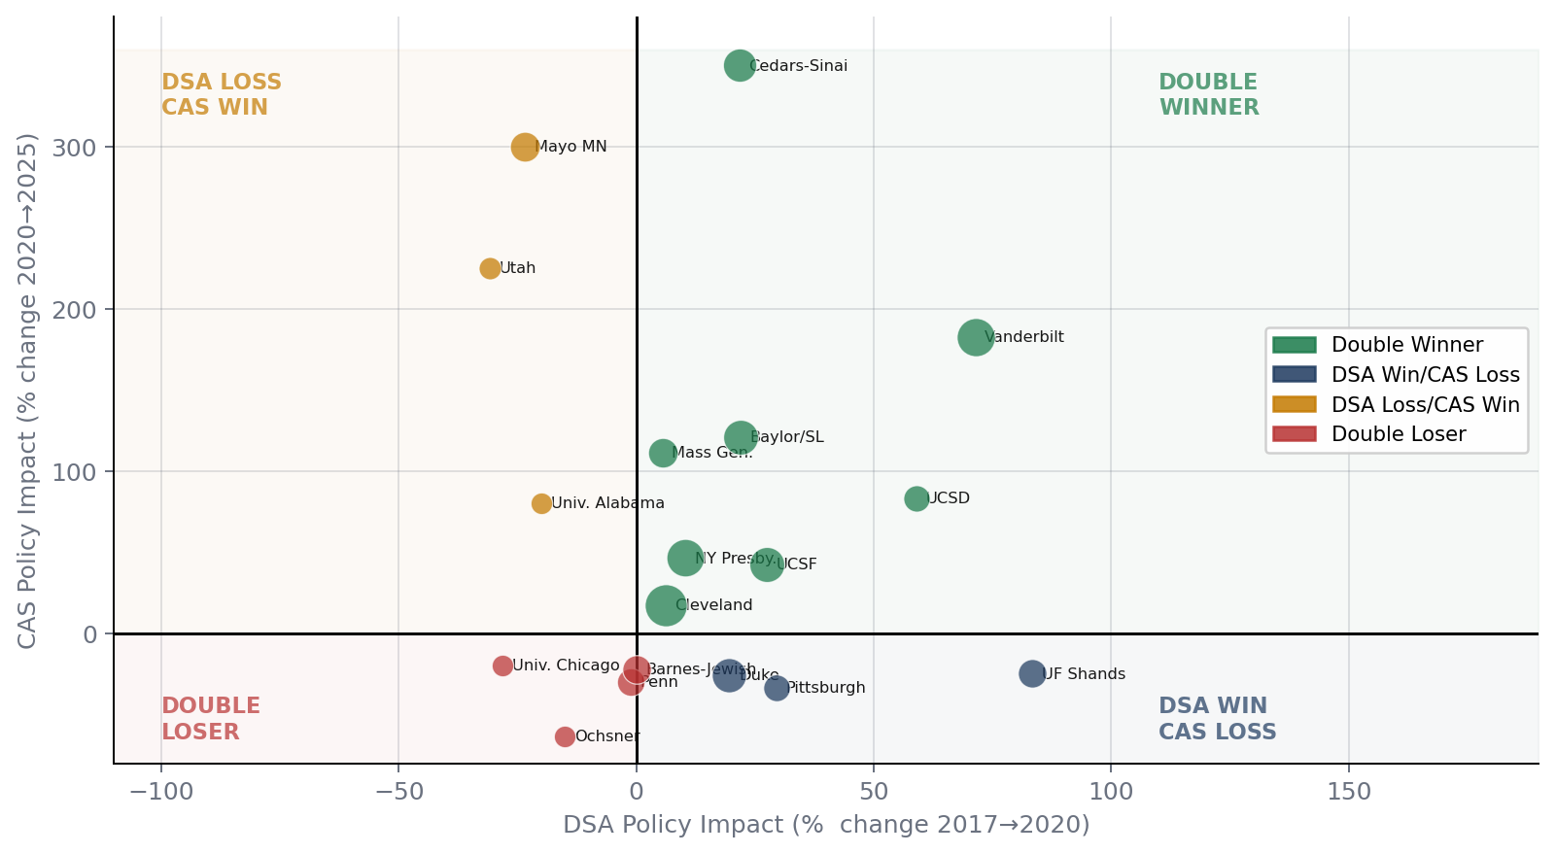
Policy Quadrant — All 51 Centers
Which programs won or lost under each allocation reform?
Double Winner (20)
Benefited from both reforms
Ex: Vanderbilt +384%, Cedars-Sinai +461%
DSA Win / CAS Loss (16)
Geographic expansion; lost on acuity
Ex: Duke −11% net, Pittsburgh −14%
DSA Loss / CAS Win (11)
Recovered under acuity scoring
Ex: Mayo MN +509%, Utah +125%
Double Loser (4)
Both reforms hurt — structural risk
Ex: Ochsner −69%*, Penn −31%
*Ochsner rebounding: 2026 pace ~23
US Lung Transplant Analytics | Policy Quadrant Analysis
7
Notes:
The policy quadrant classifies 51 centers with data in both eras by how they fared under each reform. Double Winners (20) include Vanderbilt (+384%) and Cedars-Sinai (+461%). DSA Win / CAS Loss (16) includes Duke and Pittsburgh. DSA Loss / CAS Win (11) includes Mayo Minnesota and Utah. Double Losers (4) are Ochsner, Penn, Barnes-Jewish and University of Chicago. Update: Ochsner is rebounding in 2026 — 17 transplants January–September, an annualized pace of about 23 versus 14 in 2025 — so its Double Loser label should be revisited at year end.

Slide 8
Top Centers & Double Loser Profile
Center
2025 Vol
CAS Avg
Net Δ
DOUBLE LOSERS
Temple University
178
140
+39%
Ochsner (LA)
31→10 avg
−69%
Vanderbilt
149
113
+384%
Below quality threshold, but rebounding: 17 in Jan–Sep 2026 (~23/yr pace) vs 14 in 2025.
Cleveland Clinic
143
137
+24%
Duke
104
91
−11%
Baylor/St. Luke's
102
94
+170%
Penn/HUP (PA)
86→59 avg
−31%
NY Presbyterian
101
109
+62%
Temple (same city, #1 national) dominates on CAS urgency score; Penn loses intra-city share.
Cedars-Sinai
93
86
+461%
UCSF
89
95
+82%
Jackson Miami
85
75
+433%
Barnes-Jewish (MO)
82→63 avg
−22%
Mass General
84
68
+123%
Midwest OPO geographic premium eliminated; acuity scoring doesn't compensate.
Univ. Chicago (IL)
21→12 avg
−42%
Loyola in same metro — neither policy rewarded Chicago's geographic position.
US Lung Transplant Analytics | Top Centers & Double Losers
8
Notes:
Temple leads nationally at 178 cases in 2025, followed by Vanderbilt (149) and Cleveland Clinic (143). The Double Losers are cautionary cases whose historical advantages were geographic rather than clinical. Ochsner averaged about 10 a year in the CAS era but is rebounding in 2026 (17 by September, pace ~23). Penn fell from 86 to 59 a year as Temple took intra-city share. Barnes-Jewish lost its Midwest OPO catchment advantage. University of Chicago is squeezed by Loyola in the same metro.

Slide 9
PART 2
ALUA Program Analysis
University of Alabama Hospital · Center Code: ALUA · Birmingham, Alabama
31
90.5%
1.13
1.23
23 cases
2025 Volume
1-yr Survival (PSR Jul '26)
PSR Jul 2026 1-yr HR
Offer Accept Ratio (Jan–Aug '26)
2026 Jan–Sep
SRTR PSR July 7, 2026 (data through Apr 30, 2026) · Rolling reports Oct 4, 2026 · OPTN volume through Sep 30, 2026
1. Historical Volume & Southeast Peers
2. SRTR Outcomes (PSR Jul 2026)
3. Rolling HR Surveillance
4. Offer Acceptance Analysis
5. Regression Forecast 2026–30
6. Monte Carlo Probability
7. Clinical Profile, UNOS Benchmarks & Recommendations
Notes:
Part 2 — the ALUA deep dive. Headline metrics: 31 transplants in 2025 (best since 2007); one-year patient survival of 90.5% with a hazard ratio of 1.13 in the July 2026 PSR (January: 95.7%, 0.69); an offer acceptance ratio of 1.23 for January–August 2026 (0.90 for calendar 2025 in the PSR); and 23 transplants January–September 2026, a pace of about 31. Surveillance figures come from the center's rolling reports updated October 4, 2026.

Slide 10
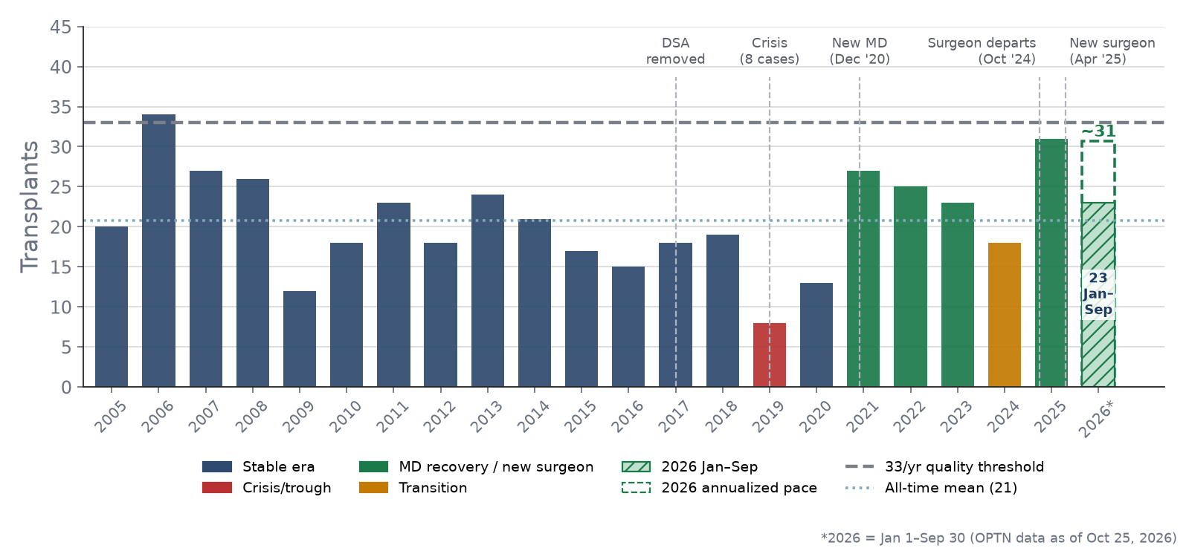
ALUA — Historical Volume 2005–2026 (Jan–Sep)
Structural event analysis across leadership transitions and policy changes
Structural Events
2006
Peak: 34 cases
All-time high
2017
DSA removed
−20% vs peer +10.5%
2019
Leadership crisis
Trough 8 cases (−58%)
Dec 2020
New MD joins
+11.2/yr effect (p=0.024)
2021–23
Recovery era
27→25→23 cases/yr
Oct 2024
Surgeon departs
−22% dip → 18 cases
Apr 2025
New surgeon
31 cases — best since 2007
2026 YTD
23 cases (Q1: 9)
Pace ~31/yr = 2025 level
US Lung Transplant Analytics | ALUA Historical Volume
10
Notes:
ALUA's volume has moved with structural events rather than a steady trend: a 2006 peak of 34; a 2019 leadership crisis trough of 8; recovery after a new medical director joined in December 2020; a dip to 18 after a surgeon departed in October 2024; and 31 in 2025 after a new surgeon arrived in April 2025. In 2026, ALUA performed 23 transplants January–September — 9 in Q1 and 14 across Q2 and Q3, about 7 a quarter. The annualized pace of about 31 matches 2025, so the April projection of ~36 (based on Q1 alone) has not held, but the program has now sustained its higher level for two years.

Slide 11
ALUA vs Southeast Peers — 2026 Volume
Jan–Sep 2026 annualized (×12/9) vs 2025 · 10 Southeast programs in the 54-center dataset
~31
4.9%
ALUA 2026 pace
ALUA SE share (5.7% '25)
+14%
+4%
Southeast 2026 pace
US 2026 pace
2.3×
43rd
Emory vs ALUA (Jan–Sep)
ALUA US rank (37th in '25)
Not in dataset: MUSC, Methodist Memphis, Jewish Louisville, Cleveland Clinic FL, Wellstar MCG.
Regional Insights
▸ Region growing fast: the 10 programs are on pace for ~621 in 2026 (+14% vs 544 in 2025), vs +4% nationally.
▸ ALUA flat at ~31 (2025: 31) → regional share 5.7% → 4.9%; national rank 37th → 43rd of 54.
▸ Emory (Atlanta, ~150 mi): 52 by Sep is already a program record; pace ~69, more than 2× ALUA after matching it in 2020–24 (~21/yr each).
▸ Vanderbilt (Nashville, ~190 mi) is levelling off at ~144 but is still ~4.7× ALUA. Growth is now led by Tampa, Emory and Shands.
US Lung Transplant Analytics | Southeast Peer Comparison
11
Notes:
New in the October update. The chart compares 2025 volume with the 2026 annualized pace (January–September × 12/9) for the 10 Southeast programs in the dataset. The region is on pace for about 621 transplants, +14% over 2025, against +4% nationally. ALUA is flat at about 31, so its regional share falls from 5.7% to 4.9% and its national rank slips from 37th to 43rd. Emory is the closest competitive threat: it averaged the same volume as ALUA in 2020–24 but has already set a program record with 52 by September (pace ~69). Vanderbilt is levelling off at about 144 a year but remains 4.7 times ALUA's volume. Caveats: the pace assumes an even monthly rate, and several Southeast programs (MUSC, Methodist Memphis, Jewish Hospital Louisville, Cleveland Clinic Florida, Wellstar MCG) are not in the 54-center scrape.

Slide 12
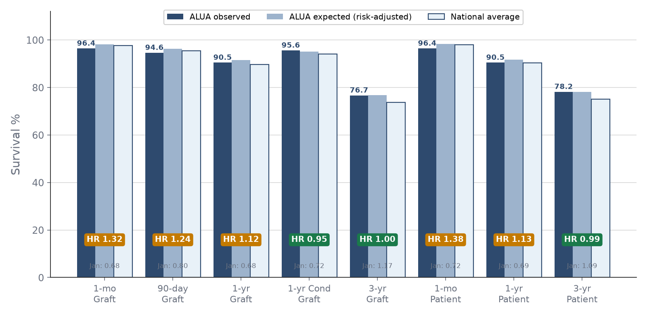
ALUA SRTR Outcomes — PSR July 2026
Cohort: Jan 2023–Jun 2025 · n=56 · Outcomes now at expected (Jan 2026 PSR: HR 0.69) · credible intervals remain wide
90.5%
1.12
1-yr Graft Survival (exp. 91.5%)
1-yr Graft HR [0.45–2.09]
90.5%
1.13
1-yr Patient Survival (exp. 91.7%)
1-yr Patient HR [0.46–2.11]
76.7%
1.00
3-yr Graft Survival (exp. 76.7%)
3-yr Graft HR [0.56–1.56]
5 obs / 4.26 exp
1-yr Graft Failures vs Expected
★ 90-day graft HR 1.24 (3 vs 2.03 exp.) · 1-yr conditional HR 0.95 — all HRs well below the MPSC threshold (2.25)
△ Jan → Jul 2026: 1-yr HR 0.69 → 1.13, survival 95.7% → 90.5%; the added failures are 2025 early-graft losses
▪ National 1-yr: 89.8% graft / 90.3% patient — ALUA now at the national rate and within expected
US Lung Transplant Analytics | SRTR Outcomes
12
Notes:
The July 7, 2026 PSR (data through April 30, 2026) covers transplants from January 2023 through June 2025 — 56 adult single-organ transplants. One-year graft survival is 90.5% against an expected 91.5% and a national 89.8%; the hazard ratio is 1.12 with a 95% credible interval of 0.45–2.09. One-year patient survival is 90.5% (HR 1.13). Five graft failures were observed against 4.26 expected. The 90-day graft HR of 1.24 matches the center's rolling report, and the 1-year conditional HR of 0.95 shows patients who survive 90 days do as expected. Three-year graft survival (July 2020 – December 2022 cohort) is 76.7%, HR 1.00 — the earlier 1.17 has resolved.
The January 2026 PSR had reported HR 0.69 and 95.7% survival on the July 2022 – December 2024 cohort. Rolling the window forward six months dropped the strong 2022 half-year and added the first half of 2025, which carries two early graft failures, so the outcomes have moved from better-than-expected to expected. With 5 events the credible intervals are wide; none of the HRs approaches the 2.25 MPSC flag, but the direction is consistent with the rolling report on the next slide.

Slide 13
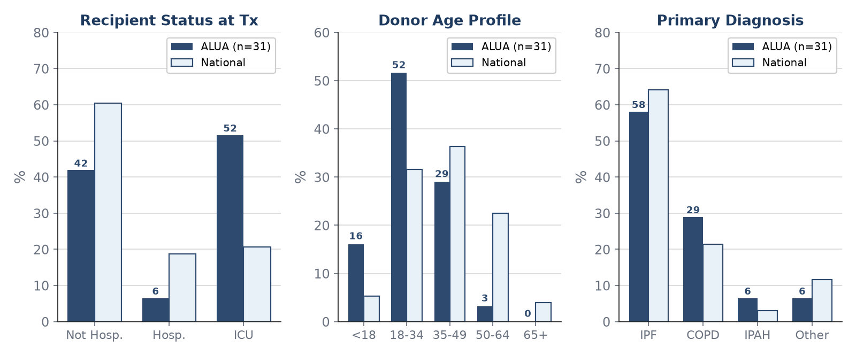
ALUA Clinical Profile
Recipient & donor characteristics vs national benchmarks · Jan–Dec 2025 · n=31 · PSR July 2026
Clinical Insights
▸ ICU at transplant: 51.6% vs national 20.7% (region 42.8%) — 2.5× national acuity intake, up from 46.2%. CAS incentivizes urgent patients; this raises early-failure risk.
▸ Donor age: 51.6% aged 18–34 vs 31.6% nationally; 16.1% under 18; only 3.2% aged 50+ (national 26.5%). Young donors remain the main protective factor.
▸ Diagnosis: COPD 29.0% vs 21.4% national; IPF 58.1% vs 64.1%. Recipient BMI ≥36: 9.7% vs 1.2% national.
▸ Post-tx LOS: median 24 days vs 21 national (region 26). Median time to transplant 3.4 mo vs 1.3 national; 83.9% of donors from outside the DSA.
US Lung Transplant Analytics | Clinical Profile
13
Notes:
Clinical profile from the July 2026 PSR, transplants performed January–December 2025 (31 recipients). 51.6% were transplanted from the ICU versus 20.7% nationally and 42.8% in the OPTN region — 2.5 times the national rate and higher than the 46.2% in the April deck. High acuity raises early graft-failure risk, which is where the rolling report shows the signal. The donor profile stays young: 51.6% aged 18–34 and 16.1% under 18, with only 3.2% aged 50 or older against 26.5% nationally. Case mix is COPD-heavy (29.0% vs 21.4%) with fewer IPF (58.1% vs 64.1%); 9.7% of recipients had a BMI of 36 or more versus 1.2% nationally. Median post-transplant length of stay is 24 days versus 21 nationally (26 in the region), longer than the 19.5 days in the earlier period. Median time to transplant is 3.4 months versus 1.3 nationally, and 83.9% of donors come from outside the local DSA.

Slide 14
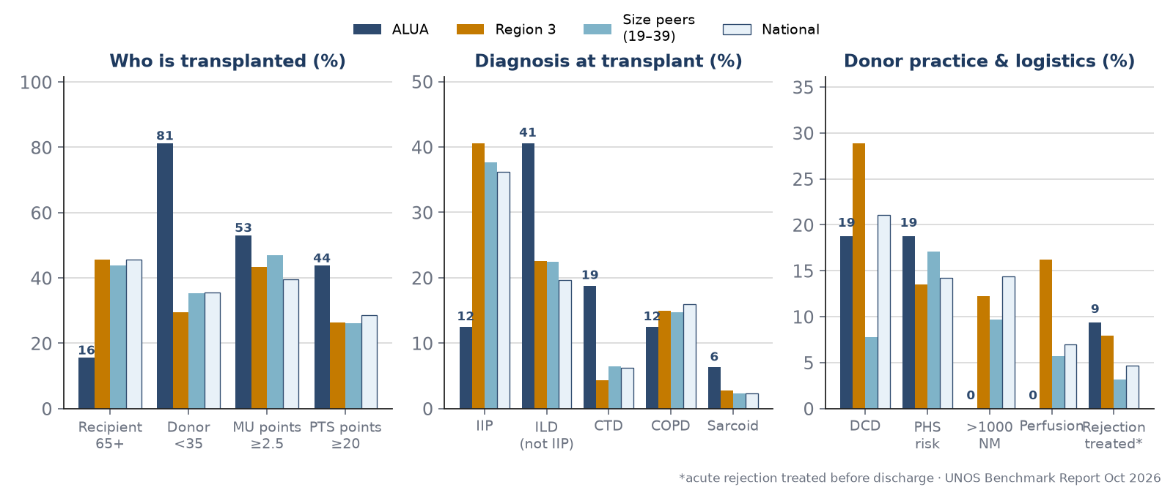
ALUA vs UNOS Benchmarks — Region 3, Size Peers, National
UNOS Benchmark Report Oct 2026 · transplants Jul 2025–Jun 2026 (n=32) · waitlist snapshot Sep 30, 2026 (n=11)
32
6.4 h
Tx Jul '25–Jun '26 (US median 40)
Median ischemic time (US 9.8)
16%
81%
Recipients 65+ (US 46%)
Donors under 35 (US 36%)
9.4%
0%
Treated rejection pre-discharge (US 4.7%)
Machine perfusion (Region 3: 16%)
Size peers = Q2:19–39 transplants/yr (19 programs); Region 3 = 8 programs. MU = medical urgency; PTS = post-tx survival points.
Benchmark Insights
▸ Young on both sides: recipients 65+ are 15.6% of ALUA transplants vs 45.7% nationally; donors under 35 are 81% vs 36% (no donors 50+). The waitlist is 9% aged 65+ vs 49% nationally — the largest untapped listing segment.
▸ Distinct case mix: non-IIP ILD 40.6% + connective-tissue disease 18.8% + sarcoid 6.3% = 66% vs 28% nationally; IIP only 12.5% vs 36.2%. Urgency is high (MU points ≥2.5: 53% vs 40%) yet predicted post-tx survival is better (PTS ≥20: 44% vs 28%).
▸ Conservative logistics protect early outcomes but cap the offer pool: median ischemic time 6.4 h vs 9.8 national (14.0 Region 3); no donors beyond 1,000 NM (14% nationally); 100% ABO-identical; 0% machine perfusion vs 16% in Region 3.
▸ Watch: acute rejection treated before discharge 9.4% vs 4.7% nationally (3.2% size peers) — consistent with the 90-day graft signal. Recipient BMI median 29.3 vs 26.3; median LOS 21 d vs 20 (Region 3: 27).
US Lung Transplant Analytics | UNOS Benchmark Comparison
14
Notes:
New in the October update, from the UNOS Benchmark Report (October 2026; transplants July 2025 – June 2026, waitlist snapshot September 30, 2026). ALUA performed 32 transplants in the window — between the national first quartile (19) and median (40) — and sits in the Q2 size group with 19 other programs.
Recipients and donors are both young: 15.6% of recipients were 65 or older against 45.7% nationally, 9.4% were 18–34 against 3.0%, and 81.3% of donors were under 35 against 35.6%, with no donors aged 50 or older (29% nationally). The waitlist shows the same pattern — 9.1% aged 65+ against 49.0% nationally — so older candidates are the largest segment ALUA is not listing. Case mix is distinctive: interstitial lung disease other than IIP (40.6%), connective-tissue disease (18.8%) and sarcoidosis (6.3%) together make up two-thirds of transplants versus 28% nationally, while IIP is 12.5% versus 36.2%. Medical-urgency points of 2.5 or more applied to 53.1% of recipients (39.5% nationally), but 43.8% had post-transplant survival points of 20 or more (28.5% nationally), reflecting the younger recipients.
Logistics are conservative: median total ischemic time 6.4 hours against 9.8 nationally and 14.0 in Region 3; no donor further than 749 NM (14.4% of national transplants exceed 1,000 NM); 100% ABO-identical against 89.6%; and no machine perfusion against 7.0% nationally and 16.2% in Region 3. DCD use (18.8%) and PHS-risk donors (18.8%) are near national rates. These choices protect early outcomes but limit the offer pool; perfusion and longer distance are the unused levers if listings grow.
Watch items: 9.4% of recipients had an acute rejection episode treated before discharge, twice the national 4.7% and three times the size-peer 3.2%, which is consistent with the 90-day graft-failure signal in the rolling report. Median recipient BMI is 29.3 against 26.3 nationally (p95 36.5 vs 33.3). Median length of stay is 21 days against 20 nationally and 27 in Region 3. On equity, Black candidates are 45.5% of ALUA's waitlist (13.1% nationally) and 25.0% of recipients (10.5%); there were no Hispanic/Latino candidates or recipients (14–20% in the comparison groups). The list is fully active (0% status 7 vs 12.2% nationally) with a median CAS subscore of about 21.5 versus 23.1 nationally.

Slide 15
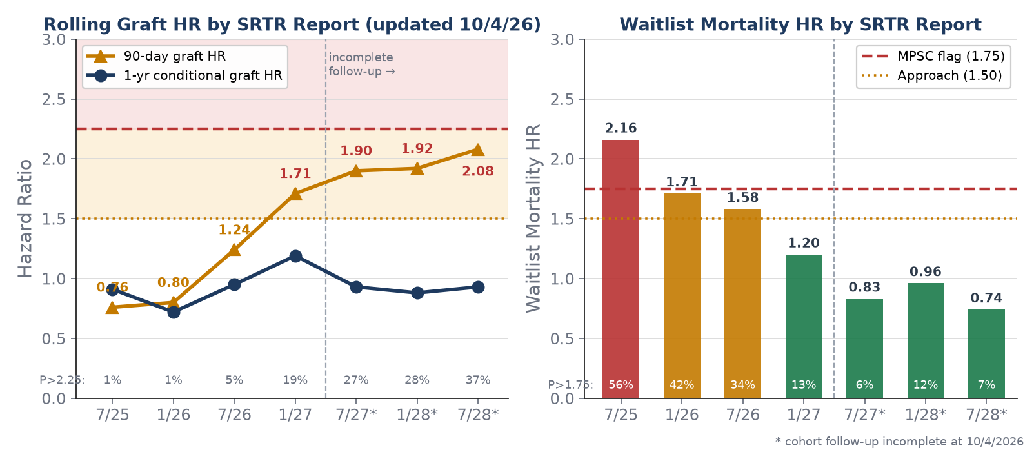
Rolling SRTR HR Trend — Surveillance Update (Oct 4, 2026)
SRTR 7/26 confirmed at 90-day graft HR 1.24 (April projection 1.25); 1/27 cohort enters approach zone at 1.71 — early graft failure, not 1-yr survival
⚠ APPROACHING FLAG — 90-DAY GRAFT
7/26 actual 1.24 → 1/27 1.71 (5 failures vs 2.1 exp.)
7/27*–7/28* tracking 1.90–2.08 | P(HR>2.25) → 37%
Approach zone 1.50–2.25 | MPSC flag >2.25
✓ WAITLIST MORTALITY RESOLVING
WLM HR 2.16 (7/25) → 1.58 (7/26) → 1.20 (1/27)
P(HR>1.75) 56% → 13%; 7/27*–7/28* at 0.74–0.96
PSR 7/26 (2024–25): pre-tx mortality 1.58 [0.68–2.84],
tx-rate ratio 0.59 [0.44–0.76] — still carry 2024 trough
WHAT THE DATA SAY
1-yr conditional graft HR stays 0.88–1.19 — the
signal is perioperative (≤90-day) failure
90-day failures: 2/16, 2/15, 1/17, 1/7 (H1'25→H2'26)
ICU intake 52% vs 20.7%; new surgeon from Apr '25
★ SRTR 1/27 (Jan 2027) will be the first official report in the approach zone — case-review the 2025–26 early graft failures now
US Lung Transplant Analytics | Rolling SRTR HR Trend
15
Notes:
Chart data are from the center's rolling 90-day/1-year graft survival and waitlist mortality reports updated October 4, 2026. The SRTR 7/26 cohort (January 2023 – June 2025) came in at a 90-day graft HR of 1.24 — almost exactly the April projection of 1.25 — with a 1-year conditional graft HR of 0.95. The 1/27 cohort (July 2023 – December 2025) is now at 1.71: five 90-day failures against 2.1 expected, with an 18.8% probability that the true HR exceeds 2.25. The incomplete 7/27, 1/28 and 7/28 windows are tracking 1.90–2.08, with that probability rising to 36.6%. None breaches the MPSC flag, but the direction is clear.
The important distinction: 1-year conditional graft HRs remain 0.88–1.19, so patients who survive 90 days do as well as expected. The signal is perioperative failure. Six-month periods show 90-day failures of 2 of 16 (H1 2025), 2 of 15 (H2 2025), 1 of 17 (H1 2026) and 1 of 7 so far in H2 2026. SRTR hazard ratios are risk-adjusted, so the 52% ICU intake explains the rise only if the model under-adjusts at this acuity; the new surgeon's ramp from April 2025 is the other candidate. Waitlist mortality is resolving: HR 2.16 at 7/25, 1.58 at 7/26, 1.20 at 1/27, with the flag probability down from 56% to 13% and later windows at 0.74–0.96. The official July 2026 PSR still carries the 2024 trough in its two-year waitlist window (January 2024 – December 2025): pre-transplant mortality ratio 1.58 [0.68–2.84] and a transplant-rate ratio of 0.59 [0.44–0.76], the one interval in the report that excludes 1.0. Candidates listed July 2023 – June 2024 had 20% waitlist mortality at 6 months versus 2% nationally. Those windows roll forward in the January 2027 PSR.

Slide 16
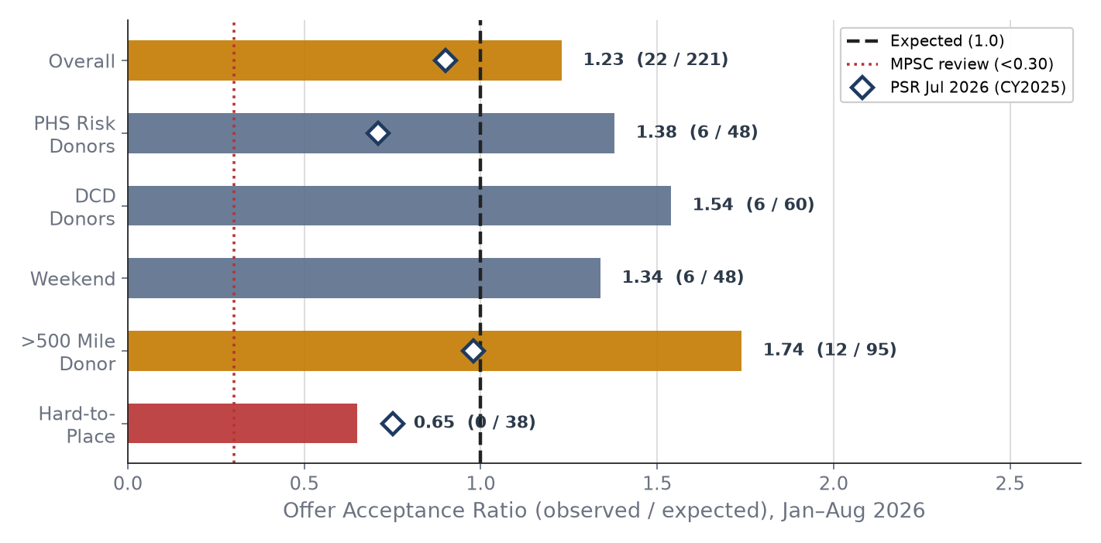
ALUA Offer Acceptance — Lever Pulled (Jan–Aug 2026)
Jan–Aug 2026: 221 offers · 22 accepted · ratio 1.23 — up from 0.90 (CY2025, PSR Jul 2026) and 0.62 (PSR Jan 2026)
Acceptance Strategy Analysis
Overall ratio: 0.62 → 0.90 → 1.23
PSR Jan '26 → PSR Jul '26 (CY2025) → Jan–Aug '26
Accepted 22 / 221 offers (Jan–Aug '26)
CY2025: 31 / 526, 34.5 expected, 0.90 [0.62–1.24]
Hard-to-place: 0.65 (CY2025: 0.75)
0 of 38 accepted — still deferred
>500 miles: 1.74 (CY2025: 0.98)
12 of 95 — distance range has been expanded
PHS risk 1.38 (was 0.71) · DCD 1.54
Both above expected — broader donor acceptance
MPSC trigger: <0.30
ALUA at 1.23 — no regulatory risk
Next constraint is listings, not acceptance:
active waitlist fell 13 → 8 (Jul '24 → Jul '26);
16–17 transplants per half-year ≈ removals.
Grow referrals; watch 90-day outcomes
as distance/DCD acceptance widens.
US Lung Transplant Analytics | Offer Acceptance
16
Notes:
The January–August 2026 offer acceptance report reverses the April story. ALUA received 221 offers and accepted 22 against 17.5 expected — an overall ratio of 1.23 ('somewhat above average'). The trajectory is 0.62 in the January 2026 PSR, 0.90 for calendar 2025 in the July 2026 PSR (31 of 526 offers, 34.5 expected, credible interval 0.62–1.24), and 1.23 for January–August 2026. Acceptance of offers over 500 miles is 1.74 (12 of 95; 0.98 in CY2025), PHS increased-risk donors 1.38 (0.71 in CY2025) and DCD donors 1.54, so the distance and donor-risk levers recommended in April have been pulled. Hard-to-place offers remain deferred (0 of 38, ratio 0.65; 1 of 71 in CY2025). Offer counts across the reports are not directly comparable because the windows and offer definitions differ; the ratios are.
With acceptance above expected and volume still about 31 a year, the constraint has moved upstream. The waitlist activity report shows the active list shrinking from 13 at the start of H2 2024 to 8 at the start of H2 2026, with 15–17 deceased-donor transplants per half-year roughly equal to removals: the program is transplanting almost everyone it lists. Growth beyond ~31 now depends on referrals and listings. The trade-off to watch is the 90-day graft signal on the surveillance slide as distance and DCD acceptance widen.

Slide 17
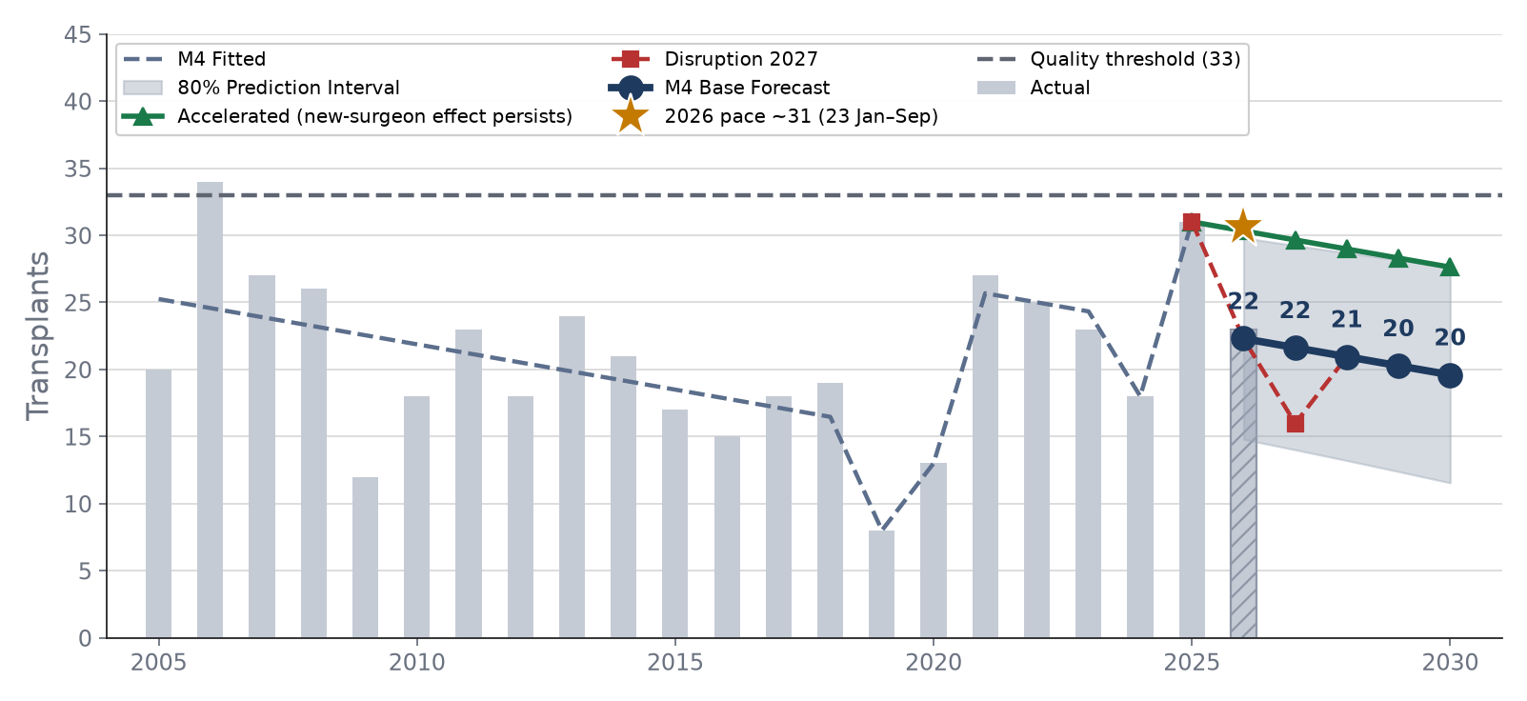
ALUA Volume Regression & Forecast 2026–2030
M4 parsimonious structural model · AIC=70.6 · Adj R²=0.448 · Lowest AIC of 4 models
Model Comparison
M1: Linear
−0.041
80.3
M2: Quadratic
0.199
75.7
M3: Full struct.
0.327
75.7
M4: Best ★
0.448
70.6
M4 Forecasts: Base vs Accelerated
2026: base 22 (PI 15–30) · accel. 30
2027: base 22 (PI 14–29) · accel. 30
2028: base 21 (PI 13–29) · accel. 29
2029: base 20 (PI 12–28) · accel. 28
2030: base 20 (PI 12–28) · accel. 28
★ 2026 pace ~31 (23 by Sep): tracking accelerated path
US Lung Transplant Analytics | Regression Forecast
17
Notes:
The M4 structural model (time trend, new-MD era from 2021, and single-year dummies for 2019, 2020, 2024 and 2025) was refit and reproduces the April figures exactly: adjusted R² 0.448, base forecast 22 for 2026 with an 80% prediction interval of 15–30. The base case treats the 2025 new-surgeon effect as a one-off; the accelerated scenario assumes it persists (30 in 2026, easing to 28 by 2030 with the trend).
With 23 transplants by September, 2026 is on pace for about 31 — at the top of the base interval and on the accelerated path. Two consecutive years at ~31 are evidence the new-surgeon effect is durable, so the base case of 22 now looks too low. Both paths remain below the 33-case threshold without further growth.

Slide 18
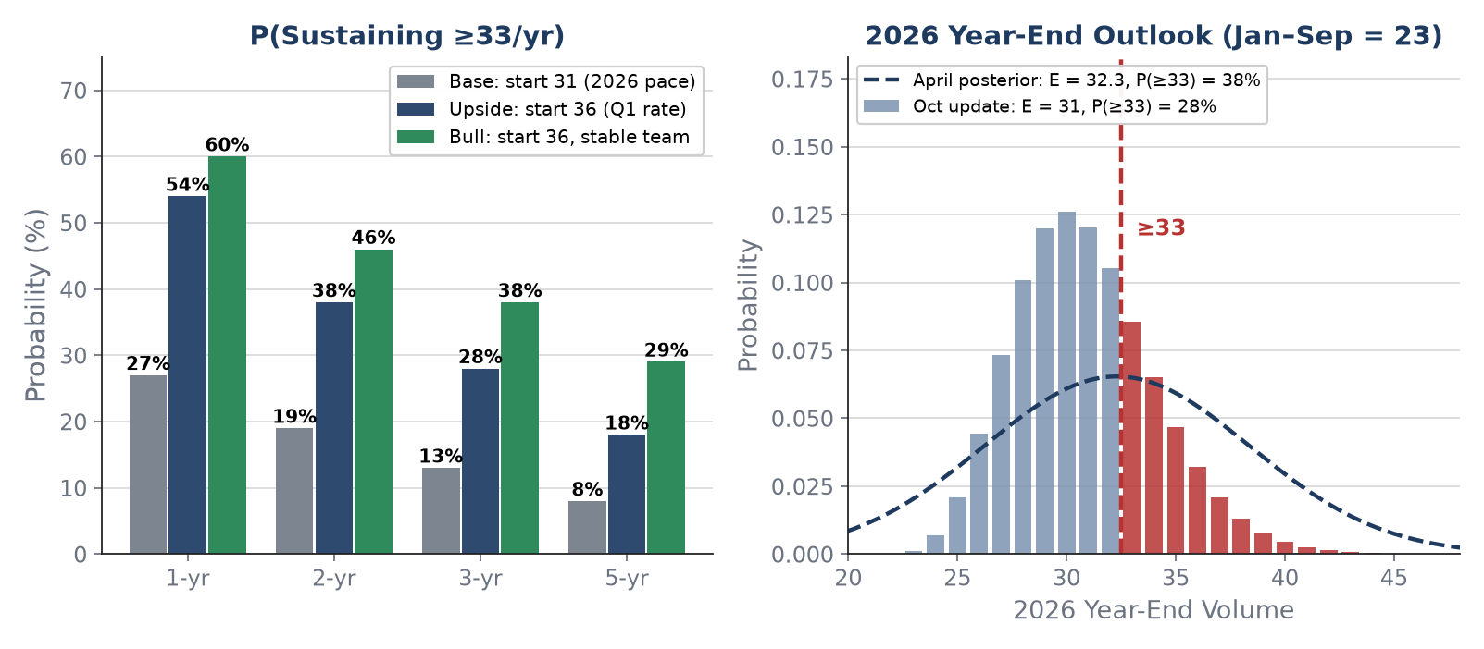
Monte Carlo Probability & Bayesian Update
100k simulated paths · Regime-switching model · Year-end update with Jan–Sep 2026 actuals
P(Sustaining ≥33 cases/yr)
Scenario
1yr
3yr
5yr
Base (start 31)
27%
13%
8%
Upside (start 36)
54%
28%
18%
Bull (36, stable)
60%
38%
29%
2026 Year-End Update
Given Jan–Sep 2026 = 23 cases (Q1 = 9):
April: E[vol] = 32.3 | P(≥33) = 38%
Oct: E[vol] = 31 (80%: 27–35) | P(≥33) ≈ 28%
Needs ≥10 in Q4 (best quarter so far: 9)
Retaining surgical team = highest-leverage action
US Lung Transplant Analytics | Monte Carlo & Bayesian
18
Notes:
Monte Carlo (100,000 paths, regime-switching with a 10% annual disruption probability). The scenarios are unchanged but relabelled: the April 'conservative' run started at 31 — exactly the 2026 pace — so it is now the base case (1-year 27%, 3-year 13%, 5-year 8% probability of sustaining 33+). The April base (start 36, from Q1 alone) becomes the upside case.
Year-end update: Q4 volume modelled as Poisson with a gamma posterior on the quarterly rate from January–September (23 cases over 3 quarters). Expected 2026 total is about 31 (80% range 27–35). Reaching 33 needs 10 or more in Q4, above any quarter so far, so P(2026 ≥ 33) is about 28%, down from 38% in April. To have a 50% chance of sustaining 33+ for three years, ALUA would need to start a year at about 43. Retaining the surgical team remains the highest-leverage action.

Slide 19
Key Recommendations & Surveillance Priorities
Actionable priorities derived from quantitative analysis of SRTR PSR, rolling data, and volume models
1
90-Day Graft Failure Review
Before SRTR 1/27 (Jan 2027)
2
Retain Surgical Team
Through April 2027
7/26 confirmed at 1.24; the 1/27 cohort is at 1.71 (5 early failures vs 2.1 expected), later windows 1.9–2.1. Case-review every 2025–26 ≤90-day failure now.
Disruption probability is the dominant model parameter. Two years at ~31/yr support a durable new-surgeon effect; a disruption resets to ~22.
3
Shift From Acceptance
to Listings
4
Monitor Acuity-Adjusted
Metrics
Acceptance ratio 1.23 (>500 mi 1.74, DCD 1.54) — the April lever is pulled. Growth now depends on listings: 65+ candidates are 49% of the national list but 9% of ALUA's.
HRs are risk-adjusted, but ICU intake is now 2.5× national (51.6%) and distance/DCD acceptance just widened. Ask SRTR whether the model under-adjusts at this acuity.
5
Q4 2026 = Year-End
Checkpoint
Needs ≥10 Q4 cases for 33 in 2026 (P ≈ 28%); realistic ~31. Set 2027 target ≥33; track Emory and Vanderbilt share.
US Lung Transplant Analytics | Recommendations
19
Notes:
Five priorities. 1) The 90-day graft signal: SRTR 7/26 came in at 1.24 as projected, but the 1/27 cohort is at 1.71 with five early failures against 2.1 expected, and the incomplete windows track 1.9–2.1. Review every 2025–26 failure within 90 days before the January 2027 report, which will be the first official report in the approach zone. 2) Retain the surgical team through April 2027: disruption probability dominates the model, and two years at ~31 support a durable new-surgeon effect. 3) Offer acceptance is no longer the lever — the ratio is 1.23 with distance and DCD acceptance above expected — so growth now depends on referrals and listings; the active waitlist has shrunk to 8. 4) SRTR HRs are risk-adjusted; ask whether the model under-adjusts at ALUA's 2.5× national ICU intake (51.6% in 2025), especially as donor acceptance widens. 5) Q4 2026: 10 or more cases would reach 33 for the year (about a 28% chance); otherwise plan for ~31 and set a 2027 target of 33+, watching regional share against Emory and Vanderbilt.

Slide 20
Summary
National Market
Policy Impact
3,083 transplants (2025), +158% since 2005; 2026 Jan–Sep 2,397 (pace ~3,196, +4%). Both reforms improved equity and access; CAS produced the largest single-year jump.
Only 4 of 51 centers lost under both reforms. CAS rewards acuity-optimized programs. Southeast volume is growing fast (+14% 2026 pace), led by Vanderbilt, Emory, Tampa and Shands.
ALUA Current State
ALUA Trajectory
PSR Jul 2026: 1-yr survival 90.5% (expected 91.7%), HR 1.13 — normalized from Jan's 0.69. 90-day graft HR 1.24; rolling 1/27 cohort at 1.71 (approach zone) on early failures. WLM resolving (1.20).
2026: 23 by Sep, pace ~31 — second year at the 2025 level. Offer acceptance 0.62 → 0.90 → 1.23; constraint is listings. P(2026 ≥33) ≈ 28%. SE share 5.7% → 4.9%.
Data: OPTN 2005–Sep 30, 2026 · SRTR PSR Jul 7, 2026 · Rolling reports Oct 4, 2026 · Offer acceptance Jan–Aug 2026 · Analysis: OLS Regression, Monte Carlo, Bayesian Update
US Lung Transplant Analytics Report · October 2026 Update · For Internal Program Use
Notes:
National: 3,083 transplants in 2025, +158% since 2005; 2026 is on pace for about 3,196 (+4%). Both reforms improved equity and access. Policy: only 4 of 51 centers lost under both reforms; the Southeast is now one of the fastest-growing regions (+14% 2026 pace), led by Vanderbilt, Emory, Tampa and Shands. ALUA current state: the July 2026 PSR puts one-year survival at 90.5% with HR 1.13 — at expected, down from the January report's 0.69 — and a 90-day graft HR of 1.24 as projected; the rolling 1/27 cohort is at 1.71 on early graft failures, while 1-year conditional survival and waitlist mortality are fine. ALUA trajectory: 23 by September, pace ~31 — a second year at the 2025 level, on the accelerated path rather than the base model's 22, with about a 28% chance of reaching 33 in 2026. Offer acceptance has risen to 1.23, so listings are now the constraint. Regionally, ALUA's share is slipping (5.7% to 4.9%) as Emory and others grow.

