Slide 1
Lung Transplant
Analytics Report
National Insights · ALUA Program Analysis · Policy Impact · Forecasts
PART 1 — NATIONAL ANALYSIS
PART 2 — ALUA PROGRAM
▸ National volume 2005–2025
▸ Historical volume & events
▸ DSA & CAS policy impact
▸ SRTR outcomes (PSR Jan 2026)
▸ Program quadrant analysis
▸ Rolling HR surveillance
▸ Equity & access metrics
▸ Regression & Monte Carlo
OPTN 2005–2025 · SRTR PSR January 2026 · Rolling PSR April 2026
Notes:
This report covers 20 years of U.S. lung transplant data across 54 active adult centers. The analysis has two parts: Part 1 examines national trends and policy impact from 2005–2025; Part 2 focuses on the ALUA program at University of Alabama. Data sources are OPTN (2005–2025) and SRTR PSR reports (January 2026 and Rolling April 2026). Use this as a comprehensive reference for understanding how the national system has evolved and where ALUA sits within it.

Slide 2
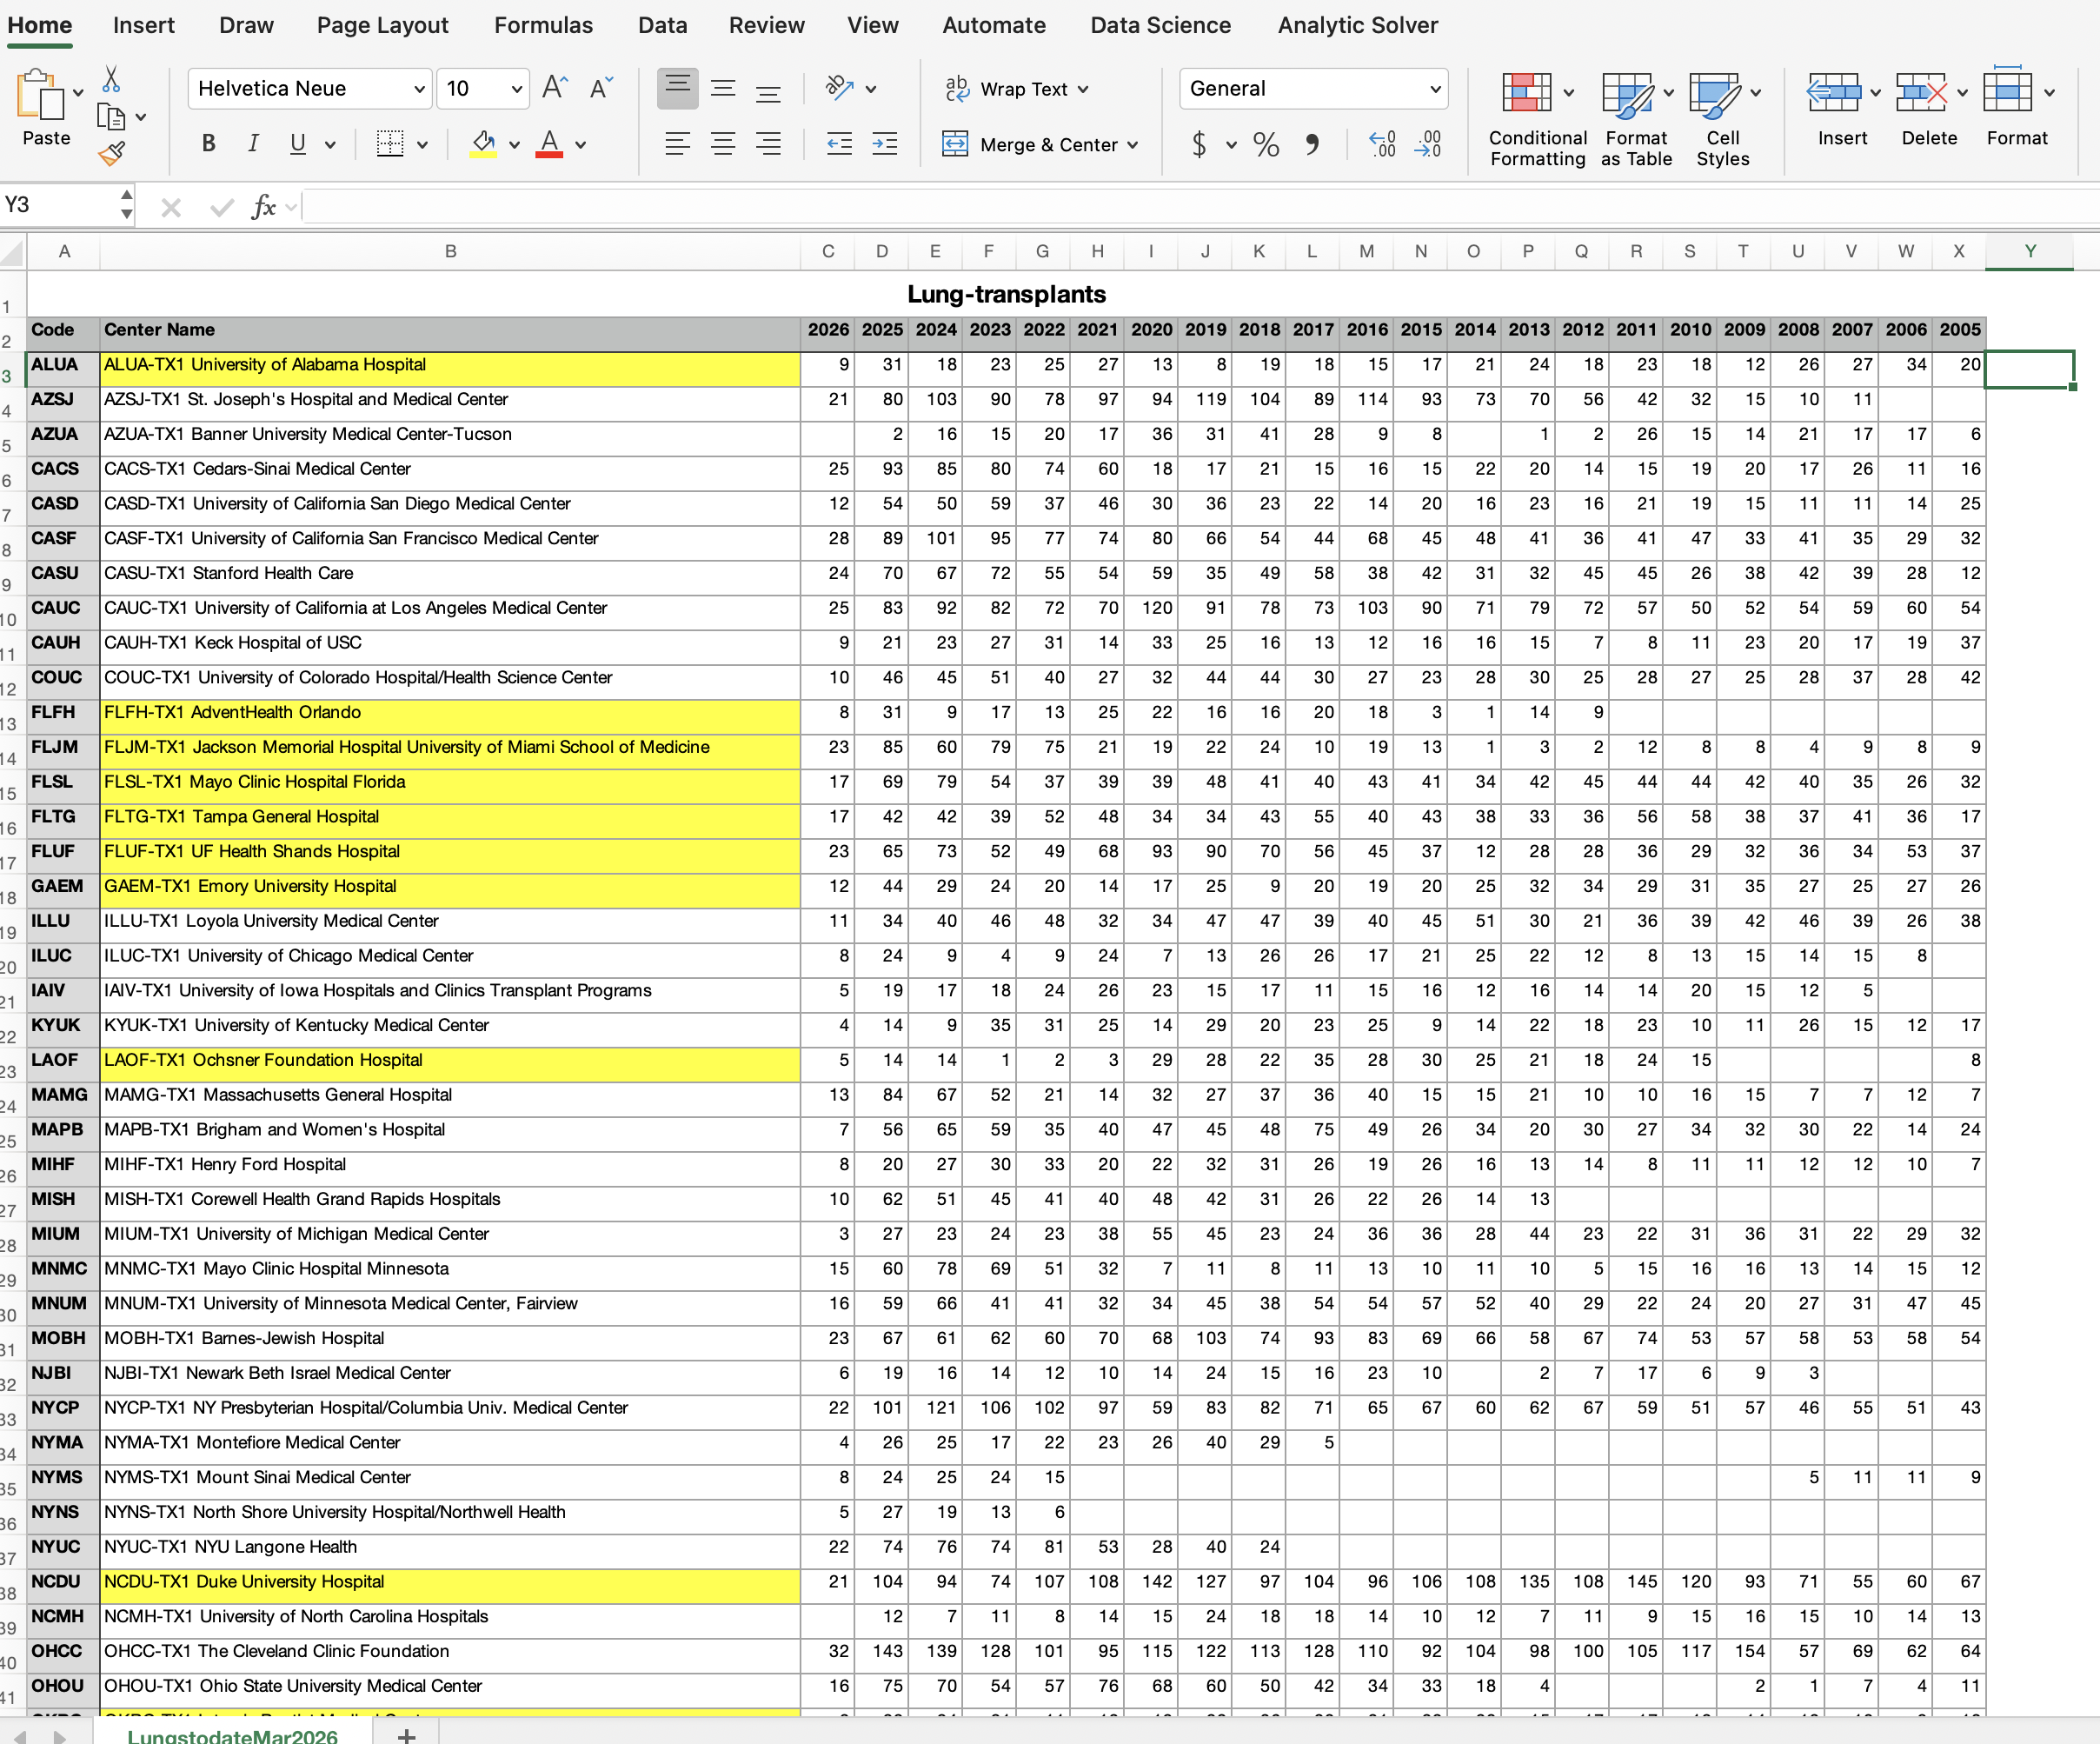
Web-scraped data
Personal project to apply text /data mining tools with AI help
OPTN-HRSA website:
Used AI to vibe code program to web scrape the lung transplant data on 54 US centers (active adult programs > 3 years)
Period 2005- Mar 2026
ALUA current PSR, SRTR report Jan 2026
Key Questions:
How has the U.S. lung transplant system changed over the past 20 years?
How did major allocation policy reforms — DSA removal and CAS implementation — redistribute volume and access across centers?
Where does ALUA stand now, what explains its recent volume recovery, and what are the major surveillance risks for 2026–2028?
Notes:
This is a personal data science project applying web scraping and AI-assisted analysis to publicly available OPTN-HRSA data. The scraper was AI-coded and captured transplant activity for 54 active adult programs over 20+ years. Key questions driving the analysis: How has national volume changed over two decades? What did the DSA and CAS policy reforms actually do to individual programs? And where does ALUA stand competitively within its peer group?

Slide 3
US Lung Transplant
Comprehensive Analytics Report
National Insights · ALUA Program Analysis · Policy Impact · Forecasts
3,083
+158%
54
31
95.7%
2025 National Volume
20-Year Growth
Active Centers
ALUA 2025 Volume
ALUA 1-yr Survival
OPTN 2005–2025 · SRTR PSR January 2026 · Rolling PSR April 2026
Notes:
The top-line numbers: the U.S. performed 3,083 lung transplants in 2025 — a 158% increase over 20 years across 54 active centers.

Slide 4
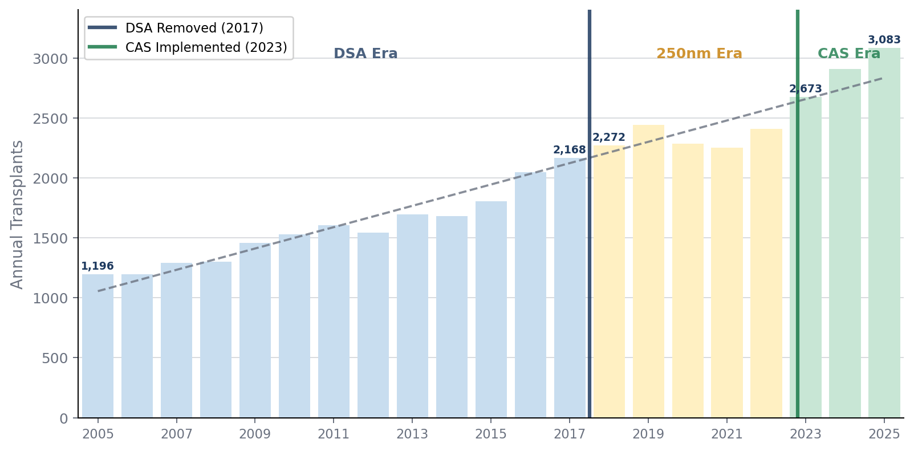
Part 1 — National Market
US Lung Transplant Volume 2005–2025 with Policy Inflection Points
Era Averages
DSA Era (2010–17): 2,006/yr
250 NM Era (2018–22): 2,333/yr (+16%)
CAS Era (2023–25): 2,888/yr (+24%)
▸ 158% growth: 1,196 → 3,083 transplants over 20 years
▸ 2023: largest single-year jump (+10.9%) — CAS effect
▸ COVID 2020 dip (−6.5%) recovered fully by 2022
▸ Post-CAS slope: +216/yr vs long-run +89/yr
▸ 2026 YTD annualizes ~3,012 — tracking conservative model
US Lung Transplant Analytics | National Volume Trend
2
Notes:
National volume grew from 1,196 in 2005 to 3,083 in 2025 — 158% growth. The trajectory has three distinct eras: the DSA era averaged 2,006 transplants per year; the 250-nautical-mile era averaged 2,333 (+16%); and the CAS era is averaging 2,888 (+24%). Two policy reforms drove step-changes in national volume. The COVID dip in 2020 was a temporary 6.5% decline, fully recovered by 2022. The CAS implementation in March 2023 produced the largest single-year jump in the dataset (+10.9%). The 2026 YTD pace (~3,012 annualized) suggests we may be normalizing to the conservative growth model rather than continuing the post-CAS surge slope of +216/year.

Slide 5
Competitive landscape: concentration is moderate, but leaders matter
National market
36.6%
Top 10 share of 2025 national volume
Largest center
Top three combined
Temple
178
470
Market is not monopolistic, but center-specific capability matters.
Leaders combine referral depth, high-acuity candidate management, donor acceptance, and surgical throughput.
ALUA competes in a system where the benchmark is no longer only local geography.
US Lung Transplant Analytics | ALUA Program Assessment
Sources: OPTN-style volume workbook, SRTR PSR Jan 2026, Rolling SRTR Apr 2026, project analysis files.
8
Notes:
Speaker notes: This slide gives the national competitive context. The top ten centers perform about 36.6 percent of national volume, so the market is moderately concentrated. The dominant centers - Temple, Vanderbilt, and Cleveland Clinic - are not simply large by chance. Their volumes likely reflect a combination of referral networks, operational scale, acuity management, donor acceptance behavior, and surgical capacity. For ALUA, the relevant message is that sustaining volume requires competing on these capabilities, not just relying on regional donor geography.

Slide 6
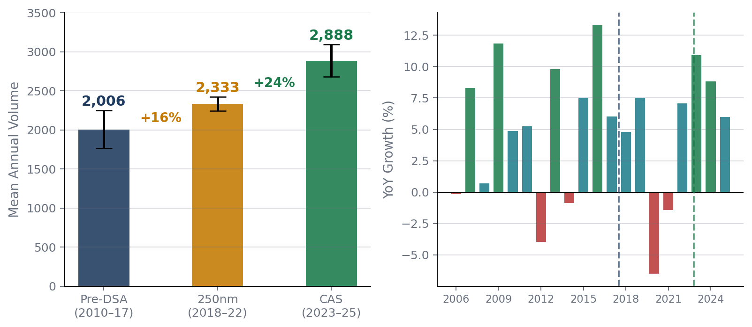
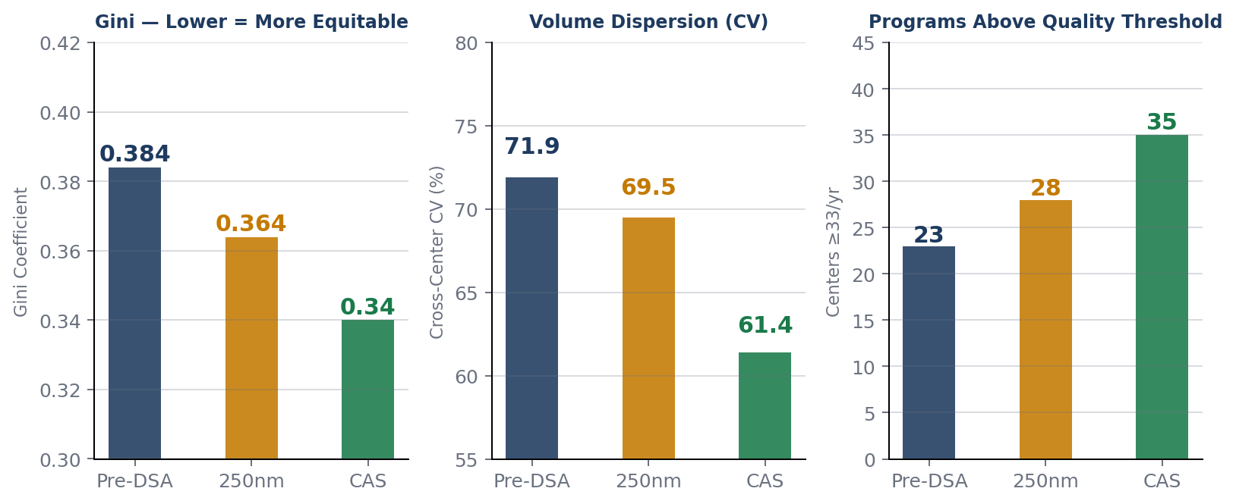
Policy Era Comparison & Equity Impact
DSA Removal (Nov 2017) · CAS Implementation (Mar 2023)
Key Policy Findings
▸ DSA removal: median waitlist time fell 9 days; transplant rate rose nationally; LOS increased 2 days (transport distance)
▸ CAS (Mar 2023): acuity-first composite scoring. Waitlist mortality: 11.2% → 8.4% → 4.1%. Largest YoY volume jump on record.
▸ Gini: 0.384→0.364→0.340. CV: 71.9%→61.4%. Centers ≥33/yr: 23→28→35. System measurably more equitable under CAS.
▸ Both reforms market-expanding: only 4 of 51 centers declined under BOTH policies (the Double Losers).
US Lung Transplant Analytics | Policy Era Analysis
3
Notes:
Two major allocation policy changes reshaped the transplant landscape. DSA Removal (Nov 2017): eliminated donation service area geography as the first distribution level. Result — median waitlist time fell 9 days, transplant rates rose nationally, but median LOS increased 2 days due to longer transport distances. CAS Implementation (March 2023): replaced the Lung Allocation Score with a composite acuity-first scoring system. This drove the largest single-year volume jump on record. Most importantly, waitlist mortality dropped dramatically — from 11.2% in the DSA era to 8.4% in the 250nm era, down to 4.1% in the CAS era.
The Gini coefficient tells you whether lung transplants are concentrated in a few powerhouse centers or spread more evenly across many centers. In the data, the falling Gini suggests that policy changes made access less geographically concentrated and more broadly distributed across programs.
The Gini coefficient across centers also fell monotonically: 0.384 → 0.364 → 0.340, showing both reforms moved the system toward greater equity and access. The geographic CV also fell, confirming that fewer programs dominate total volume.
The computed program-level CV over 2015–2025, requiring at least 8 of 11 years of data. Low-CV programs are interpreted as having predictable referral pipelines and stable donor access; high-CV programs often include centers that recently scaled rapidly, where growth itself mathematically creates variance
For mature high-volume programs, a low CV usually signals operational stability. For fast-growing centers, high CV can simply mean they scaled from a small base.
In the analysis, UW Medical Center and Cleveland Clinic are examples of stable low-CV programs, while Vanderbilt, Cedars-Sinai, and Mayo Minnesota are high-CV but largely because they grew rapidly.
Across the national system, CV measures how unevenly volume is distributed across centers. This is conceptually similar to the Gini coefficient, but CV is more sensitive to spread around the mean.
In the policy-era analysis, cross-center CV fell from 71.9% pre-DSA to 61.4% in the CAS era, meaning lung transplant volume became more evenly distributed across programs after allocation reforms.
ALUA’s CV is 34.0% over 2015–2025, which places it almost exactly at the peer median; the peer median is 35.1%. So ALUA is not unusually volatile relative to its peer group. The main outlier is the 2019 trough of 8 cases, which strongly influences the volatility profile.
The “quality threshold” refers to the ≥33 lung transplants/year benchmark.
Below 33/year Program may have higher statistical uncertainty and potentially higher volume-related outcome risk
At or above 33/yea rProgram is above the empirical volume-quality floor
Sustained ≥33/year More meaningful than a single-year crossing; suggests durable operational capacity
Era based : Centers ≥33/yearPre-DSA era23 of 51Post-DSA / 250-nautical-mile era28 of 52CAS era35 of 54
That means the number of programs operating above the empirical quality threshold increased after each allocation reform.

Slide 7
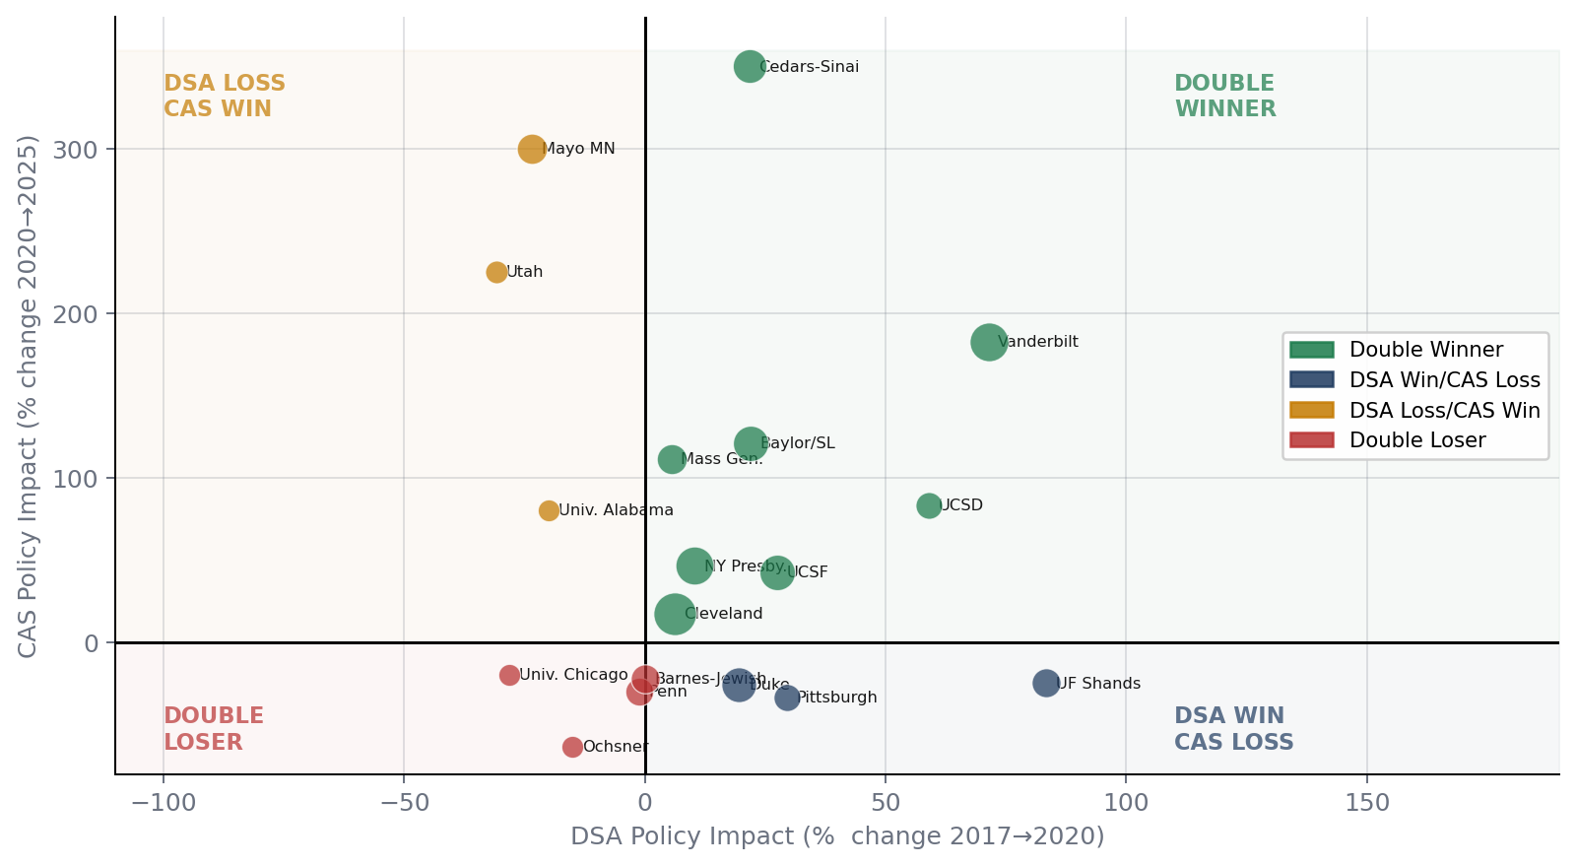
Policy Quadrant — All 51 Centers
Which programs won or lost under each allocation reform?
Double Winner (20)
Benefited from both reforms
Ex: Vanderbilt +384%, Cedars-Sinai +461%
DSA Win / CAS Loss (16)
Geographic expansion; lost on acuity
Ex: Duke −11% net, Pittsburgh −14%
DSA Loss / CAS Win (11)
Recovered under acuity scoring
Ex: Mayo MN +509%, Utah +125%
Double Loser (4)
Both reforms hurt — structural risk
Ex: Ochsner −69%, Penn −31%
US Lung Transplant Analytics | Policy Quadrant Analysis
4
Notes:
The policy quadrant categorizes all 51 centers by how they fared under each reform. Double Winners (20 centers): benefited from both — examples include Vanderbilt (+384%) and Cedars-Sinai (+461%). These programs had strong clinical infrastructure that was previously suppressed by geography. DSA Win / CAS Loss (16 centers): expanded geographically under the 250nm rule but lost share when acuity scoring took over. Duke (-11% net) and Pittsburgh (-14%) are prime examples — they expanded by pulling organs from a wider radius, but aren't as acuity-optimized as competitors. DSA Loss / CAS Win (11 centers): had their geographic advantage stripped in 2017 but recovered under acuity scoring. Mayo Minnesota (+509% net) and Utah (+125%) are the standout cases. Double Losers (only 4 centers): the most strategically concerning group — Ochsner, Penn/HUP, Barnes-Jewish, and University of Chicago. Both reforms hurt them, which requires structural explanation beyond bad luck.

Slide 8
Top Centers & Double Loser Profile
Center
2025 Vol
CAS Avg
Net Δ
DOUBLE LOSERS
Temple University
178
140
+39%
Ochsner (LA)
31→10 avg
−69%
Vanderbilt
149
113
+384%
Critical: below quality threshold. Gulf South OPO advantage eliminated under both policies.
Cleveland Clinic
143
137
+24%
Duke
104
91
−11%
Baylor/St. Luke's
102
94
+170%
Penn/HUP (PA)
86→59 avg
−31%
NY Presbyterian
101
109
+62%
Temple (same city, #1 national) dominates on CAS urgency score; Penn loses intra-city share.
Cedars-Sinai
93
86
+461%
UCSF
89
95
+82%
Jackson Miami
85
75
+433%
Barnes-Jewish (MO)
82→63 avg
−22%
Mass General
84
68
+123%
Midwest OPO geographic premium eliminated; acuity scoring doesn't compensate.
Univ. Chicago (IL)
21→12 avg
−42%
Loyola in same metro — neither policy rewarded Chicago's geographic position.
US Lung Transplant Analytics | Top Centers & Double Losers
5
Notes:
Temple University leads nationally at 178 cases in 2025, followed by Vanderbilt (149) and Cleveland Clinic (143). The Double Losers deserve particular attention as cautionary cases. Ochsner in New Orleans is the most alarming: a program averaging only 10 cases/year in the CAS era is operating well below the 33-case quality threshold — their Gulf South OPO geographic advantage was stripped under DSA removal and CAS compounded it. Penn/HUP fell from 86 cases/year pre-DSA to 59 average — Temple University, in the same city, now dominates on CAS urgency scoring and captures intra-city organ share. Barnes-Jewish lost its large Midwest OPO catchment advantage — their geography no longer confers any benefit. University of Chicago at 12 cases/year is a competitor-squeeze story — Loyola in the same metro has been stable, and neither policy rewarded their geographic position. The key insight from Double Losers: these are not random — they represent programs whose historical advantages were geography-based rather than clinical-quality-based.

Slide 9
PART 2
ALUA Program Analysis
University of Alabama Hospital · Center Code: ALUA · Birmingham, Alabama
31
95.7%
0.69
0.62
9 cases
2025 Volume
1-yr Survival
PSR Jan 2026 HR
Offer Accept Ratio
2026 Q1 Actual
SRTR PSR January 2026 · Data through October 31, 2025 · Rolling PSR April 3, 2026
1. Historical Volume & Events
2. SRTR Outcomes (PSR Jan 2026)
3. Rolling HR Surveillance
4. Offer Acceptance Analysis
5. Regression Forecast 2026–30
6. Monte Carlo Probability
7. Clinical Profile & Recommendations

Slide 10
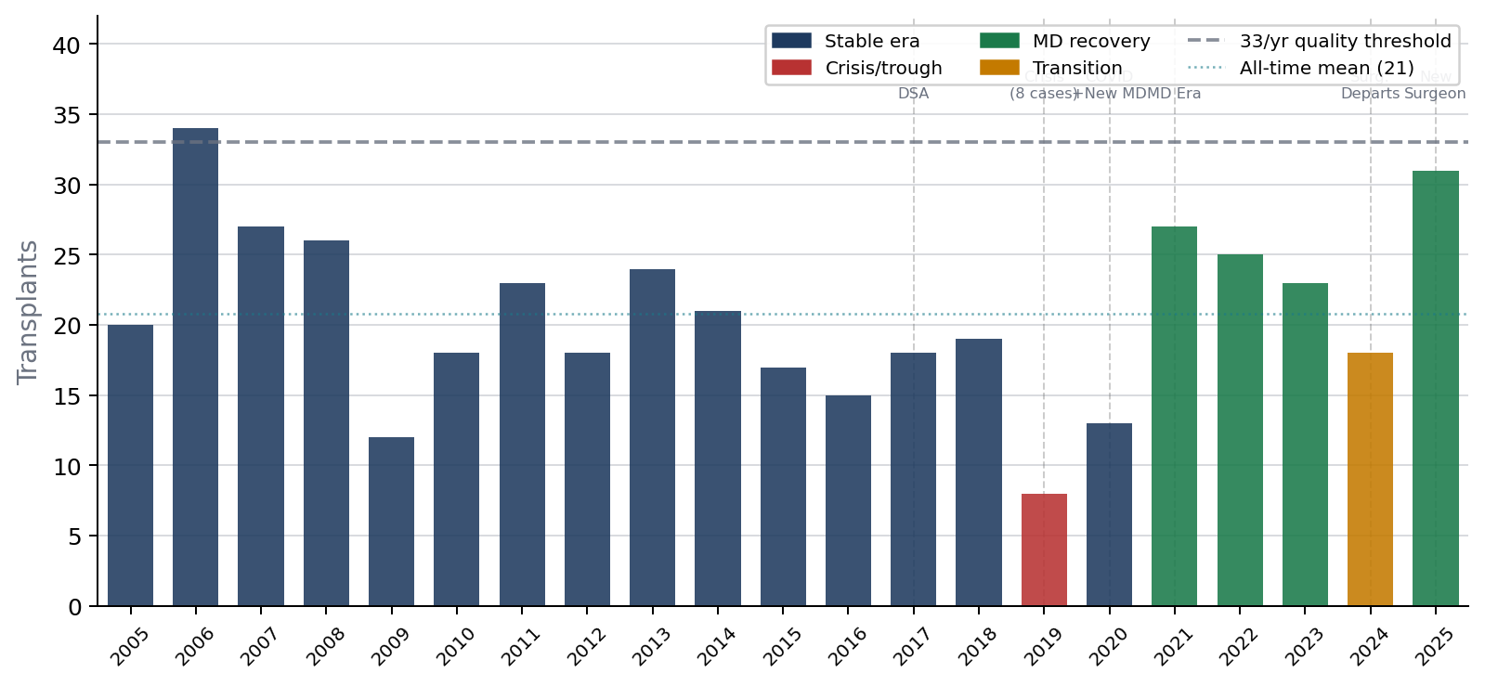
ALUA — Historical Volume 2005–2025
Structural event analysis across leadership transitions and policy changes
Structural Events
2006
Peak: 34 cases
All-time high
2017
DSA removed
−20% vs peer +10.5%
2019
Leadership crisis
Trough 8 cases (−58%)
Dec 2020
New MD joins
+11.2/yr effect (p=0.024)
2021–23
Recovery era
27→25→23 cases/yr
Oct 2024
Surgeon departs
−22% dip → 18 cases
Apr 2025
New surgeon
31 cases — best since 2007
Q1 2026
9 actual cases
Annualizes to ~36/yr
US Lung Transplant Analytics | ALUA Historical Volume
7
Notes:
Part 2 — the ALUA-specific deep dive. The University of Alabama at Birmingham (ALUA) is a mid-tier program that has had a turbulent history but is now showing promising signs. The five headline metrics set the frame: 31 cases in 2025 (best since 2007), 95.7% one-year survival (significantly above the 89.6% national rate), a PSR hazard ratio of 0.69 (well below the 2.25 MPSC flag threshold), an offer acceptance ratio of 0.62 (38% below national — a key volume lever), and 9 cases already in Q1 2026. The 7 sections of the ALUA analysis build from the historical record through outcomes data to forward-looking projections and operational recommendations. Note that the SRTR data cutoff is October 31, 2025, and the Rolling PSR is from April 3, 2026.

Slide 11
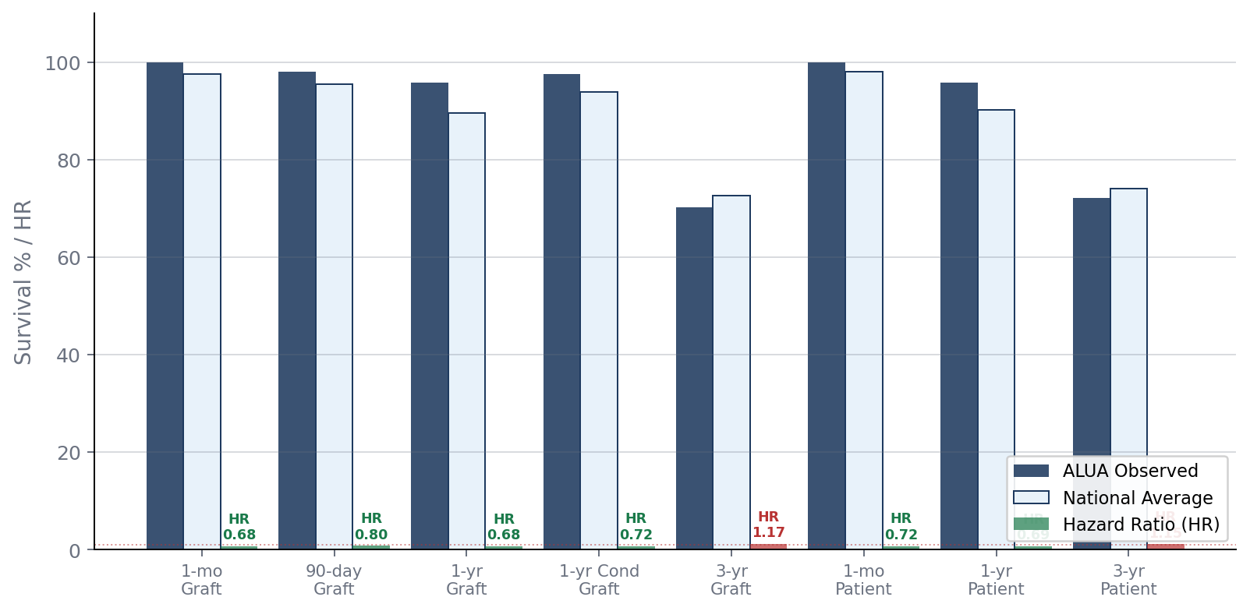
ALUA SRTR Outcomes — PSR January 2026
Cohort: Jul 2022–Dec 2024 · n=52 · All short-term metrics significantly better than national average
95.7%
0.68
1-yr Graft Survival
1-yr Graft HR
95.7%
0.69
1-yr Patient Survival
1-yr Patient HR
70.3%
1.17
3-yr Graft Survival
3-yr Graft HR
2 obs / 3.91 exp
1-yr Failures vs Expected
★ All short-term HRs well below MPSC review threshold (2.25)
△ 3-yr cohort (2020–22) partially overlaps crisis/COVID period
▪ National 1-yr: 89.6% graft / 90.2% patient — ALUA exceeds by 6pp
US Lung Transplant Analytics | SRTR Outcomes
8
Notes:
The January 2026 PSR covers the cohort from July 2022 through December 2024 — 52 transplants since medical staffing transition . Every short-term metric is better than expected. One-year graft survival is 95.7% vs 89.6% nationally — a 6 percentage-point advantage. The hazard ratio for both 1-year graft and patient survival is 0.68–0.69, meaning roughly 32% fewer failures than expected for a program this size. Actual 1-year failures were only 2 vs 3.91 expected. The one flag is 3-year graft survival at 70.3% with an HR of 1.17 — this cohort (2020–2022) partially overlaps the COVID period and the leadership crisis trough, so these cases may not represent current program performance. Critically, all short-term HRs are well below the MPSC review threshold of 2.25. This PSR is an unambiguously strong result for the new medical leadership era.

Slide 12
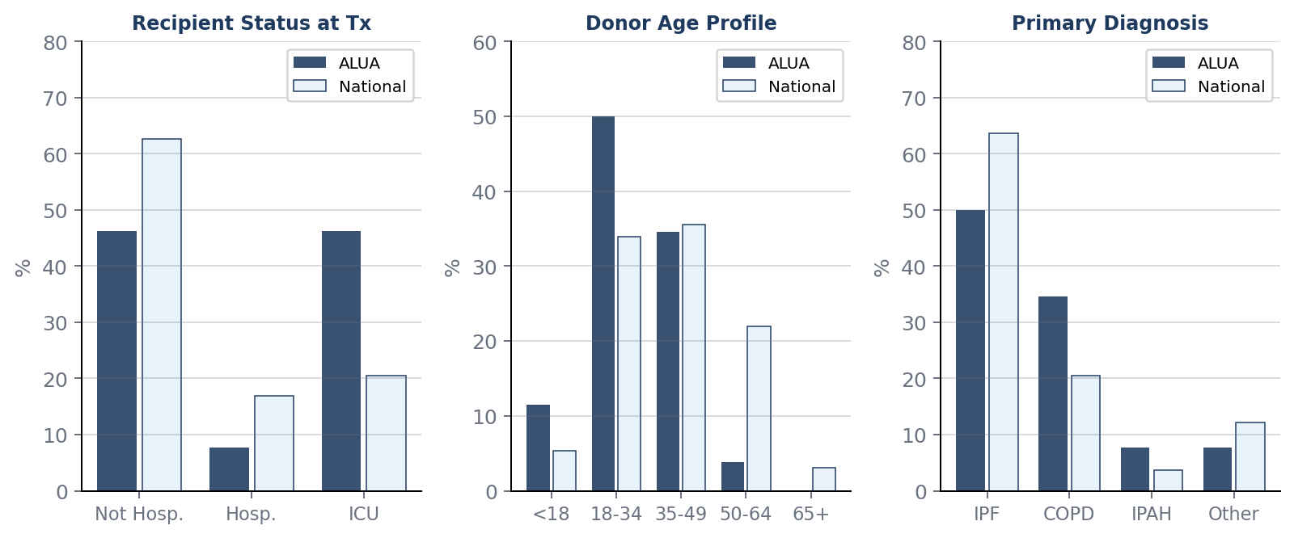
ALUA Clinical Profile
Recipient & donor characteristics vs national benchmarks · Jul 2024–Jun 2025 · n=26
Clinical Insights
▸ ICU at transplant: 46.2% vs national 20.5% — 2.3× higher acuity intake. CAS incentivizes urgent patients. This drives excellent outcomes AND elevated early mortality risk.
▸ Donor age: 50% age 18–34 vs 33.9% nationally. Zero donors age 50+. Younger lungs → lower ischemic injury → strong 1-year outcomes. Key quality driver.
▸ Diagnosis: COPD 34.6% vs 20.5% national. COPD post-transplant survival systematically better than IPF — partially offsets ICU acuity risk.
▸ Post-tx LOS: 19.5 days vs 20.0 national — favorable despite higher ICU intake. Median time to transplant: 3.5 mo vs 1.4 national (conservative acceptance strategy).
US Lung Transplant Analytics | Clinical Profile
13
Notes:
ALUA's clinical profile explains both its excellent outcomes and its rising HR projections.
The most important number: 46.2% of ALUA recipients were transplanted from the ICU, versus 20.5% nationally. That is 2.3 times the national rate.
CAS explicitly incentivizes accepting the sickest patients — ALUA is responding correctly to the policy design. This high-acuity case mix drives excellent short-term outcomes because these patients have no other option (selection effect) but also elevates raw mortality risk because ICU patients are fragile.
On donor profile: 50% of ALUA donors are age 18-34 versus 33.9% nationally, and zero ALUA donors were age 50 or older.
Younger donor lungs have lower ischemic injury and better one-year outcomes — this is a deliberate procurement strategy that contributes to the strong PSR.
The offer acceptance analysis on the next slide explains where volume growth opportunity lies.
The integrated takeaway: ALUA's clinical choices are strategically coherent — high-acuity recipients, young donors — but they create a surveillance obligation around outcomes monitoring.

Slide 13
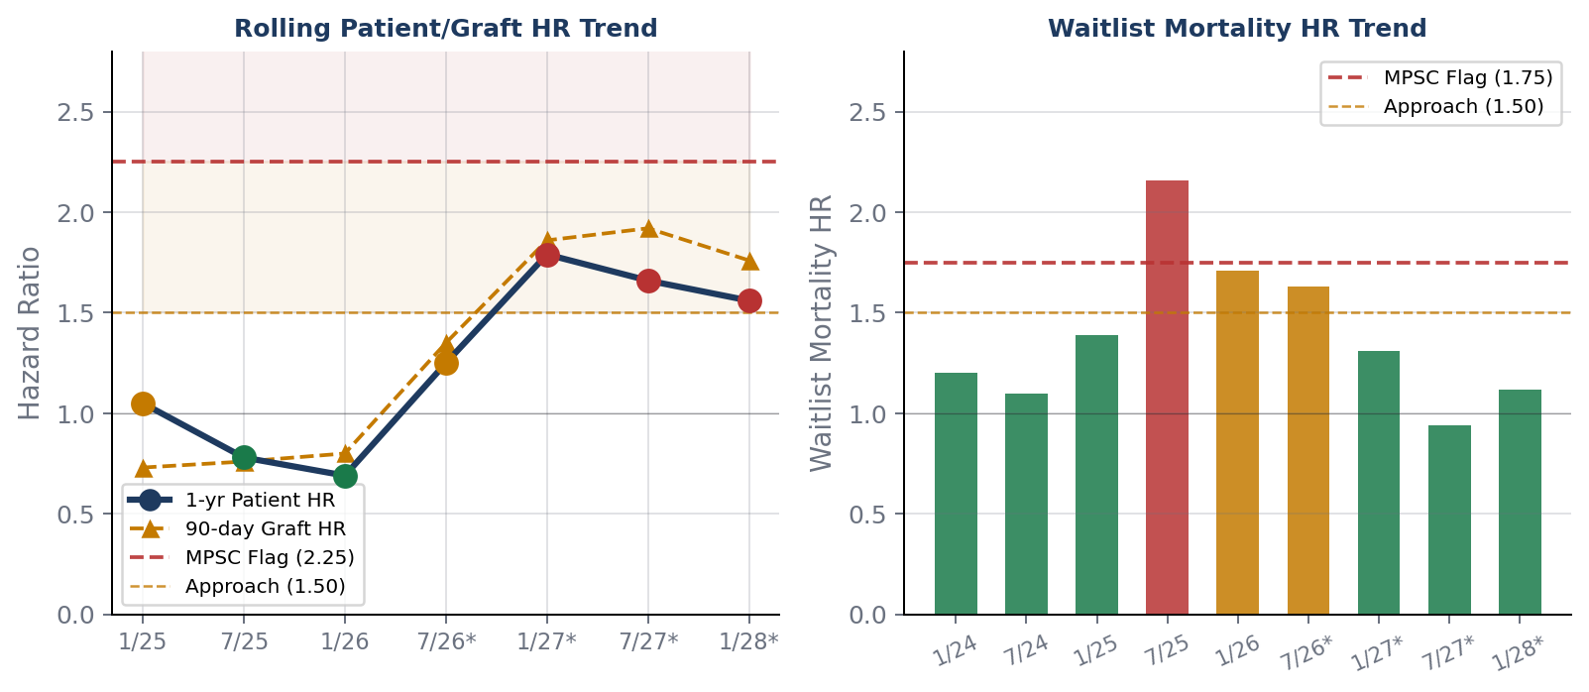
Rolling SRTR HR Trend — Surveillance Alert
Current PSR excellent; projected 2027–2028 windows enter approaching-flag zone
⚠ APPROACHING FLAG
Projected SRTR 1/27–1/28: HR 1.56–1.79
Approach zone: 1.50–2.25 | MPSC flag: >2.25
Driven by high ICU acuity + incomplete follow-up
✓ WAITLIST MORTALITY RESOLVED
WLM HR peaked 2.16 (SRTR 7/25) → now 0.94
Throughput recovery confirmed
MECHANISM: WHY HR IS RISING
46.2% recipients from ICU vs 20.5% national
Periods 8/9 (H1+H2 2025) incomplete —
full 1-yr follow-up not yet adjudicated
New surgeon ramp (Apr 2025 onboard)
★ SRTR 7/26 report (July 2026) — critical adjudication point
US Lung Transplant Analytics | Rolling SRTR HR Trend
9
Notes:
This is the most forward-looking and surveillance-critical slide in the deck. The current PSR (January 2026) is excellent at HR=0.69. However, rolling projections show the HR trajectory rising: SRTR 7/26 is projected at 1.25 (approaching zone), SRTR 1/27 at 1.56, and SRTR 1/28 at 1.79 — all in the 'approaching flag' zone of 1.50–2.25. The MPSC flag threshold is 2.25; none of the projections breach it, but the trend warrants monitoring.
The causal mechanism is not surgical quality decline — it is case mix. ALUA transplants 46.2% of recipients from the ICU versus 20.5% nationally (2.3x higher acuity).
CAS incentivizes accepting the sickest patients; ALUA appears to be responding to those incentives.
Additionally, 2025 cases have incomplete 1-year follow-up that hasn't been adjudicated yet.
The waitlist mortality concern (HR peaked at 2.16 in SRTR 7/25 due to the surgeon transition trough) has resolved — projected WLM HR for 7/27 is 0.94. The critical decision point is the SRTR 7/26 report in July 2026.

Slide 14
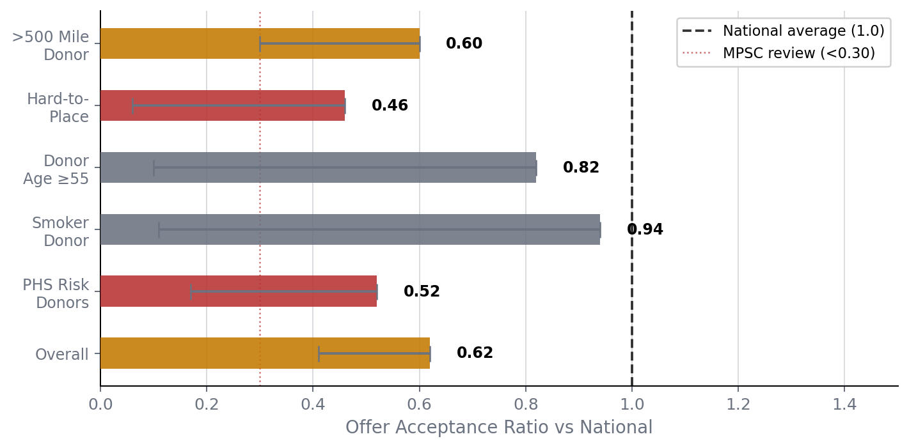
ALUA Offer Acceptance — Volume Lever Analysis
730 offers received · 25 accepted (3.4%) · Overall ratio 0.62 vs national 1.0
Acceptance Strategy Analysis
Overall ratio: 0.62
38% below national — primary volume driver
Accepted 25/730 offers
Transplant rate ratio: 0.56
Hard-to-place: 0.46
0 of 104 marginal offers
>500 miles: 0.60
Lowest-risk expansion lever
PHS risk: 0.52
CI crosses 1.0 — selective room
MPSC trigger: <0.30
ALUA at 0.62 — not at risk
Target: Accept more well-matched
younger donors at 250–400 miles.
Avoid marginal offers during
surgical ramp period.
US Lung Transplant Analytics | Offer Acceptance
10
Notes:
ALUA received 730 organ offers in the reporting period and accepted only 25 — a 3.4% acceptance rate. The overall acceptance ratio of 0.62 means ALUA accepts 38% fewer offers than the national average. This is the primary volume lever available to the program.
Breaking it down: the hard-to-place lung ratio is 0.46 (more selective than average on difficult organs),
the distance ratio for offers over 500 miles is 0.60 (room for expansion here), the PHS risk organ ratio is 0.52 but the confidence interval crosses 1.0, suggesting they could selectively expand here. Critically, ALUA accepted zero of 104 marginal offers — the lowest-risk area to avoid during surgical ramp.
The MPSC trigger for acceptance ratio is below 0.30 — ALUA at 0.62 is not at regulatory risk.
The recommended strategy: target well-matched younger donors at 250–400 miles, where ischemic time is manageable and risk is low.
Avoid marginal and hard-to-place offers until the new surgeon reaches 24-month maturity (April 2027).

Slide 15
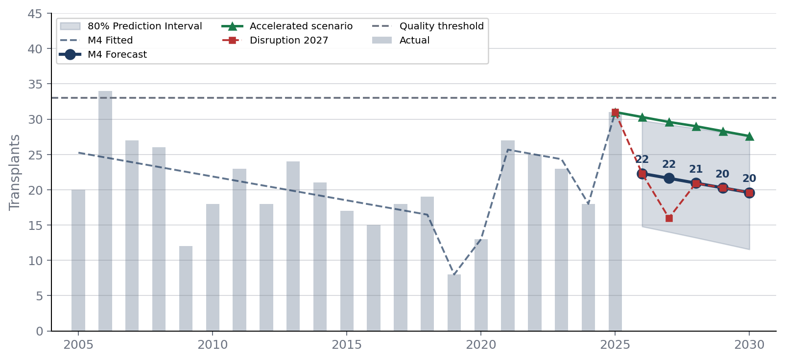
ALUA Volume Regression & Forecast 2026–2030
M4 parsimonious structural model · AIC=70.6 · Adj R²=0.448 · Lowest AIC of 4 models
Model Comparison
M1: Linear
−0.041
80.3
M2: Quadratic
0.199
75.7
M3: Full struct.
0.327
75.7
M4: Best ★
0.448
70.6
M4 Base Scenario Forecasts
2026: 22 cases (80% PI: 15–30)
2027: 22 cases (80% PI: 14–29)
2028: 21 cases (80% PI: 13–29)
2029: 20 cases (80% PI: 12–28)
2030: 20 cases (80% PI: 12–28)
★ Q1 2026=9 actual → annualizes ~36 (above 80% PI upper=30)
US Lung Transplant Analytics | Regression Forecast
11
Notes:
ALUA does not behave like a steadily growing program. It behaves like a program whose volume changes when leadership, staffing, policy environment, surgical stability, and referral dynamics change.
The M4 parsimonious regression model is the best of four models tested — lowest AIC (70.6), best adjusted R-squared (0.448).
The ALUA volume regression shows that ALUA’s historical volume is not explained by a simple time trend. The best model is a parsimonious structural model because leadership and operational events explain far more variance than time alone. The new medical leadership era is the strongest statistically significant positive factor, while the 2025 new-surgeon effect is promising but not yet statistically durable. The base forecast remains below the 33-case threshold, but Q1 2026 volume is running above model expectations, making Q2 2026 the critical validation point.
The variance decomposition tells the story clearly: a simple time trend (M1) explains essentially nothing (R2=0.011).
Adding the new medical leadership effect (Dec 2020) adds delta R2=0.138 — confirming the new MD is the second most significant structural factor. The forecasts are sober: base case projects 22 cases/year through 2026-2030, with wide 80% prediction intervals (15-30 for 2026).
Adding the 2019 leadership crisis dummy contributes the single largest explanatory variable (delta R2=0.204).
The critical caveat: Q1 2026 actual of 9 cases annualizes to roughly 36 — above the 80% PI upper bound of 30. This means the current trajectory is outperforming the model, but it's only Q1.
The model's verdict: in 21 years of data, ALUA has never demonstrated a trajectory capable of sustaining 33+ cases without a specific structural positive shock. The new surgeon represents exactly that kind of positive shock — but the model can't confirm durability from one year of data.

Slide 16
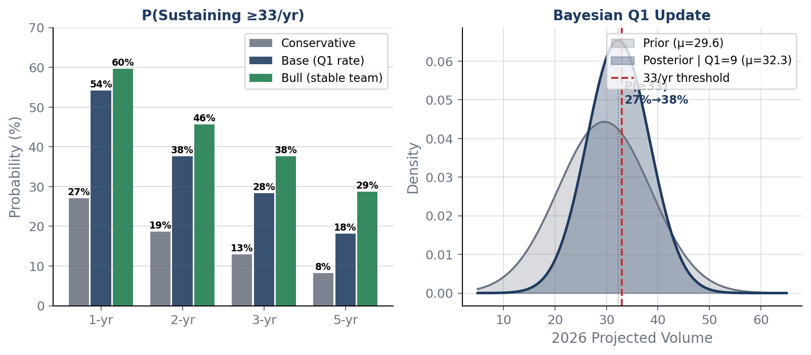
Monte Carlo Probability & Bayesian Update
100k simulated paths · Regime-switching model · Q1 2026 Bayesian posterior update
P(Sustaining ≥33 cases/yr)
Scenario
1yr
3yr
5yr
Conservative
27%
13%
8%
Base (Q1 rate)
54%
28%
18%
Bull (stable)
60%
38%
29%
Bayesian Q1 Update
Given Q1 2026 = 9 cases observed:
Prior: E[vol] = 29.6 | P(≥33) = 27%
Post: E[vol] = 32.3 ± 6.1 | P(≥33) = 38%
For 50% 3yr probability → need ≥43 cases/yr
Retaining new surgeon = highest-leverage action
US Lung Transplant Analytics | Monte Carlo & Bayesian
12
Notes:
The Monte Carlo model answers:
“Given ALUA’s historical volatility and known structural risks, what is the probability that ALUA reaches or sustains ≥33 lung transplants/year?”
The Bayesian update answers:
“Now that we observed 9 actual cases in Q1 2026, how should we revise our prior forecast for full-year 2026?”
The Monte Carlo analysis used 100,000 simulated paths with a regime-switching model that accounts for structural disruptions — leadership transitions — rather than treating all volatility as random.
Three scenarios:
Conservative (starting at 31 cases, 10% annual disruption probability): 1-year P(>=33) = 27%, 3-year sustained = 13%, 5-year = 8%.
Base case (starting at 36 annualized from Q1, 10% disruption): 1-year = 54%, 3-year = 28%, 5-year = 18%.
Bull — no disruption scenario (stable leadership, start 36): 1-year = 60%, 3-year = 38%, 5-year = 29%.
The Bayesian Q1 update is important: given the observed 9 cases in Q1 2026, the posterior probability of hitting 33+ for the full year rises from 27% to 38%, with expected annual volume rising to 32.3.
The operational target ladder: to achieve 30% probability of sustaining 33+ cases for three consecutive years, ALUA needs to begin a year at 38 cases.
For 50% probability, the starting point needed is 43.
The single most important model variable is not the growth rate — it is disruption probability. Retaining the new surgeon through April 2027 is the highest-leverage action.

Slide 17
Key Recommendations & Surveillance Priorities
Actionable priorities derived from quantitative analysis of SRTR PSR, rolling data, and volume models
1
SRTR 7/26 — Priority Review
July 2026
2
Retain Surgical Team
Through April 2027
First full 12-month follow-up on 2025 surge cohort. If HR remains >1.5, trigger formal quality review with acuity-adjusted analysis.
Disruption probability is the dominant model parameter. Retention to 24-month milestone shifts 3yr P(≥33) from 28% → 38%.
3
Expand Offer Acceptance
Selectively
4
Monitor Acuity-Adjusted
Metrics
Target well-matched younger donors at > 250–400 miles. Avoid hard-to-place lungs until surgeon reaches 24-month maturity.
ICU intake 2.3× national inflates raw HR. Request SRTR sensitivity analysis with updated acuity covariates.
5
Q2 2026 = Bayesian Update
Point
≥8 Q2 cases → P(2026 ≥33) exceeds 50%. ≤6 → base case of 22 is the anchor. Update Monte Carlo starting volumes.
US Lung Transplant Analytics | Recommendations
14
Notes:
Five prioritized action items derived from the quantitative analysis. Priority 1 — SRTR 7/26 Review (July 2026): This is the most time-sensitive item. The July 2026 PSR will be the first full 12-month follow-up on the 2025 surge cohort. If HR remains above 1.5, trigger a formal quality review that includes acuity-adjusted analysis — because the raw HR inflated by ICU case mix is not an apples-to-apples comparison with peer programs. Priority 2 — Retain Surgical Team through April 2027: The disruption probability is the dominant model parameter. Every leadership transition in ALUA's history produced a 22–58% single-year volume decline. Retention to the 24-month milestone shifts the 3-year probability of sustaining 33+ cases from 28% to 38%. Priority 3 — Expand Offer Acceptance Selectively: Target well-matched younger donors at 250-400 miles. This is the lowest-risk expansion lever — longer distances than currently accepted but manageable ischemic time. Hold off on marginal offers until surgical maturity. Priority 4 — Monitor Acuity-Adjusted Metrics: Request SRTR to run sensitivity analysis with updated acuity covariates. ALUA's 2.3x ICU rate inflates raw HR — the program needs the adjusted number to make fair comparisons. Priority 5 — Q2 2026 Bayesian Update: 8 or more Q2 cases tips P(2026 >= 33) above 50%. 6 or fewer cases means the model base case of 22 is the realistic anchor. This is a critical data point.

Slide 18
Summary
National Market
Policy Impact
3,083 transplants (2025) — 158% growth since 2005. Both reforms improved equity and access. CAS produced the largest policy-driven uplift in program history.
Only 4 of 51 centers lost under both reforms. CAS rewards acuity-optimized programs. The Southeast access gap (AL, LA, GA) remains a structural equity concern.
ALUA Current State
ALUA Trajectory
PSR Jan 2026 outstanding: 1-yr survival 95.7% vs 89.6% national. HR=0.69. Rising projected HRs (1.56–1.79) reflect acuity and incomplete follow-up — not confirmed quality failure.
Regression base: 22 cases/yr. Q1 2026 annualizes to 36 (above model). New surgeon effect may persist. 3yr P(≥33): 28–38%. Retention and selective offer acceptance are the levers.
Data: OPTN 2005–2025 · SRTR PSR January 2026 · Rolling PSR April 2026 · Analysis: OLS Regression, Monte Carlo, Bayesian Update
US Lung Transplant Analytics Report · April 2026 · For Internal Program Use
Notes:
The closing summary frames four key takeaways. National Market: 3,083 transplants in 2025 — 158% growth since 2005. Both the DSA removal and CAS implementation improved equity and access. CAS produced the largest policy-driven volume uplift in program history. The post-CAS growth slope is more than double the long-run average. Policy Impact: Only 4 of 51 centers lost volume under both reforms — demonstrating that both policies were genuinely market-expanding. CAS specifically rewards acuity-optimized programs. The Southeast access gap — Alabama, Louisiana, Georgia — remains a structural equity concern that is unlikely to be addressed without programmatic investment in the region. ALUA Current State: The PSR is outstanding (1-year survival 95.7% vs 89.6% national, HR=0.69). The rising projected HRs (1.56–1.79 range) are driven by a 2.3x ICU case mix and incomplete 2025 follow-up — not a confirmed quality failure. This must be monitored but should not be misread as a deteriorating program. ALUA Trajectory: The regression base case is 22 cases/year, but Q1 2026 annualizes to 36 — above the model. The 3-year probability of sustaining 33+ cases is 28–38% depending on scenario. The two levers are surgical team retention through April 2027 and selective offer acceptance expansion at 250–400 miles.

