Slide 1
IIIT Hyderabad
Faculty Hiring Portal
Web Application for hiring faculty for IIIT Hyderabad
SSAD Team-4
Notes:
Shantanu - Give an introduction of our team.

Slide 2

Portal aims to simplify and automate the process of faculty hiring in IIIT-H.
Notes:
Shantanu :- Just read the same thing as in slide.

Slide 3
Public
User
Faculty
Hiring
Commitee
Staff
User Profiles
Faculty
Admin
Notes:
PVNS - Talks about the different user profiles.

Slide 4
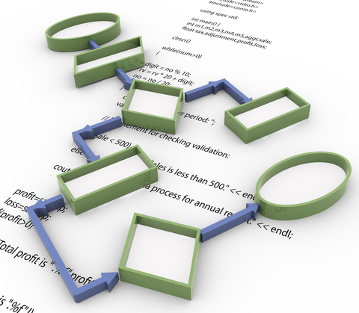
The Workflow
Notes:
PVNS enters.

Slide 5
Candidate logs in after successful registration.
1
Completes the profile.
2
3
Screened by staff and hiring committee.
Fill review form and forward to hiring committee.
Forward applications to
all faculty.
4
5
Applicant called for interview.
6
Notes:
PVNS just explains the steps very briefly.

Slide 6
Project Demonstration
Notes:
Super fast by Abhishek.

Slide 7
Improvements for final deliverable
Faculty Interface. Faculty can review the applications.
Notes:
Abhishek- Explains.

Slide 8
Future Improvements
Notes:
Sahith enters

Slide 9
Improvements
Having filters for Staff,Hiring Committee for viewing applications.
Notes:
Abhishek- Explains.

Slide 10
Thank You

