Slide 1
Assessing the impact of chronic sleep restriction on sleep and performance-associated regional brain activation using near infrared spectroscopy
Tushar Kamath
Division of Sleep Medicine
Brigham and Women’s Hospital/Harvard Medical School

Slide 2
Problem
Chronic sleep restriction as an epidemic (Colten and Altevogt, 2006)
  Drowsy driving (Czeisler and Gooley, 2007)
  Medical workers (Czeisler and Gooley, 2007)
  Sleep in space (Barger et al., in prep)
Notes:
50-70 million Americans est. to chronically suffer from disorder of sleep/wakefulness
15 million drivers have nodded off to sleep…10% of these drivers fall off the road
1/5 makea sleep-related mistake. 1/20 make one which results in a death. Increase by 600% and 300% with sleep loss
..extended hour shifts
Sleep on space station is around 6 hours and on space shuttle is around 6 hours….indicates insufficient sleep

Slide 3
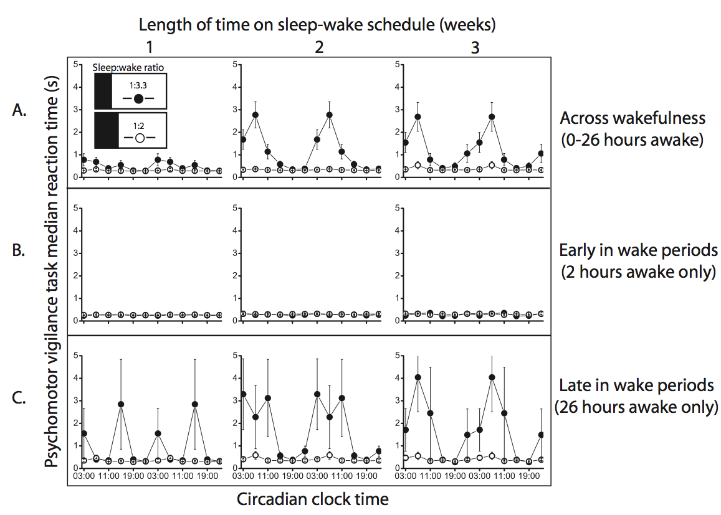
Background
Chronic sleep restriction mechanistically different from acute sleep deprivation (Cohen et al., 2009)
PVT performance affected by:
Short-term homeostatic sleep deprivation
Long-term chronic sleep restriction
Circadian cycles

Slide 4
Aims
Impact of CSR on brain activity in response to cognitive performance testing remains unknown…
------------------------------------------------------------------------------
Hemodynamic responses in the prefrontal cortex (PFC) to psychomotor vigilance test (PVT) will exhibit a circadian rhythm measurable by near infrared spectroscopy (NIRS)
Hemodynamic responses in PFC to PVT will be reduced during chronic sleep restriction measurable by NIRS

Slide 5
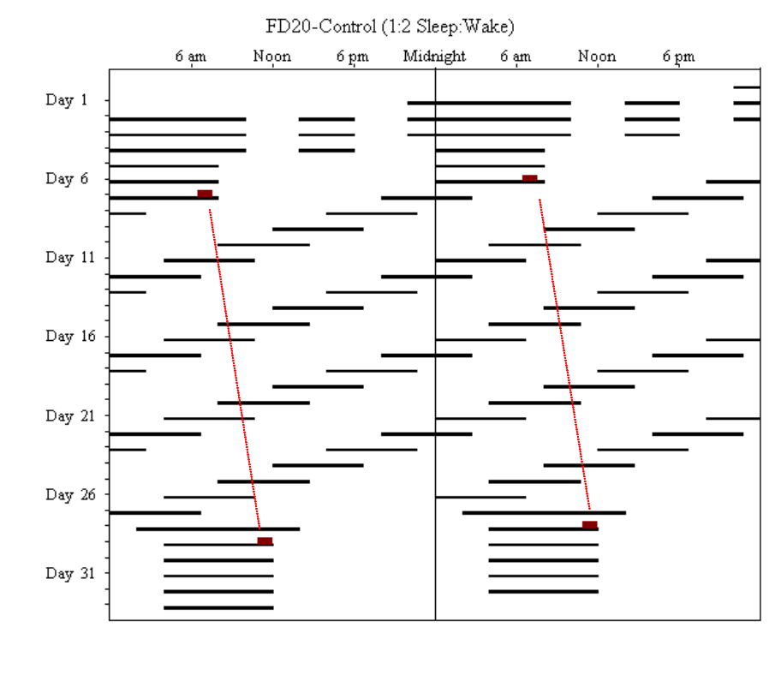
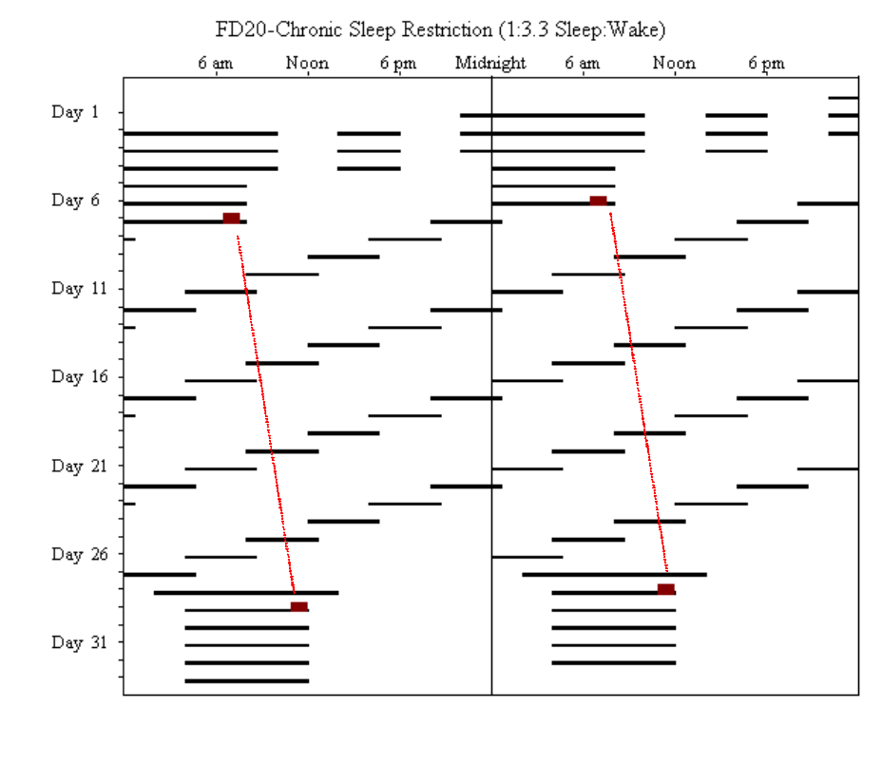
Protocol
32-day forced desynchrony
NIRS data measured during cognitive battery (every 2 hours for each waking period)
Psychomotor vigilance test (PVT) results
Control (1:2 Sleep:Wake)
Chronic Sleep Restriction(1:3.3 Sleep:Wake)

Slide 6
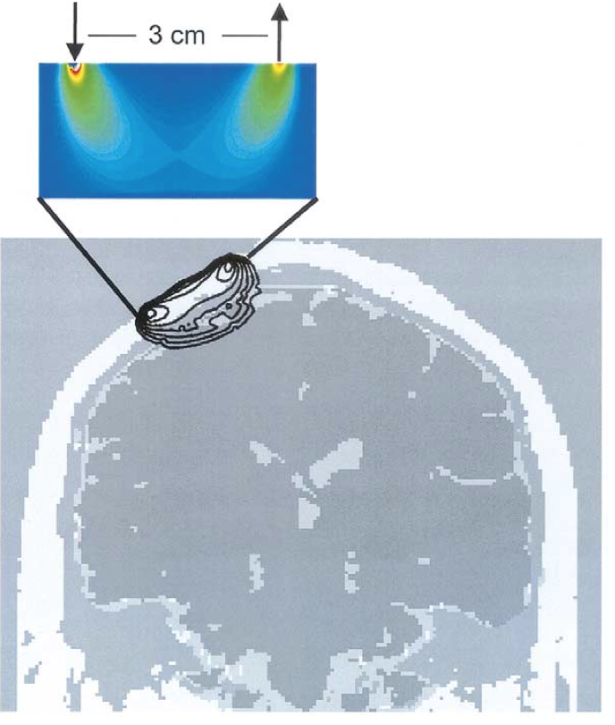
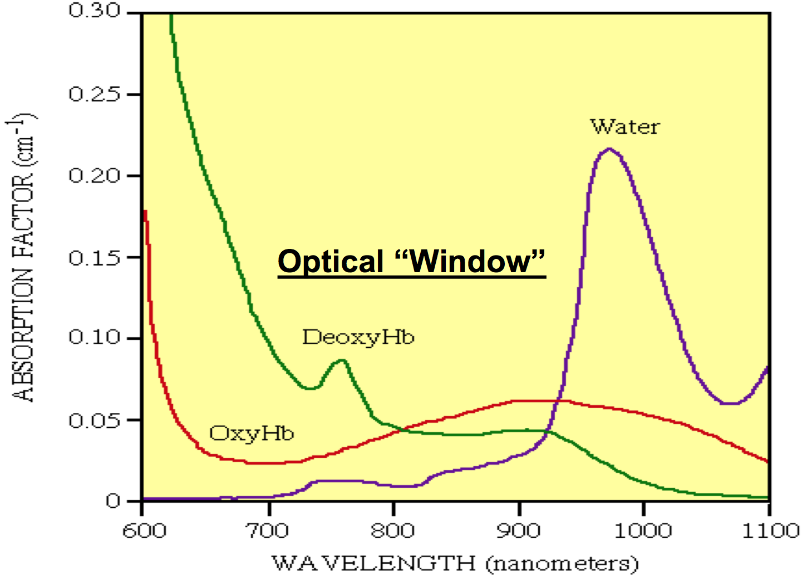

Near Infrared Spectroscopy (NIRS) Theory

Slide 7
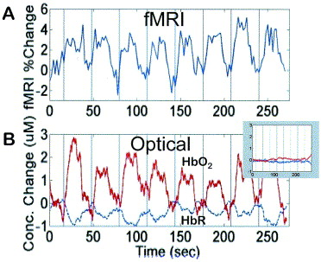
NIRS
Neurovascular coupling causes a hemodynamic response function, visible in the NIRS data
-Measuring HbR and HbO2 up to 2-3cm under the skin
-Non-invasive and provides good temporal resolution (250Hz)
-More portable than fMRI/PET
-Signal-to-noise ratio is relatively low
-Low spatial resolution
fMRI and NIRS output at the motor cortex during finger tapping (Strangman et al., 2002)

Slide 8
NIRS vs. everyone else
vs. EEG
  Can have finer spatial resolution (placing multiple sensors around the brain)
  Comparable temporal resolution
vs. fMRI and PET
  Much less expensive
  Much smaller
  Better temporal resolution but worse spatial
  Much less noisy
  Allows for corrections for movement
Notes:
Temporal is 1Hz for fMRI and 250 for NIR

Slide 9
Previous sleep loss results
With EEG
  Enhancement of slow-wave (delta/theta) sleep increased in frontal areas (Cajochen et al., 1999)
With fMRI
  Prefrontal cortex activation significantly correlated with sleepiness in verbal learning tasks (Drummond et al., 2000)
With PET
  Reduction in PFC activity correspond to reduced performance on ADD/subtract task (Thomas et al., 2001)

Slide 10
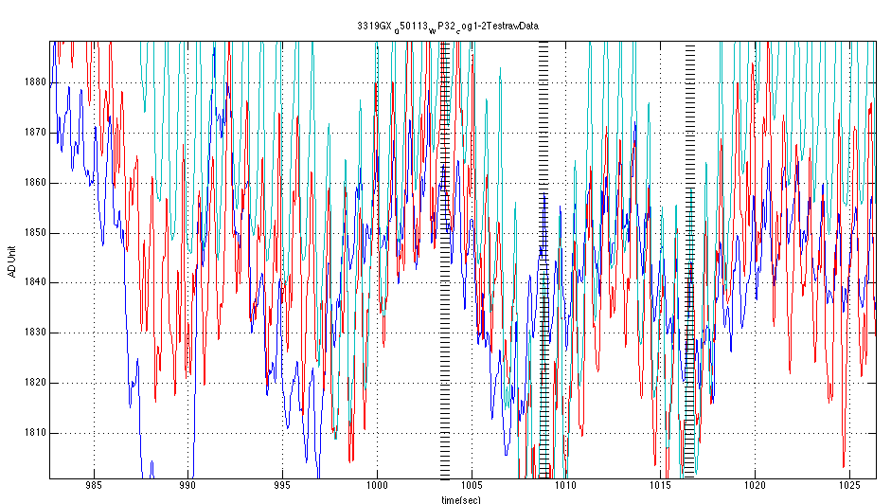
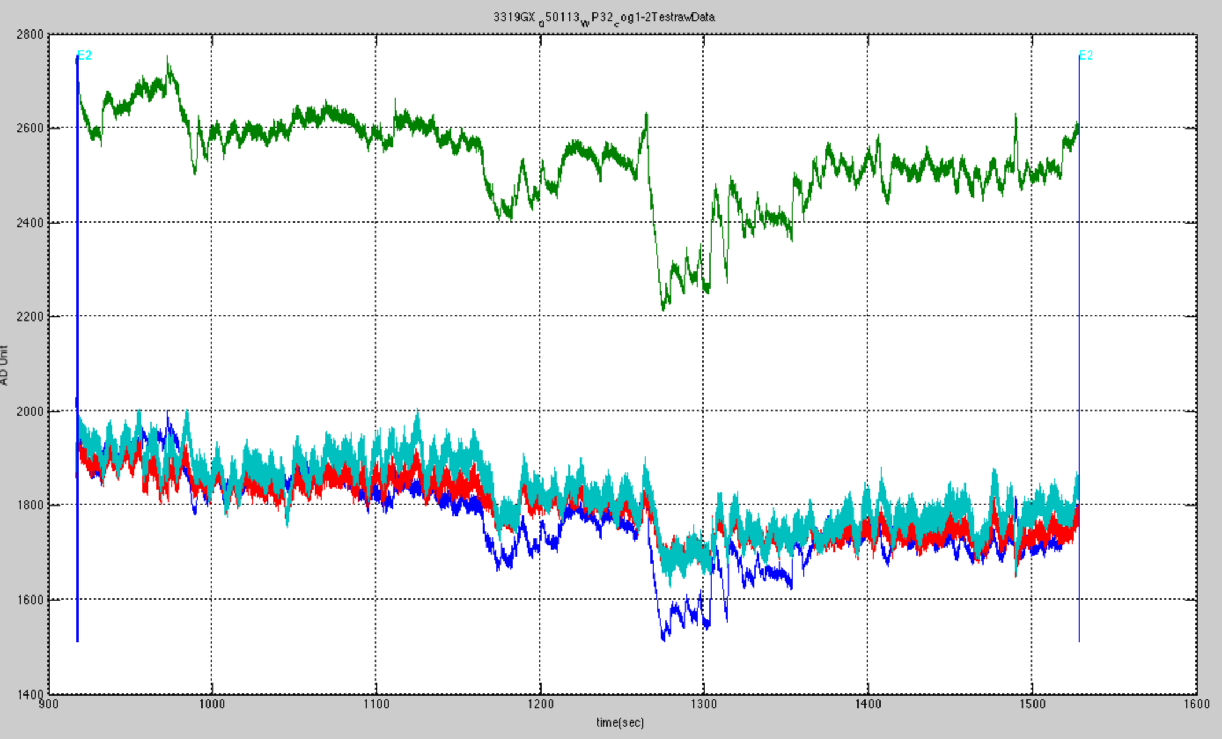
Raw NIRS data
Green = near, 826nm
Red = far, 775nm
Blue = near, 775nm
Light blue = far, 826nm
Notes:
Legend, talk about larger time first….add PVT start times

Slide 11
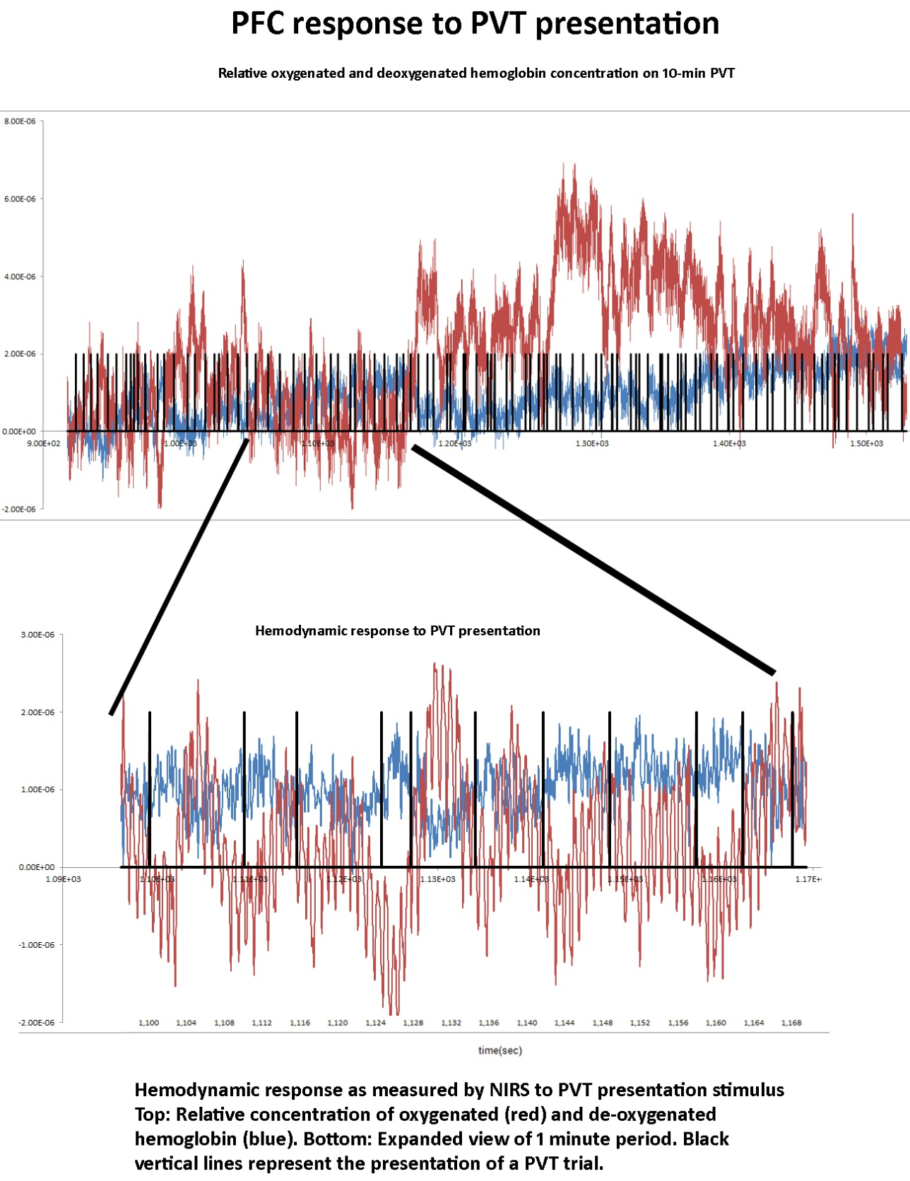
NIRS data
HbO₂
HbR

Slide 12
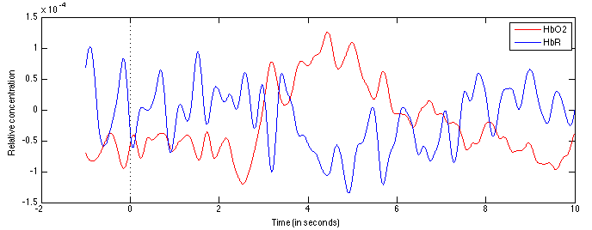
Adaptive filtering and block averaging
Figure: Filtered and block averaged NIRS result of PFC activity after PVT (3319GX, cog1, WP32, 1:2 sleep-to-wake cycle)

Slide 13
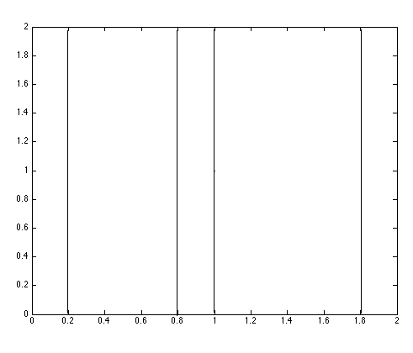
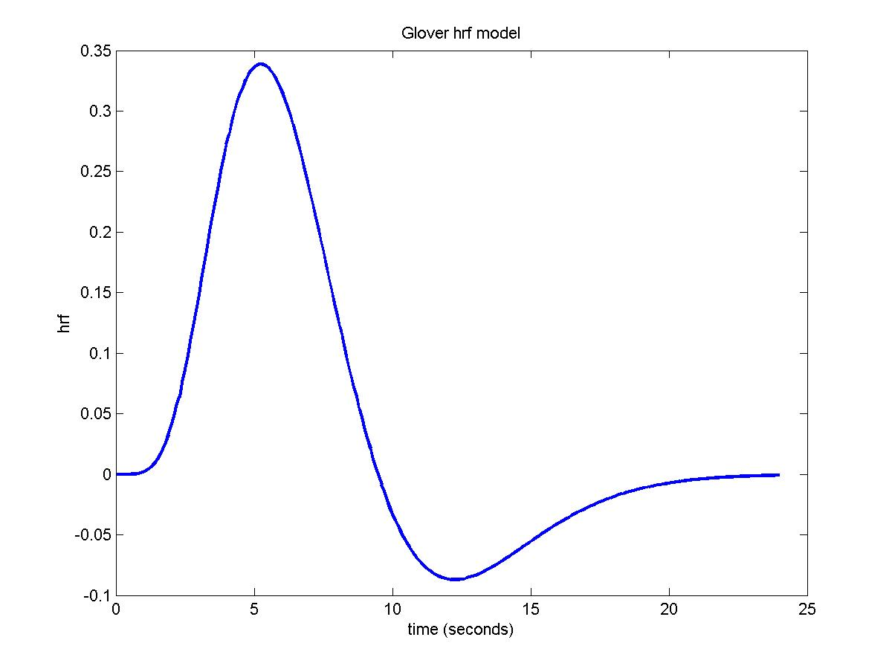
Deconvolution and regression
Deconvolution:
Baseline response
Figure: Example of PVT time graph
Figure: Standard hemodynamic response function (Glover et al., 1999)
Regression analysis
Circadian phase
Time awake
Time in FD
Condition
Notes:
List of PVTs…standard HRF…actual baseline response….actual response happening later in protocol

Slide 14
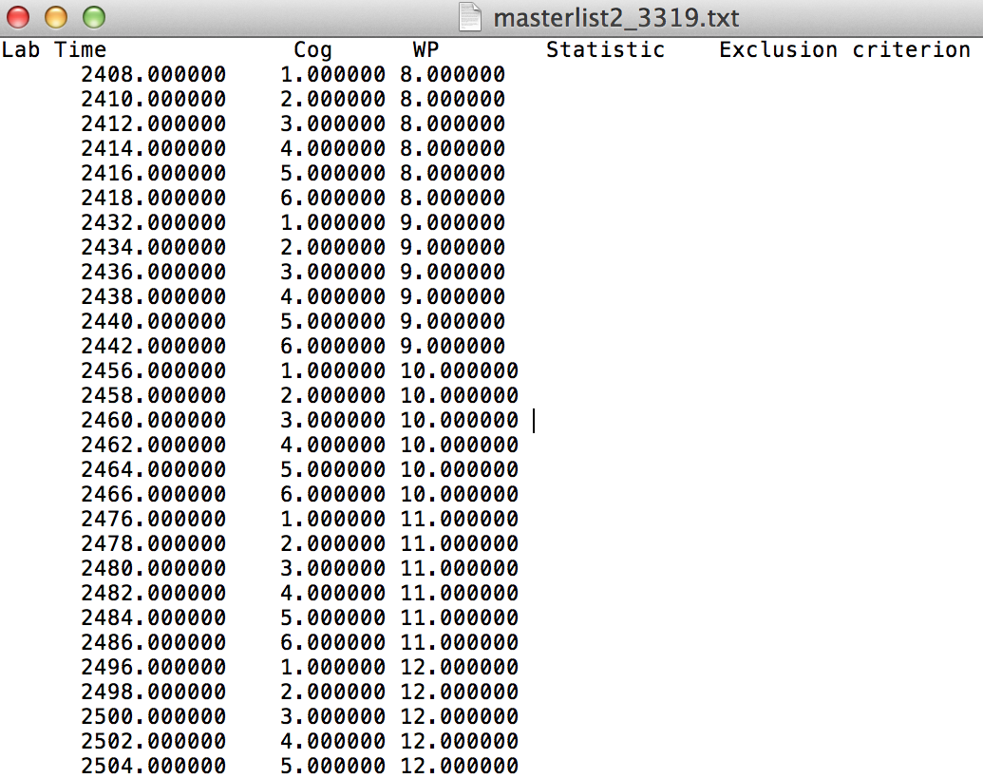
Future work
Compile all data into one text file and identify exclusion criteria
Generate a statistic for comparing between outputs (amplitude, area under curve, etc.)
Compare using statistic across weeks and condition (CSR or normal) using mixed-effects modeling

