Slide 1
MATLAB ASSIGNMENT
Newton-Raphson methods, Secant and Runge-Kutta methods: FOR and WHILE loop solutions, flowcharts and pseudocode

Slide 2
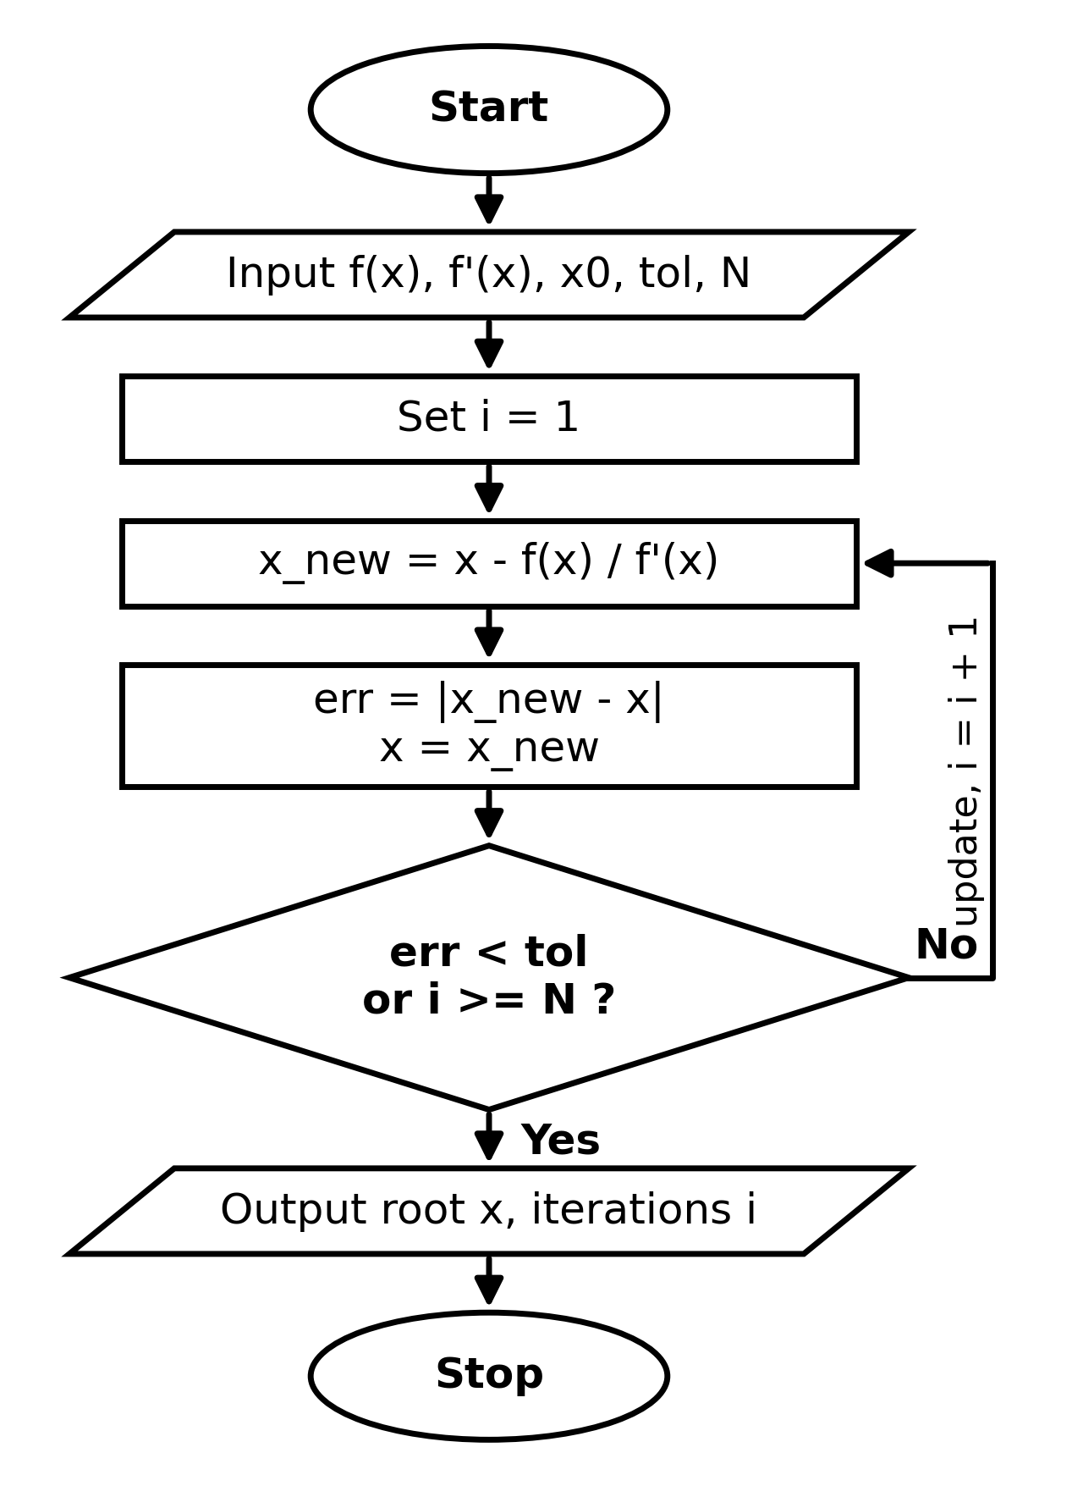
NEWTON-RAPHSON METHOD
Formula: x(n+1) = x(n) - f(x(n)) / f'(x(n))
Flowchart
PSEUDOCODE FOR LOOP: PSEUDOCODE-WHILE LOOP:
INPUT: initial_guess x0=3, max_iterations N=20, tol=1e-5
FOR i FROM 1 TO N DO:
fx = f(x0) // x^2 - 4
dfx = f'(x0) // 2x
IF dfx == 0 THEN:
PRINT "Error: Derivative is zero"
STOP
END IF
x1 = x0 - (fx / dfx)
PRINT "Iteration", i, ": x =", x1
IF ABS(x1 - x0) < tol THEN BREAK
x0 = x1
END FOR
OUTPUT: x1 A// 2.00000
INPUT: initial_guess x0=3, tol=1e-5, max_iter=20
SET err = 1, count = 0, x_while = x0
WHILE err > tol AND count < max_iter DO:
fx = f(x_while)
dfx = f'(x_while)
IF dfx == 0 THEN STOP
x1 = x_while - fx/dfx
err = ABS(x1 - x_while)
PRINT "Iteration", count, ": x =", x1
x_while = x1
count = count + 1
END WHILE
OUTPUT: x_while

Slide 3
NEWTON-RAPHSON METHOD EXAMPLE1: : f(x) = x^2 - 4, f'(x) = 2x
MATLAB CODE: FOR LOOP
%% SECTION 1: NEWTON-RAPHSON METHOD
% Example function: f(x) = x^2 - 4, f'(x) = 2x
f_nr = @(x) x^2 - 4;
df_nr = @(x) 2*x;
x0 = 3; tol = 1e-5; max_iter = 20;
% Newton-Raphson using FOR loop
x_for = x0;
for i = 1:max_iter
x_for = x_for - f_nr(x_for)/df_nr(x_for);
end
fprintf('NR (for loop) Root: %.5f\n', x_for);
MATLAB CODE: WHILE LOOP
% Newton-Raphson using WHILE loop
x_while = x0; err = 1; count = 0;
while err > tol && count < max_iter
x_new = x_while - f_nr(x_while)/df_nr(x_while);
err = abs(x_new - x_while);
x_while = x_new;
count = count + 1;
end
fprintf('NR (while loop) Root: %.5f in %d iterations\n\n', x_while, count);
Root: 2.00000 in 5 iterations

Slide 4
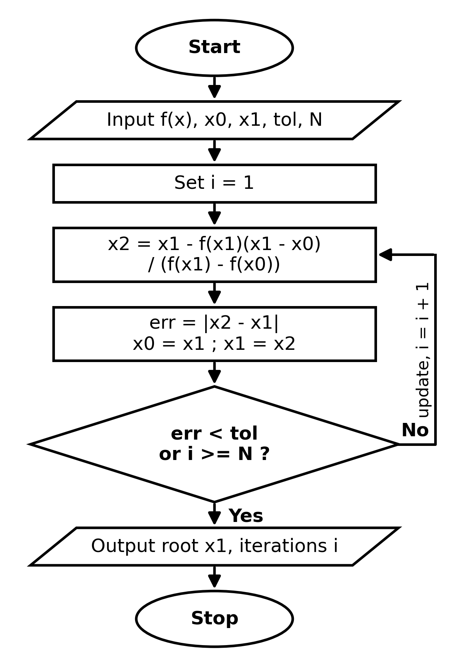
SECANT METHOD
Formula: x(n+1) = x(n) - f(x(n)) [x(n) - x(n-1)] / [f(x(n)) - f(x(n-1))]
PSEUDOCODE: For loop PSEUDOCODE: While loop
INPUT: x0=1, x1=3, max_iterations N=20, tol=1e-5
FOR i FROM 1 TO N DO:
f0 = f(x0)
f1 = f(x1)
IF (f1 - f0) == 0 THEN STOP
x2 = x1 - f1*(x1 - x0)/(f1 - f0)
PRINT "Iteration", i, ": x =", x2
IF ABS(x2 - x1) < tol THEN BREAK
x0 = x1
x1 = x2
END FOR
OUTPUT: x2
INPUT: x0=1, x1=3, max_iterations N=20, tol=1e-5
FOR i FROM 1 TO N DO:
f0 = f(x0)
f1 = f(x1)
IF (f1 - f0) == 0 THEN STOP
x2 = x1 - f1*(x1 - x0)/(f1 - f0)
PRINT "Iteration", i, ": x =", x2
IF ABS(x2 - x1) < tol THEN BREAK
x0 = x1
x1 = x2
END FOR
OUTPUT: x2

Slide 5
SECANT METHOD EXAMPLE: f(x) = x^2 - 4
MATLAB CODE:FOR LOOP
%% SECTION 2: SECANT METHOD
% Example function: f(x) = x^2 - 4
f_sec = @(x) x^2 - 4;
x0 = 1; x1 = 3;
% Secant using FOR loop
x_old0 = x0; x_old1 = x1;
for i = 1:max_iter
x2 = x_old1 - f_sec(x_old1)*(x_old1 - x_old0)/(f_sec(x_old1) - f_sec(x_old0));
x_old0 = x_old1;
x_old1 = x2;
end
fprintf('Secant (for loop) Root: %.5f\n', x2);
MATLAB CODE:WHILE LOOP
% Secant using WHILE loop
x_old0 = x0; x_old1 = x1; err = 1; count = 0;
while err > tol && count < max_iter
x2 = x_old1 - f_sec(x_old1)*(x_old1 - x_old0)/(f_sec(x_old1) - f_sec(x_old0));
err = abs(x2 - x_old1);
x_old0 = x_old1;
x_old1 = x2;
count = count + 1;
end
fprintf('Secant (while loop) Root: %.5f in %d iterations\n\n', x2, count);
Result: Converged in 6 iterations

Slide 6
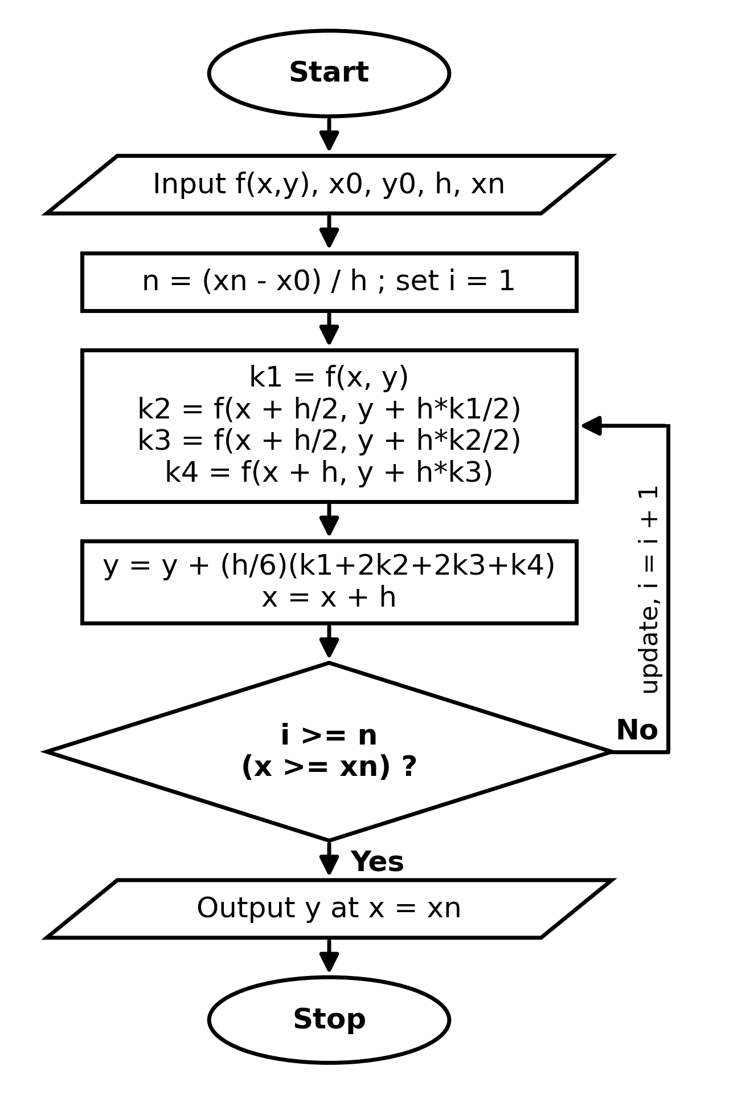
RUNGE-KUTTA (4th ORDER) METHOD
Formula: y(i+1) = y(i) + (h/6)(k1 + 2k2 + 2k3 + k4)
PSEUDOCODE:FOR LOOP PSEUDOCODE: WHILE LOOP:
INPUT: x0=0, y0=1, h=0.1, xn=0.5, N=5
SET x = x0, y = y0
FOR i FROM 1 TO N DO:
k1 = f(x, y)
k2 = f(x + h/2, y + h*k1/2)
k3 = f(x + h/2, y + h*k2/2)
k4 = f(x + h, y + h*k3)
y = y + (h/6)*(k1 + 2*k2 + 2*k3 + k4)
x = x + h
PRINT x, y
END FOR
OUTPUT: y
INPUT: x0=0, y0=1, h=0.1, xn=0.5, N=5
SET x = x0, y = y0
FOR i FROM 1 TO N DO:
k1 = f(x, y)
k2 = f(x + h/2, y + h*k1/2)
k3 = f(x + h/2, y + h*k2/2)
k4 = f(x + h, y + h*k3)
y = y + (h/6)*(k1 + 2*k2 + 2*k3 + k4)
x = x + h
PRINT x, y
END FOR
OUTPUT: y

Slide 7
EXAMPLE: : dy/dx = x + y, y(0) = 1
MATLAB CODE:FOR LOOP
%% SECTION 3: RUNGE-KUTTA 4TH ORDER (RK4)
% Example ODE: dy/dx = x + y, y(0) = 1
f_rk = @(x, y) x + y;
x0 = 0; y0 = 1; x_end = 1; h = 0.1;
N = (x_end - x0)/h;
% RK4 using FOR loop
x_curr = x0; y_curr = y0;
for i = 1:N
k1 = h * f_rk(x_curr, y_curr);
k2 = h * f_rk(x_curr + h/2, y_curr + k1/2);
k3 = h * f_rk(x_curr + h/2, y_curr + k2/2);
k4 = h * f_rk(x_curr + h, y_curr + k3);
y_curr = y_curr + (k1 + 2*k2 + 2*k3 + k4)/6;
x_curr = x_curr + h;
end
fprintf('RK4 (for loop) y(1): %.5f\n', y_curr);
MATLAB CODE:WHILE LOOP
% RK4 using WHILE loop
x_curr = x0; y_curr = y0;
while x_curr < x_end
k1 = h * f_rk(x_curr, y_curr);
k2 = h * f_rk(x_curr + h/2, y_curr + k1/2);
k3 = h * f_rk(x_curr + h/2, y_curr + k2/2);
k4 = h * f_rk(x_curr + h, y_curr + k3);
y_curr = y_curr + (k1 + 2*k2 + 2*k3 + k4)/6;
x_curr = x_curr + h;
Result: At x=0.5, y=1.797441

