Slide 1

ETHICS AND DATA PRIVACY ISSUES FOR DATA SCIENCE
DALL-E3 Prompt: Decepticon tries to steal data from university students
Notes:
DALL-E Prompt: Data Scientists celebrate a generative ai Halloween

Slide 2
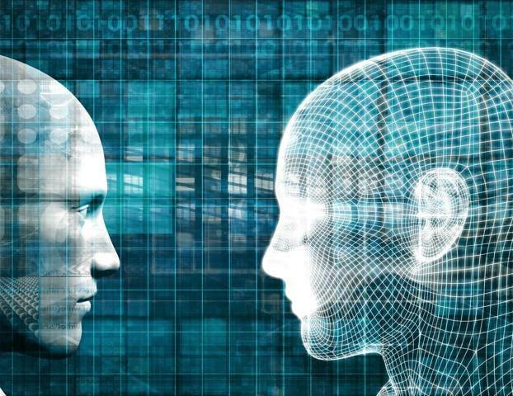
AGENDA
Ethical Issues in AI
  Bias
  Data Privacy
  Job Displacement
  Liability
  Disinformation
  Transparency
  The Singularity--AGI
  Impact of AI Regulations

Slide 3
FORM BREAKOUT GROUPS AND PICK
  Bias
  Privacy
  Job Displacement
  Liability
  Disinformation
  Transparency
  The Singularity--AGI
  Impact of AI Regulations
  Is AI fair? Who stands most to lose/win? What can we do about it?

Slide 4
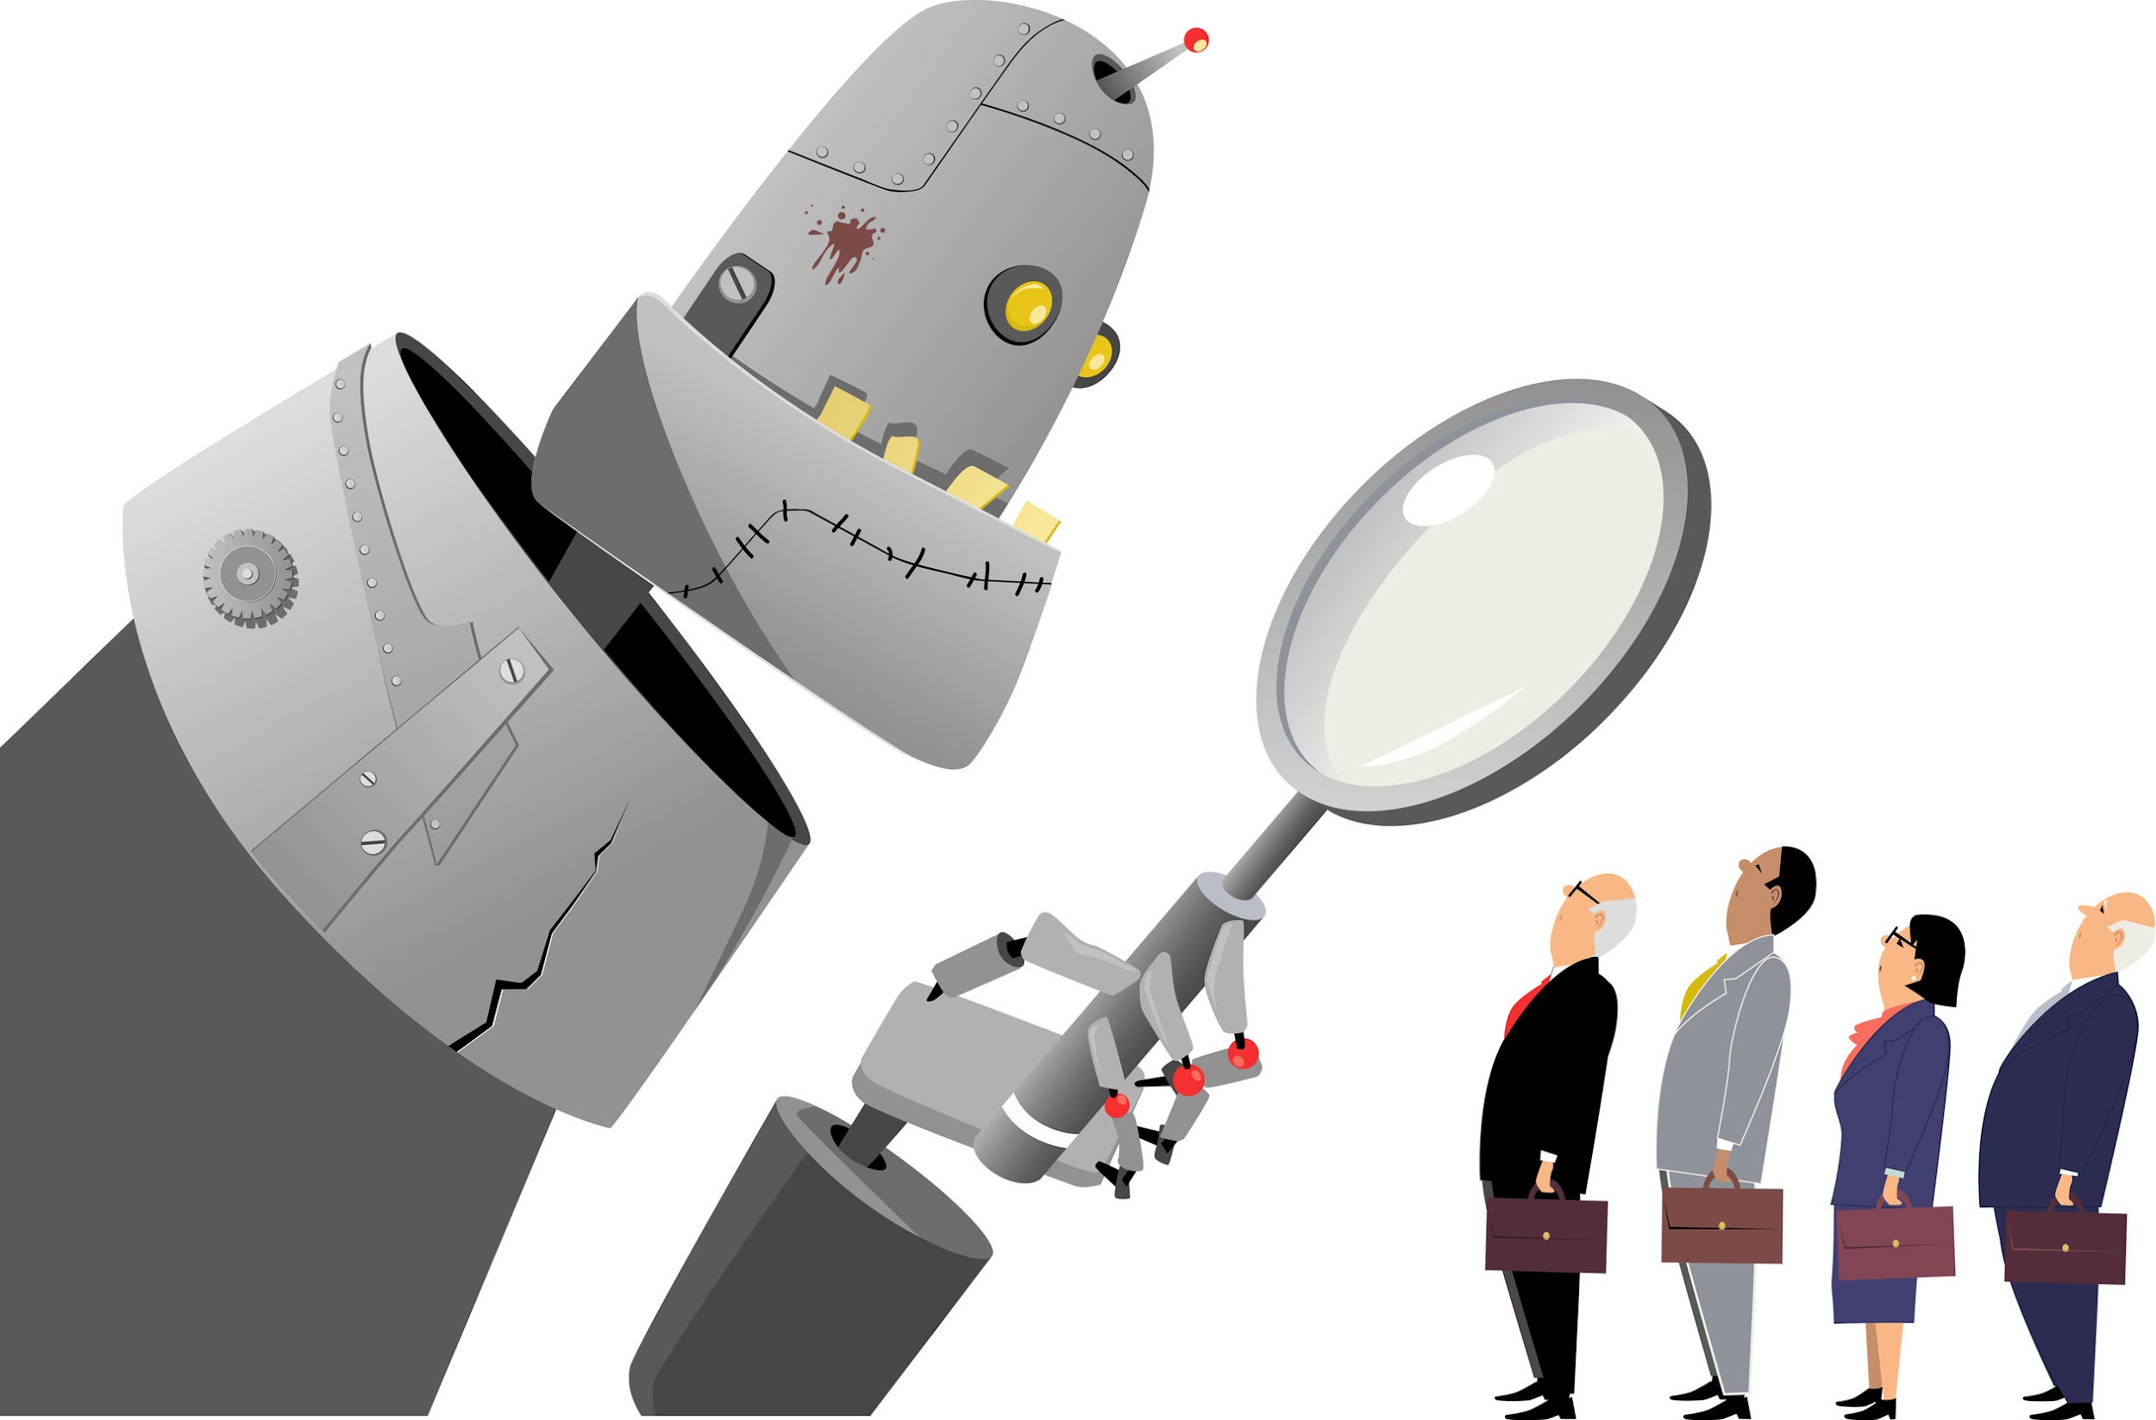
BIAS
Is AI fair?
If not, who stands the most to lose?
How do we fix this?

Slide 5
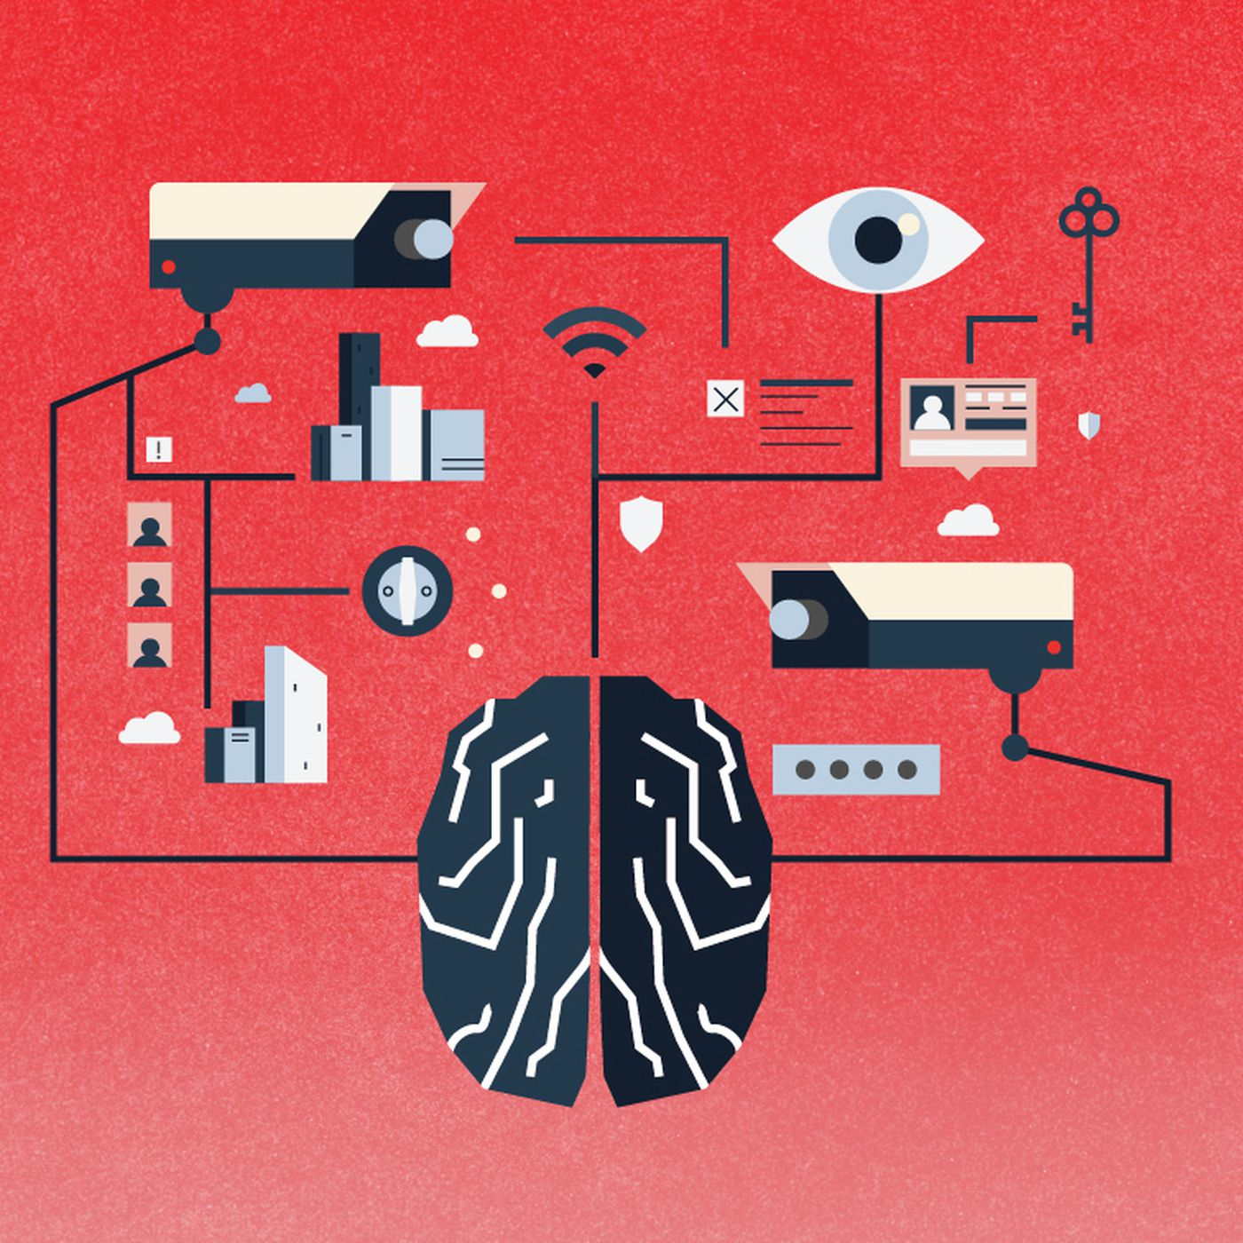
PRIVACY AND SURVEILLANCE
What expectations for right to privacy should we have?
What data should be treated as private vs public?
What rights do we have to data collected about us?

Slide 6
SMALL SAMPLE OF RECENT DATA PRIVACY FINES
Meta (Facebook): In 2019, the FTC imposed a record-breaking $5 billion fine on Facebook for privacy violations related to the Cambridge Analytica scandal. The company had deceived users about their ability to control the sharing of personal data with third parties. This penalty was accompanied by new restrictions on Facebook’s data handling practices to ensure greater accountability in the future.
Amazon: The Luxembourg National Commission for Data Protection fined Amazon €746 million ($888 million) in 2021. The penalty was for improper targeting of ads and mishandling customer data without obtaining proper consent, violating the European Union’s GDPR.
Meta (Instagram): In a separate case, Meta faced a €405 million fine by the Irish Data Protection Commission in 2022 over Instagram’s mishandling of teenagers’ data. The regulator found that the platform had made children’s personal information publicly accessible without adequate protective measures.
Capital One: In 2020, Capital One paid an $80 million fine following a data breach in 2019 that exposed personal data of over 100 million individuals. The U.S. Office of the Comptroller of the Currency penalized the company for lacking effective risk management and security practices.
Google: The FTC fined Google $170 million in 2019 for violating the Children’s Online Privacy Protection Act (COPPA). The tech giant was found to have illegally collected personal data from children on YouTube without parental consent.
Notes:
I'd be happy to help you create a PowerPoint presentation on recent data privacy fines for major companies between 2019 and 2024. You can reference the table provided in the search results for the specific fine amounts and details. Here are some key points for your presentation:
Title Slide: "Major Data Privacy Fines 2019-2024"
Slide 1: Introduction
- Brief overview of GDPR and data privacy regulations
- Mention increasing focus on enforcement in recent years
Slide 2: Top Fines Overview
- Highlight that Meta/Facebook companies received several of the largest fines
- Note the record €1.2 billion fine to Meta in 2023
Slide 3-7: Individual Fine Details
Create a slide for each of the top 5 fines, including:
- Company name
- Fine amount
- Year issued
- Brief description of the violation
Slide 8: Other Notable Fines
- List 3-5 other significant fines from the period
- Include company, amount, and year
Slide 9: Key Takeaways
- Trend of increasing fine amounts
- Focus on tech/social media companies
- Importance of GDPR compliance
Slide 10: Conclusion
- Recap of largest fines
- Emphasis on continued regulatory scrutiny
Remember to use visuals like charts or icons to make the presentation engaging. You can reference the table in the search results for the specific fine amounts and details to populate your slides. Let me know if you need any clarification or additional assistance with the presentation content!
Citations:
[1] https://www.bbc.com/news/articles/cvgl8lerx85o
[2] https://www.statista.com/statistics/1133337/largest-fines-issued-gdpr/
[3] https://nerdynav.com/biggest-gdpr-fines/
[4] https://www.hipaajournal.com/hipaa-violation-cases/
[5] https://dataprivacymanager.net/5-biggest-gdpr-fines-so-far-2020/
[6] https://termly.io/resources/articles/biggest-gdpr-fines/
[7] https://www.enzuzo.com/blog/biggest-gdpr-fines
[8] https://www.skillcast.com/blog/biggest-gdpr-fines-2024
[9] https://www.skillcast.com/blog/20-biggest-gdpr-fines
[10] https://fortune.com/europe/2023/05/22/facebook-meta-1-3-billion-privacy-fine-eu-gdpr-max-schrems/
[11] https://www.edpb.europa.eu/news/news/2023/12-billion-euro-fine-facebook-result-edpb-binding-decision_en
[12] https://www.zdnet.com/article/amazon-fined-887-million-for-gdpr-privacy-violations/
[13] https://thehackernews.com/2023/01/whatsapp-hit-with-55-million-fine-for.html
[14] https://www.insideprivacy.com/eu-data-protection/google-fined-e50-million-in-france-for-gdpr-violation/
[15] https://www.bbc.com/news/technology-54418936
[16] https://dataprivacymanager.net/e278-million-gdpr-fine-for-italian-telecom-tim/
[17] https://www.grip.globalrelay.com/italys-garante-fines-enel-energia-over-e79m-for-data-privacy-violations-in-telemarketing/
[18] https://cms.law/en/int/publication/gdpr-enforcement-tracker-report/italy
[19] https://www.wolframalpha.com/input?input=%2416.5+million+to+euros+conversion
[20] https://edition.cnn.com/2024/02/22/tech/ftc-avast-cybersecurity-company-fine/index.html
[21] https://www.pcmag.com/news/ftc-bans-antivirus-provider-avast-from-selling-users-browsing-data
[22] https://thehackernews.com/2023/09/tiktok-faces-massive-345-million-fine.html

Slide 7
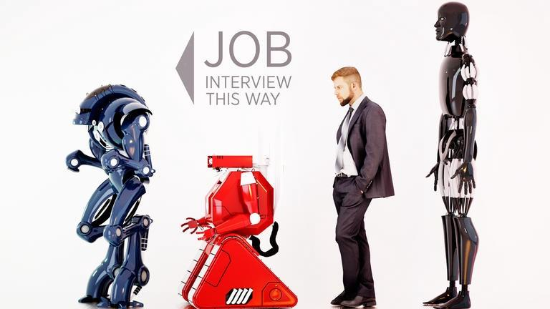
JOB DISPLACEMENT
Is AI getting rid of jobs?
Who benefits from AI?

Slide 8
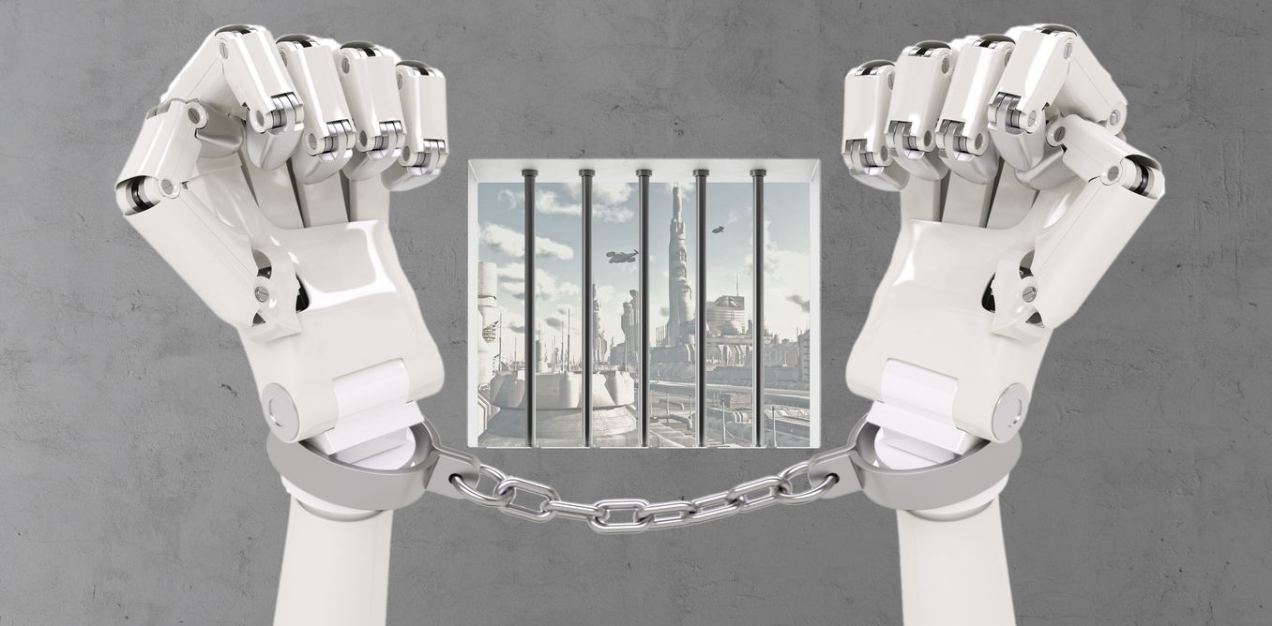
LIABILITY/ACCOUNTABILITY
Who is responsible for AI when makes mistakes?
Who is responsible for unintended consequences of AI?
How do we fix this?

Slide 9
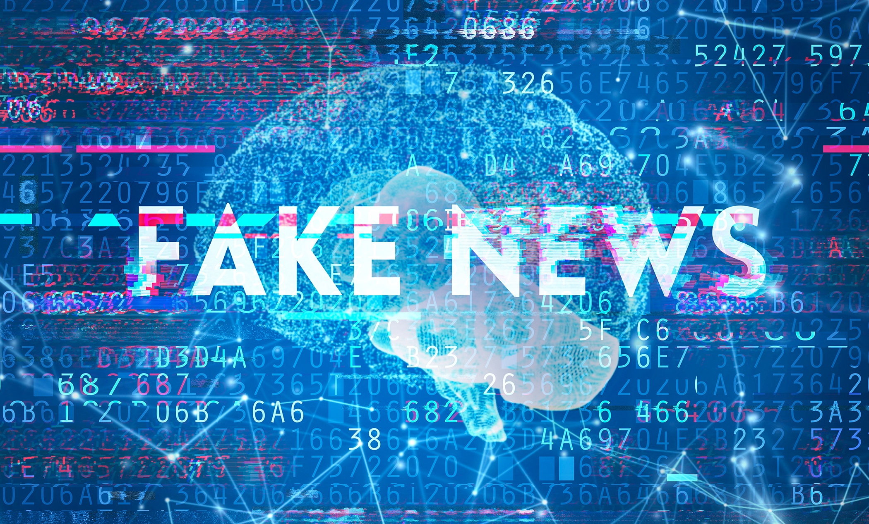
DISINFORMATION
If an AI system generates deep fakes, who is liable?
Should we regulate systems that can produce harmful disinformation?
How?

Slide 10
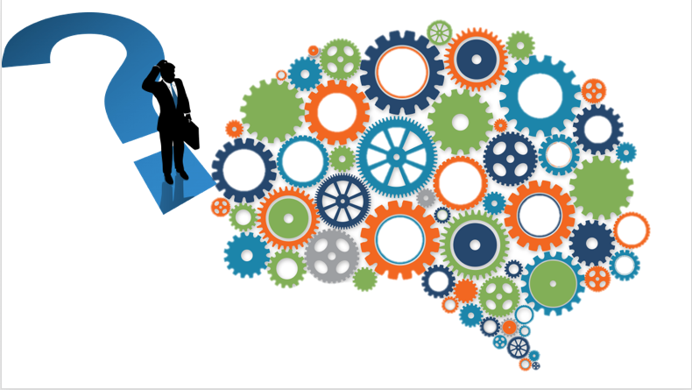
TRANSPARENCY
Should we require high-impact systems to be transparent or explainable?

Slide 11
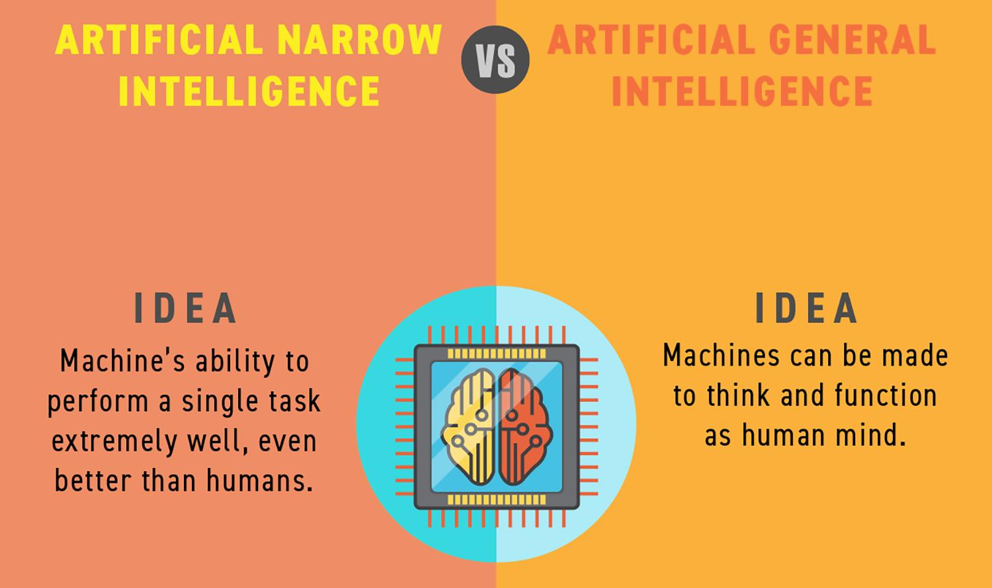
DOMAIN-SPECIFIC AI VS. ARTIFICIAL GENERAL INTELLIGENCE
Is general-purpose AI too dangerous?
If so, how can we stop / slow its development?

Slide 12

SINGULARITY / EXISTENTIAL RISKS
Is superintelligence a realistic possibility?
If so, how can we ensure its values are aligned with ours?
Notes:
Why neural net pioneer Geoffrey Hinton is sounding the alarm on AI: https://mitsloan.mit.edu/ideas-made-to-matter/why-neural-net-pioneer-geoffrey-hinton-sounding-alarm-ai
Geoffrey Hinton warns of AI’s growing danger after Nobel Prize win https://www.independent.co.uk/news/science/nobel-prize-university-of-toronto-british-nobel-prize-in-physics-google-b2626208.html

Slide 13

AI RIGHTS?
Can an AI suffer?
When can we / should we turn it off?
What rights should an AI be afforded?

Slide 14
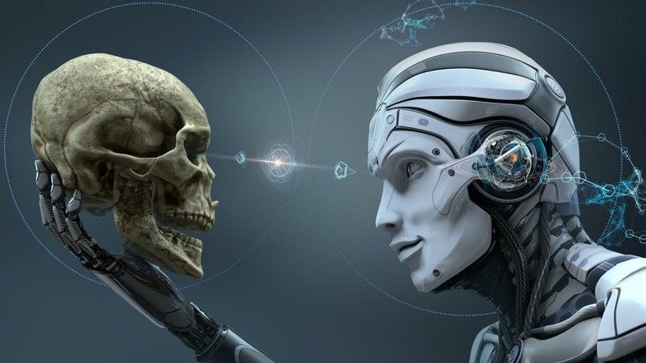
UNINTENDED CONSEQUENCES
Will we stop talking to each other?
Who is liable?

Slide 15
