Slide 1
Introduction to NGS data analysis
Thomas Karaouzene
tkaraouzene@gmail.com
November the 7th 2017

Slide 2

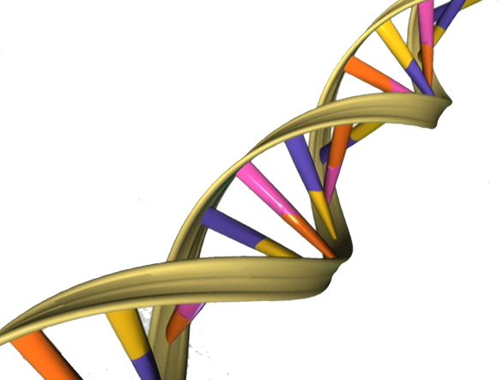
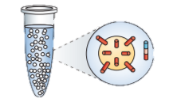
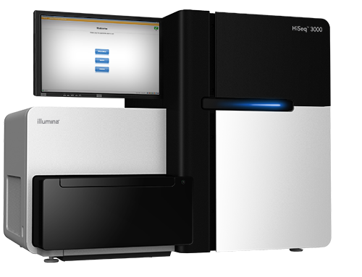
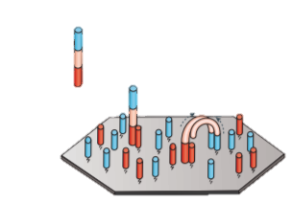
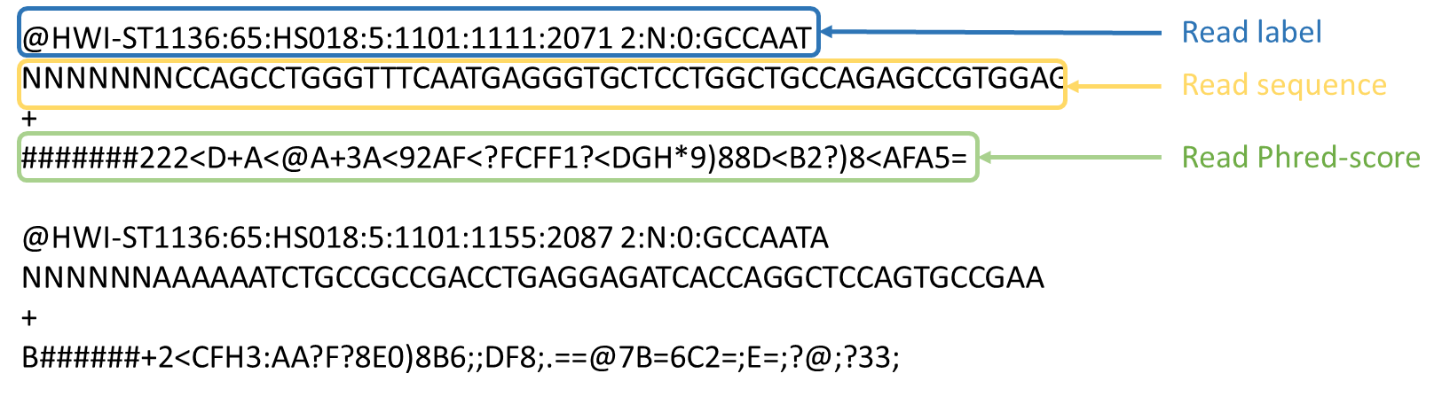
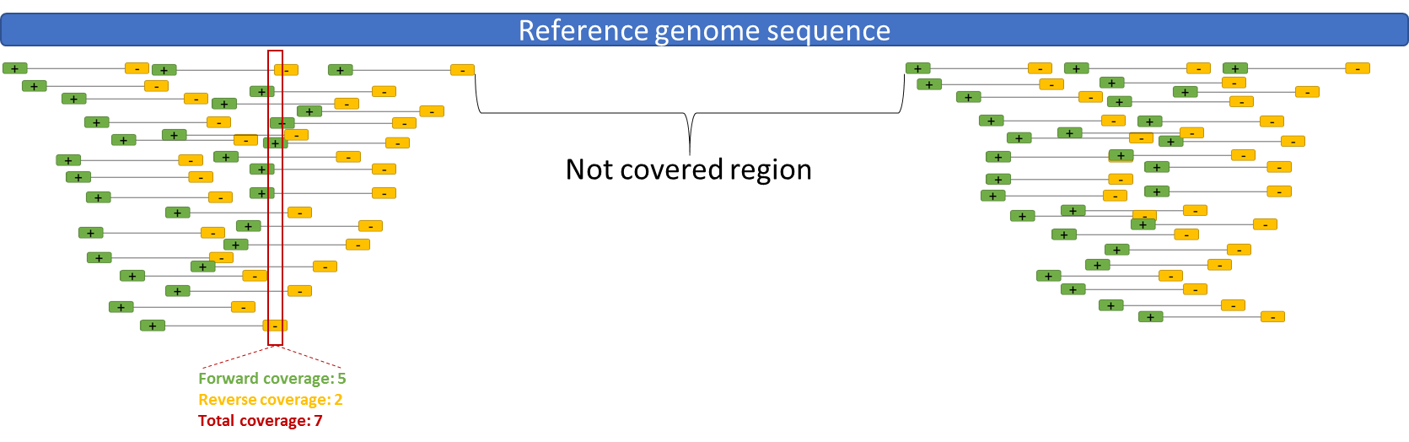
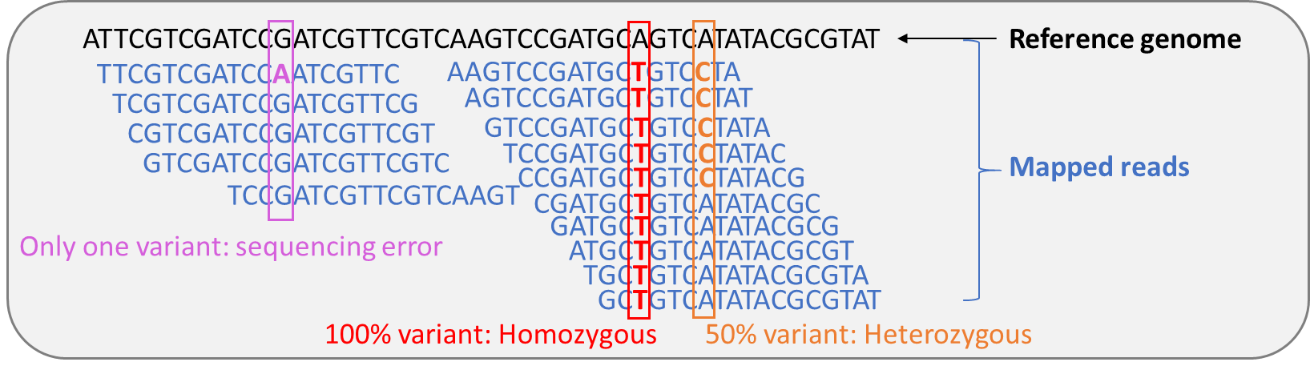
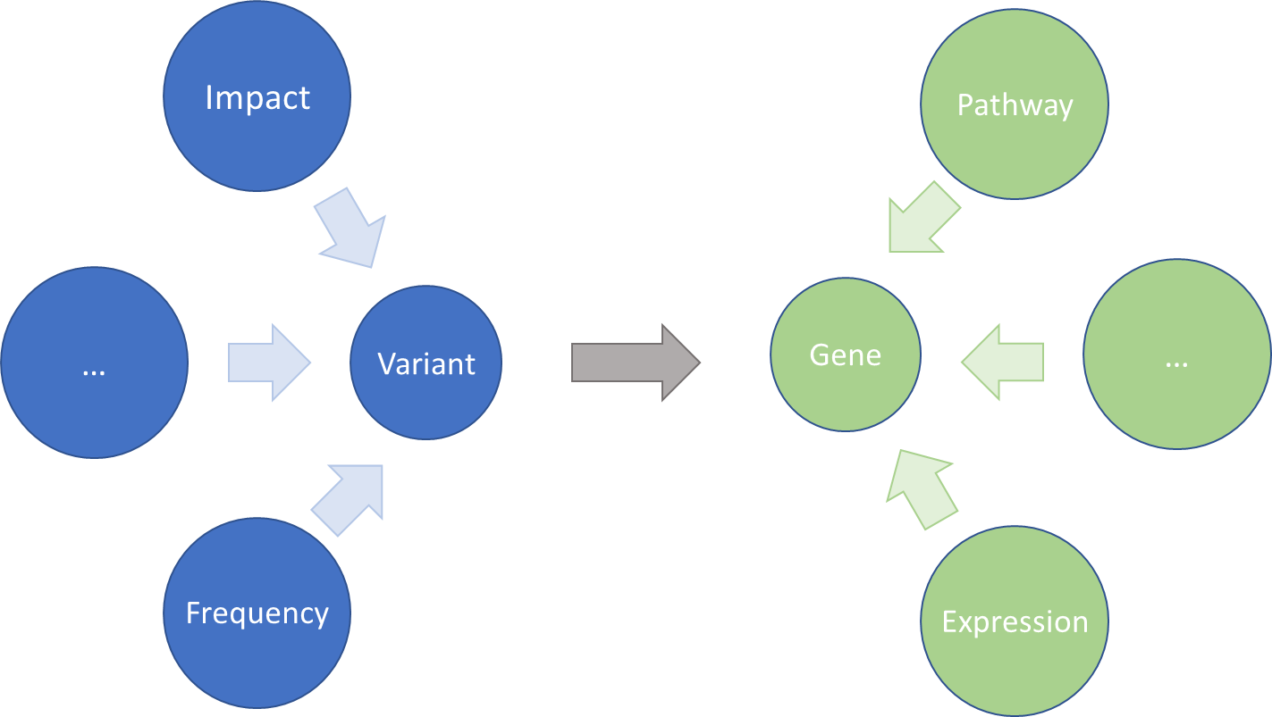
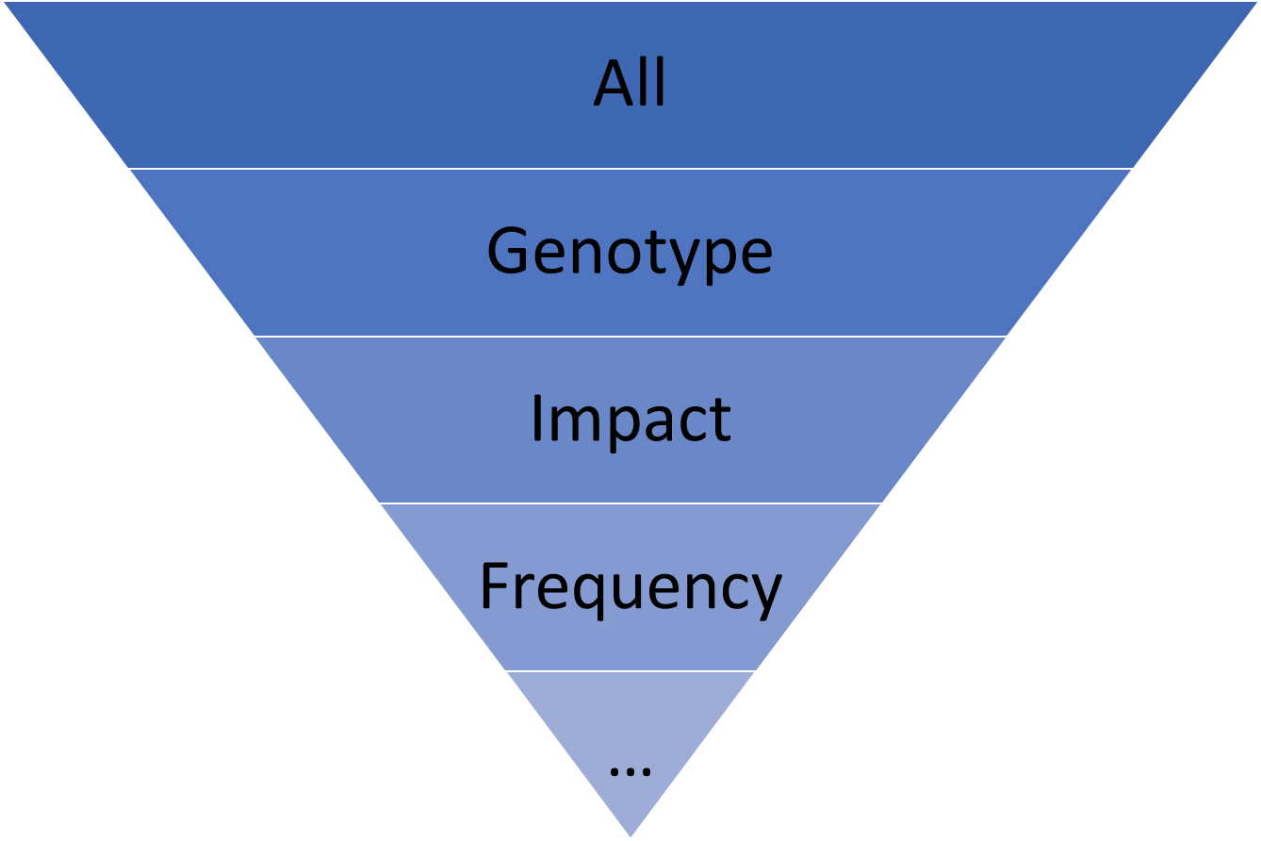
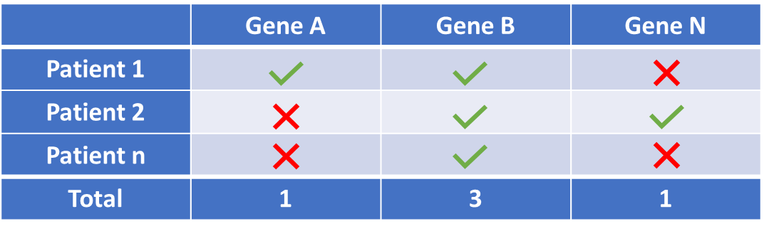
NGS workflow
Experimental steps
DNA extraction
Cloning
Sequencing
Bioinformatic steps
Short reads production
Mapping on reference genome
Variant calling
Annotation
Filtering
Gene prioritization

Slide 3
NGS workflow
Experimental steps
DNA extraction
Cloning
Sequencing
Bioinformatic steps
Short reads production
Mapping on reference genome
Variant calling
Annotation
Filtering
Gene prioritization

Slide 4
NGS workflow
Experimental steps
DNA extraction
Cloning
Sequencing
Bioinformatic steps
Short reads production
Mapping on reference genome
Variant calling
Annotation
Filtering
Gene prioritization

Slide 5
NGS workflow
Experimental steps
DNA extraction
Cloning
Sequencing
Bioinformatic steps
Short reads production
Mapping on reference genome
Variant calling
Annotation
Filtering
Gene prioritization

Slide 6
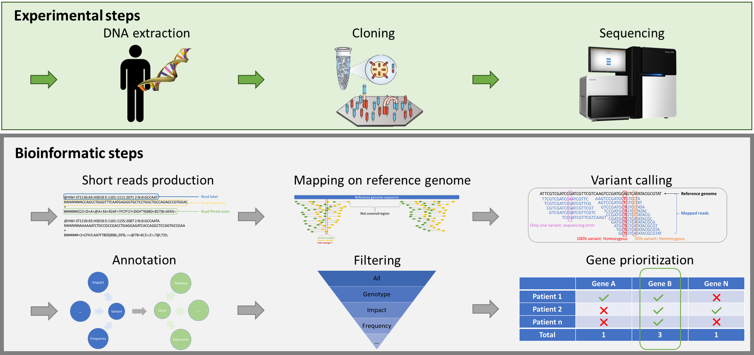
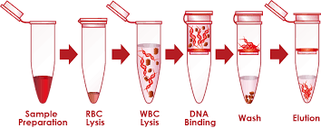
DNA extraction
Extraction
Fragmentation
Amplification
Exome capture

Slide 7
DNA extraction
Extraction
Fragmentation
Amplification
Exome capture
From blood or saliva

Slide 8
DNA extraction
Extraction
Fragmentation
Amplification
Exome capture
DNA fragment
Adaptator
Notes:
L’adn a ensuite été fragmenté en fragment d’une taille comprise entre 180 et 280 pb.

Slide 9
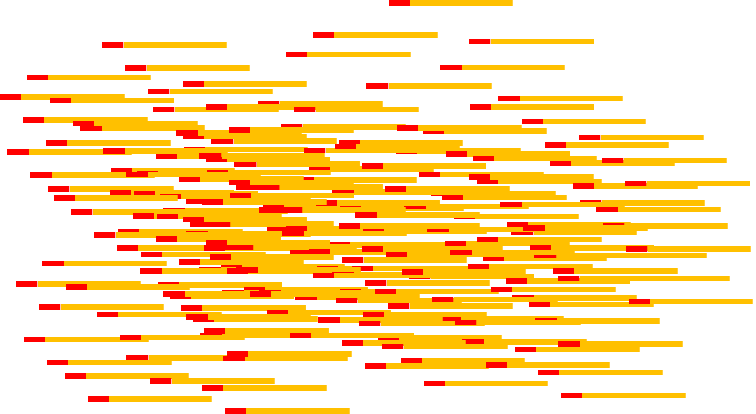
DNA extraction
Extraction
Fragmentation
Amplification
Exome capture
Notes:
Les fragments subissent ensuite une amplification par PCR

Slide 10
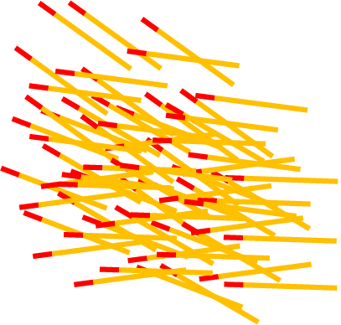

DNA extraction
Extraction
Fragmentation
Amplification
Exome capture
Notes:
Les séquences exoniques sont ensuite capturés grâce à des billes magnétiques

Slide 11


DNA extraction
Extraction
Fragmentation
Amplification
Exome capture
Notes:
Les séquences exoniques sont ensuite capturés grâce à des billes magnétiques

Slide 12
Cloning amplification

Slide 13
Cloning amplification

Slide 14
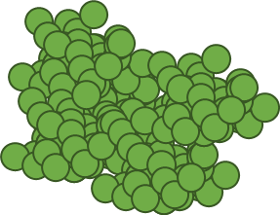
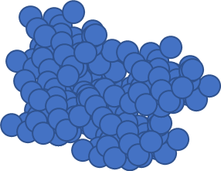

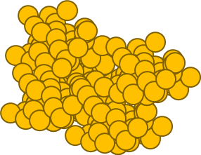
Cloning amplification

Slide 15
Sequencing reaction
ATTCGGTCGGGCTG………….CGTCGGGCTG
ATTCGGTCGGGCTG………….CGTCGGGCTG
ATTCGGTCGGGCTG………….CGTCGGGCTG
ATTCGGTCGGGCTG………….CGTCGGGCTG

Slide 16
NGS workflow
Experimental steps
DNA extraction
Cloning
Sequencing
Bioinformatic steps
Short reads production
Mapping on reference genome
Variant calling
Annotation
Filtering
Gene prioritization

Slide 17
NGS workflow
Experimental steps
DNA extraction
Cloning
Sequencing
Bioinformatic steps
Short reads production
Mapping on reference genome
Variant calling
Annotation
Filtering
Gene prioritization

Slide 18
Fastq format
@HWI-ST1136:65:HS018:5:1101:1111:2071 2:N:0:GCCAAT
NNNNNNNCCAGCCTGGGTTTCAATGAGGGTGCTCCTGGCTGCCAGAGCCGTGGAG
+
#######222<D+A<@A+3A<92AF<?FCFF1?<DGH*9)88D<B2?)8<AFA5=
@HWI-ST1136:65:HS018:5:1101:1155:2087 2:N:0:GCCAATA
NNNNNNAAAAAATCTGCCGCCGACCTGAGGAGATCACCAGGCTCCAGTGCCGAA
+
B######+2<CFH3:AA?F?8E0)8B6;;DF8;.==@7B=6C2=;E=;?@;?33;

Slide 19
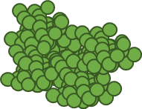

Fastq format
@HWI-ST1136:65:HS018:5:1101:1111:2071 2:N:0:GCCAAT
NNNNNNNCCAGCCTGGGTTTCAATGAGGGTGCTCCTGGCTGCCAGAGCCGTGGAG
+
#######222<D+A<@A+3A<92AF<?FCFF1?<DGH*9)88D<B2?)8<AFA5=
@HWI-ST1136:65:HS018:5:1101:1155:2087 2:N:0:GCCAATA
NNNNNNAAAAAATCTGCCGCCGACCTGAGGAGATCACCAGGCTCCAGTGCCGAA
+
B######+2<CFH3:AA?F?8E0)8B6;;DF8;.==@7B=6C2=;E=;?@;?33;
Read 1
Read 2

Slide 20
Fastq format
@HWI-ST1136:65:HS018:5:1101:1111:2071 2:N:0:GCCAAT
NNNNNNNCCAGCCTGGGTTTCAATGAGGGTGCTCCTGGCTGCCAGAGCCGTGGAG
+
#######222<D+A<@A+3A<92AF<?FCFF1?<DGH*9)88D<B2?)8<AFA5=
@HWI-ST1136:65:HS018:5:1101:1155:2087 2:N:0:GCCAATA
NNNNNNAAAAAATCTGCCGCCGACCTGAGGAGATCACCAGGCTCCAGTGCCGAA
+
B######+2<CFH3:AA?F?8E0)8B6;;DF8;.==@7B=6C2=;E=;?@;?33;
label
Read 1
Read 2

Slide 21
Fastq format
@HWI-ST1136:65:HS018:5:1101:1111:2071 2:N:0:GCCAAT
NNNNNNNCCAGCCTGGGTTTCAATGAGGGTGCTCCTGGCTGCCAGAGCCGTGGAG
+
#######222<D+A<@A+3A<92AF<?FCFF1?<DGH*9)88D<B2?)8<AFA5=
@HWI-ST1136:65:HS018:5:1101:1155:2087 2:N:0:GCCAATA
NNNNNNAAAAAATCTGCCGCCGACCTGAGGAGATCACCAGGCTCCAGTGCCGAA
+
B######+2<CFH3:AA?F?8E0)8B6;;DF8;.==@7B=6C2=;E=;?@;?33;
label
Read 1
sequence
Read 2

Slide 22
Fastq format
Fasta + Quality score = Fastq
@HWI-ST1136:65:HS018:5:1101:1111:2071 2:N:0:GCCAAT
NNNNNNNCCAGCCTGGGTTTCAATGAGGGTGCTCCTGGCTGCCAGAGCCGTGGAG
+
#######222<D+A<@A+3A<92AF<?FCFF1?<DGH*9)88D<B2?)8<AFA5=
@HWI-ST1136:65:HS018:5:1101:1155:2087 2:N:0:GCCAATA
NNNNNNAAAAAATCTGCCGCCGACCTGAGGAGATCACCAGGCTCCAGTGCCGAA
+
B######+2<CFH3:AA?F?8E0)8B6;;DF8;.==@7B=6C2=;E=;?@;?33;
label
Read 1
sequence
phred-score
Read 2

Slide 23
NGS workflow
Experimental steps
DNA extraction
Cloning
Sequencing
Bioinformatic steps
Short reads production
Mapping on reference genome
Variant calling
Annotation
Filtering
Gene prioritization

Slide 24
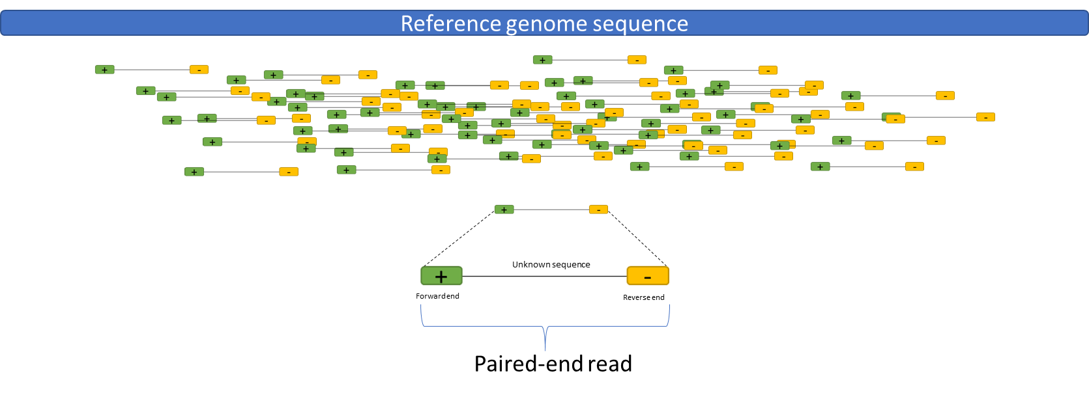
Reads mapping

Slide 25
Reads mapping

Slide 26
Reads mapping

Slide 27
Reads mapping

Slide 28
NGS workflow
Experimental steps
DNA extraction
Cloning
Sequencing
Bioinformatic steps
Short reads production
Mapping on reference genome
Variant calling
Annotation
Filtering
Gene prioritization

Slide 29
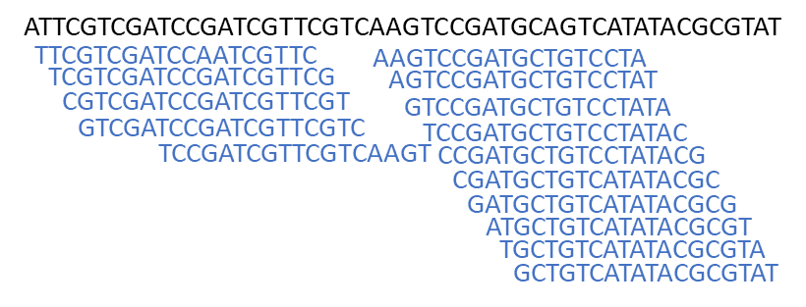
Variant calling
Reference genome

Slide 30
Variant calling
Mapped reads

Slide 31
Variant calling
0% variant:Reference

Slide 32
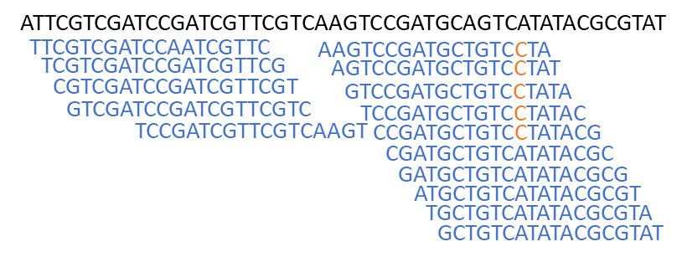
Variant calling
50% variant: Heterozygous

Slide 33

Variant calling
100% variant: Homozygous

Slide 34
NGS workflow
Experimental steps
DNA extraction
Cloning
Sequencing
Bioinformatic steps
Short reads production
Mapping on reference genome
Variant calling
Annotation
Filtering
Gene prioritization

Slide 35
Variant annotation
Variant
Frequency

Slide 36
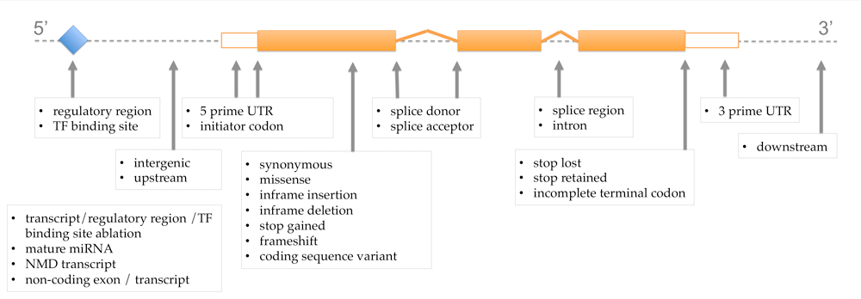
Variant annotation
Impact
Pathway
…
Variant
Gene
Frequency
Expression

Slide 37


Variant annotation
Impact
Pathway
…
Variant
Gene
Frequency
Expression

Slide 38
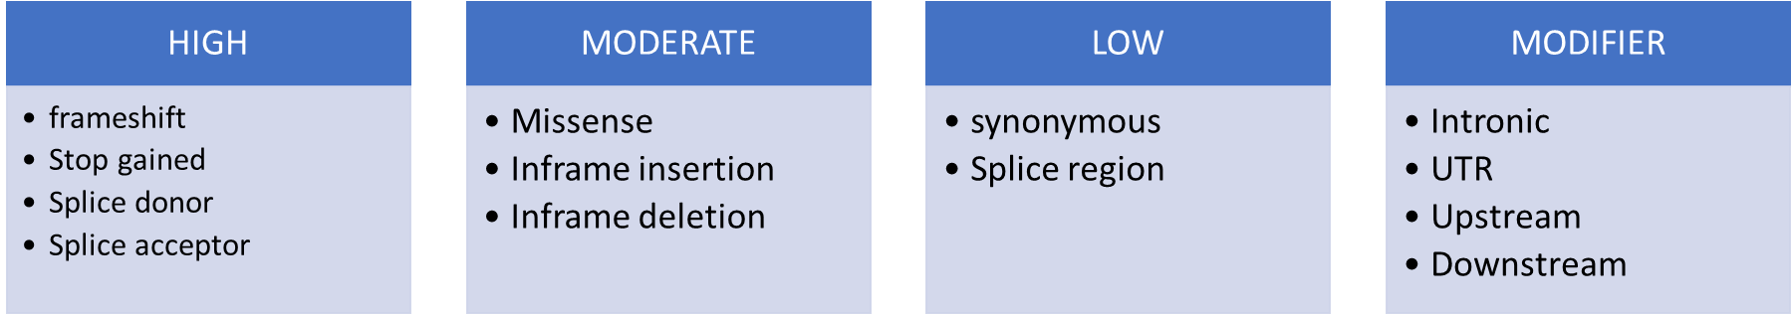
Variant annotation
Impact
Pathway
…
Variant
Gene
Frequency
Expression

Slide 39
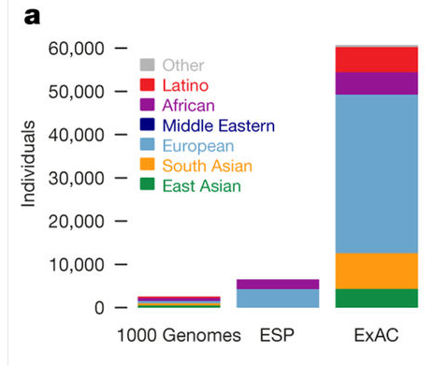
Variant annotation
Impact
Pathway
…
Variant
Gene
Frequency
Expression
Lek et al., 2016

Slide 40
Variant annotation
Impact
Pathway
…
Variant
Gene
Frequency
Expression

Slide 41
Variant annotation
Impact
Pathway
…
Variant
Gene
Frequency
Expression

Slide 42
Variant annotation
Impact
Pathway
…
…
Variant
Gene
Frequency
Expression

Slide 43
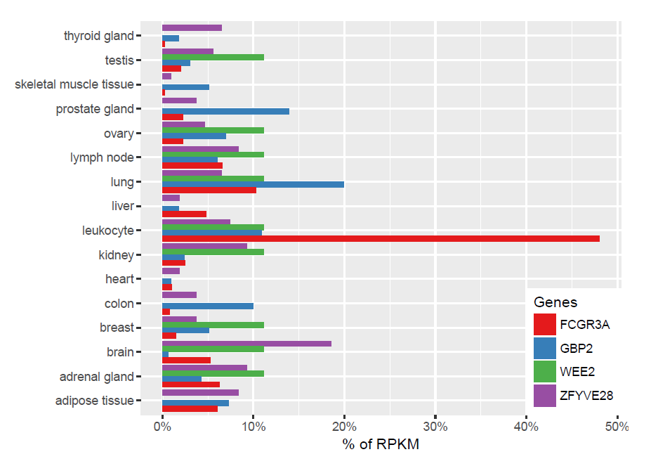
Variant annotation
Impact
Pathway
…
…
Variant
Gene
Frequency
Expression

Slide 44
Variant annotation
Impact
Pathway
…
…
Variant
Gene
Frequency
Expression

Slide 45
NGS workflow
Experimental steps
DNA extraction
Cloning
Sequencing
Bioinformatic steps
Short reads production
Mapping on reference genome
Variant calling
Annotation
Filtering
Gene prioritization

Slide 46
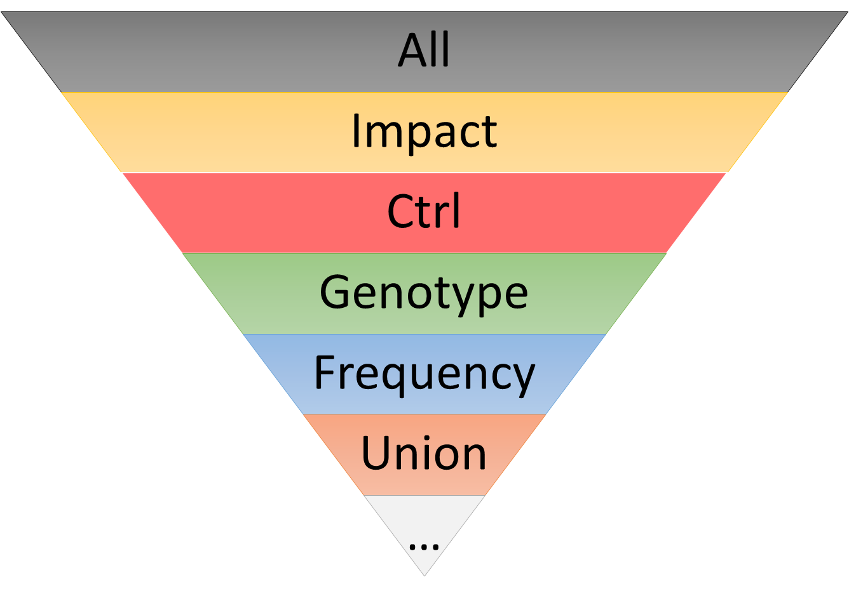
Variant filtering

Slide 47
Variant filtering
≈ 50000

Slide 48
Variant filtering
≈ 50000

Slide 49
Variant filtering
≈ 50000

Slide 50
Variant filtering
≈ 50000

Slide 51
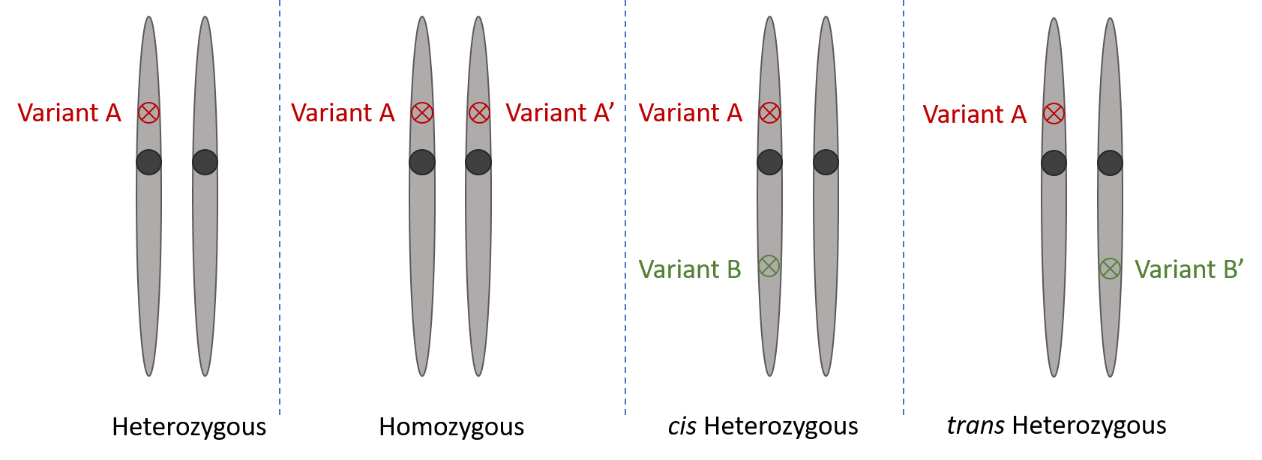
Variant filtering
≈ 50000

Slide 52
Variant filtering
≈ 50000
Kept
Homozygous

Slide 53
Variant filtering
≈ 50000
Kept
Homozygous
Compound heterozygous ?

Slide 54
Variant filtering
≈ 50000
???
Kept
Homozygous
Compound heterozygous ?

Slide 55
Variant filtering
≈ 50000
Kept
Filtered
Homozygous
Compound heterozygous ?
Heterozygous

Slide 56
Le séquençage haut débit
≈ 50000
Frequency cutoff = 1%

Slide 57


Variant filtering
≈ 50000
Hypothesis:
The phenotype of two brothers is explain by the same variant

Slide 58
Variant filtering
≈ 50000
Hypothesis:
The phenotype of two brothers is explain by the same variant

Slide 59
Variant filtering
≈ 50000
Hypothesis:
The phenotype of two brothers is explain by the same variant

Slide 60
Variant filtering
≈ 50000
Hypothesis:
The phenotype of two brothers is explain by the same variant

Slide 61
Variant filtering
≈ 50000
Hypothesis:
The phenotype of two brothers is explain by the same variant

Slide 62
Variant filtering

Slide 63
Variant filtering
≈ 50000
Few

Slide 64
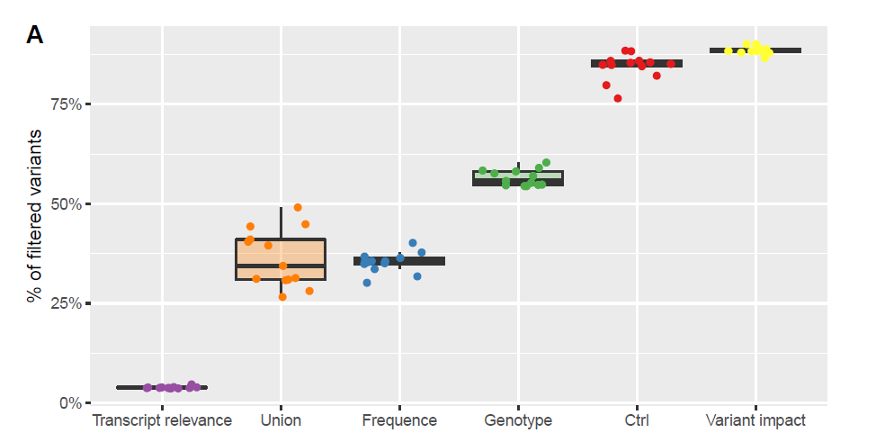
Variant filtering
≈ 50000
Few

Slide 65
NGS workflow
Experimental steps
DNA extraction
Cloning
Sequencing
Bioinformatic steps
Short reads production
Mapping on reference genome
Variant calling
Annotation
Filtering
Gene prioritization

Slide 66

Gene priorisation

Slide 67
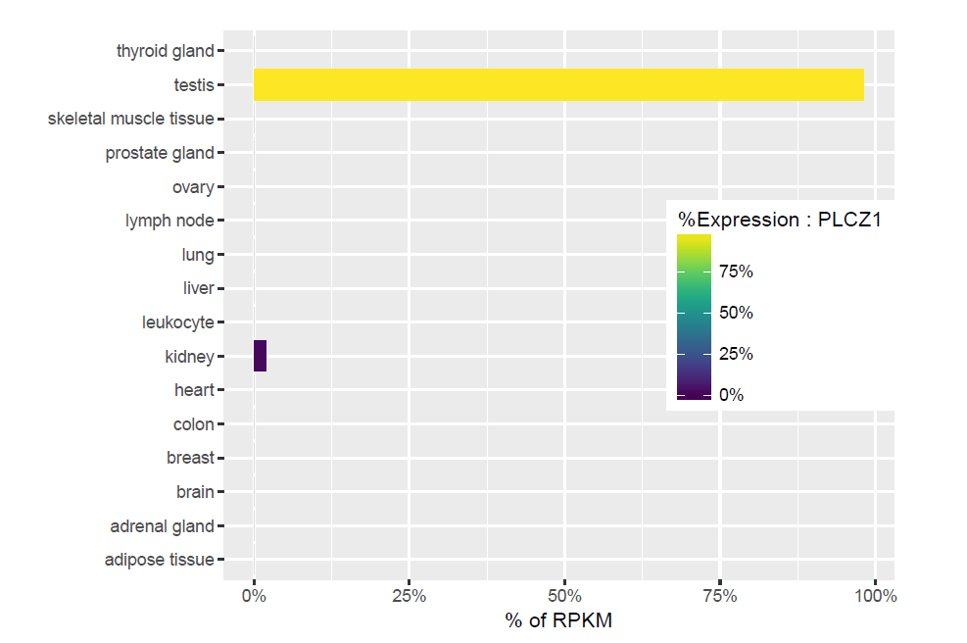
Gene priorisation

Slide 68
This is just the beginin…
Experimental steps
DNA extraction
Cloning
Sequencing
Bioinformatic steps
Short reads production
Mapping on reference genome
Variant calling
Annotation
Filtering
Gene prioritization

Slide 69
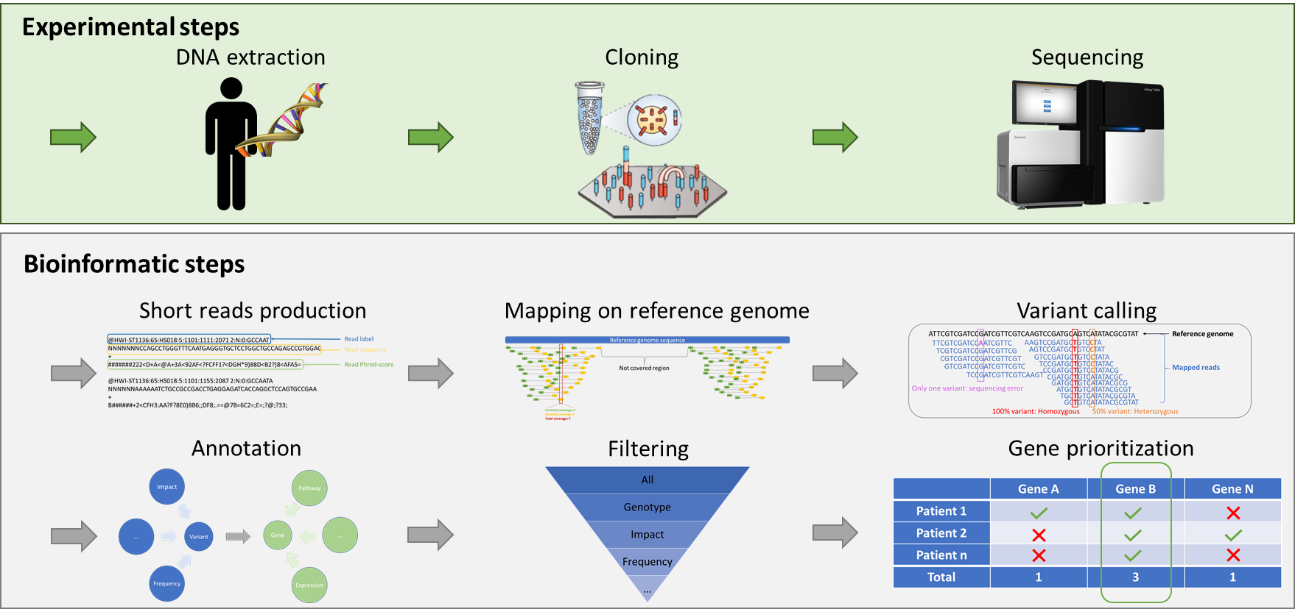
This is just the beginin…
Experimental steps

Slide 70
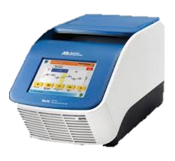
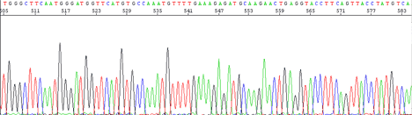
This is just the beginin…
Experimental steps
Validation

Slide 71

This is just the beginin…
Experimental steps
Validation
Animal experimentation

Slide 72

This is just the beginin…
Experimental steps
Validation
Animal experimentation
Knowledge

Slide 73
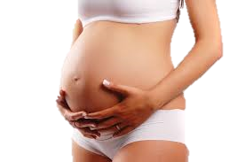
This is just the beginin…
Experimental steps
Medical advices and
pregnancy
Validation
Animal experimentation
Knowledge

Slide 74
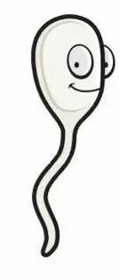
Reproduction and informatic…
A single sperm has 38 MB of DNA information in it.
That means a normal ejaculation represents a data transfer of around 1600 GB in about 3 seconds…
And you thought 4G was fast

