Slide 1

Data Lineage
Tomasz Kaszuba

Slide 2
Background
NWU asked a lot of questions about the origination of RCRS fields from the gdwh
Rado asked a lot of questions about origination of HOREP fields
Extension of BIS DDS (COREP Extensions, HOREP loading)
BCBS 239 Specifications
SAS DI Studio didn’t provide analysis on the “lookup” step
First prototype created in June 2015 during SEP project

Slide 3
Data Lineage
Data lineage is the process of tracing the data’s origins, what happens to it and where it moves over time.
Reverse data lineage, leads to the final destination's data points and its intermediate data flows.
Forward data lineage does the opposite.
These views can be combined to form end to end lineage for a reference point that provides complete audit trail of that data point of interest from source(s) to its final destination(s).

Slide 4
Data Lineage
Data lineage provides the audit trail of the data points at the lowest granular level, but presentation of the lineage may be done at various zoom levels to simplify the vast information.
Data Lineage can be visualized at various levels based on the granularity of the view. At a very high level data lineage provides what systems the data interacts before it reaches the destination.

Slide 5
Data Lineage
Data lineage can provide the following:
Auditing / Reporting
Data Governance
Impact Analysis
Big Data Debugging
Code Analysis / Governance

Slide 6
Modules
Ruby solution consisting of SAS metadata crawler (sas-md-crawler)
Audit module consisting of reporting tool (datlin-reporter) running on document database (mongo)
Trace module running on a graph database (neo4j)
Audit module optimized for auditing/documentation purposes by business users
Trace module created for ad-hoc queries more suited for developers
All jobs controlled by jenkins

Slide 7
Audit module
Ruby solution consisting of SAS metadata crawler (sas-md-crawler) and reporting tool (datlin-reporter) controlled by jenkins jobs
Crawler crawls through metadata and saves full unique transitions (aka paths) into mongo
Datlin reporter generates static html and excel reports from this data
Deployed and ready for testing

Slide 8
Audit module
Challenges encountered:
Transition coverage (direct, indirect, reference)
Missing metadata (views, expressions, code)
Circular references
Different data sources (table, view, file, lib, cube)
Large amount of data (1 Million unique paths)
Nightly build loading time
Query time and reporting in general
Extensibility of data model

Slide 9
Audit module
Types of transitions (aka paths):
Direct
Transition of attributes that have no conditional logic applied to them. Can be renamed and reformatted
Estimated to be around 99%* of all the transitions in RCRS
Only transitions covered by SAS DI Studio
Notes:
Show ex_3; return accumulator

Slide 10
Audit module
Types of transitions (aka paths):
Direct con’t
proc sql;
create view work.CRM as
select
DDS2HOREP_FINANCIAL_ACCOUNTS.ACCOUNT_RK length = 8
(…)
ACCOUNT_CREDIT_RISK_MITIGANT.TOTAL_VALUE_AMT/CREDIT_RISK_MITIGANT.PROTECTION_VALUE_AMT as allocation_perc length = 8
label = 'Total Value Amount',
case when ACCOUNT_CREDIT_RISK_MITIGANT.TOTAL_VALUE_AMT eq . then 0
else ACCOUNT_CREDIT_RISK_MITIGANT.TOTAL_VALUE_AMT/EXTRACT_FX_QUOTE.RCRS_FX_RT end as MARKET_VALUE_amt length = 8
label = 'Total Value Amount',
CREDIT_RISK_MITIGANT.CURRENCY_CD length = 3
label = 'Currency Code'
from
CPM_ST.DDS2HOREP_FINANCIAL_ACCOUNTS as DDS2HOREP_FINANCIAL_ACCOUNTS inner join
work.ACCOUNT_CREDIT_RISK_MITIGANT as ACCOUNT_CREDIT_RISK_MITIGANT
on
(
DDS2HOREP_FINANCIAL_ACCOUNTS.ACCOUNT_RK = ACCOUNT_CREDIT_RISK_MITIGANT.ACCOUNT_RK
) inner join
work.CREDIT_RISK_MITIGANT as CREDIT_RISK_MITIGANT
on
(
ACCOUNT_CREDIT_RISK_MITIGANT.CREDIT_RISK_MITIGANT_RK = CREDIT_RISK_MITIGANT.CREDIT_RISK_MITIGANT_RK
) inner join
work.EXTRACT_FX_QUOTE as EXTRACT_FX_QUOTE
on
(
CREDIT_RISK_MITIGANT.CURRENCY_CD = EXTRACT_FX_QUOTE.BUY_CURRENCY_CD
);
quit;

Slide 11
Audit module
Types of transitions (aka paths):
Indirect
Transition of attributes that are affected by conditional logic such as case statements, expressions, macros …
SAS DI Studio treats case statements and expressions as direct transitions (which is fine for audit purposes)
Main point of the sas-md-crawler (at the beginning) was to retrieve the value in a hash key lookup

Slide 12
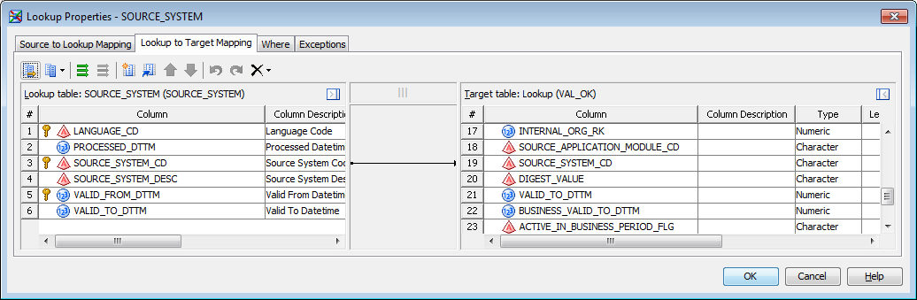
Audit module
Types of transitions (aka paths):
Indirect con’t

Slide 13
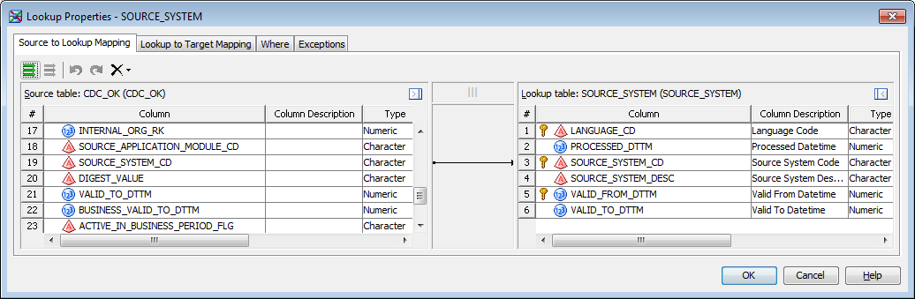
Audit module
Types of transitions (aka paths):
Reference
Attributes that affect transitions but might not get propagated. The boolean conditions as in where condition, case statements, expressions, macros or the key in a hash key lookup

Slide 14
Audit module
Types of transitions (aka paths):
Reference con’t
proc sql;
create view work.CRM as
select
DDS2HOREP_FINANCIAL_ACCOUNTS.ACCOUNT_RK length = 8
(…)
ACCOUNT_CREDIT_RISK_MITIGANT.TOTAL_VALUE_AMT/CREDIT_RISK_MITIGANT.PROTECTION_VALUE_AMT as allocation_perc length = 8
label = 'Total Value Amount',
case when ACCOUNT_CREDIT_RISK_MITIGANT.TOTAL_VALUE_AMT eq . then 0
else ACCOUNT_CREDIT_RISK_MITIGANT.TOTAL_VALUE_AMT/EXTRACT_FX_QUOTE.RCRS_FX_RT end as MARKET_VALUE_amt length = 8
label = 'Total Value Amount',
CREDIT_RISK_MITIGANT.CURRENCY_CD length = 3
label = 'Currency Code'
from
CPM_ST.DDS2HOREP_FINANCIAL_ACCOUNTS as DDS2HOREP_FINANCIAL_ACCOUNTS inner join
work.ACCOUNT_CREDIT_RISK_MITIGANT as ACCOUNT_CREDIT_RISK_MITIGANT
on
(
DDS2HOREP_FINANCIAL_ACCOUNTS.ACCOUNT_RK = ACCOUNT_CREDIT_RISK_MITIGANT.ACCOUNT_RK
) inner join
work.CREDIT_RISK_MITIGANT as CREDIT_RISK_MITIGANT
on
(
ACCOUNT_CREDIT_RISK_MITIGANT.CREDIT_RISK_MITIGANT_RK = CREDIT_RISK_MITIGANT.CREDIT_RISK_MITIGANT_RK
) inner join
work.EXTRACT_FX_QUOTE as EXTRACT_FX_QUOTE
on
(
CREDIT_RISK_MITIGANT.CURRENCY_CD = EXTRACT_FX_QUOTE.BUY_CURRENCY_CD
);
quit;

Slide 15
Audit module
Missing Metadata:
DI Studio doesn’t provide metadata for all different types of transformations, such as macros (very difficult to do) or the transpose step
Missing view definitions, only way to map through views is to do it in two steps
RCRS provides ddls and it’s possible to parse (simple views) and create “bridge” metadata
Expressions are stored as text in the metadata but it is possible to extract variable information for indirect or reference transitions

Slide 16
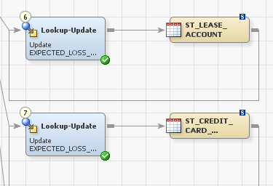
Audit module
Circular references:
It is possible for a transition to circle back onto itself. A data lineage tool must deal with this situation.

Slide 17
Audit module
Different data sources :
RCRS receives data from different source such as csv files, tables, views and outputs to csv files, tables or cubes.
The Audit version of the data lineage tool was created around the concept of the SAS library and hence each input/output source is stored like a library in the database even if it is not.

Slide 18
Audit module
Different data sources con’t:
FILE.forbearance_status.csv.EBA_Status --forb_01_import_csv:File Reader--> WORK.W8TJHXPJ.EBA_Status
WORK.W8TJHXPJ.EBA_Status --forb_01_import_csv:Table Loader--> ext_data.FORBEARANCE_STATUS.EBA_Status
ext_data.FORBEARANCE_STATUS.EBA_Status --forb_02_load_stage:Filter by date and transform--> WORK.FORB_COUNTERPARTY.EBA_STATUS
WORK.FORB_COUNTERPARTY.EBA_STATUS --forb_02_load_stage:Join--> WORK.W8UFG4I1.EBA_STATUS
WORK.W8UFG4I1.EBA_STATUS --forb_02_load_stage:Lookup--> WORK.W98YZGW3.EBA_STATUS
WORK.W98YZGW3.EBA_STATUS --forb_02_load_stage:Extract--> WORK.CURRENT.EBA_STATUS
WORK.CURRENT.EBA_STATUS --forb_02_load_stage:Append History and Current--> WORK.W9ZZJIL7.EBA_STATUS
WORK.W9ZZJIL7.EBA_STATUS --forb_02_load_stage:Filter unmapped records--> WORK.W367IBS4.EBA_STATUS
WORK.W367IBS4.EBA_STATUS --forb_02_load_stage:Table Loader--> bis_st.ST_FORBEARANCE_STATUS.EBA_STATUS
bis_st.ST_FORBEARANCE_STATUS.EBA_STATUS --st2bis_tx2_forbearance_status:Extract--> WORK.forbearance_status_1.EBA_STATUS
WORK.forbearance_status_1.EBA_STATUS --st2bis_tx2_forbearance_status:Lookup Referential Integrity--> WORK.RefIntOut.EBA_STATUS
WORK.RefIntOut.EBA_STATUS --st2bis_tx2_forbearance_status:Lookup--> WORK.EBA_1.EBA_STATUS
WORK.EBA_1.EBA_STATUS --st2bis_tx2_forbearance_status:Correct EBA_STATUS--> WORK.EBA_STATUS_CORRECTION.EBA_STATUS
WORK.EBA_STATUS_CORRECTION.EBA_STATUS --st2bis_tx2_forbearance_status:Correct CONCESSION_TYPE--> WORK.CONCESSION_CORRECTION.EBA_STATUS
WORK.CONCESSION_CORRECTION.EBA_STATUS --st2bis_tx2_forbearance_status:RCRS_CDC_Transform--> WORK.CDC_OK.EBA_STATUS
WORK.CDC_OK.EBA_STATUS --st2bis_tx2_forbearance_status:Lookup Validation--> WORK.VAL_OK.EBA_STATUS
WORK.VAL_OK.EBA_STATUS --st2bis_tx2_forbearance_status:RCRS_DDS_Load_Transform--> WORK.DDSEXT_Load.EBA_STATUS
WORK.DDSEXT_Load.EBA_STATUS --st2bis_tx2_forbearance_status:Table Loader--> ddsext.xt_forbearance_status.eba_status

Slide 19
Audit module
Large amount of data:
Approximately 1 Million unique paths
Audit module uses the crawler to traverse each unique path and saves the entire path in a denormalized way in the database, as would be done in a dwh
Downside is that each path has to be traversed or “exploded” before it gets saved, including if it was already traversed. Possible to get around this limitation with caching (lots of memory) or a fast query engine (either option not yet implemented)

Slide 20
Audit module
Large amount of data con’t:
Traversing paths is expensive in terms of cpu time and memory and therefore indirect mappings are limited to only one step back and not the full path traversal (ex. currency code lookup)
The denormalised data structure is very good for certain types of queries, has very constant performance due to missing joins (even with large datasets) and fits well with the design of a document database like mongo
Downside is that it holds a lot of duplicate data
Another downside (not related to mongo) is that 98% of SAS metadata provides NO USEFUL information since most of it is direct mappings through temporary work tables

Slide 21
Audit module
Nightly build loading times:
The data structure coupled with mongo allow for extremely fast insert speeds but it is hindered by the amount of time it takes to do full path traversals
Only a few common libraries have been currently configured but it is possible that with the right machine (lots of CPU) all the libraries could be mapped in a reasonable amount of time

Slide 22
Audit module
Queries and reporting:
Around 110k unique paths are currently mapped through jenkins
Queries are very fast when searching against library, table or attribute name
db.datlin.transition.find({"transition.input_library" : "FILE", "transition.input_attribute" : "EBA_Status"})[1]
db.datlin.transition.find({"transition.output_library" : "ddsext", "transition.output_attribute" : "EBA_Status"})[1]
db.datlin.transition.find({"transition.output_library" : "bis_st", "transition.output_attribute" : "EBA_STATUS"})[3]
Datlin report tool provides very basic search functionality but for more detailed analysis you can use the built in query language (UI can of course extended)

Slide 23
Audit module
Extensibility of data model:
The DB is recreated nightly (not a delta load) so there is no issue with schema changes

Slide 24
Trace module
Same SAS metadata crawler (sas-md-crawler) controlled by jenkins jobs
Crawler crawls through metadata and saves “hops” into graph database neo4j
Reporting is done using graph specific query language, “cypher”
Prototype: Provides basic functionality overview

Slide 25
Trace module
Motivation:
Since the expansion of possible paths is very expensive we delegated this task to a specialized graph db engine

Slide 26
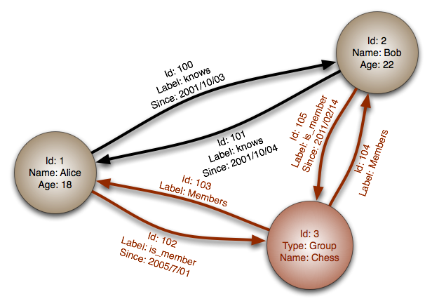
Trace module
What is a graph db?
A standard definition of a graph db is a collection of nodes called vertices, and the connections between them, called edges or relationships. Nodes and relationships can contain properties.

Slide 27
Trace module
What is a graph con’t?
Easiest way to think about a graph is a bunch of points in space connected by lines
Famous graphs:
Facebook, linkedin, twitter
Fraud detection
Big Data frameworks (Spark uses it for data redundancy)
Your GPS

Slide 28
Trace module
Benefits to using graphs for Data Lineage?
For large amounts of mined data we realized that a graph would be more extendible for certain functionality and ad hoc queries
Constant query performance; adding new nodes and relationships doesn’t affect graph traversal. Scales very well
The Audit module is also a graph but optimised in a format suitable for searching while the Tracer module is stored as a graph

Slide 29
Trace module
Benefits to using graphs in Data Lineage?
Path expansion is usually very fast as no table scans are performed
Graphs treat relationships as first class citizens and allow complex relationships to be easily modeled

Slide 30
Trace module
Neo4j in Data Lineage:
The metadata crawler no longer needs to save entire paths but only the “hops” (ie: two nodes and the relationships between them).
No more redundant data. Path expansion is only performed when needed (ie: Queries)

Slide 31
Trace module
Neo4j in Data Lineage:
All types of transitions can now be modeled as separate relationships:
Direct
Indirect
Reference
Metadata (ex: expression code) or anything really (ex. source system) can be attached as a property to a node or a relationship. Making the data structure flexible and queryable.

Slide 32
Trace module
Neo4j in Data Lineage:
Views can be treated as a hop and hence can be traversed (implemented)
Specialized path expansion algorithms, such as shortest path, which cut down on heavy query times (ex. currency) from 2,5 hours to 30 seconds
Specialized query language suited to path traversals, not a compromise like SQL or XPATH (SAS)
Downside is initial db loading time!

Slide 33
Trace module
Neo4j in Data Lineage:
Total number of nodes:
MATCH (n) RETURN DISTINCT LABELS(n), COUNT(n)
Total number of relationships:
MATCH ()-[r]->() RETURN type(r) as rel_type, count(r) as count union match ()-[r]->() return "total" as rel_type, count(r) as count

Slide 34
Trace module
Cypher:
Manual forward then backward path traversal
MATCH (a:attribute {fullname:"FILE.FORBEARANCE_STATUS.CSV.EBA_STATUS"}) return a

Slide 35
Trace module
Cypher:
Reverse analysis:
MATCH (:attribute {fullname:"DDSEXT.XT_FORBEARANCE_STATUS.EBA_STATUS"})<-[:maps_to*]-(a:attribute) where not a.fullname starts with "WORK.“ return distinct a.fullname;
Forward analysis:
MATCH (:attribute {fullname:"DDSEXT.XT_FORBEARANCE_STATUS.EBA_STATUS"})-[:maps_to*]->(a:attribute) where not a.fullname starts with "WORK.“ return distinct a.fullname;
Change an arrow!
Possible to control how “deep” to traverse the path “[:maps_to*1..2]”

Slide 36
Trace module
Cypher:
End to end report
MATCH (el:library {name:"CPM_ST"})<-[]-(et)<-[:attribute_in_table]-(ea:attribute {name:"EBA_STATUS"}) with el,et,ea match (ea)<-[:maps_to*]-(sa:attribute) where sa.fullname starts with "GDWH_UNL.UNL" or sa.fullname starts with "DDS." or sa.fullname starts with "DDSEXT." or sa.fullname starts with "FILE." with el,et,ea,sa match (sa)-[:attribute_in_table]->(st)-[:table_in_library]->(sl) return distinct el.name, et.name, ea.name,"<---" as From, sl.name, st.name,sa.name

Slide 37
Trace module
Cypher:
Expensive query (Currency):
MATCH (el:library {name:"CPM_ST"})<-[]-(et:table {name:"DDS2HOREP_COLLATERALS"})<-[:attribute_in_table]-(ea:attribute {name:"CURRENCY_LAST_VALUATION"}) with el,et,ea match shortestPath((ea)<-[:maps_to*]-(sa:attribute)) with distinct el,et,ea,sa match (sa) where sa.fullname starts with "GDWH_UNL.UNL" or sa.fullname starts with "DDS." or sa.fullname starts with "DDSEXT." with el,et,ea,sa match (sa)-[:attribute_in_table]->(st)-[:table_in_library]->(sl) return el.name, et.name, ea.name,"<---" as From, sl.name, st.name,sa.name

Slide 38
Trace module
Future:
Most important is to extend analyzed data sources gdwh-> rcrs -> modules (EC, HOREP)
Increase coverage
Map through “transpose” step
Improve “expression” step handling
Improve “indirect” and “reference” transitions
Increase initial db load times
Impact analysis (ex. change how an attribute gets loaded, useful for gdwh)
Conduct code analysis (ex. proper macro is used with certain attributes)

Slide 39
Trace module
Cypher:
Expensive query (Currency):
Expensive queries can be debugged by using the cypher language profiler
It is enough to put the keyword “PROFILE” in front of the query
PROFILE MATCH (el:library {name:"CPM_ST"})<-[]-(et:table {name:"DDS2HOREP_COLLATERALS"})<-[:attribute_in_table]-(ea:attribute {name:"CURRENCY_LAST_VALUATION"}) with el,et,ea match shortestPath((ea)<-[:maps_to*]-(sa:attribute)) with distinct el,et,ea,sa match (sa) where sa.fullname starts with "GDWH_UNL.UNL" or sa.fullname starts with "DDS." or sa.fullname starts with "DDSEXT. " with el,et,ea,sa match (sa)-[:attribute_in_table]->(st)-[:table_in_library]->(sl) return el.name, et.name, ea.name,"<---" as From, sl.name, st.name,sa.name

Slide 40
Non shortest path profile
Operator | Estimated Rows | Rows | DB Hits | Variables | Other
Expand(All) | 3 | 19 | 38 | anon[414], sl -- anon[386], ea, el, et, sa, st | (st)-[:table_in_library]->(sl)
Expand(All) | 3 | 19 | 38 | anon[386], st -- ea, el, et, sa | (sa)-[:attribute_in_table]->(st)
Filter | 3 | 19 | 2002 | a, el, et, sa| Ors(StartsWith(sa.fullname,{ AUTOSTRING3}), StartsWith(sa.fullname,{ AUTOSTRING4}), StartsWith(sa.fullname,{ AUTOSTRING5}))
Distinct | 128 | 678 | 0 | ea, el, et, sa| el, et, ea, sa
Filter | 128 | 334812480 | 669618290 | anon[177], anon[35], anon[81], ea, el, et, sa | sa:attribute
VarLengthExpand(All) | 128 | 669618290 | 1494585385 | anon[177], sa -- anon[35], anon[81], ea, el, et | (ea)<-[:maps_to*]-(sa)|

