Slide 1
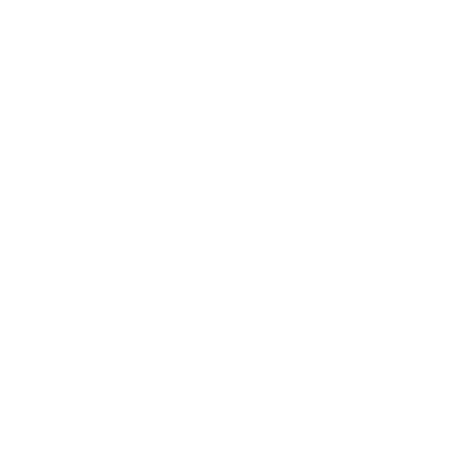
Diffusion Limited Aggregation

Slide 2
Classes
Particle - A particle object performs the random walk. Assumption - It can move to any of the 8 neighboring pixels depending on the direction specified to it.
Field - Field / "Image" captures the particle movements and aggregation. The Field object allows certain customizations to the particle movements. Initially the field is empty with one particle at the center.
DlaSimulation - DlaSimulation simulates the Diffusion Limited Aggregation and stores images at regular intervals
BinarySearchTree - The BinarySearchTree class is used to store the aggregated particles. It can find the nearest aggregated particle to a given particle.

Slide 3
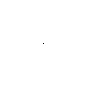
Approach 1 – Brute Force
The particle starts the random walk from the edge pixels
The particle moves to any of the four neighboring pixels with equal probability.
In this case the simulation is extremely slow and is not practical as the probability to reach the center pixel is negligible. The particle jitters around but tends to stay at the same pixel where it was generated.

Slide 4
Approach 2 – Add drift
The particle starts the random walk from the edge pixels
The particle moves randomly but in general drifts towards the center
The simulation is still slow, as most of the time the particle is random walking far from the center.

Slide 5
Approach 3 – Optimize start
The particle starts from a random pixel at a certain "max_dist" away from the nearest aggregated particle.
The particles also starts at a minimum distance away from the aggregated particles
The particle moves randomly but in general drifts towards the center
For this approach , the aggregated particles or “Structure” is stored in a 2DTree. The distance between the particle and the nearest aggregated particle is calculated.

Slide 6
Approach 4 – Nearest neighbor
The particle starts from a random pixel at a certain "max_dist" away from the nearest aggregated particle.
The particles also starts at a minimum distance away from the aggregated particles
The particle moves randomly but in general drifts towards the nearest aggregated particle
For this approach , the aggregated particles or “Structure” is stored in a 2DTree. The distance between the particle and the nearest aggregated particle is calculated.

Slide 7
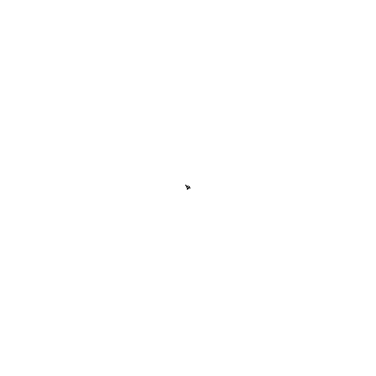
Simulation Results
dimension = 500
stickiness factor = 1
max_dist = 1000
iterations = 2000
attractor = center
With a central attractor, the branching is minimal

Slide 8

Simulation Results
dimension = 500
stickiness factor = 0.5
max_dist = 500
iterations = 2000
attractor = center
With a central attractor, the branching is minimal

Slide 9

Simulation Results
dimension = 500
stickiness factor = 0.5
max_dist = 500
iterations = 3500
attractor = nearest neighbor

Slide 10

Simulation Results
dimension = 500
stickiness factor = 0.2
max_dist = 400
iterations = 7500
attractor = nearest neighbor

