Slide 1
AMOVA F_{ST} Haplotype Networks
Conservation Genetics
2/17/2016

Slide 2
Neutral Genetic Markers
Observed genetic variation has no affect on the fitness of the organisms being studied
Useful for understanding random processes acting on a population (e.g., genetic drift)
Most programs used for conservation genetics assume neutrality

Slide 3
Definitions
Locus = location of a gene or other DNA sequence in a genome
Allele = variant form of a locus
Heterozygosity = proportion of diploid genotypes composed of two different alleles
Haplotype = group of genes or other loci inherited together from a single parent

Slide 4
Definitions
Haplotype diversity = measure of uniqueness of haplotypes
analogous to heterozygosity; calculated for haplotypes to provide a measure of diversity.
Ranges from 0 (no diversity) to 1 (very high diversity).
Nucleotide diversity (π) = average number of nucleotide differences per site between two individuals in a population
Theta (Θ) = mutation rate. If this number is the same or similar to π, then neutrality is assumed for the molecular marker in question.
Tajima’s D provides a test of this hypothesis.

Slide 5
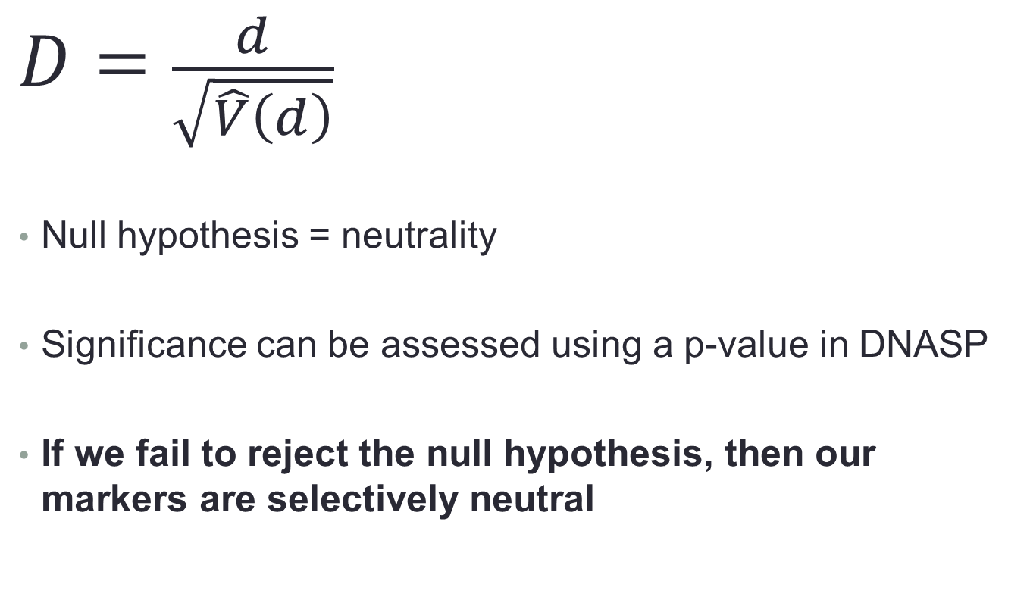
Tajima’s D (Test for Neutrality)
$$D=\frac{d}{\sqrt{\hat{V}\left(d\right)}}$$
Null hypothesis = neutrality
Significance can be assessed using a p-value in DNASP
If we fail to reject the null hypothesis, then our markers are selectively neutral
Difference between π and Θ
Standard deviation of d

Slide 6
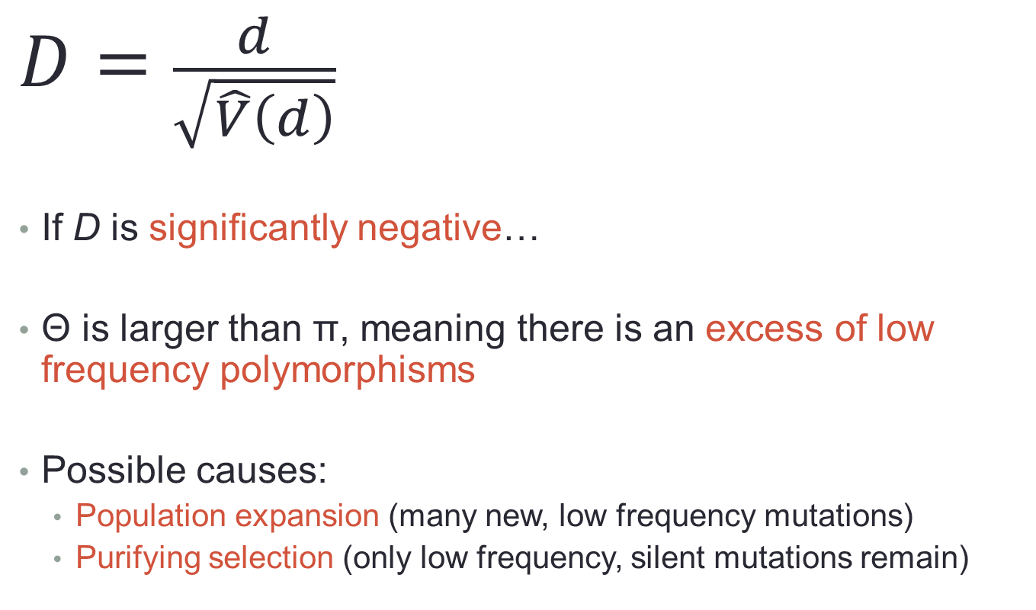
Tajima’s D
$$D=\frac{d}{\sqrt{\hat{V}\left(d\right)}}$$
If D is significantly negative…
Θ is larger than π, meaning there is an excess of low frequency polymorphisms
Possible causes:
Population expansion (many new, low frequency mutations)
Purifying selection (only low frequency, silent mutations remain)
Difference between π and Θ
Standard deviation of d

Slide 7
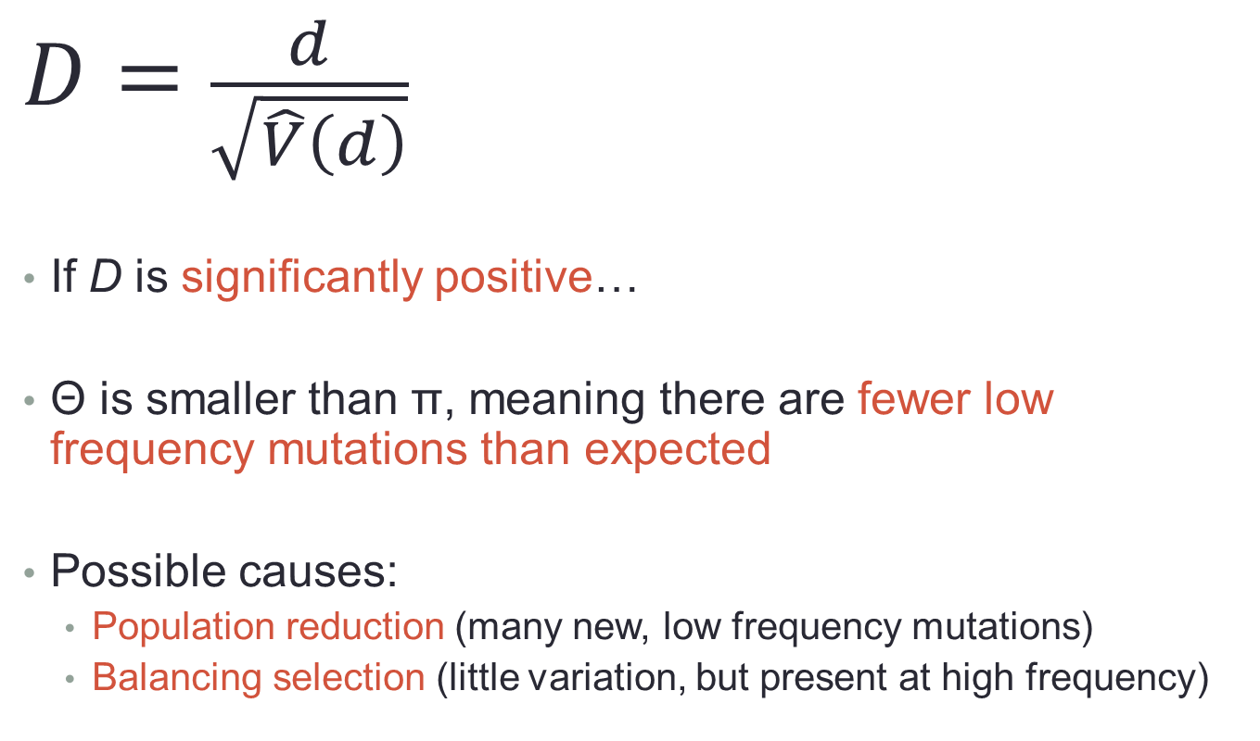
Tajima’s D
$$D=\frac{d}{\sqrt{\hat{V}\left(d\right)}}$$
If D is significantly positive…
Θ is smaller than π, meaning there are fewer low frequency mutations than expected
Possible causes:
Population reduction (many new, low frequency mutations)
Balancing selection (little variation, but present at high frequency)
Difference between π and Θ
Standard deviation of d

Slide 8
Population Structure
Looking at subdivisions of populations – which groups within a population are interbreeding?
Important for conservation genetics and management
Various methods
AMOVA (Analysis of Molecular Variance – Excoffier et al. 1992)
A priori assumptions of population structure
Bayesian clustering algorithms (e.g., Structure – Pritchard et al. 2000)
No a priori assumptions.

Slide 9
Fixation Indices (F-Statistics)
Used to describe levels of genetic variation within and among populations
F_{ST} = proportion of genetic variance contained in a subpopulation relative to the total
F_{IS} = proportion of genetic variance in a subpopulation contained in an individual
F_{IT} = proportion of genetic variance contained in an individual relative to the total variance.

Slide 10
Fixation Indices (F-Statistics)
F_{IT}
Individual
Subpopulation
Total
F_{IS}
F_{ST}

Slide 11
Fixation Indices (F-Statistics)
We will mostly be concerned with F_{ST} in this course
F_{IT}
Individual
Subpopulation
Total
F_{IS}
F_{ST}

Slide 12
F_{ST}
Variance among subpopulations relative to the total population variance.
Can be highly influenced by sampling
Values differ between microsatellites and DNA sequence data
F_{ST} ranges from 0 to 1
0 = no population differentiation
1 = very high differentiation
Negative values can be interpreted as 0 values
Or inappropriate groupings of samples

Slide 13
F_{ST}
Population A
Population B

Slide 14
F_{ST} – Influence of sample size (high F_{ST})
Population A
Population B

Slide 15
F_{ST}
Population A
Population B

Slide 16
F_{ST} – Influence of sample size (low F_{ST})
Population A
Population B

Slide 17
AMOVA
AMOVA (Analysis of Molecular Variance – Excoffier et al. 1992)
A priori assumptions of population structure
Hierarchical Analysis of Variance (ANOVA)
Creates a distance matrix
Partitions the sum of squared deviations from the distance matrix into hierarchical variance components
Tests for significance using permutation tests.

Slide 18
Permutation tests
Allow for testing of hypotheses when:
Distributional properties of your data are unknown
Data is known to not follow a normal distribution
Permutation Test - Allows for the null distribution to be obtained, and significance to be tested.
Reorder the data by randomly assigning individuals to new groups, populations, etc.
New matrix is made
Calculations are performed again
Repeat
Arlequin manual recommends 16,000 permutations

Slide 19
AMOVA
Examining genetic diversity at three levels
Among populations = F_{ST}
Among populations within groups = F_{SC}
Among groups = F_{CT}
Arlequin 3.5 (Excoffier and Lischer 2010)
Handles DNA sequence and fragment (microsatellite, RFLP, etc.) data

Slide 20
Fixation Indices (F-Statistics)
F_{IT}
F_{SC}
F_{CT}
Individual
Subpopulation
Population Groups
Total
F_{IS}
F_{ST}

Slide 21
AMOVA
Populations = sampling locations
Groups = clusters of sampling locations
The user must define groups (may be based on geographical barriers, ecological differences, etc.)
Procedure
Define groups
Run AMOVA
Has the “among group” variance increased?
Repeat
Are the results significant?

Slide 22
Haplotype Networks
Different methods of constructing haplotype networks
Minimum Spanning Network
Raw distance (i.e., number of nucleotides that differ) between haplotypes
Hapstar (Teacher and Griffiths 2010)
Statistical Parsimony
Parsimony = the simplest solution is the best solution
TCS (Clement et al. 2000)

Slide 23
Why Use Haplotype Networks?
Tree Assumptions:
Observed genotypes represent terminal nodes of the tree
No ancestral genotypes are left in the population
Ideally, trees are bifurcating
Within population variation may not be sufficient for constructing a tree
Haplotype networks allow for the presence of ancestral genotypes within your dataset.

Slide 24
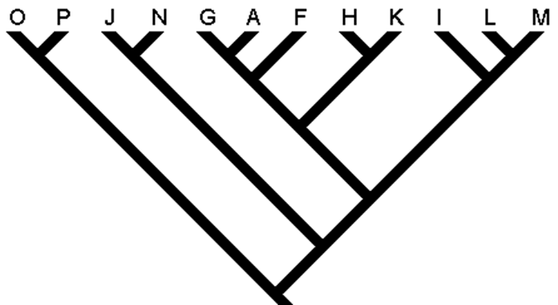
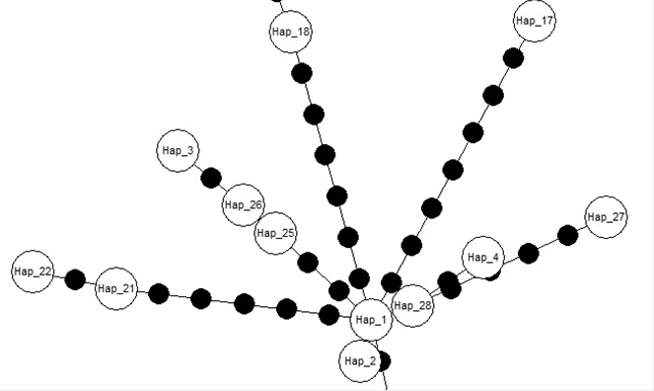
Tree vs. Network – Different assumptions for Ancestral Genotypes
Phylogenetic Tree
Haplotype Network

Slide 25

Reading Haplotype Networks
Open circles = observed haplotypes
Filled circles = unobserved, hypothetical intermediates
Distance between nodes = number of bases at which haplotypes differ

Slide 26
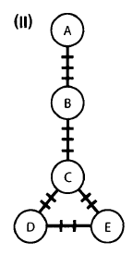
Minimum Spanning Network
Does not truly reconstruct hypothetical ancestors
Tick marks in the network to the right represent the number of bases that vary between observed nodes.
The unobserved nodes (tick marks) will not be connected to more than two other nodes

Slide 27
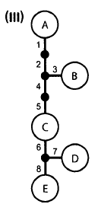
Statistical Parsimony
Calculates the probability that two haplotypes differing by a single change actually result from a single substitution.
Can result in ambiguity (such as loops) in the network.
Reconstructs hypothetical ancestors
Steiner Nodes (i.e., unobserved nodes with 3 or more connections)
TCS uses frequency data in its calculations
Do not collapse sequences into haplotypes

Slide 28
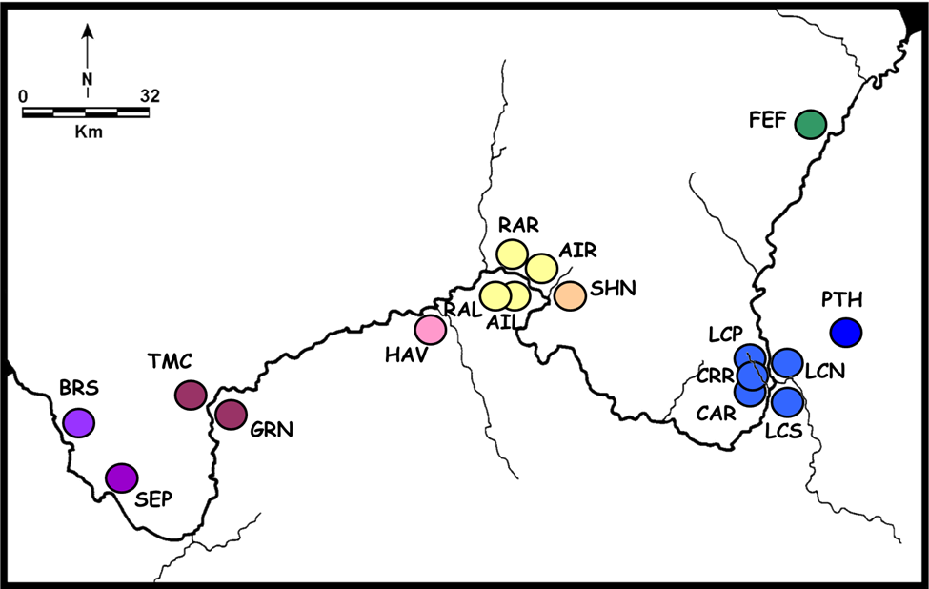
Today’s Dataset

