Slide 1
Structure
Conservation Genetics
4/9/2014 – 4/11/2014

Slide 2
Assignment Tests
Assignment test – placing individuals into populations or clusters given individual genotypes, a set of populations, and allele frequencies for those populations.
Often accomplished using Bayes’ Theorem
Can do partial assignment of an individual to multiple populations
Good for detecting:
Migrants
Gene flow
Cryptic population structure

Slide 3
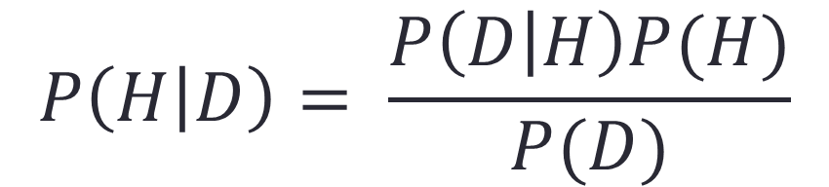
Bayes’ Theorem
“The probability of the hypothesis given the data is equal to the probability of the data given the hypothesis times the probability of the hypothesis, divided by the probability of the data.”
Likelihood
Prior probability
Posterior Probability
$$P\left(H | D\right)= \frac{P\left(D | H\right)P(H)}{P(D)}$$
Marginal Likelihood

Slide 4
How Structure Works
Tell the program there are K populations.
Randomly assign individuals to K populations.
Estimate allele frequencies for each random population based on individuals assigned to it.
Markov Chain Monte Carlo (MCMC)
Reassign individuals to populations based on allele frequencies
Estimate allele frequencies based on this reassignment
Repeat step 4 for the specified number of generations

Slide 5
Models
The most important options are selecting models of ancestry and allele frequencies
These differ from the mutation models (IAM and SMM) that we discussed last week
No equivalent to “Modeltest” for Structure
Select best models based on knowledge of your data / study system

Slide 6
Ancestry Models
Refer to population history (biogeography, historical population demographics)
Admixture = interbreeding between previously isolated populations
Admixture Model
Applicable in most cases
Can be used to find cryptic population structure, recent migrants, etc.
Often a good starting point for analyses
“Safe option”
No Admixture Model
More specialized
Only use if you know your data contains non-breeding groups that have been separated for many generations
Gives weird results if misapplied

Slide 7
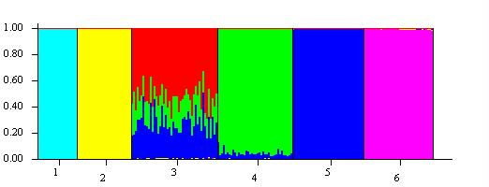
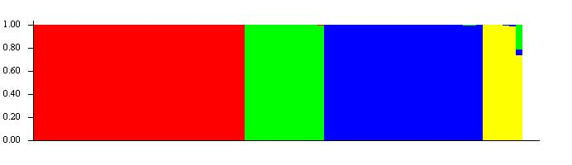
Ancestry Models
Admixture – an individual may have mixed ancestry
No Admixture – each individual is almost completely assigned to a single population

Slide 8
Ancestry Models
The admixture model estimates alpha – a parameter that describes the degree of admixture
Alpha < 1 = little admixture
Alpha > 1 = mixed ancestry
Can estimate a different alpha for each K value
Estimating more parameters makes it more difficult for chains to converge
Altering priors on alpha can improve mixing

Slide 9
Allele Frequency Model
Independent Allele Frequencies – allows allele frequencies to differ more among populations (no gene flow, deep historical population separation)
Correlated Allele Frequencies – assumes allele frequencies are similar, possibly due to gene flow or shared ancestry

Slide 10
Other Options
Can use location priors (LOCPRIOR model)
Uses sampling location, or other specification of population origin, to inform the assignment of individuals in Structure
Lots of options for adjusting priors on other parameters

Slide 11
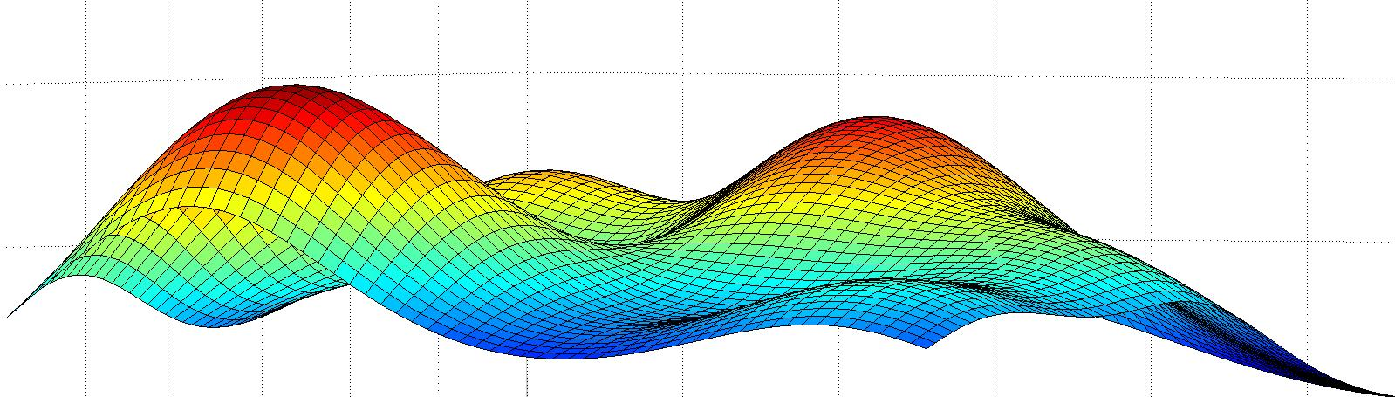
Sampling Parameter Space
Different starting points can lead to different answers
“Multimodality”
May not be able to climb the tallest “peak”
3-dimensional probability distribution surface
MCMC can potentially become stuck on local “peaks”
Structure has difficulty crossing these valleys

Slide 12
Assessing MCMC Sampling
Mixing
How efficiently is parameter space being sampled – is the chain stuck sampling the same place for long periods of time?
Convergence
Are independent runs finding the same result?

Slide 13
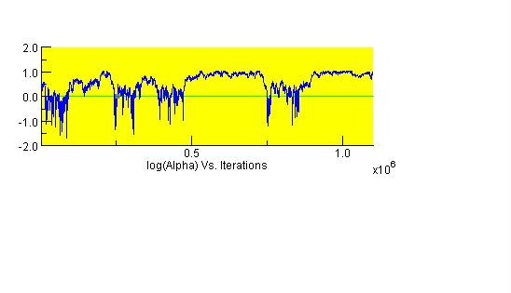
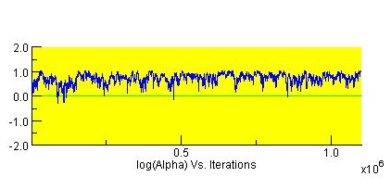
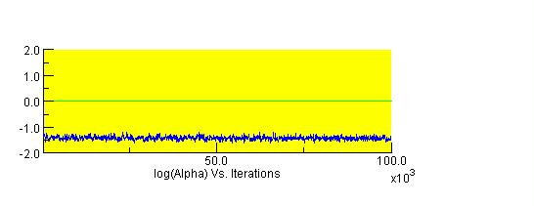
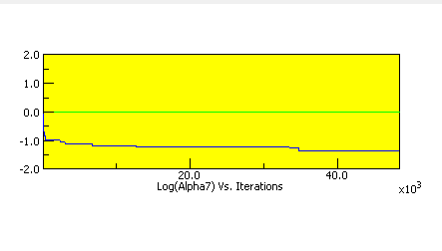
Assessing Mixing – look at trace plots of a parameter
Could be worse, but could be a lot better
Bad
Good
Bad

Slide 14
Autocorrelation
Long, straight lines in a trace indicate Autocorrelation
= similarity of samples to one another as a function of time between sampling events
Some MCMC algorithms are more prone to this than others…
It is unclear if or how Structure deals with this.
However, it does use the Metropolis-Hastings MCMC sampling algorithm which is less prone to autocorrelation
More on this next week…

Slide 15
Convergence
Difficult to “prove”
Structure does not provide a good means of assessing convergence
Ideally, independent runs will find the same answer
Program CLUMPP helps deal with this

Slide 16
Estimating K
Structure does not directly estimate K
User feeds a range of K values to the program
After Structure has run at each K, the output is analyzed to determine the best K
Sometimes the answer is unclear
Multiple methods

Slide 17
Methods for Determining K
Calculate posterior probability of each K value you test assuming a uniform distribution of K
Described in Structure manual
Plot ln(likelihood) against K
Evanno method

Slide 18
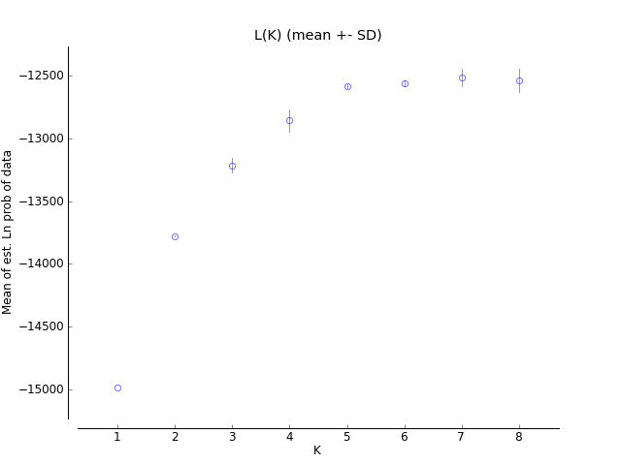
Plotting Ln Likelihood
Ln(Likelihood) on Y axis
K on X axis
Look for asymptote

Slide 19
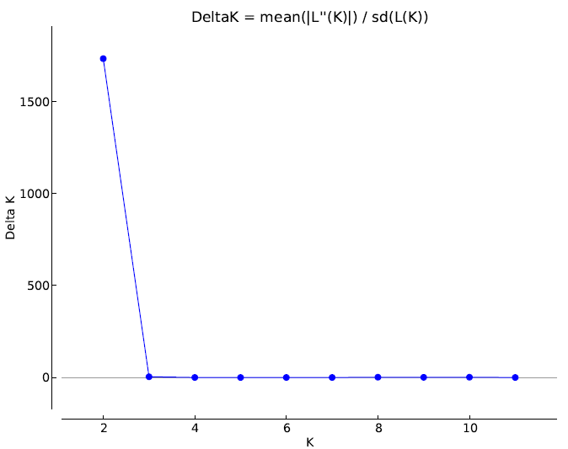
Evanno Method
Very computationally intensive
K value associated with greatest value of Delta K is the true number of populations

Slide 20
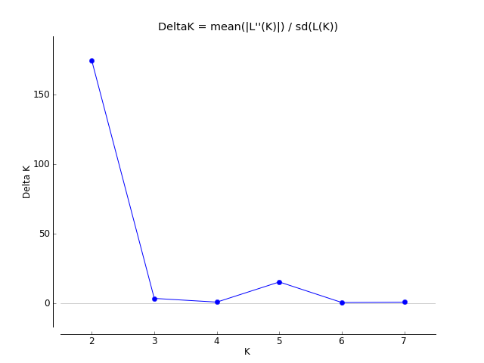
Evanno Method

Slide 21

Evanno Method
Run time for Structure increases exponentially
Structure run in parallel on 16 processor cores
21 microsatellite loci
101 individuals
Tested K = 1 through 16
20 runs at each K
Run length = 1,000,000 generations (burnin = 100,000)
K = 1 through 15 completed in approximately 12 hours.
K = 16 ran for an additional 4 hours.

Slide 22
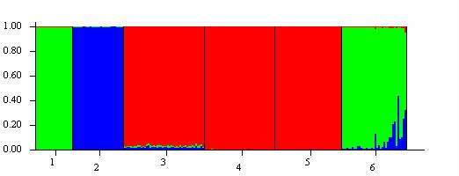
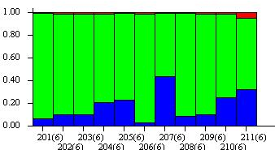
Structure Bar Plots
Bar plot contains one vertical bar for each individual
Color within the bar indicates proportion of ancestry

Slide 23
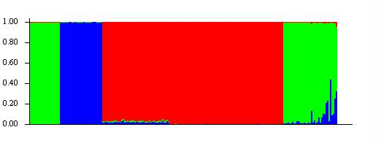
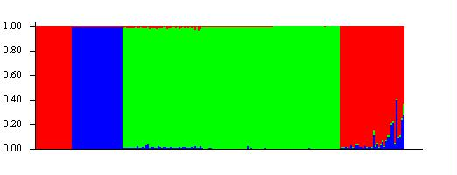
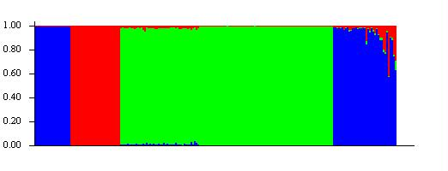
Bar Plots
Structure randomly assigns colors
All of these plots are equivalent

Slide 24
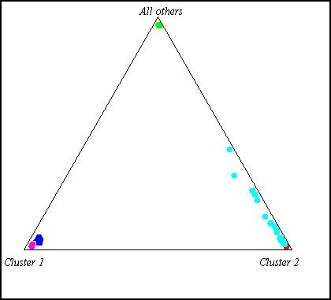
Structure Triangle Plots
Most useful when K = 3

Slide 25
Supplementary Readings
Structure has gone through revisions
Pritchard et al. 2000
Falush et al. 2003; 2007
Hubisz et al. 2009
Delta K and a review paper on population structure
Evanno et al. 2005
Waples & Gaggiotti 2006
Google Groups
http://groups.google.com/group/structure-software

Slide 26
Processing Structure Output
structureHarvester.py
http://taylor0.biology.ucla.edu/structureHarvester/
Runs Evanno method
Automatically produces some input files necessary for CLUMPP
CLUMPP
http://www.stanford.edu/group/rosenberglab/clumpp.html
Permutes output from independent runs so these runs will match as closely as possible
DISTRUCT
http://www.stanford.edu/group/rosenberglab/distructDownload.html
Provides high level of customization for graphical output of Structure results

Slide 27
Other Programs
Structurama (Huelsenbeck et al. 2011)
http://cteg.berkeley.edu/~structurama/
Pros:
Uses (mostly) the same algorithms as Structure
Can use MCMC to estimate K
Cons:
Awful Nexus-like file format is used by no other program.
GUI version only works reliably in Snow Leopard and earlier.
Difficult to choose priors if estimating K
“We offer no advice for setting the shape and scale parameters. However, the mean of the gamma distribution is shape/scale and the variance is shape/scale^2.”

Slide 28
Structure with Large Datasets
Structure 2.3.4 is inefficient when dealing with large datasets or large values of K
fastStructure
New (Dec. 2013) program for working with large SNP datasets
Python
http://rajanil.github.io/fastStructure/

