Slide 1

Lab 1: Intro to Biological Computing
BIOL 4174/5174: Conservation Genetics Lab
1/24/2018

Slide 2
Contact Info
Email: tkchafin@email.uark.edu
Office: 705 SCEN
Office Hours: By appointment

Slide 3
Lab Schedule – Sequence Data
Lab 1: Intro to Computing
Lab 2: Sequence Editing (Sequencher)
Lab 3: Sequence Alignment (Clustal, BLAST, Mesquite)
Lab 4: Phylogeography (DNASP, Arlequin, Hapstar, TCS)
Lab 5: Phylogenetics I: Maximum Parsimony (MEGA)
Lab 6: Phylogenetics II: Maximum Likelihood (jModelTest, PhyML)
Lab 7: Phylogenetics III: Bayesian Trees (MrBayes)
Lab 8: Coalescent theory and molecular clocks (BEAST)

Slide 4
Lab Schedule – Microsatellite Data
Lab 9: Genetic Diversity and distance (Genepop, GenAlEx)
Lab 10: Population structure and assignment tests (Structure)
Lab 11: Identifying recent migration (Bayesass)

Slide 5
Lab Schedule – Genomic Data
OPTIONAL FOR UNDERGRADUATES
Lab 12: Intro to next-generation sequencing
Lab 13: Assembling RADseq data (pyRAD)
Lab 14: Detecting hybridization and introgression (D-statistics)

Slide 6
Lab Policies
SCEN 606 computer lab
Account: ConsGen
Password: Sanger#1
Password is case sensitive.
Do not give the password to anyone.
Lab door opens with a D4 Set 6 key
Room (606) schedule available Biology Department Office
Extra work time available by appointment with TKC as needed

Slide 7
Lab Policies
These are shared computers, so…
Do not delete or modify any files you did not create.
Do not install / remove any programs unless I instruct you to do so
Make backups of your files (e.g. portable flash drive)
Be careful with food and drink
Bringing snacks, etc OK

Slide 8
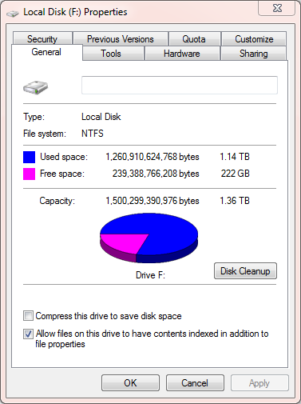
External Drive Formatting
NTFS Format
OS X can read these drives
OS X cannot write to these drives
Reformat as FAT32 or exFAT if you want to maintain compatibility with both Mac and Windows
Linux can read/write NTFS or FAT32

Slide 9
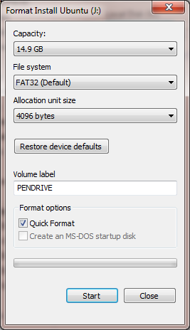
External Drive Formatting
Back up files
In “My Computer”
Right-click your flash drive
Select “format…”
Set the File System to FAT32
Notes:
Windows will not format a drive larger than 32GB as FAT32
FAT32 does not support files larger than 4GB

Slide 10
Today’s class

Slide 11
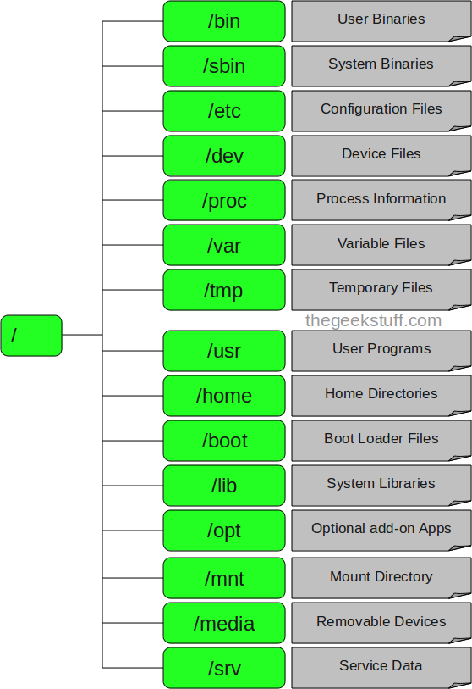
Directory Structure
Structure of the root directory of a Mac
Do not modify anything in any directory other than /Users
/Users

Slide 12
Users Directory Structure
When you open a terminal window, you will be in your user account
/Users
This will be your home directory
Other user accounts
/ConsGen
/Desktop
/Documents
/Downloads
/local

Slide 13
Bash - Commands
Required
Helpful
pwd
mkdir
cd
cp
mv
rm
ls
tar
chmod
Exit
git
which
cat
head
tail
less
clear
man
date
history

Slide 14
Warnings and Considerations
Commands and directories are case sensitive
Desktop/ and desktop/ are two different directories
less -s and less -S are different commands
Do not copy/paste from PowerPoints, Word documents, or PDF files to the command line.
Hidden formatting issues (more on this later)
Autocorrect in Microsoft programs will change some characters

Slide 15

Major Warnings
All commands are permanent
There is no undo button
There is no recycle bin
You will rarely be prompted when overwriting or deleting files

Slide 16
Basic Command Format
command -[options] [additional arguments]
Required
Optional (usually)
If you need to specify a file or directory name, it usually goes here

Slide 17
Where am I?
Open a terminal window
Type pwd to get the full path of your current directory
Can be a useful command when you forget where you are in the directory structure.

Slide 18
Using Flags: Listing Directory Contents
Options that modify the behavior of a command
ls lists the contents of a directory
ls -l lists the contents of a directory in “long” format (provides date of last modification, file sizes, etc.)
Can use multiple options at once
ls -al lists all contents of a directory in “long” format including hidden files

Slide 19
Where do I find the flags for a command?
The man page will explain the command and its options
Some man pages are significantly better than others
Example:
man ls

Slide 20
Changing Directories
Use the cd command followed by a directory name to change into a new directory.
Use the command cd Desktop/ to move into your desktop directory
Note: All commands are case-sensitive
If you use the cd command and do not specify a directory, you will be taken back to your home directory.

Slide 21
Changing Directories: Shortcuts
Instead of specifying a whole path, there are also the following shortcuts
Shortcut | Result
cd | Changes to home directory
cd ~ | Changes to home directory
cd - | (dash) changes the current working directory to the last used working directory
cd .. | Moves UP one directory (e.g. if you are in Desktop/ConsGen18, you will move to Desktop)

Slide 22
Making Directories
Use the mkdir command to make a new directory.
In your Desktop directory, type mkdir <username> to make a new folder with the same name as your UARK user name.
You will use this same computer for all future labs, and place all of your work for the class in this folder.
Use cd to change directories into this new folder

Slide 23
Making Directories
You can make several directories at once with the mkdir command:
Example: mkdir dir1 dir2 dir3
Type ls -l to get the directory contents, and you should see all three of the directories you just created.

Slide 24
Accessing data for this class
Github is a cloud hosting service often used by programmers
Data, powerpoints, handouts, etc for this lab will be hosted in Github at:
https://github.com/tkchafin/ConsGen2018
To download the lab github repository:
git clone https://github.com/tkchafin/ConsGen2018.git
To update the repository for each lab:
git pull

Slide 25
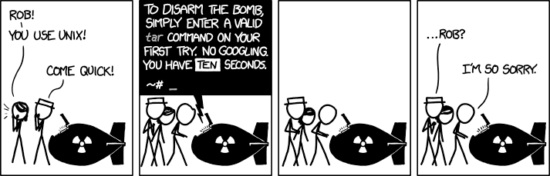
Unzipping Files
Various formats of file compression exist
A common format is the “tarball” or files ending in .tar.gz
The command tar -zxvf [file] will unzip a .tar.gz file

Slide 26
Copying Files
The command cp is used to copy files. It follows the format of:
cp [file_location] [file_destination]

Slide 27
Moving and Renaming Files
The mv command is used to both move and rename files.
Format:
mv [file] [destination]
Moving files:
Make sure you are in the example_files directory
Move the file named “move_me.txt” to the folder named “zip_me”
mv move_me1.txt zip_me/move_me1.txt
You could also accomplish this with the following:
mv move_me2.txt zip_me/.
Or, you could cd into the zip_me directory, and do any of the following:
mv ~/Desktop/<username>/lab_1/example_files/move_me3.txt .
mv ../move_me4.txt .

Slide 28
Renaming Files
The mv command can also be used to rename files
Format:
mv [old_name] [new_name]

Slide 29
Zipping Files
Basic format using the tar command:
tar -zcvf [output_filename] [folder]
Example:
tar -zcvf zipfile.tar.gz zip_me/

Slide 30
Deleting Files and Folders
Use the rm command to delete files
Example:
rm delete_me.txt
To delete a folder, a special flag is required
Example:
rm -r delete_me/

Slide 31
Changing User Permissions
Many programs are offered as downloadable Perl or Python scripts
You will need to be able to make these scripts executable using the chmod command.
There are many options with this command, but the following will be important to this class:
chmod u+x [filename]
Example:
chmod u+x fasta_split.pl

Slide 32
Running a Program from your Current Directory
To run a script that is in your current directory:
Scripts can be highly variable in their execution depending on what they have been written to accomplish
Very crude format example:
./[script] [options]
Example:
./fasta_split.pl r_osculus_cytb.fasta

Slide 33
Concatenating Files
There are many built-in commands useful for manipulating files and data
The cat command is one example
Format:
cat [files]
Examples:
cat DQ990297.1.fasta
cat DQ*.fasta

Slide 34
Redirecting Output
Output that prints in your terminal window is called “STDOUT” or “standard output”
You may find it useful to redirect this output to another program, or into a file.
> writes output of a command to a new file
cat DQ*.fasta > cytb.fasta
>> appends output of a command to an existing file
cat DQ*.fasta >> cytb.fasta
| pipes output into another program
cat DQ*.fasta | less -S

Slide 35
Helpful Shortcuts and Commands
You can autocomplete directory names and file names by pressing the tab key
Use the up and down arrows to cycle through past commands rather than retyping them
You can kill a program running in your terminal window by pressing Ctrl and C simultaneously

Slide 36
Running previous commands
Typing history will generate a list of previously used commands
The left-most column of the output is a series of numbers
Typing ![number] will run the command associated with [number]
Example:
!998 will run the 998th command in your history

Slide 37
Other Commands
which [program] will tell you if a program is installed, as well as its location on your computer.
Example: which phyml
head [filename] will print the first ten lines of a text file to your terminal
Example: head r_osculus_cytb.fasta
less [filename] will print the entire contents of a file to your screen
Example: less r_osculus_cytb.fasta
clear will clean up your terminal window
date will print the current date and time to your screen

Slide 38
Ending a terminal session
Type exit at the command prompt when you are done with a session.
Not typing exit is similar to unplugging your computer when you are finished using it.

Slide 39
File Naming Practices
Don’t use spaces.
Use underscores, dashes, periods, etc. instead
Reminder: file and folder names are case-sensitive

Slide 40
Text Editors
Use a full-featured text editor
Examples of better text editors:
Notepad++ (Windows): http://notepad-plus-plus.org/
TextWrangler (Mac): http://www.barebones.com/products/textwrangler/
SciTE (Windows and Linux): http://www.scintilla.org/SciTE.html

Slide 41
Text Files
Most data files will be simple text files.
Never use MS Word documents or any other kind of rich text format to store data
These files contain hidden formatting that our genetics programs will not be able to interpret
Try opening “word_document.docx” in Text Wrangler

Slide 42

Line Breaks
Different operating systems use different “hidden formatting” to designate new lines in a text file
Unix cannot interpret Windows line breaks
Windows and Unix line breaks are different
Windows = CRLF
Unix = LF
These abbreviations come from typewriters
“LF” = Line Feed
“CR” = Carriage Return

Slide 43
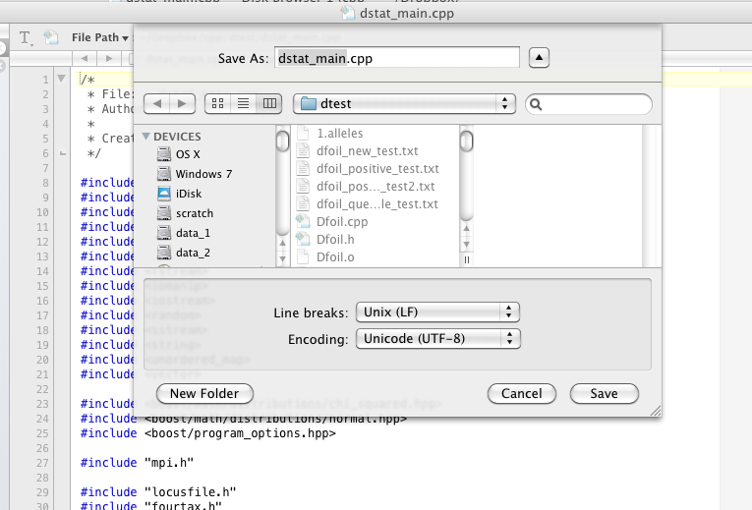
Line Breaks – Text Wrangler
Open a text file in Text Wrangler and go to:
File → Save as…
to view or change the type of line breaks in a file

Slide 44
If you have trouble completing a lab…
Do not wait until the last minute.
Email me.
Set up a time to meet with me.

Slide 45
Assignment
Lab 1 Assignment:
Spend the next 10 minutes using the terminal window and exploring the commands in this PowerPoint
When finished, export your history using the following command, where username is replaced with your UARK username
history > username_hist.txt
Submit your history to the SafeAssign link in the Lab 1 folder on Blackboard

