Slide 1
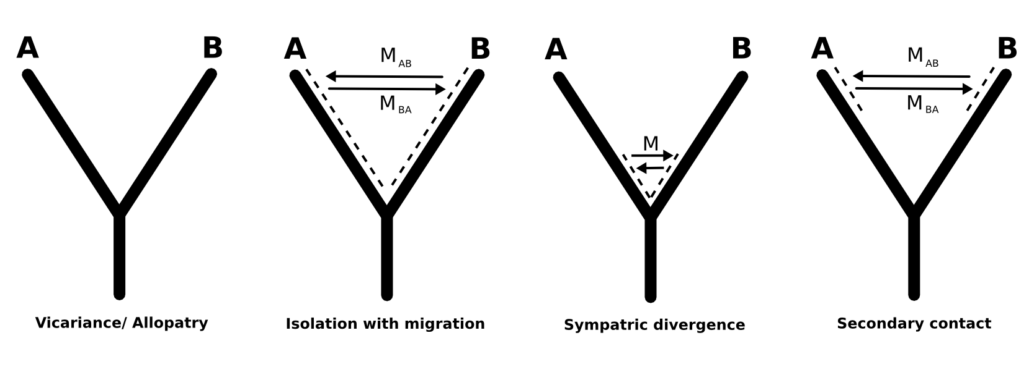
Testing alternative demographic histories using multi-locus coalescent time estimations
Tyler K. Chafin
CSCE 5013
Notes:
Project: To use coalescent times across multiple loci to try to diagnose alternative demographic scenarios. Or basically what I'm trying to do is find a phylogenetic signal of what was going on while species, or populations, have been diverging throughout history. Were they geographically discrete, with no genetic exchange? Was there gene flow throughout their divergence? Or is it more likely that they were isolated for some time, and then hybridized upon secondary contact?

Slide 2
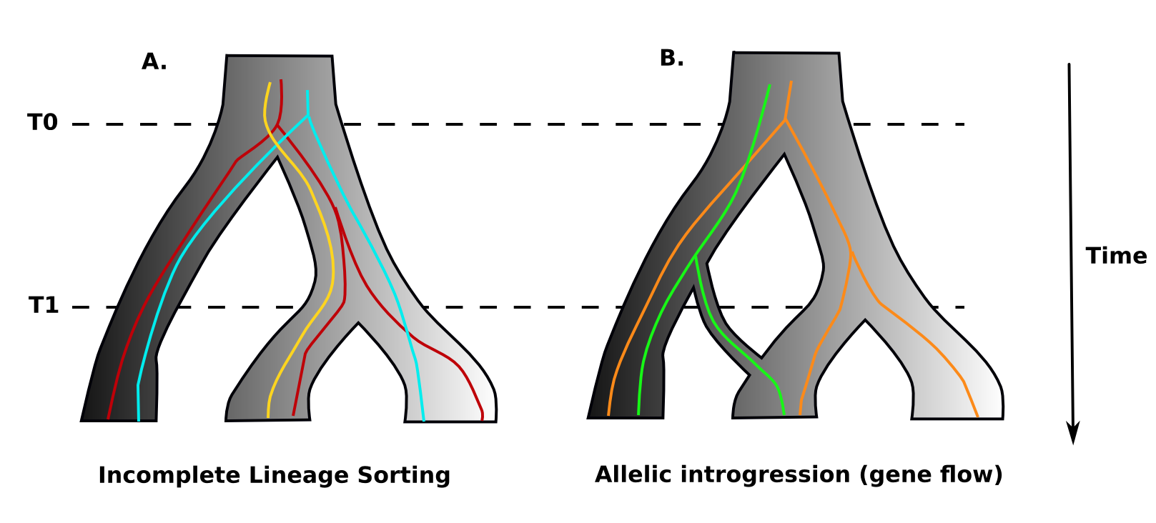
Gene tree discordance
Gene flow (one of many) causes of conflicting gene trees
How to distinguish this discordant signal from that expected by chance?
1 2 3 1 2 3
Notes:
To do this, I am looking at the species relationships inferred from many different gene trees. Essentially, like you've sampled many parts of the genome, and see what they tell you about how the groups you've sampled are related... When we do this, we expect to see plenty of discordance in these various gene trees- meaning we expect them to yield conflicting relationships. This could be caused by random chance, like in this first tree where this ancestral variation happens to sort out in these derivative lineages in such a way that some of them- if looked at alone- would yield erroneous relationships. This is called incomplete lineage sorting. Another source of gene tree discordance is hybridization, or gene flow between lineages, which would have the effect of homogenizing them. The problem, then, is that in real life we don't know this history, so how can we distinguish gene flow from ILS? And even beyond, can we distinguish different types and times of the introgression?

Slide 3
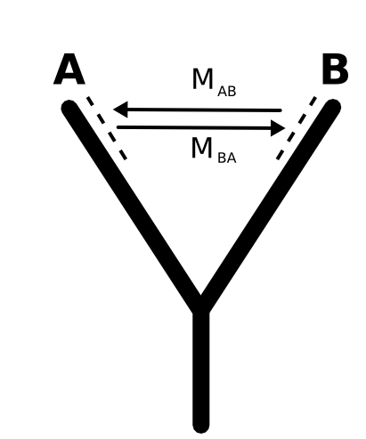
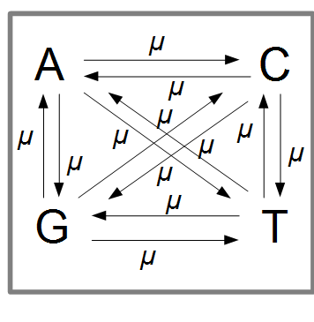
Simulating neutral evolution...
c++ and MPI vs perl... No contest. >100X speed-up
Markov chain (memoryless) permutation of allele frequencies along fixed 3-taxon tree
Monte Carlo simulation of pseudo-sampling (Kimura 1980)
Mutation according to Jukes-Cantor substitution model
Notes:
But, in order to see if I can diagnose alternative demographic histories, I need to be able to impose those different histories. To do this, I simulate sequence evolution, making a lot of assumptions to simplify things:
-No selection; evolution is purely neutral
-Random mating (allele frequencies permuted by Kimura 1980 method)
-No bias in different types of mutation rates - Jukes Cantor, random and back-mutations are possible
And when I run the program, I can build the particular demographic model by feeding paramters to the program.

Slide 4
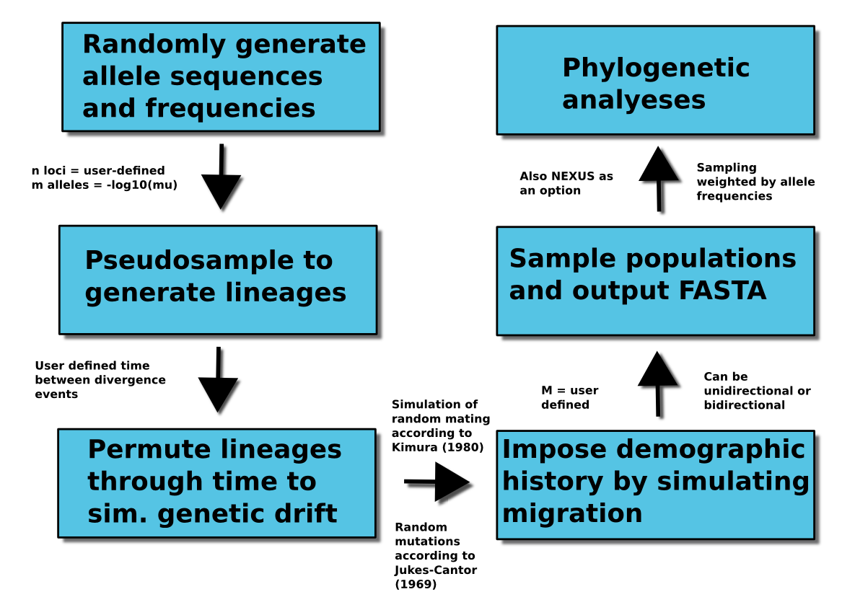
Simulation workflow
Notes:
4

Slide 5
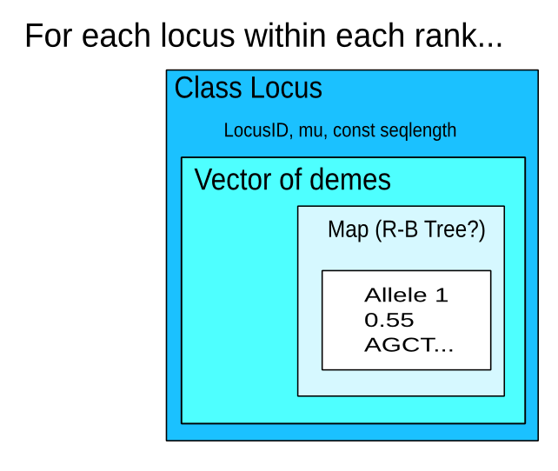
Data structure

Slide 6
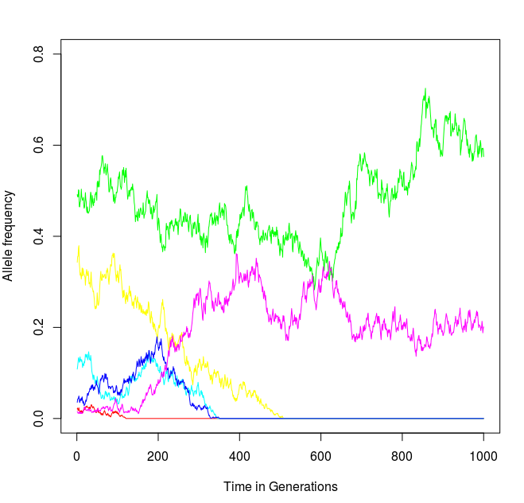
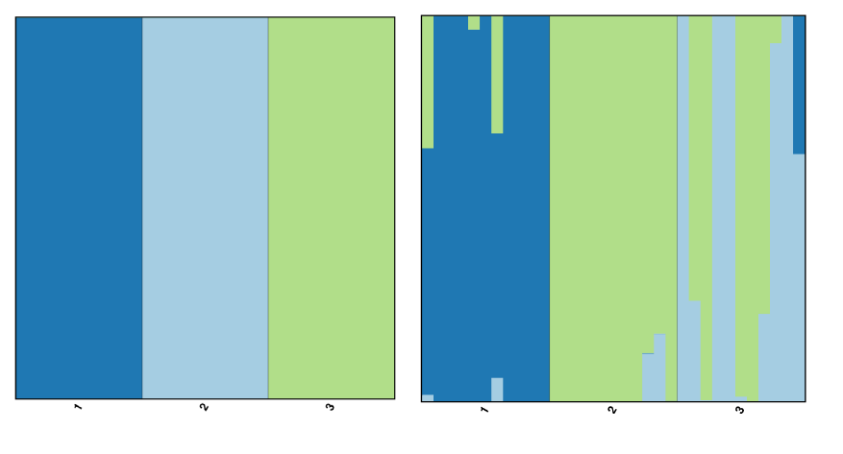
Simulation validation
Notes:
Top: Shows genetic drift... Bottom: Bayesian assignment test on 3 simulated populations under no migration, and high secondary migration
5

Slide 7
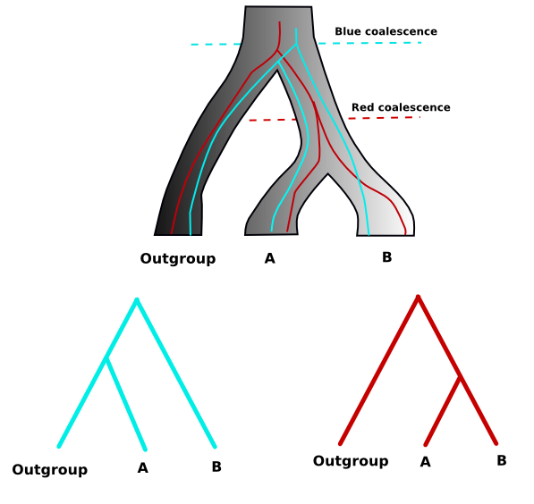
Coalescence
Coalescence: “Time to most recent common ancestor”
Build maximum-likelihood gene trees using RaxML
Infer average time to coalescence using ape R library
Coalescence of A and B
Notes:
Then, for the sequences my program produces, I use a maximum likelihood approach to phylogeny inference. Then, given those various independent gene genealogies, I estimate the time to coalescence pairwise between my populations of interest. So if you look at the figure, you can see that not only do the “red” and “blue” genes yield discordant phylogenies, they yield very different coalescent times for taxon A and B, with blue having a much deeper coalescence time.

Slide 8
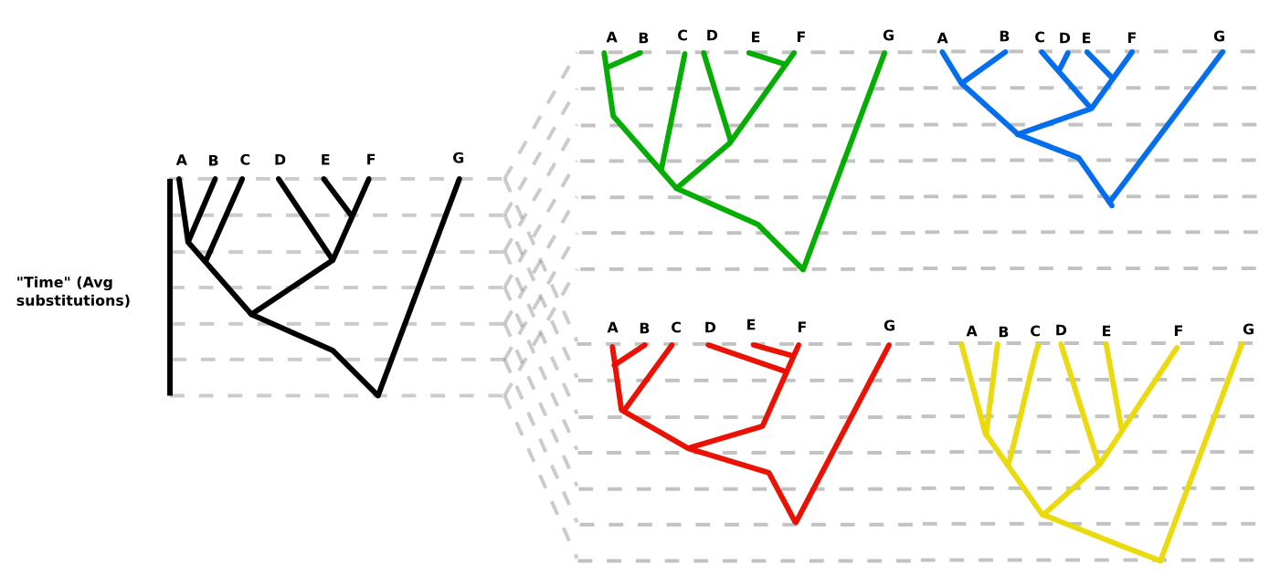
Distribution of coalescence times
Species tree Gene trees
Notes:
And the coalescence times that are estimated from all different loci will be different, due to differing rates of evolution, and also the fact that demographic processes like gene flow will have heterogenous affects across the genome...

Slide 9
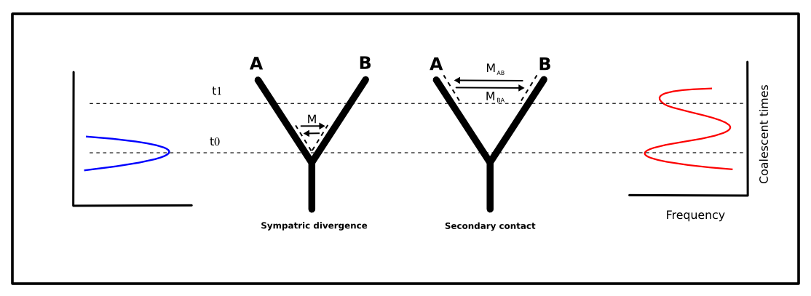
Demographic history should shape this distribution
Problem is picking up the signal vs the noise.
Notes:
And in theory, what we expect to see is a greater number of shallow coalescent times in a case of secondary contact, as opposed to a model of either no migration, or migration during early divergence.
And to an extent, this is what we actually see…

Slide 10
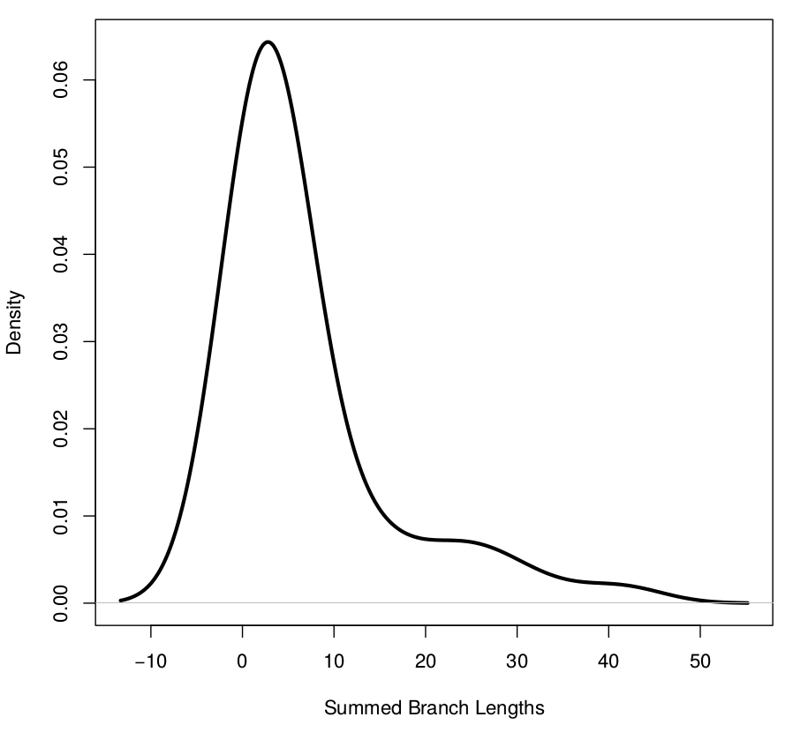
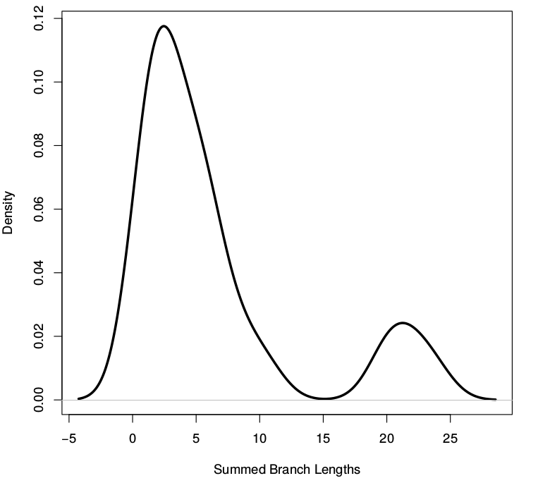
Results: Distinguishing demographic models?
Parapatric divergence Secondary contact
Notes:
All I have so far is a qualitative analysis, but you can see here the distribution of avg. pairwise genetic distances- measured in observed nucleotide differences between them- for individuals sampled from my diverging populations. They are analogous to coalescent times. And here – again qualitatively – we can see somewhat of a difference between a model of parapatry vs one of secondary contact, in that in the secondary contact model we see overall a much higher proportion of loci with very low divergences, and a smaller number of highly divergent loci. This is sort of what we expected to see- BUT-

Slide 11
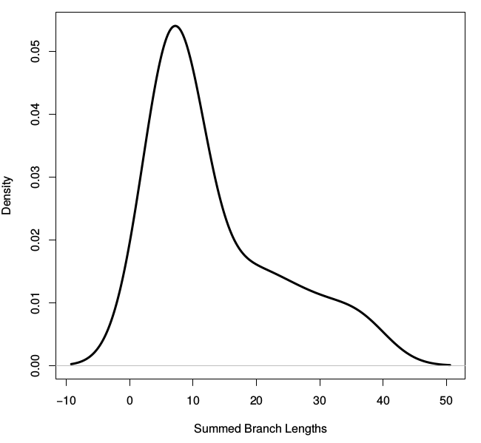
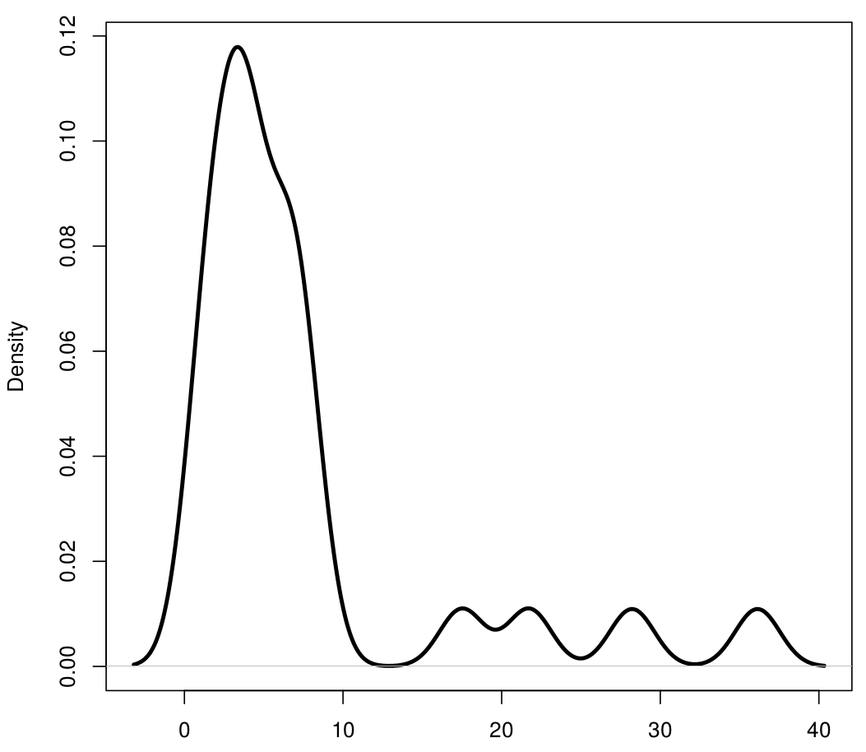
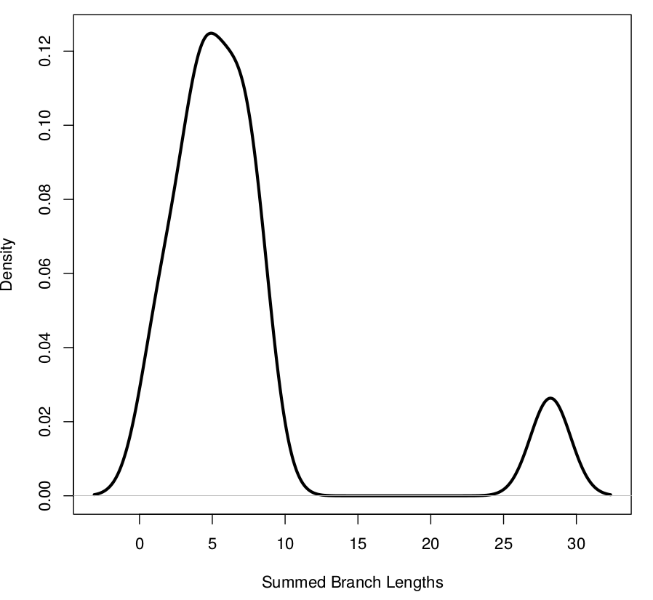
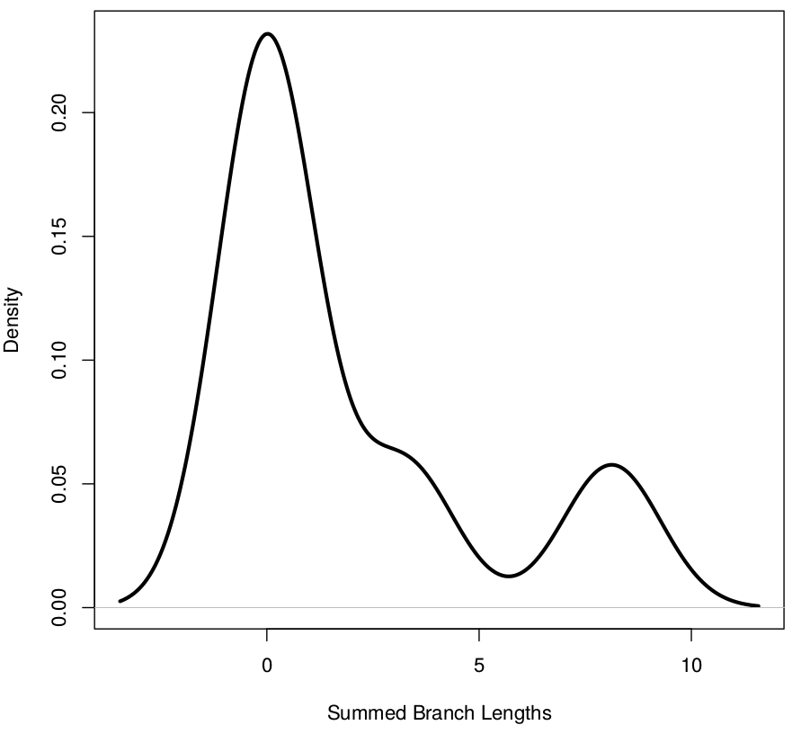
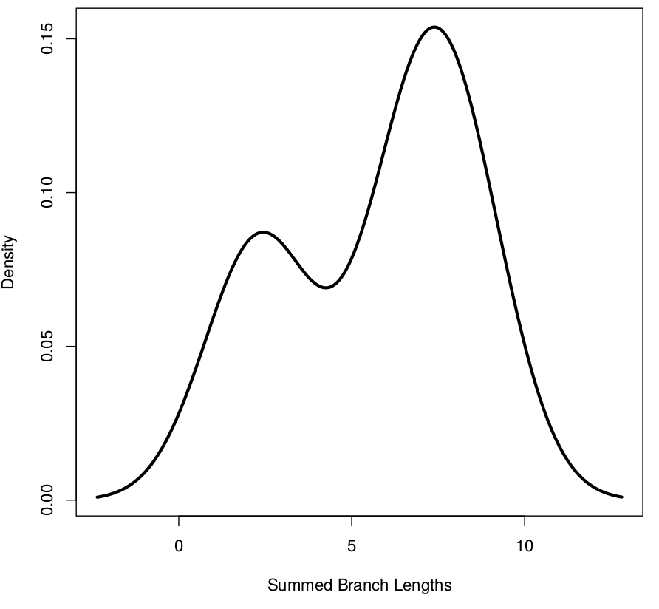
Oh no! Rate heterogeneity can cause similar pattern!
Low(er) rate heterogeneity (M=0) High rate heterogeneity (M=0)
Notes:
...What I forgot to account for was the fact that the exact same distribution- and really ANY sort of shape to this distribution- could be entirely shaped by the evolutionary rates of the loci you happen to sample. So we could get a trend indicative of different demographic scenarios entirely by chance. So here I greatly increased the range of mutation rates I sampled, increasing the probability of sampling a high rate locus... And here are several different distributions that might otherwise look like they imply an interesting demographic history, but unfortunately do not.

Slide 12
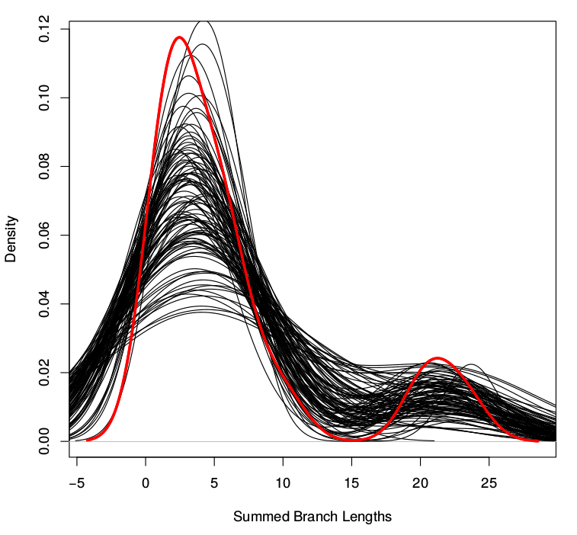
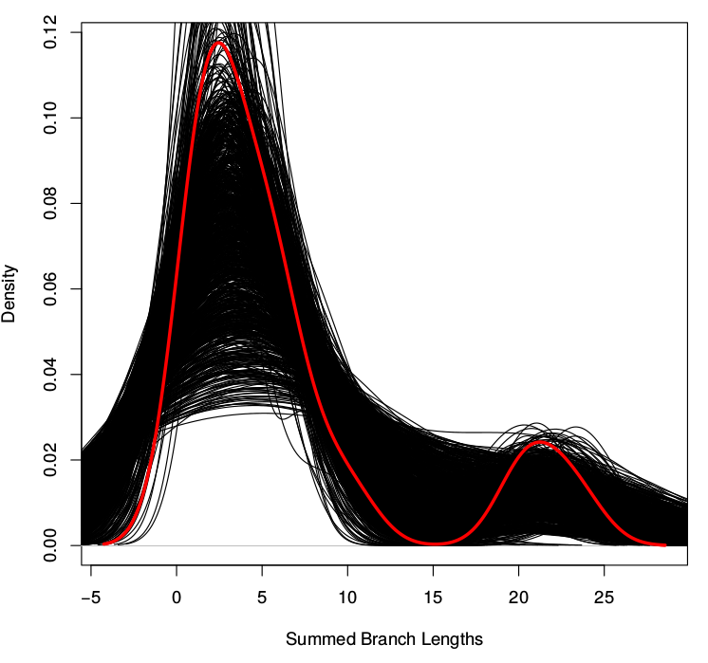
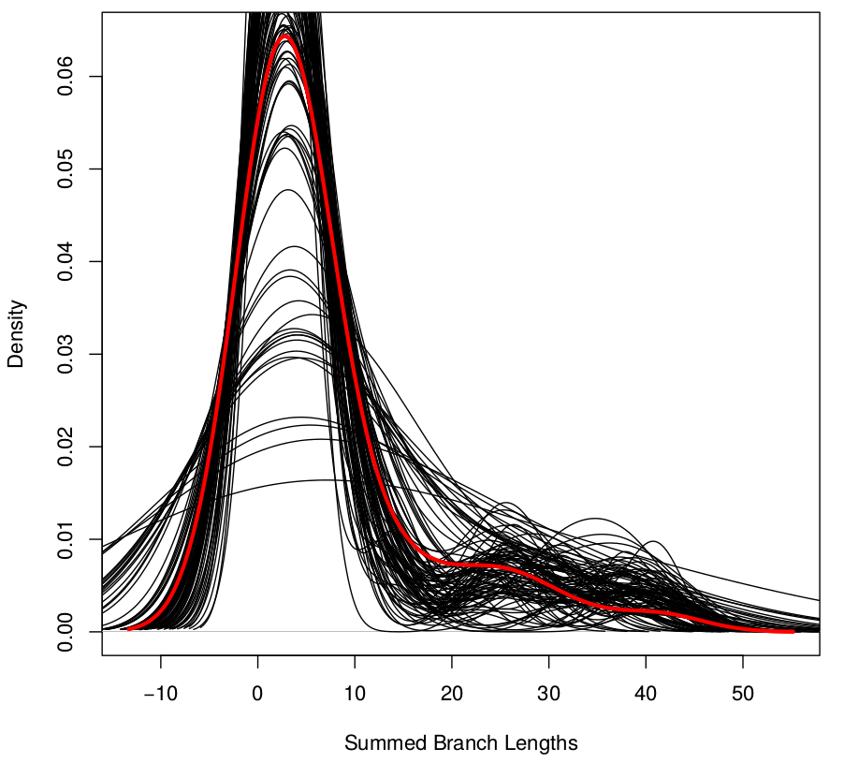
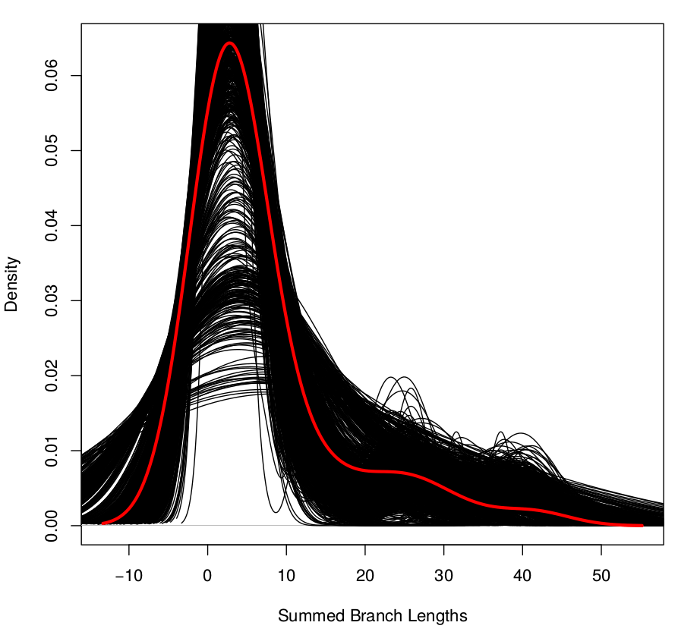
Bootstrapping
Pseudoreps = 100 Pseudoreps = 1000
Secondary contact
Parapatric divergence

Slide 13
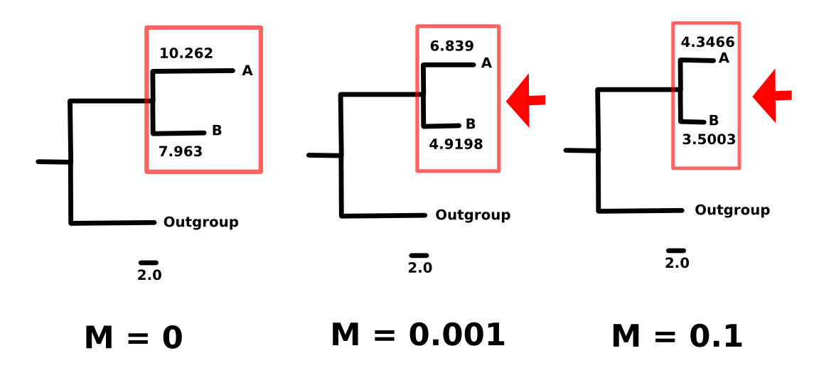
General trends
Gene flow following isolation causes species tree compression
Also, greater bimodality in coalescent time distribution, but can it be distinguished from random chance?
Notes:
No the short answer to the question my project was trying to address... is NO. However it did reinforce some interesting trends about the impact of different demographies during divergence on the estimation of species trees... For one, as one might expect, gene flow. Particularly later during divergence, tends to cause a compression in the species tree- indicating a closer relationship between divergent taxa than you would infer without gene flow... Also, we can show that secondary contact does to an extent cause bimodality in the distribution of coalescent times, however this is not distinguishable from what you could get via random chance.

Slide 14
Further direction
Minimize rate heterogeneity - but removing loci biases results. In practice, methods to sample genome are biased as well.
Investigate newer methods such as approximate bayesian computation
Maybe in combination with admixture tests, D-statistics, H-indices (steal work of lab mates)
New species tree analysis methods - bayesian concordance analysis, etc

Slide 15

Questions?

Slide 16
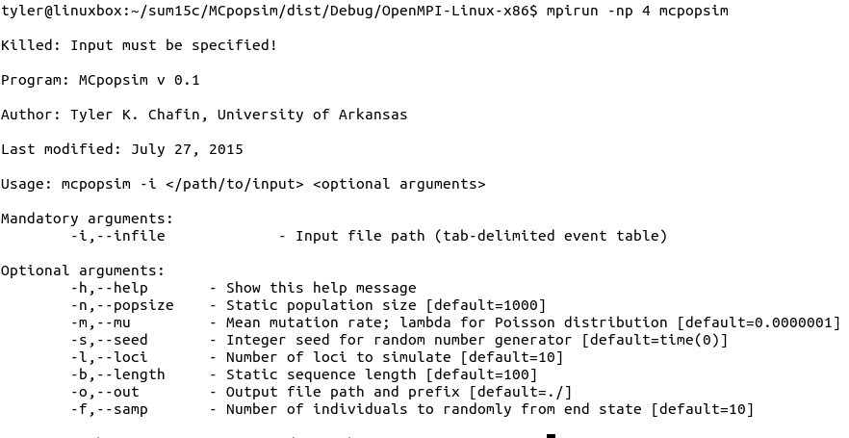

Slide 17
Improvements
Add ways for user to manipulate fixation probabilities for certain alleles- thus simulate selection
Implement more realistic mutation model (GTR)

Slide 18
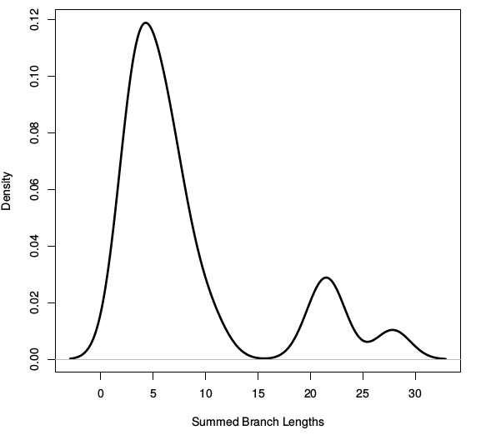

High migration swamps signal of isolation
M = .001 M = .1

