Slide 1
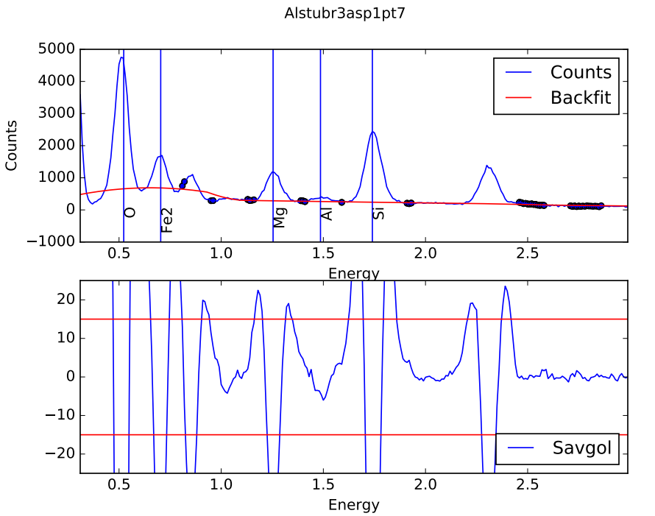
Ni-L potential problem

Slide 2
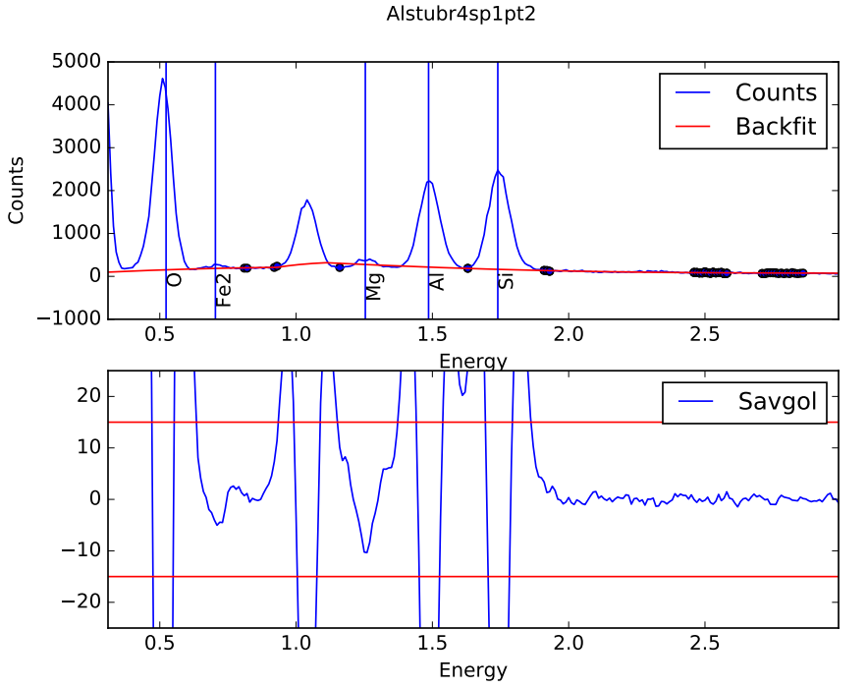
Minor problem with large Na

Slide 3
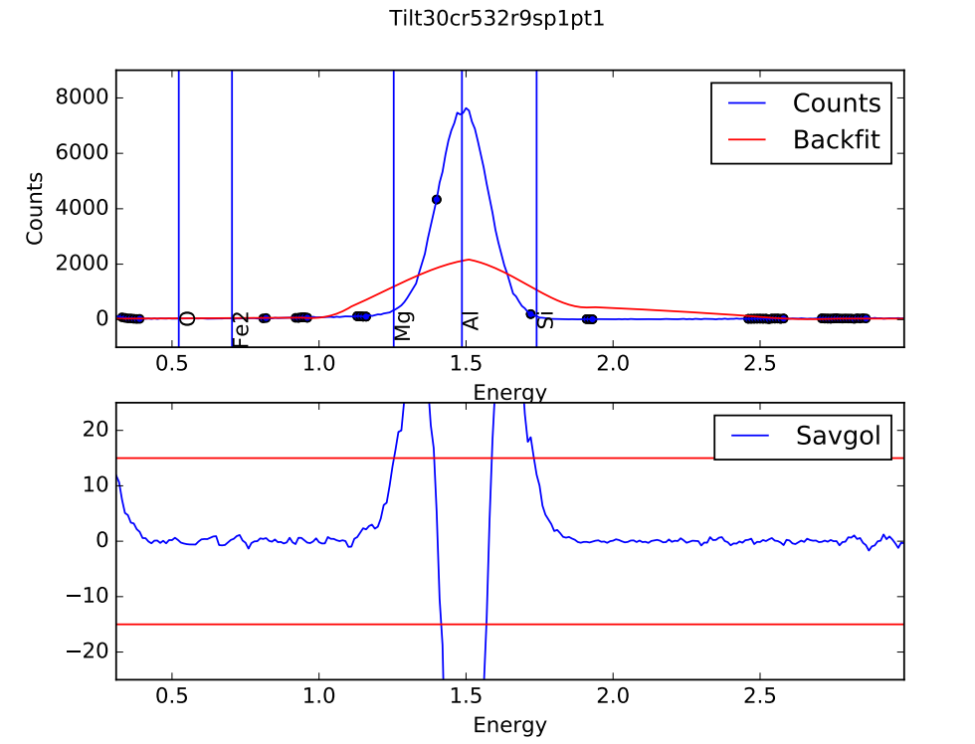
Fat Al peak problem (only w/ 2000 time const which is stupid)

