Slide 1
Joining Many Topics
with Kafka Streams

Slide 2
Tim Drahn
Principal Technologist
tim.drahn@objectpartners.com

Slide 3
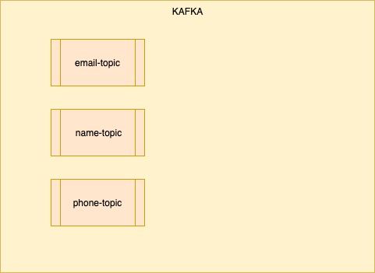
Use Case
Given 1..n topics
Each contains pieces of related data

Slide 4
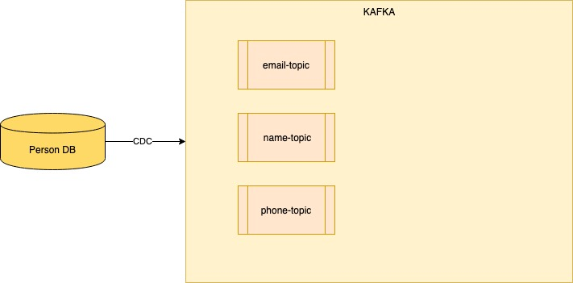
Use Case
Common in CDC solutions

Slide 5
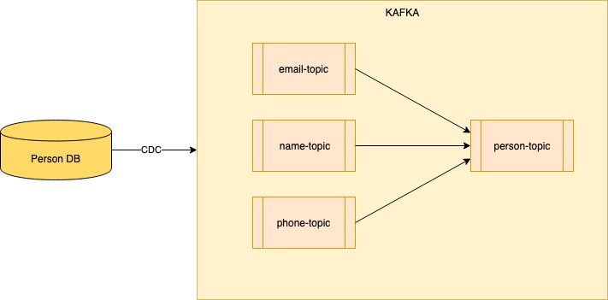
Use Case
How can we put these topics back together?

Slide 6
Schemas
Name
KEY
{
"personId":"person-1"
}
VALUE
{
"firstName":"Tim",
"lastName":"Drahn"
}

Slide 7
Schemas
Email
KEY
{
"personId":"person-1",
"emailType":"OFFICE"
}
VALUE
{
"address":"tim.drahn@objectpartners.com",
"emailType":"OFFICE"
}

Slide 8
Schemas
Phone
KEY
{
"personId":"person-1",
"phoneType":"CELL"
}
VALUE
{
"phoneNumber":"123-456-7890",
"phoneType":"CELL"
}

Slide 9
Schemas
Desired Output
KEY
{
"personId":"person-1"
}
VALUE
{
"firstName": "Tim",
"lastName": "Drahn",
"cellPhoneNumber": "123-456-7890",
"officeEmail": "tim.drahn@objectpartners.com"
}

Slide 10
What are our options?

Slide 11
Kafka Streams
Java library to operate on Kafka data
Input and output are Kafka Topics with no external dependency
KStream DSL

Slide 12
Kafka Streams
KStream-to-KTable Joins
only left-side (stream) will trigger a join
typical use case: stream enrichment

Slide 13
Kafka Streams
KStream-to-KStream Joins
both sides create an update
windowed

Slide 14
Kafka Streams
KTable-to-KTable Joins
both sides create an update
non-windowed

Slide 15
Join Limitations
2 topics at a time
Requires co-partitioning
same key
same # of partitions

Slide 16
Join Structure
Rekeying: One-to-One
KStream<PersonNameKey, PersonName> nameStream = builder.stream("name-topic");
nameStream
.selectKey((k, v) -> buildPersonKey(k.getPersonId()))
.to("name-by-person-topic");

Slide 17
Join Structure
Rekeying: One-to-Many
phoneStream
.groupBy((k, v) -> buildPersonKey(k.getPersonId()))
.aggregate(
() -> PhoneAggregate.newBuilder().build(),
(personKey, newRecord, aggregate) -> {
return addToAggregate(aggregate,newRecord);
}
)
.toStream()
.to("phone-by-person-topic");

Slide 18
Join Structure
PhoneAggregate
{
"cellNumber": "123-456-7890",
"landlineNumber": "999-888-7777"
}

Slide 19
Join Structure
Construct KTables
KTable<PersonKey, EmailAggregate> emailTable =
builder.table("email-by-person-topic");
KTable<PersonKey, PhoneAggregate> phoneTable =
builder.table("phone-by-person-topic");
KTable<PersonKey, PersonName> nameTable =
builder.table("name-by-person-topic");

Slide 20
Join Structure
Join Each One
KTable<PersonKey, EmailPhoneAggregate> emailPhoneTable =
emailTable.outerJoin(
phoneTable,
(emailAggregate, phoneAggregate) ->
EmailPhoneAggregate.newBuilder()
.setEmail(emailAggregate)
.setPhone(phoneAggregate)
.build()
);

Slide 21
Join Demo

Slide 22
That’s a Pain
Co-partitioning
requires rekeying code and topics
2 topics at a time
requires code for each join
Resources we created
{type}-by-person-topics (X partitions each)
changelog + repartition topic for each 1-to-many
local state stores for each Ktable

Slide 23
Is there a better way?
Aggregation Topic
Forget about “joins”
Rekey everything to a single topic
The key should be your “join” criteria

Slide 24
Aggregate Structure
Rekeying
emailStream
.selectKey((k, v) -> buildPersonKey(k.getPersonId()))
.to("person-aggregate-topic");
phoneStream
.selectKey((k, v) -> buildPersonKey(k.getPersonId()))
.to("person-aggregate-topic");
nameStream
.selectKey((k, v) -> buildPersonKey(k.getPersonId()))
.to("person-aggregate-topic");

Slide 25
Aggregate Structure
Aggregate
builder
.stream("person-aggregate-topic")
.groupByKey()
.aggregate(
() -> Person.newBuilder().build(),
(personKey, incomingRecord, aggregate) -> {
return addToAggregate(aggregate,newValue);
}
)
.toStream()
.to("person-topic");

Slide 26
Aggregate Structure
Type Checking
if (incomingRecord instanceof Email) {
Email newEmail = (Email) incomingRecord;
if (newEmail.getType() == EmailType.OFFICE) {
aggregate.setOfficeEmail(newEmail.getAddress());
}
if (newEmail.getType() == EmailType.HOME) {
aggregate.setHomeEmail(newEmail.getAddress());
}
}

Slide 27
Aggregation Demo

Slide 28
Improvements
co-partitioning no longer needed
fewer topics to manage
N copartitioned topics + M changelog/repartitioning topics (join method)
single aggregation topic (and a single state store)
code clarity

Slide 29
Real life adjustments
More normalized Keys
KEY
{
“emailId”:"email-ABC"
}
VALUE
{
"address":"tim.drahn@objectpartners.com",
“emailType”:"OFFICE",
“personId”: “person-1”
}

Slide 30
Questions?

