Slide 1
Practical Sandboxing on the Windows Platform
An assessment of the Internet Explorer, Adobe Reader and Google Chrome sandboxes
By Tom Keetch

Slide 2
About Me
Verizon Business
  Lead consultant for Code Review in EMEA
Previous Presentations
  OWASP AppSec EU 2011 – Practical Sandboxing with Chromium
  CONfidence 2011 - Assessing Practical Sandboxes (Updated)
  BlackHat Europe 2011 – Assessing Practical Sandboxes
  Hack.LU 2010 - Protected Mode Internet Explorer
Exploit mitigations are my favourite topic!
  How to make exploits prohibitively expensive to find and exploit…

Slide 3
Introduction
What is Practical Sandboxing?
  User-mode sandboxing methodology
  Based on Windows OS facilities
Overview of 3 implementations:
  Protected Mode Internet Explorer (limited)
  Adobe Reader X
  Chromium
This presentation is about:
  Breaking out of such Sandboxes with the minimum required effort.

Slide 4
Agenda
Sandboxes for exploit mitigation (Theory)
Overview of Practical Sandboxing Implementations (Background)
Sandboxing Flaws (Practical)
A counter-argument to Adobe’s view of their sandbox as an exploit mitigation (Argumentative)
Conclusions

Slide 5
Sandboxes for Exploit Mitigation

Slide 6
Sandboxes for exploit mitigation
Two options for exploit mitigation:
  Increase cost of exploitation (DEP, ASLR)
  Decrease target value (Sandboxes)
But a second stage exploit, can usually bypass the sandbox for finite cost...
This presentation focuses on sandbox-escape.
Please read the whitepapers for more information.
  Too much to cover in just 1 hour
  Come talk to me after!

Slide 7
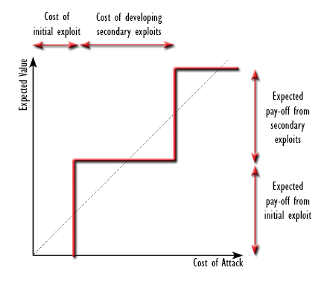
“Return-on-Exploitation”

Slide 8
Two Potential Failures
The cost of bypassing the exploit mitigation is too low to deter a potential attacker.
  Trivial to bypass?
  High Target Value?
The reduction of value of the target is not sufficient to deter a potential attacker.
  Protecting the wrong assets?
  Some assets cannot be protected by a sandbox.

Slide 9
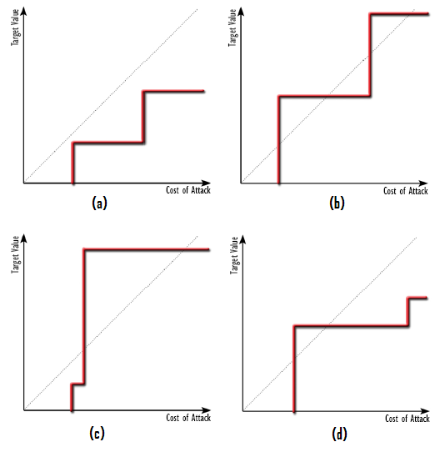

Slide 10
Looking for “cheap” exploits
This research set out to find the easiest places to find sandbox-escape exploits.
Cheap-to-find exploit types were found:
  Previously unexposed interfaces
  Easily detectable (and exploitable) conditions
  Mostly due to incomplete sandbox implementations…
  … but also sandbox-specific issues.
Also, resources not protected by sandbox:
  Network Access
  Resources protected by the Same Origin Policy
  Kernel Interfaces

Slide 11
Overview of Practical Sandbox Implementations

Slide 12
The Practical Sandboxing
Methodology
Restricted Access token
  Deny-only SIDs (Discretionary)
  Low Integrity (Mandatory)
  Privilege Stripping (Capability)
GUI Sub-System Security
  Window Station Isolation
  Desktop Isolation
Job Object Restrictions
Each mitigates against a different attack!

Slide 13
Protected Mode Internet Explorer
Internet Explorer
(Broker)
Session
WinStation
Desktop
Medium Integrity
Low Integrity
Browser Tab
(Internet Zone)
Browser Tab
(Trusted Zone,
Local Intranet Zone)

Slide 14
Protected Mode Internet Explorer
Practical Sandboxing Check-list
OS Control | Implemented?
Restricted Token
- Restricted Token | No
- Privilege Stripping | Yes
- Low Integrity | Yes
Job Object Restrictions | No
Window Station Isolation | No
Desktop Isolation | No

Slide 15
Protected Mode Internet Explorer
Sandboxing
Sandbox Limitations:
  Only supported on Vista and later, because only Integrity Levels are used.
  Only protected the Integrity of the system, not confidentiality.
  Full access to Windows station resources (including Clipboard, GAT).
Many possible sandbox escape routes including:
  UAC Launches
  Trusted Broker attacks
  Generic PMIE bypass for a domain-joined workstation.
More information previously presented at Hack.LU, Oct 2010.
  Not a Security Boundary, for many reasons.
  Lots of potential elevation routes.

Slide 16
Adobe Reader X
Adobe Reader
(Broker)
Session
Medium Integrity
(Workstation)
(Desktop)
PDF Renderer
Restricted Token
Low Integrity
Job Object

Slide 17
Adobe Reader X
Practical Sandboxing Check-list
OS Control | Implemented?
Restricted Token
- Restricted Token | Yes
- Privilege Stripping | Yes
- Low Integrity | Yes
Job Object Restrictions | Partial
Window Station Isolation | No
Desktop Isolation | No

Slide 18
Adobe Reader X Sandboxing
Makes use of Chromium sandboxing and IPC framework (BSD license)
PDF Rendering is sandboxed.
Sandbox Limitations:
  The broker does not restrict read access.
  Sandbox doesn't protect user’s clipboard
  Full Access is granted to the Global Atom Table.
  “NT Authority\RESTRICTED” SID -> BNO Namespace squatting.
No WinSta or Desktop isolation, but compensated for with Job Object restrictions.
  Read Adobe Blog posts for more information.

Slide 19
Chromium
Google Chrome
(Broker)
Session
Medium Integrity
GPU
Process
Browser Tab
Plug-in
Restricted Token
Low Integrity
Job Object
Per plug-in
sandboxing.

Slide 20
Chromium
Practical Sandboxing Check-list
OS Control | Implemented?*
Restricted Token
- Restricted Token | Yes
- Privilege Stripping | Yes
- Low Integrity | Yes
Job Object Restrictions | Yes
Window Station Isolation | Yes
Desktop Isolation | Yes
*Renderer sandbox.

Slide 21
Chromium sandboxing
A flexible framework for applying the full “practical sandboxing” methodology
Renderer is in the most restrictive possible sandbox.
3rd Party Plug-ins are often not sandboxed
  Shockwave, Java etc.
Adobe Flash has a *limited* sandbox.
GPU process is not sandboxed (planned for future release)

Slide 22

The VUPEN Exploit (I)

Slide 23
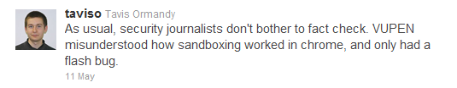
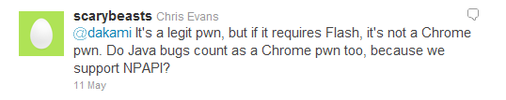
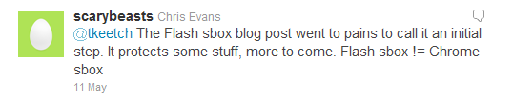
The VUPEN Exploit (II)

Slide 24
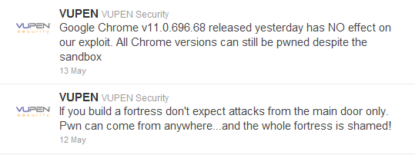
The VUPEN Exploit (III)

Slide 25
The Adobe Flash Sandbox
OS Control | Implemented?
Restricted Token
- Restricted Token | Partial
- Privilege Stripping | No
- Low Integrity | No
Job Object Restrictions | No
Window Station Isolation | No
Desktop Isolation | No
Bypass using “shatter attacks”!

Slide 26
Cheap Exploit Vectors

Slide 27
Cheap Exploit Vector #1

Slide 28
BNO Namespace Squatting
Shared sections can be created with a name in the 'Local' namespace
  Shared Sections
  Mutexes, Events, Semaphores (Synchronisation objects)
By “squatting” on named object, we can set arbitrary permissions on the object if:
  It can be created before the application
  If the application does not fail if the named object already exists.
  If we know or can predict the name of the object.
This can expose applications outside the sandbox to attacks they never knew existed…

Slide 29
BNO Namespace Squatting –
PMIE Sandbox-Escape
Terminate the Medium IL iexplore.exe process.
Predict the PID of the new process.
Create the “ie_lcie_main_<pid>” shared section.
Initialise the section with malicious data.
When iexplore.exe initialises LCIE, malicious code will execute outside of the sandbox.

Slide 30
The Fuzzer that found it...
int _tmain(int argc, _TCHAR* argv[])
{
unsigned int size = _tstoi(argv[2]);
HANDLE hSection = CreateFileMapping(NULL, NULL, PAGE_EXECUTE_READWRITE, 0, size, argv[1]);
unsigned char* lpBuff = (unsigned char*) MapViewOfFile(hSection, FILE_MAP_WRITE | FILE_MAP_READ, 0, 0, size);
// Take a copy of the initial contents of the section.
memcpy(init, lpBuff, size);
while(1)
{
memcpy(lpBuff, init, sizeof(init));
for(unsigned int i = 32; i < size; i++)
if(rand() % 1000 < 5 ) lpBuff[i] = (unsigned char) rand();
PROCESS_INFORMATION ProcInfo1 = {0};
STARTUPINFOA StartupInfo1 = {0};
CreateProcessA(NULL, "C:\\Program Files\\Internet Explorer\\iexplore.exe", NULL, NULL, FALSE, 0, NULL, NULL,&StartupInfo1, &ProcInfo1);
CloseHandle(ProcInfo1.hProcess);
CloseHandle(ProcInfo1.hThread);
Sleep(2000);
PROCESS_INFORMATION ProcInfo2 = {0};
STARTUPINFOA StartupInfo2 = {0};
CreateProcessA(NULL, "pskill iexplore.exe", NULL, NULL, FALSE, 0, NULL, NULL, &StartupInfo2, &ProcInfo2);
CloseHandle(ProcInfo2.hProcess);
CloseHandle(ProcInfo2.hThread);
Sleep(1000);
}
return 0;
}

Slide 31
MSRC’s Response
“As we are able to reproduce the crashes I have asked the Internet Explorer product team to address this issue in a next release of IE, which will most likely be IE10 rather than IE9 as that version is pretty much complete”
…
“We decided to close the case because Protected Mode IE is not presently a security boundary, thus a sandbox escaping is not considered a security vulnerability.”

Slide 32
BNO Namespace Squatting –
Other Practical Sandboxes
Exploitable from Protected Mode IE
  Low Integrity only
Exploitable from Adobe Reader X
  Process Token has “NT AUTHORITY\RESTRICTED”
  Grants access to create objects in Local BNO
Not Exploitable from Chrome Renderer sandbox
  “Naked” Process Token.
But if Microsoft won’t fix this bug until IE 10?
  How many more similar vulnerabilities are there?
  Adobe Reader and other incomplete implementations will remain vulnerable to BNO Namespace Squatting issues.

Slide 33
Cheap Exploit #2

Slide 34
NPAPI Interface Exploits
(Chromium Specific)
NPAPI was originally used to interface between the Netscape browser and an in-process plug-in.
Browser
Process
Browser Tab
NPAPI Plug-in
(DLL)
NPAPI

Slide 35
Out-of-Process NPAPI
Later NPAPI crossed process boundaries
Improved stability, no improved security.
Google Chrome
(Broker Process)
Session
Browser Tab
(Process)
Trusted
Plug-in
(Process)
NPAPI

Slide 36
NPAPI In Chrome (Today)
NPAPI now crosses a security boundary between sandboxed tabs and un-sandboxed plug-ins.
Google Chrome
(Broker Process)
Session
Browser Tab
(Process)
Trusted
Plug-in
(Process)
NPAPI
Sandbox

Slide 37
NPAPI Exploits
NPAPI Callers were previously trusted...
...Now they are not.
Flash and other plug-ins are currently not securely sandboxed.
Exploitable bugs in Adobe (and other vendors) code will allow sandbox-escape.
But these bugs were previously not vulnerabilities
→ Implicit Calling conventions?

Slide 38
A benign crash?
Thread 9 *CRASHED* ( EXCEPTION_ACCESS_VIOLATION @ 0x09ccf232 )
0x102e5c06 [NPSWF32.dll - memcpy.asm:257] memcpy
0x102e1828 [NPSWF32.dll + 0x002e1828] CBitStream::Fill(unsigned char const*, int)
0x102e0b96 [NPSWF32.dll + 0x002e0b96] mp3decFill
0x102e0892 [NPSWF32.dll + 0x002e0892] PlatformMp3Decoder::Refill(int,unsigned char*)
0x10063d21 [NPSWF32.dll + 0x00063d21] CMp3Decomp::GetDecompressedData(short*,int,int,int,int)
0x10063f62 [NPSWF32.dll + 0x00063f62] CMp3Decomp::Decompress(short *,int)
0x100ad448 [NPSWF32.dll + 0x000ad448] CoreSoundMix::BuildBuffer(int)
0x100ae2c5 [NPSWF32.dll + 0x000ae2c5] CoreSoundMix::SendBuffer(int,int)
0x10153d6b [NPSWF32.dll + 0x00153d6b] PlatformSoundMix::SoundThread()
0x10154034 [NPSWF32.dll + 0x00154034] PlatformSoundMix::SoundThreadFunc(void *)
0x7c80b728 [kernel32.dll + 0x0000b728] BaseThreadStart
Full report @ http://crash/reportdetail?reportid=b370c132fc6587f7
Google Chrome 4.0.249.70 (Official Build 36218)
This was found by accident (using Chromium)
  Fixed by Adobe!

Slide 39
Input events
Can also send key and mouse events.
  NPP_InputEvent().
Possible to bypass Flash Security Dialogs
  Enable web-cam
  Enable Microphone
Plug-ins are currently unable to distinguish between user input and simulated input from renderer.
  Hopefully this is fixed in “Pepper”.

Slide 40
Cheap Exploit #3

Slide 41
Handle Leaks
Handles which refer to privileged resources may exist in sandboxes for several reasons.
A handle can be used for any operation for which it has already been granted access.
If the right type of handle is leaked into the sandbox, it can be used for sandbox-escape.
These handles are easily detected at run-time!

Slide 42
What causes “Handle Leaks”?
Deliberately granted by broker.
Accidentally granted by broker.
Incorrectly granted by broker (policy error)
Unclosed handles from sandbox initialisation
  Before Lock-down (init. with unrestricted token)
  Internal handles kept open by libraries
  Internal handles kept open by 3rd Party Hook DLLs
  Libraries in use must be “sandbox friendly”

Slide 43
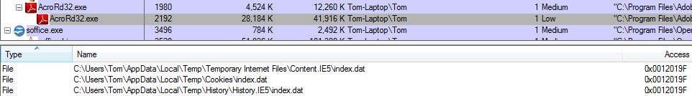
Adobe Reader X Handle Leaks
Sandboxed renderer has write access to the Medium-integrity Internet Explorer cookie store, history etc.
The ARX broker also doesn't currently restrict read access to local file system.

Slide 44
Cheap Exploit #4

Slide 45
Clipboard Attacks
In PMIE and AR-X, the clipboard is shared between the sandbox and the rest of the user's session.
Ever put your password in the clipboard?
What about attacking other applications?
Previously, the clipboard contents were normally trustworthy, now they are not.

Slide 46
Clipboard Attacks
What about...
  Pasting malicious command lines into a shell followed by a new line?
  Inputting maliciously formatted data into the clipboard?
Do application developers implicitly trust clipboard contents?

Slide 47
A counter-argument to Adobe’s
view of the sandbox

Slide 48
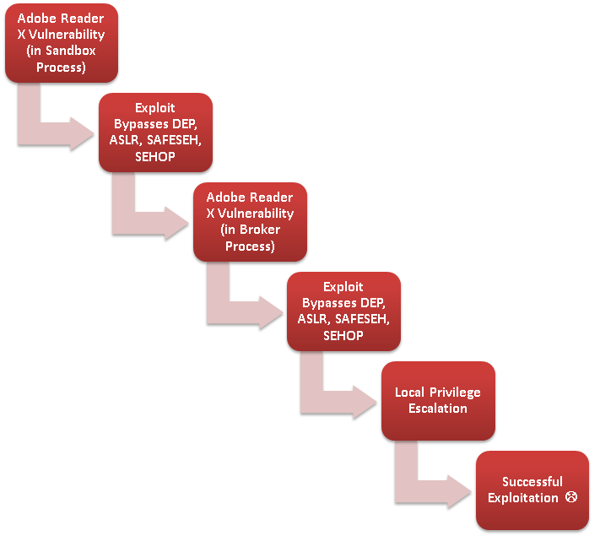

Slide 49
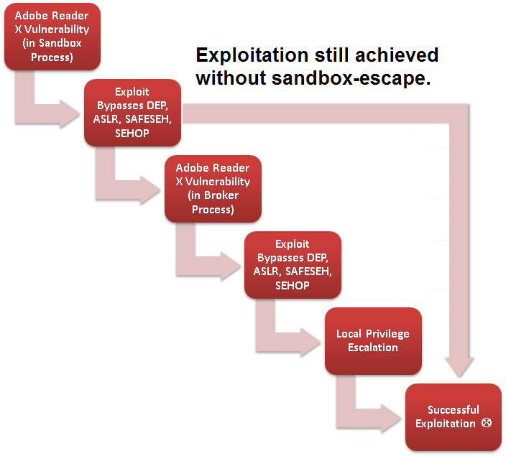

Slide 50
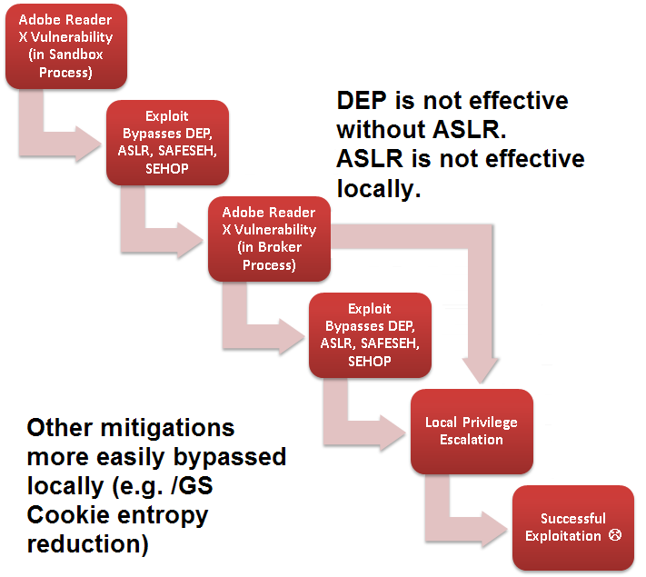

Slide 51
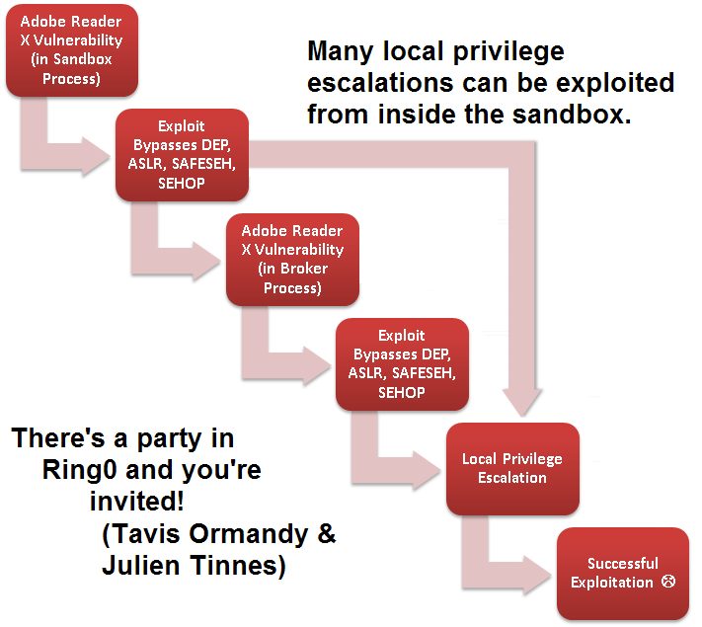

Slide 52
Conclusions

Slide 53
Conclusions
Developing sandbox escape exploits varies considerably between different implementations
Secondary (local) exploits cheaper to find and develop than the primary (remote) exploit.
Not necessarily a big disincentive for attackers.
Especially if the goal is to steal a resource available inside the sandbox!

Slide 54
Relative Security of Sandbox Implementations
Google Chrome Renderer
Adobe Reader X
Protected Mode Internet Explorer
Google Chrome Flash Plug-in
Privilege Stripping
No Sandbox
More Protection
Less Protection

Slide 55
Conclusions
Sandboxes have changed the exploitation landscape and will continue to do so
  Greater emphasis on local privilege escalation
  Desktop applications under greater scrutiny
  New attack surfaces
When forced to attackers will start to adopt sandbox-aware malware.
  Insufficient motivation to do so yet!
  PMIE sandbox escapes only started getting attention when Pwn2Own made it a requirement of “own”.
  There are now at least 4 un-patched PMIE escapes (source: Twitter).

Slide 56
Any Questions?
Twitter: @tkeetch
tom.keetch@uk.verizonbusiness.com

Slide 57
More information
My OWASP AppSec EU Slides
  http://www.owasp.org/index.php/AppSecEU2011
My Black Hat Briefings Europe 2011 Materials
  https://blackhat.com/html/bh-eu-11/bh-eu-11-archives.html#Keetch
My Protected Mode IE Whitepaper
  http://www.verizonbusiness.com/resources/whitepapers/wp_escapingmicrosoftprotectedmodeinternetexplorer_en_xg.pdf
My Hack.LU 2010 Presentation on Protected Mode IE
  http://archive.hack.lu/2010/Keetch-Escaping-from-Protected-Mode-Internet-Explorer-slides.ppt
Richard Johnson: “Adobe Reader X: A Castle Built on Sand”
  http://rjohnson.uninformed.org/Presentations/A%20Castle%20Made%20of%20Sand%20-%20final.pdf
Stephen Ridley: “Escaping the Sandbox”
  http://www.recon.cx/2010/slides/Escaping_The_Sandbox_Stephen_A_Ridley_2010.pdf
Skywing: “Getting out of Jail: Escaping Internet Explorer Protected Mode”
  http://www.uninformed.org/?v=8&a=6&t=sumry

