Slide 1
Escaping from Protected Mode Internet Explorer
Tom Keetch
Application Security Specialist
Threat & Vulnerability Management EMEA

Slide 2
Introduction
Outline
What is Protected Mode Internet Explorer?
The Design of Protected Mode Internet Explorer
Mandatory Integrity Control / Integrity Levels
Attack Patterns and Bypassing the feature
Impact on Adobe Reader, Google Chrome & Microsoft Office

Slide 3
Protected Mode Internet Explorer
Introduction
Feature introduced in Internet Explorer 7
Requires Windows Vista and later OS.
  Uses Mandatory Integrity Control
  a.k.a “Integrity Levels”
According to Microsoft, this mechanism “significantly reduces the ability of an attack [against IE] to write, alter or destroy data on the user’s machine”.
  Mitigates 0-day attacks against IE.
Based on “Practical Sandboxing” technology.

Slide 4
Protected Mode Internet Explorer
Introduction
“The idea behind Protected Mode IE is that even if an attacker somehow defeated every defense mechanism and gained control of the IE process and got it to run some arbitrary code that code would be severely limited in what it could do.”
– IEBlog (2006)

Slide 5
Protected Mode Internet Explorer
Introduction
“What's interesting about this is the fact that Firefox doesn't have the benefit of Protected Mode under Vista, which can somewhat mitigate the damage that can be done if Internet Explorer 7 is exploited by [the ANI] vulnerability.”
– ZDNet (2007)

Slide 6
“[Protected Mode is not a security Boundary]”
- Mark Russinovich
(Windows Security Boundaries)

Slide 7
What’s a “Security Boundary”?
Microsoft Terminology
A security boundary is a separation between distinct privilege levels which can enforce a security policy. Any security holes within this boundary will be patched within the monthly update cycle.
E.g. A web server cannot execute arbitrary code on the client without informed consent.

Slide 8
Protected Mode Internet Explorer
Introduction
Unclear exactly how much PMIE protects users from remote code execution attacks.
This research set out to make this clear....

Slide 9
Protected Mode Internet Explorer
When is it enabled?
UAC must be enabled
Protected Mode is a per-zone setting
Current default settings :-
IE Zone | Protected Mode?
Trusted Internet Zone | No
Local Intranet Zone* | No**
Internet Zone | Yes
Restricted Sites | Yes
Local Computer Zone | No
* Enabled by Default in domain-joined workstation
** Previously enabled by default.

Slide 10
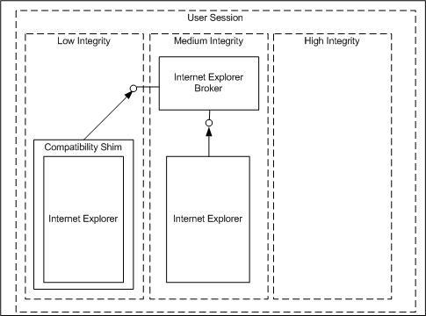
Protected Mode Internet Explorer
Design

Slide 11
Protected Mode Internet Explorer
Design
IE Processes can run at different Integrity levels
  Un-trusted tabs at Low Integrity
  Trusted tabs at Medium/High integrity.
  In IE 7, trusted and un-trusted tabs appeared in different windows.
Compatibility shim part of Low Rights IE (LRIE)
  Redirects requests for privileged operations to broker.
  Re-directs file and registry access.
Loosely-Coupled IE (LCIE) in IE8
  Trusted and un-trusted tabs in same window
Elevating Low-> Medium will bypass PMIE.

Slide 12
Protected Mode Internet Explorer
Broker Interface
Available to callers at all integrity levels in user session.
Implemented using Local Procedure Calls (LPC)
Privileged operations require either:
  User consent, OR
  To be authorised by the Elevation Policy.
Allows Low Integrity Processes to:
  Launch of new processes at Low or Medium Integrity
  Create new tabs/windows
  Save files in User folders marked Medium Integrity

Slide 13
Protected Mode Internet Explorer
Elevation Policy
\SOFTWARE\Microsoft\Internet Explorer\Low Rights\ElevationPolicy\
Value (DWORD) | Numeric Value | Example
3 | Protected Mode silently launches the broker as a medium integrity process | Winword.exe
2 | Protected Mode prompts the user for permission to launch the process. If permission is granted, the process is launched as a medium integrity process | All other processes
1 | Protected mode silently launches the broker as a low integrity process | iexplore.exe
0 | Protected mode prevents the process from launching | cmd.exe

Slide 14
Protected Mode Internet Explorer
Trusted Brokers
Auto-elevating processes are of particular interest
  Potential elevation routes
  Low -> Medium Integrity
Compare with UAC
  Medium -> High Integrity
“Trusted Brokers” used by IE and IE extensions to complete trusted operations
What about Low -> High Integrity via UAC?

Slide 15
Protected Mode Internet Explorer
UAC Elevation from Low Integrity
PMIE Elevations do not allow the current working directory (CWD) of the elevated process to be set.
Allowing this exposes DLL-Load hijacking attacks.
  DLLs are frequently loaded from the CWD.
  Possibility of tricking launched process into loading a malicious DLL.
But CWD can be set for UAC elevations.
  Such elevations are possible from Low Integrity processes.
  As the next slide shows....
  A UAC bypass will also bypass Protected Mode. (Low->High)

Slide 16
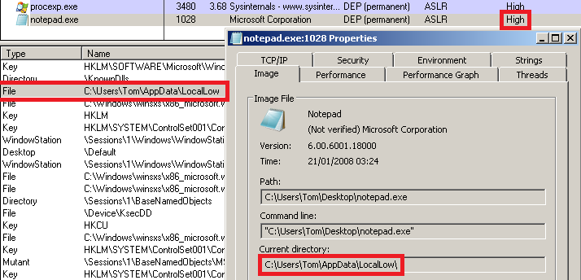
Protected Mode Internet Explorer
UAC Elevation from Low Integrity

Slide 17
Protected Mode Internet Explorer
Compatibility Shim
2 different hooking mechanisms
IE Broker Shim
  iebrshim.dll
  Redirects process launch requests to broker
Application Compatibility shims
  AcLayers.dll
  AcRedir.dll
  Redirect registry and file access to low integrity locations

Slide 18
Protected Mode Internet Explorer
Compatibility Shim
User mode hooking is implemented within the same virtual address space
  Therefore arbitrary code executing in a hooked process can ignore hooking policy.
  User mode hooking is a compatibility feature...
  Many pre-existing IE extensions can continue to work without modification.
But this shim can protect against some attacks.
  E.g. Arbitrary file read/write vulnerabilities in In-Process extensions.

Slide 19
Mandatory Access Control
Mandatory Access Control
  Under control of the operating system (mandatory)
  e.g. Mandatory Integrity Control, SE Linux.
Discretionary Access
  At the discretion of the resource owner
  e.g. Users and Groups
First Mandatory, then Discretionary access check.

Slide 20
Mandatory Integrity Control
Introduces the concept of a less-trusted process.
Integrity Level (IL) | Numeric Value | Example
Un-trusted | 0x0000h | Anonymous Sessions
Low | 0x1000h | Protected Mode IE
Medium (Default) | 0x2000h | Normal User, Un-elevated Super-Users
High | 0x3000h | Super-Users (including Admin)
System | 0x4000h | All services
Protected | 0x5000h | DRM Processes

Slide 21
Mandatory Integrity Control
Every securable object has an integrity level.
  And one or more “mandatory labels”
Policies are defined in terms of generic access rights. GENERIC_MAPPINGs define how policy applies to object specific access rights.
Label | Applied by Default to..
No Write Up | Files, Processes, Synchronisation objects, ...
No Read Up | Processes
No Execute Up | Out of Process COM servers

Slide 22
Mandatory Integrity Control winnt.h on GENERIC_MAPPINGs
#define GENERIC_READ (0x80000000L)
#define GENERIC_WRITE (0x40000000L)
#define GENERIC_EXECUTE (0x20000000L)
#define GENERIC_ALL (0x10000000L)
// Define the generic mapping array. This is used to denote the
// mapping of each generic access right to a specific access mask.
typedef struct _GENERIC_MAPPING {
ACCESS_MASK GenericRead;
ACCESS_MASK GenericWrite;
ACCESS_MASK GenericExecute;
ACCESS_MASK GenericAll;
} GENERIC_MAPPING;
typedef GENERIC_MAPPING *PGENERIC_MAPPING;

Slide 23
Mandatory Integrity Control
No Write Up
This policy gives us the feature’s informal name “Integrity Levels”
Processes are unable to modify higher integrity objects
  Including other processes
Low IL processes can only write to designated files and registry keys
  Prevent drive-by downloads from installing malware
  Maintain the integrity of the machine

Slide 24
Mandatory Integrity Control
No Read Up
Maintains confidentiality.
Applied only to processes by default.
ReadProcessMemory() and WriteProcessMemory() are denied on higher integrity processes.

Slide 25
Mandatory Integrity Control
No Execute Up
COM is “Integrity-Aware”
By default out-of-process COM objects are marked as “No Execute Up”.
Otherwise Low Integrity objects could get COM objects to perform actions on their behalf.

Slide 26
Mandatory Integrity Control
Protected Mode Internet Explorer
The browser process runs at Low Integrity
The user’s files are Medium Integrity
Files/Registry are marked No Write Up
Therefore a compromised IE process can read (and steal), but not write, alter or delete user files.
But else what can a low integrity process do?

Slide 27
Generic Mappings
Some Points of Interest
Low IL processes can:
  Enumerate and Terminate higher integrity processes
  Be notified when threads/processes terminate
  Hold (and abandon) a higher integrity mutex
There are also a couple of anomalies:
  Requesting “no-access” to a ↑IL file succeeds
  GENERIC_WRITE access to a ↑IL Mutex is allowed
Registry “Symlink attacks” are possible
  Registry Symlinks can point to higher integrity registry keys
These mappings will be useful later on...

Slide 28
Mandatory Integrity Control
Applicability to object types
All SE_KERNEL_OBJECTs are subject to MIC
  But not all objects are SE_KERNEL_OBJECTs
What’s not subject to MIC?
  Sockets
  Services
  Base Named Object (BNO) namespace
  Kernel interfaces (IOCTLs)
  Remote Procedure Calls
  ...
Also, open handles!
  Access check has already happened.

Slide 29
Sockets
Processes can bind to any port, regardless of Integrity Level
The Windows XP Firewall cannot prevent Low IL servers either.
In a Windows Vista Beta release, SMB loopback was used to bypass UAC.
  \\localhost\c$\...
  Fixed in final release.
Use loopback-bound servers to elevate privilege?
  E.g. SSDP bound to 127.0.0.1 by default.

Slide 30
Services
The Service Control Manager is not “Integrity-Aware” like the COM subsystem
But discretionary access control still applies.
  No privileged groups enabled in a Low/Medium Integrity Access Token
  Privileged groups are only enabled in the High-Integrity “Linked Token”
  This is functionality implemented by UAC
However, weak service ACLs may still be exploitable from Low IL.

Slide 31
Base Named Object Namespace
This is where securable (named) objects are created
Mandatory Integrity Control doesn’t apply here either.
  Namespace squatting attacks?
This was given as one of two main reasons why Protected Mode was not a “security boundary” by Mark Russinovich
  The other was UI overlay attacks
  Required user intervention / “social engineering”
Candidate for good PMIE bypass methods

Slide 32
Window Stations & Desktops
Both are objects of type SE_WINDOW_OBJECT
  Not SE_KERNEL_OBJECT
Also, every interactive process has handles to:
  A Winsta0 – default window station for session
  The “Default” desktop – shared with other interactive processes.
Sharing a desktop allows UI spoofing attacks
  Known limitation of PMIE.
Sharing a Window Station allows other attacks!

Slide 33
Window Stations & Desktops
Window Station Attack Surface
Another example is the Global Atom Table
  Contains strings and Integers
  Primitive form of Inter-Process Communication.
Created a dumb Atom Table fuzzer running at Low Integrity
  NULL dereference in Process Explorer (running at High Integrity)
  Internet Explorer’s UI got mangled, but no crashes.
Dynamic Data Exchange (DDE) IPC used Global Atoms
  So a smarter fuzzer might find more interesting bugs.
  Global Atoms are normally trustworthy
  So it’s likely that exploitable bugs exist in atom handling code.

Slide 34
Open Handles
What are the interesting ones?
Write-access handles that are shared with higher integrity processes
Handles that refer to higher integrity securable objects
One of the first Protected Mode IE bypasses was a handle leak
  Handle was to a medium integrity process/thread object
  Handle was closed by a low integrity process
  Discovered by SkyWing
  Published in the Uninformed.org journal – volume 8.
Wrote a tool “Shandle” to find these which uses GENERIC_MAPPINGs from before. (BSoD)

Slide 35
Kernel Object Type | Name (Kernel Space)
Directory | \KnownDlls
WindowStation | \Sessions\1\Windows\WindowStations\WinSta0
Desktop | \Default
Directory | \Sessions\1\BaseNamedObjects
Section | \Sessions\1\BaseNamedObjects\windows_shell_global_counters
Section | \BaseNamedObjects\windows_shell_global_counters
Section | \Sessions\1\BaseNamedObjects\UrlZonesSM_Tom
Mutant | \Sessions\1\BaseNamedObjects\ZonesCounterMutex
Mutant | \Sessions\1\BaseNamedObjects\ZoneAttributeCacheCounterMutex
Mutant | \Sessions\1\BaseNamedObjects\ZonesCacheCounterMutex
Mutant | \Sessions\1\BaseNamedObjects\ZonesLockedCacheCounterMutex
Mutant | \Sessions\1\BaseNamedObjects\LRIEElevationPolicyMutex
Section | \Sessions\1\BaseNamedObjects\LRIEElevationPolicy_

Slide 36
Open Handles
Do any provide elevation routes?
Already discussed :-
  \Sessions\1\Windows\WindowStations\WinSta0
  \Default
  \Sessions\1\BaseNamedObjects
We have FILE_ADD_FILE access to \KnownDlls
  Is this exploitable?
Interesting Attack Surface :-
  \Sessions\1\BaseNamedObjects\LRIEElevationPolicyMutex
  \Sessions\1\BaseNamedObjects\LRIEElevationPolicy_
IE extensions provide new options.

Slide 37
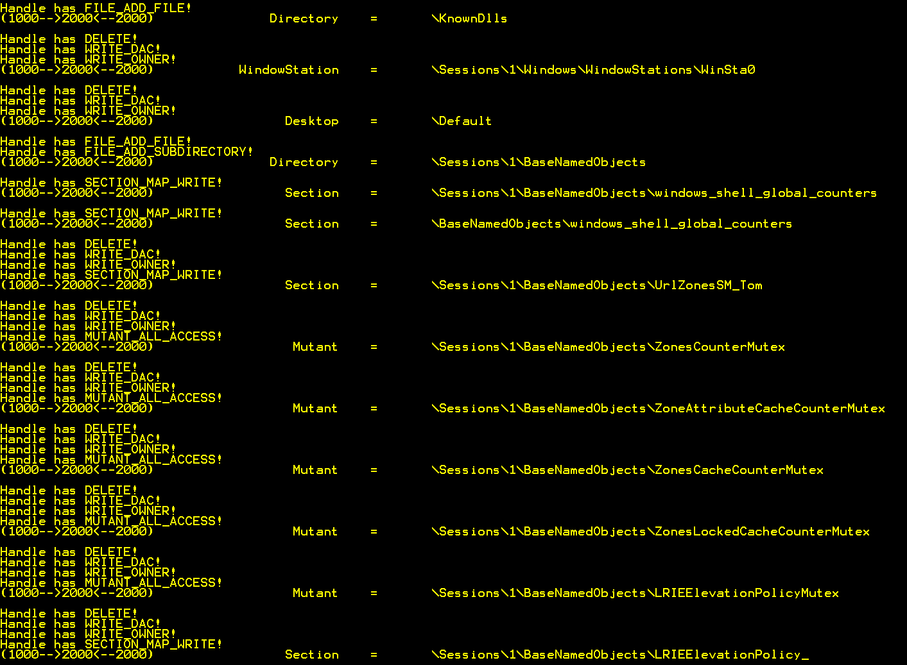

Slide 38
Other Attack Vectors...
IE Zone Elevations...
  Local
  Remote
  XSS
Via Clipboard (part of WinSta0)
File Reads
  Session Cookies written to disk?
  Files containing credentials etc.
Trusted Broker Attacks
  Malicious Command Lines to Auto-elevate brokers.
  Vulnerabilities in Low Integrity Interfaces.

Slide 39
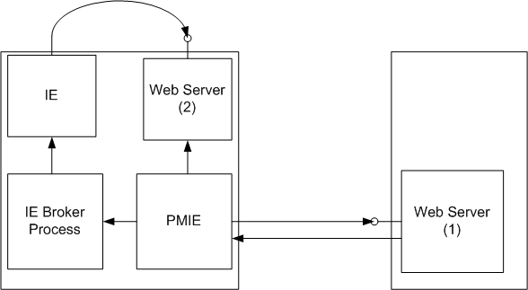
How To Escape From Protected Mode IE
The harder way

Slide 40
How To Escape From Protected Mode IE
Step By Step
1) Browser visits web server (1) on a domain joined workstation.
2) IE exploited using exploit A.
3) The payload binds a web server (2) to loopback interface.
4) The payload navigates to webpage hosted by web server(2).
5) IE Exploited using exploit A.
6) Payload has full privileges of the user!

Slide 41
The Exploit Re-Use Problem
Design Flaw
We can use the same exploit twice to bypass Protected Mode IE.
Exploits == $Money.
Exploit Mitigation Mechanisms should materially raise the cost of successful exploitation.
No estimated fix release date from MS.

Slide 42
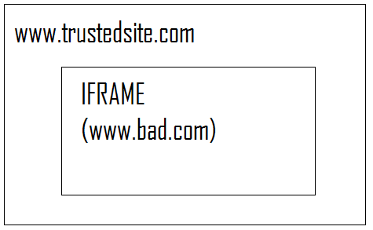
How To Escape From Protected Mode IE
The easier way
Embed malicious site in the IFRAME of a trusted site.
Protected Mode is determined by outermost frame.
Exploit payload will run at Medium Integrity.

Slide 43
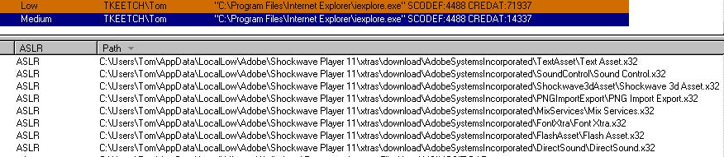
How To Escape From Protected Mode IE
The easy way
Assuming Adobe Shockwave is installed…
The design of PMIE has exposed new attack surface to applications between applications in the same session.

Slide 44
Conclusions
Protected Mode IE currently provides relatively little in terms of additional assurance against memory corruption attacks.
  Too many options for elevating Integrity Level.
  New attack surface that didn’t previously exist
Security features should clearly state what guarantees they are making
  In this case, the claims are unclear.
But ultimately should bypassing PMIE be considered a vulnerability? MS say no (It’s not a “security boundary”)
  Is it reasonable to think that Protected Mode would make you a lot safer?

Slide 45
Protected Mode
The Saga Continues...
Protected Mode Adobe Reader is due out November 2010
Protected Mode Microsoft Office is already available
Google Chrome uses Practical Sandboxing
If Microsoft are unwilling to consider PMIE a security boundary, what does this mean for other products based on similar techniques?

Slide 46
More Information
A fully referenced technical whitepaper is available from:
  http://.???
Questions/Comments/Corrections/Flames to:
  Email: tom.keetch @ uk.verizonbusiness.com
  Twitter: @tkeetch

Slide 47
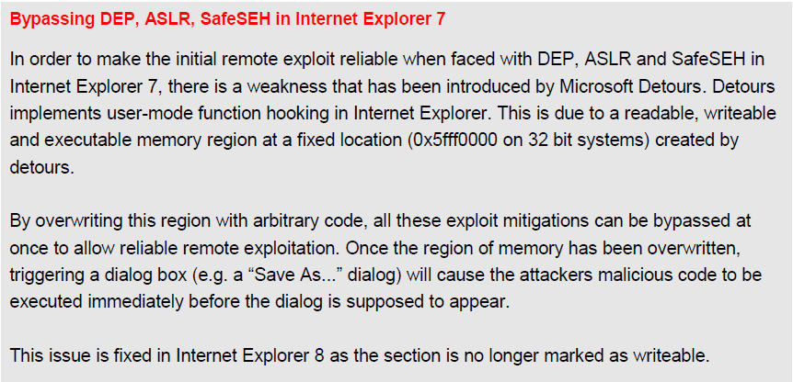
Bonus Slide

