Slide 1
Practical Sandboxing
on Windows
with Chromium
Tom Keetch

Slide 2
About Me
Verizon Business
  Lead consultant for Code Review in EMEA
Previous Presentations
  CONfidence 2011 - Assessing Practical Sandboxes (Updated)
  BlackHat Europe 2011 – Assessing Practical Sandboxes
  Hack.LU 2010 - Protected Mode Internet Explorer
All attack-orientated, this is more defence-orientated
Exploit mitigations are my favourite topic!
  How to make exploits prohibitively expensive to find and exploit…

Slide 3
Agenda
What is Practical Sandboxing?
What are the Pros and Cons?
Should an application implement practical sandboxing?
How can I implement a sandbox?
What can go wrong? (Real-world sandbox escapes)

Slide 4
Introduction

Slide 5
What is Practical Sandboxing?
Methodology - combination of techniques
Popularised by David LeBlanc and others at Microsoft
Allows User-mode only sandboxing (no kernel drivers)
Based on OS facilities
Used by:
  Protected Mode Internet Explorer (IE7+, Vista+)
  Microsoft Office Isolated Conversion Environment (MOICE, 2007)
  Adobe Reader X (2010)
  Google Chrome

Slide 6
Introduction to Practical Sandboxing
Combines many overlapping mechanisms
Restricted Tokens
Job Objects
Integrity Levels (Optional, Vista+)
Desktop / ‘Window Station’ Isolation
Brief Introduction to each of these…

Slide 7
Restricted Tokens
Any Access Token from CreateRestrictedToken()
  Primary Tokens for Processes
  Secondary Tokens for Threads
Three types of access control
  Discretionary Access Control is under the control of the resource owner
  Mandatory Access Control is enforced system-wide
  Capabilities are enforced by the subsystems that allow specific actions
Three ways in which they can be restricted
  Remove group membership SIDs – Discretionary Access Control
  Lower the Integrity Level of the Token – Mandatory Integrity Control
  Remove privileges – Capability Access Control
A “naked” token has no groups or privileges

Slide 8
Job Objects
Introduced in Windows 2000
Allows a group of processes to be managed as a unit
  Resource limitations
  Accounting
  Scheduling
  UI Restrictions
Can prevent sandboxed processes from:
  Spawning new processes
  Accessing resources associated with Desktops and Window Stations
  Interfering with the user’s visual desktop
Sandboxed processes are placed in Job Objects

Slide 9
Desktop / ‘WindowStation’ Isolation
A “Window Station” contains all the resources that applications share in a single user environment
In a multi-user environment (Terminal Services)
  Each user has their own Window Station (WinSta0)
Each Window Station can contain multiple “Desktops”
  Interactive Session WinStation has 3 desktops by default
  “Default”, “Secure” & “Screensaver”
Every app on a Desktop was in same security context
  e.g. “Shatter Attacks”, UI Hooks
Every app sharing a Window Station shared resources
  Clipboard, Global Atom Table, …
Sandboxed applications need their own Desktop & Window Station

Slide 10
Mandatory Integrity Control
Better Known as “Integrity Levels”
  First added in Windows Vista
  Introduces the concept of a “less-trusted” process
Every securable object has an integrity level including processes, but not threads
  Low – Sandboxed processes
  Medium – Default – Normal user processes
  High – Administrator processes (UAC)
  System – Services launched by the SCM
3 “Rules”
  No Write-Up (Default Rule)
  No Read-Up
  No Execute-Up
Low Integrity is an optional part of Practical Sandboxing

Slide 11
An Introduction to Handles
A Handle is an opaque reference to an securable object
  Securable objects are stored in Kernel Memory
  Reference is passed to kernel whenever the object is accessed
  Similar to a File Descriptor on Unix
Handles are scoped per-process
Access Checks are performed at open time
  Refers to a single securable kernel object
  Has a set of granted access rights
  It can only be used for operations for which rights were granted
  Once a handle is open, no further access checks are performed
It is possible to duplicate a handle
  And make it valid in another process
  This is crucial to how sandboxes are implemented

Slide 12
Sandbox Designs

Slide 13
Sandbox Design
Simplest Mode of operation
  A Single Process launched with limited privileges
  Restricts self, post-initialisation
Normal loading process requires certain privileges
Process can lock itself down if still “trustworthy”
Sandbox
Least Functional Option
  Any securable objects have to be opened pre-lockdown
  Useful for batch processing (?)
Target
(Partial/No-Trust)

Slide 14
Sandbox Design
More Functional Option allows the sandbox to communicate with a broker
Broker can be used implement very granular policies
Broker performs more privileged operations
Secure IPC required
Used by Adobe Reader X
Broker
(Full Trust)
Sandbox
Target
(Partial/No-Trust)

Slide 15
Sandbox Design
Broker can co-ordinate multiple components
Sandboxing some, but not others
Used by Protected Mode IE
Broker
(Full Trust)
Sandbox
Target
(Un-trusted)
Target
(Full trust)

Slide 16
Sandbox Design
Broker
(Full Trust)
Component
(Full Trust)
Sandbox
Sandbox
Target
(Un-trusted)
Component
(Un-trusted)
Fully compartmentalised architecture
Different sandbox for each component
Used by Google Chrome

Slide 17
Chromium Sandboxing

Slide 18
Introduction to the Chromium Sandbox
Re-usable framework
  Part of Google Chrome browser
  http://www.chromium.org/developers/design-documents/sandbox
Applies the full “Practical Sandboxing” Methodology
Used by Adobe Reader X
  BSD License
  http://code.google.com/chromium/terms.html
Does the heavy-lifting of:
  Process-lockdown
  Secure IPC.

Slide 19
Chromium Sandboxing
Token Restriction Level
Job Object Restriction Level
Integrity Level
Window Station Isolation (Y/N)
Desktop Isolation (Y/N)

Slide 20
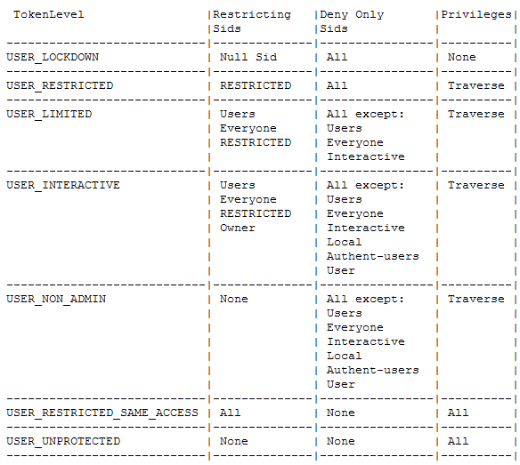
Chromium Sandboxing

Slide 21
When are Sandboxes Effective?

Slide 22
Theory of Exploit Mitigations
Two options for exploit mitigation:
1) Increase cost of exploitation
2) Decrease target value
But a second stage exploit, can usually bypass the sandbox for finite cost...

Slide 23
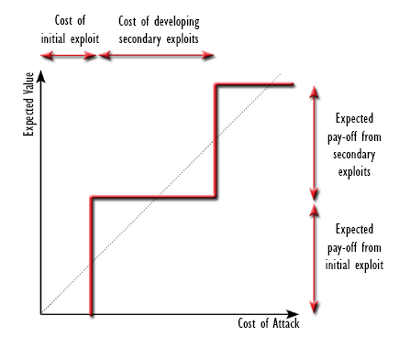
Theory of Exploit Mitigations

Slide 24
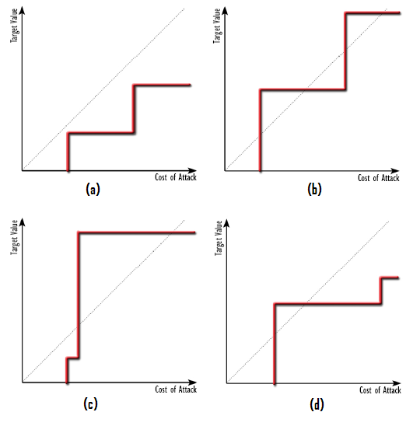
Theory of Exploit Mitigations

Slide 25
Theory of Exploit Mitigations
Two Potential Failures:
The cost of bypassing the exploit mitigation is too low to deter a potential attacker.
  Trivial to bypass?
  High Target Value?
The reduction of value of the target is not sufficient to deter a potential attacker.
  Protecting the wrong assets?
  Some assets cannot be protected by a sandbox.

Slide 26
When are Sandboxes Ineffecive?

Slide 27
Common Sandbox Flaws
Incomplete “Practical Sandbox” implementation
Un-sandboxed components
Broker vulnerabilities
Broker Policy Errors
Handle Leaks

Slide 28
Real-world problems - Example #1
Affected: Internet Explorer 7
Problem Type: Handle Leak
Details:
  Handles leaked to Low Integrity Process
  Handles referred to Medium Integrity Process and Thread objects
  Manipulation of Process or Thread allowed code injection
  Code injection into broker allows sandbox escape
Discovered by SkyWing (Uninformed.org, 2007)

Slide 29
Real-world problems - Example #2
Affected: Internet Explorer 7,
Adobe Reader X (both un-patched)
Problem Type: Incomplete Sandbox, Memory Corruption
Details:
  Local BNO Namespace Squatting
  BNO contains shared memory sections and synchronisation objects
  Creating a specific shared section allows privilege escalation
  IE bug, but exploitable from any sandbox which allows creation of named objects in BNO namespace.
Still un-patched in Internet Explorer 9!

Slide 30
Real-world problems - Example #3
Affected: Internet Explorer,
Google Chrome
Problem Type: Insecure Plug-ins
Details:
  Flash and other plug-ins not sandboxed in Chrome
  Plug-ins can opt-out of the sandbox in IE
  Internet Explorer does not sandbox sites in “more trusted zones”
Generally difficult to sandbox legacy 3rd party components

Slide 31
Other Issues
None of these sandboxes limit network access
Adobe Reader X Handle Leak through ‘Wininet’
PMIE and Adobe Reader X allow full read access to all user files
  PMIE because only Integrity Levels are used.
  AR-X through broker policy.
PMIE Bypass if Local Intranet Zone is enabled
  (e.g. on a typical corporate desktop)

Slide 32
Is a Sandbox Appropriate for your Application?

Slide 33
Should you implement a sandbox?
Questions you should ask:
  Have remote code execution exploits been developed, or are they likely to, for your application ?
  Is it high-value application?
  Will a sandbox be able to segregate key assets?
Also, questions that affect the cost:
  Is it a legacy application?
  Are the libraries it uses suitable for sandboxing?
    [D]COM is not suitable.
    WinInet may not be suitable.
    I don’t have hard data on which libraries are not suitable…

Slide 34
Should you implement a sandbox?
Have you implemented…
  ‘banned.h’?
  /GS Stack Cookies?
  ASLR-compatible binaries?
  SafeSEH-compatible binaries?
  Removal of all RWX shared-sections?
  EMET compatibility?
  Developer security training?
  Semi-regular “fuzzing”?
  Security design reviews?
  Internal security testing?
  External security reviews?
If no to any of the above, then don’t implement a sandbox!
  You can get more “bang for your buck” elsewhere…

Slide 35
Roadmap for Implementing a sandbox
Vulnerability Prevention before Mitigation
Ensure other cheaper mitigations are implemented first
Determine the level of need
Identify High Risk Components
Allow components to interact across process boundaries
Restrict Privileges of high-risk components
Sandbox high-risk components
Validate
Iterate, you won’t get it right first time…

Slide 36
Summary & Conclusions

Slide 37

Pros and Cons of a Sandbox
Layered Defence
Minimum privilege
Componentisation improves reliability.
Only really protects against remote code execution vulnerabilities
Increased development costs
Increased maintenance costs

Slide 38
Conclusions
Sandboxing can be very expensive!
  Only effective in certain situations
  Prevention is better than cure
  Many other exploit mitigations options to consider first
Implementing minimum privilege and application compartmentalisation
  Makes sandboxing much easier
  Good engineering practise!
Not all “sandboxes” are created equal
  But a powerful exploit mitigation technique when implemented correctly
  Much easier if built in from day 0.

Slide 39
A Practical Guide to Relative Sandbox Security
Google Chrome Renderer
Adobe Reader X
Protected Mode Internet Explorer
Google Chrome Flash Plug-in
Privilege / ‘Admin Rights’ Stripping
No Sandbox
More Protection
Less Protection

Slide 40
More Conclusions
Exploitation is a market driven economy
  Supply & Demand (for exploits)
  Marginal Cost (of exploitation)
  Return on Investment (ratio of cost of exploit to value of targets)
  Barriers to Entry
Effective defence raises the cost of exploitation
  Exploit mitigations achieve this to varying degrees
  Exploit mitigations are only part of the solution
Effective exploit mitigations can be implemented for a low cost and greatly increase the difficulty of attack

Slide 41
My Soap Box
If you implement a security sandbox…
…or something that just looks like a “sandbox”.
Please be honest about it's limitations
Be clear about what it achieves
Otherwise someone will show it to be insecure and blame you!
  You can replace “sandbox” with any potential security feature

Slide 42
Any Questions?
Email: tom.keetch@uk.verizonbusiness.com
Twitter: @tkeetch

Slide 43
More information
My Black Hat Briefings Europe 2011 Materials
  https://blackhat.com/html/bh-eu-11/bh-eu-11-archives.html#Keetch
My Protected Mode IE Whitepaper
  http://www.verizonbusiness.com/resources/whitepapers/wp_escapingmicrosoftprotectedmodeinternetexplorer_en_xg.pdf
My Hack.LU 2010 Presentation on Protected Mode IE
  http://archive.hack.lu/2010/Keetch-Escaping-from-Protected-Mode-Internet-Explorer-slides.ppt
Richard Johnson: “Adobe Reader X: A Castle Built on Sand”
  http://rjohnson.uninformed.org/Presentations/A%20Castle%20Made%20of%20Sand%20-%20final.pdf
Stephen Ridley: “Escaping the Sandbox”
  http://www.recon.cx/2010/slides/Escaping_The_Sandbox_Stephen_A_Ridley_2010.pdf
Skywing: “Getting out of Jail: Escaping Internet Explorer Protected Mode”
  http://www.uninformed.org/?v=8&a=6&t=sumry

