Slide 1
Reverse Engineering Obfuscated Android Applications
Tom Keetch, IntrinSec SSA Ltd.
SteelCon – Sheffield – 4th July 2015

Slide 2
About Me
Independent Software Security Consultant in London
IntrinSec SSA Ltd.
All forms of software security consultancy
Process / SDLC
Architecture / Design Review
Code Review (white-box)
Reverse Engineering / Penetration Testing (black-box)
Interested in: reverse engineering, sandboxes/container/virtualization, low-level software, cryptographic protocols
Contact: @tkeetch, tom@intrinsec.co.uk

Slide 3
Contents
Introduction
Reverse Engineering
Android Application Runtime Environment
Android Reverse Engineering Tools
Standard Tools & Techniques
Reverse Engineering Obfuscated Applications
More advanced material
Conclusions

Slide 4
Reverse Engineering

Slide 5
Reverse Engineering
The process of decomposition an object or system to discover it’s internal operation or construction.
With software, we usually have a full description of the program in a machine readable form, but we want it in a human understandable form.
Techniques fall into two main groups:
Static Analysis
Runtime Analysis
The focus of this presentation is static analysis

Slide 6
Reverse Engineering Inputs
Compiled object code
Dynamic application behaviour
Static Resources – configuration files etc.
Associated systems e.g. server for a client
Similar applications /systems
Public Documentation / Standards
Open source code (i.e. libraries, LGPL components)
Patents
Company Structure & History
Mergers, Acquisitions, Licensing Deals
Open Source Intelligence (i.e. LinkedIn, Leaked Documents)

Slide 7
Static vs. Dynamic Analysis
Typically want to combine both approaches
Sometimes static analysis is required first to:
Remove anti-debugging functionality
Bypass root/jailbreak detection
Identify hidden functionality
Disable certificate pinning
Dynamic analysis can be faster if app is heavily obfuscated
Dependent on the app, and what you want to find out
Normally fastest way to identify attack surface

Slide 8
Reverse Engineering - Legality

Slide 9

I am not a lawyer!

Slide 10

Reverse Engineering – Legal Impediments
End User License Agreements (EULAs)
Anti-Circumvention Legislation (e.g. DMCA)
Non-Disclosure Agreements (NDAs)
Trade Secrets / Law of Confidence (UK)
Copyright
Future: Wassenar Arrangement (?!#?)
Esp. Dual-use technologies.
Computer Misuse Act (!)
More Background: http://www.computing.co.uk/ctg/analysis/2373094/trade-secrets-and-reverse-engineering-the-legal-view

Slide 11
The Android Runtimes

Slide 12





Android Applications - Platforms
?????

Slide 13
Dalvik Runtime
The original Android Runtime (Android 1.0, 2008)
An application virtual machine similar to the JVM
Just In Time compilation (JIT) of bytecode
Optimised for mobile devices
DEX (Dalvik Executable) => ODEX (Optimised DEX)
ODEX files don’t need to be portable, so optimisations can be OS/device/platform specific.

Slide 14
ART
New Android Runtime
Previewed in KitKat (Android 4.4, 2013)
Now default runtime in Lollipop (Android 5.0, 2014)
Compiles DEX files to native ELF executables at install-time
Uses Ahead Of Time (AOT) compilation
Instead of Just In Time (JIT) compilation

Slide 15
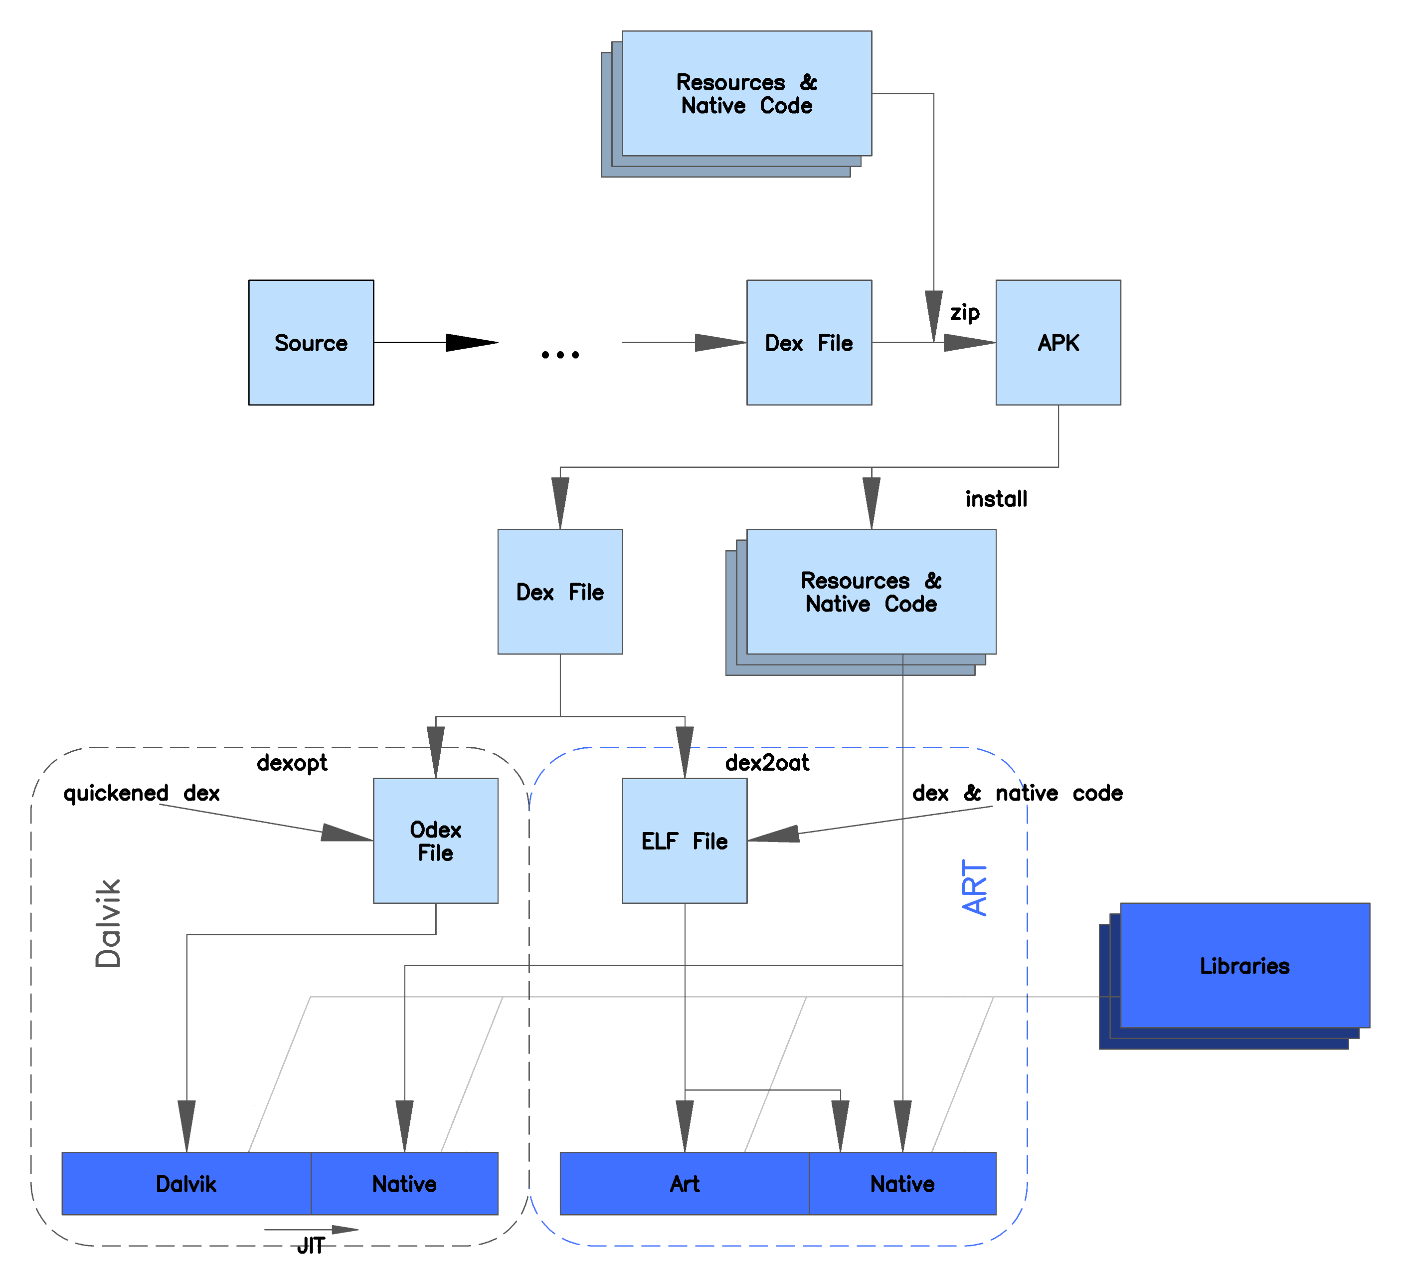
DEX files are common to both the Dalvik and ART runtimes.
Packaged in an APK
Source: https://commons.wikimedia.org/wiki/File:ART_view.png

Slide 16
Let’s Reverse an Android App!

Slide 17
First we need an APK…
Download from App Store
Web Application: http://apps.evozi.com/apk-downloader/
Firefox plugin: https://addons.mozilla.org/en-US/firefox/addon/apk-downloader/
Chrome plugin: https://chrome.google.com/webstore/detail/apk-downloader/cgihflhdpokeobcfimliamffejfnmfii
2) Copy from the device
adb shell pm list packages
adb pull “/data/apps/<package_name>.apk”
3) Download from a 3rd Party AppStore
Not always a good idea…

Slide 18
Inside the APK
An APK is just a ZIP archive, containing:
/assets/
/lib/
/META-INF/
/res/
AndroidManifest.xml
classes.dex
resources.arsc

Slide 19


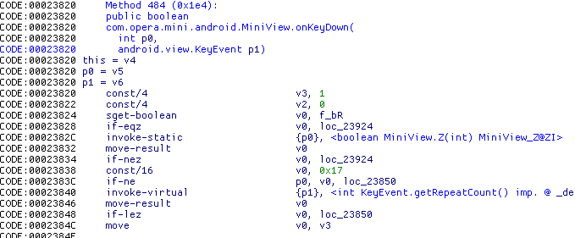
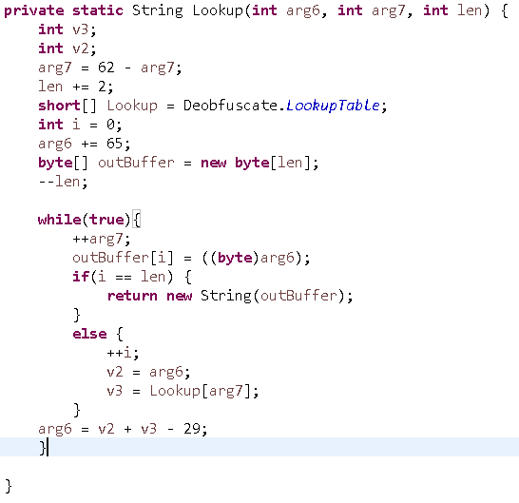
APK Analysis Process
APK
DEX Bytecode
Smali Disassembly
Java Source Code
Understandable Code

Slide 20
Reversing an APK
APK
java –jar apktool.jar decode in.apk
DEX Bytecode
Smali Disassembly
java –jar apktool.jar build in.apk
Java Source Code
Understandable Code

Slide 21
APK Analysis Tools – apktool & baksmali
APK
java –jar apktool.jar decode –s in.apk
DEX Bytecode
java –jar baksmali.jar classes.dex
Smali Disassembly
Java Source Code
Understandable Code

Slide 22
APK Analysis Tools –smali & apktool
APK
DEX Bytecode
java –jar apktool.jar build <app_path>
Smali Disassembly
java –jar smali.jar *.smali
Java Source Code
Understandable Code

Slide 23
APK Analysis Tools – dex2jar & jd-gui
APK
DEX Bytecode
Windows: d2j-dex2jar.bat –o out.jar in.apk\classes.dex
Linux: d2j-dex2jar.sh –o out.jar in.apk\classes.dex
Java ARchive (JAR)
JD-GUI – Java Decompiler
Java Source Code
Understandable Code

Slide 24
Reversing an APK – JEB Decompiler
APK
DEX Bytecode
JEB Decompiler – a[n expensive] commercial tool
Smali Disassembly
Java Source Code
Understandable Code

Slide 25
Detour: Modifying the APK
Put the Android device in development mode.
Alter the Smali code (not covered in this presentation)
Assemble the modified code using smali
Re-package the APK using apktool or Zip (depending on unpacking)
Sign the APK package with jarsigner.jar
Instructions: http://developer.android.com/tools/publishing/app-signing.html#signing-manually
Use the keystore located at: <HOME>\.android\debug.keystore
Keystore password “android”
Install the new APK with adb:
adb install modified.apk

Slide 26

Java Source Code?
After running jd-gui or JEB, we will have Java Source code!
It may be easily readable, or it could be ()BfuSc4t3d….

Slide 27


Slide 28
Overcoming Obfuscation

Slide 29
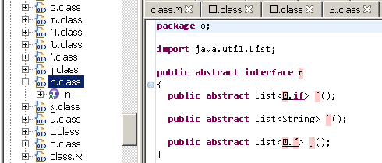
Obfuscated Java Code
All classes, methods, variables renamed to single Unicode characters, “semantically meaningless names”…

Slide 30
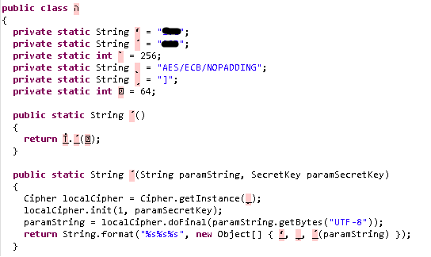
It’s Not All Bad…
Some code can’t be obfuscated:
Primitive types
Standard Java API calls
Exported/Public APIs
Code relying on Java Reflection

Slide 32
Identifying Classes (1)
Object
Class A
Class B
Class C

Slide 33
Identifying Classes (2)
Object
Service
Class B
Class C

Slide 34
Identifying Classes (3)
Object
ISerializable
Class A
Class B
Class C

Slide 35
Identifying Classes (4)
Object
ISomeInterface
IOtherInterface
Class A
Class B
Class C

Slide 36
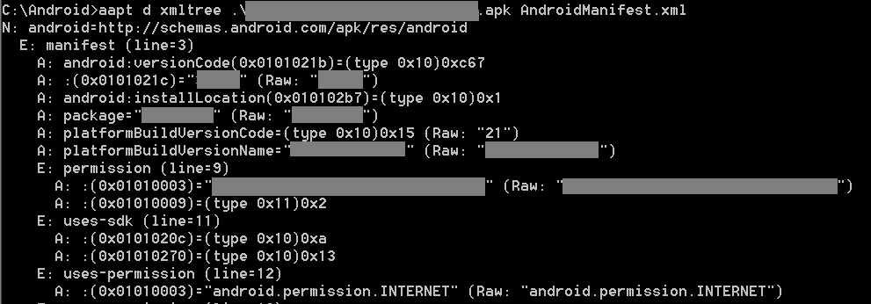
Android Manifest
The manifest cannot be obfuscated
It needs to be readable by Android OS
Encoded in a Binary Format called Android XML (AXML)
Decode contents using AXMLPrinter2.jar or aapt (from the SDK):
java -jar AXMLPrinter2.jar .\in.apk\AndroidManifest.xml
aapt dump xmltree in.apk AndroidManifest.xml

Slide 37
Android Manifest Contents
Statically Registered Broadcast Receivers
For notifications of system events, or broadcast messages
Public/Private Activities
Especially Browsable Activities
Public/Private Content Providers
Permissions
Requested Permissions
Custom Permissions
Public/Private Services

Slide 38
Where to Start?
Identify classes associated with application entry-points. For example:
android.app.Activity
android.content.BroadcastReciever
android.content.ContentProvider
android.content.Intent
android.content.IntentFilter
android.app.Service
Other interesting functionality:
References to the Cipher class, encryption classes, or large arrays
Reflection API methods such as getMethod() and invoke()

Slide 39
Some Common Obfuscations
Improve/retain Performance
Degrade Performance
Dead code removal
Class/method/fields/variable renaming
Remove logging code
Peephole optimisations
String encryption*
Call-hiding with reflection*
Resource/asset encryption
Control flow obfuscation
Junk code insertion
Data Flow obfuscation

Slide 40
DexGuard String Encryption

Slide 41
ProGuard & DexGuard
Proguard ships for free with the Android SDK
DexGuard is a paid version by the same author

Slide 42
Example: DexGuard String Encryption
public void LoadObfuscatedAsset() {
…
InputStream obfAsset = OsAppContext.getAssets().open(
ObfuscatedAppConfig.Lookup(
ObfuscatedAppConfig.LookupTable[12],
52,
ObfuscatedAppConfig.LookupTable[67] - 1));

Slide 43
ObfuscatedAppConfig.Lookup
Let’s reverse the ‘Lookup’ method used by the “configuration” class
It takes 3 integers and returns a String.
I’ve simplified the Java a little first
We’ll go step by step through the reasoning
Don’t worry about following the code, just the logic.
We could just copy and paste the code to get the decrypted string.

Slide 44
private static String Lookup(int arg6, int arg7, int arg8) {
int v3;
int v2;
arg7 = 62 - arg7;
arg8 += 2;
short[] Lookup = Deobfuscate.LookupTable;
int v1 = 0;
arg6 += 65;
byte[] b = new byte[arg8];
--arg8;
while(true){
++arg7;
b[i] = ((byte)arg6);
if(v1 == arg8) {
return new String(b);
}
else {
++v1;
v2 = arg6;
v3 = Lookup[arg7];
}
arg6 = v2 + v3 - 29;
}

Slide 45
private static String Lookup(int arg6, int arg7, int arg8) {
int v3;
int v2;
arg7 = 62 - arg7;
arg8 += 2;
short[] Lookup = Deobfuscate.LookupTable;
int v1 = 0;
arg6 += 65;
byte[] outBuffer = new byte[arg8];
--arg8;
while(true){
++arg7;
outBuffer[i] = ((byte)arg6);
if(v1 == arg8) {
return new String(outBuffer);
}
else {
++v1;
v2 = arg6;
v3 = Lookup[arg7];
}
arg6 = v2 + v3 - 29;
}

Slide 46
private static String Lookup(int arg6, int arg7, int arg8) {
int v3;
int v2;
arg7 = 62 - arg7;
arg8 += 2;
short[] Lookup = Deobfuscate.LookupTable;
int i = 0;
arg6 += 65;
byte[] outBuffer = new byte[arg8];
--arg8;
while(true){
++arg7;
outBuffer[i] = ((byte)arg6);
if(i == arg8) {
return new String(outBuffer);
}
else {
++i;
v2 = arg6;
v3 = Lookup[arg7];
}
arg6 = v2 + v3 - 29;
}

Slide 47
private static String Lookup(int arg6, int arg7, int len) {
int v3;
int v2;
arg7 = 62 - arg7;
len += 2;
short[] Lookup = Deobfuscate.LookupTable;
int i = 0;
arg6 += 65;
byte[] outBuffer = new byte[len];
--len;
while(true){
++arg7;
outBuffer[i] = ((byte)arg6);
if(i == len) {
return new String(outBuffer);
}
else {
++i;
v2 = arg6;
v3 = Lookup[arg7];
}
arg6 = v2 + v3 - 29;
}

Slide 48
private static String Lookup(int char_val, int arg7, int len) {
int v3;
int v2;
arg7 = 62 - arg7;
len += 2;
short[] Lookup = Deobfuscate.LookupTable;
int i = 0;
char_val += 65;
byte[] outBuffer = new byte[len];
--len;
while(true){
++arg7;
outBuffer[i] = ((byte)char_val);
if(i == len) {
return new String(outBuffer);
}
else {
++i;
v2 = char_val;
v3 = Lookup[arg7];
}
char_val = v2 + v3 - 29;
}

Slide 49
private static String Lookup(int char_val, int key_ptr, int len) {
int v3;
int v2;
key_ptr = 62 – key_ptr;
len += 2;
short[] Lookup = Deobfuscate.LookupTable;
int i = 0;
char_val += 65;
byte[] outBuffer = new byte[len];
--len;
while(true){
++key_ptr;
outBuffer[i] = ((byte)char_val);
if(i == len) {
return new String(outBuffer);
}
else {
++i;
v2 = char_val;
v3 = Lookup[key_ptr];
}
char_val = v2 + v3 - 29;
}

Slide 50
private static String Lookup(int char_val, int key_ptr, int len) {
int v3;
int v2;
key_ptr = 62 – key_ptr;
len += 2;
short[] Lookup = Deobfuscate.LookupTable;
int i = 0;
char_val += 65;
byte[] outBuffer = new byte[len];
--len;
while(true){
++key_ptr;
outBuffer[i] = ((byte)char_val);
if(i == len) {
return new String(outBuffer);
}
else {
++i;
char_val2 = char_val;
differential_key_value = Lookup[key_ptr];
}
char_val = char_val2 + differential_key_value - 29;
}

Slide 51
String Encryption Summary
Array of Bytes, differences between adjacent characters
Arg 1: Starting character value
Arg 2: Starting key index
Arg 3: String length
Start Value = “b”, start Index = 1, length = 3
Array: { 20, 1, -2, 19, 5 }
Result: “cat” (b + 1 = c), (c - 2 = a), ( a + 19 = t)

Slide 52
Call Hiding Using Reflection
UnknownObject1 =
String.class.getMethod(
ObfuscatedAppConfig.Lookup(
ObfuscatedAppConfig.LookupTable[40] - 1,
ObfuscatedAppConfig.LookupTable[2] - 1,
6),
String.class).invoke(string1, string0);

Slide 53
Native Code

Slide 54
Android Native Code
APKs can contain native code in the /lib/ directory
One sub-directory for each supported architecture (or ABI)
E.g. armeabi, armeabi-v7a, x86
Android Java interfaces with native code using the Java Native Interface (JNI)
Standardised by Oracle: https://docs.oracle.com/javase/7/docs/technotes/guides/jni/spec/jniTOC.html
Java: System.loadLibrary(“foo”) // Loads ./lib/libfoo.so

Slide 55
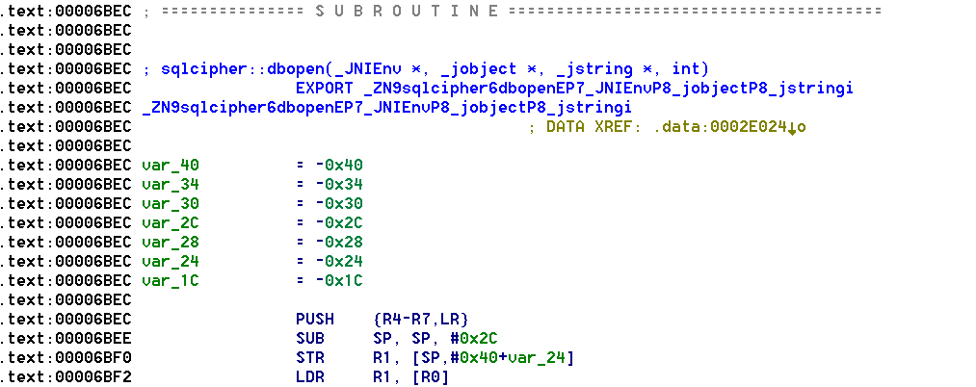
JNI Exports
JNIEXPORT void JNICALL Java_ClassName_FunctionName (
JNIEnv *jniEnv,
jobject classInstancePointer,
<…args…>);

Slide 56
Conclusions

Slide 57
Conclusions
Obfuscators slow down attackers
Arms-race between attackers & defenders
Both apply to legitimate software & malware
Obfuscators don’t fix vulnerabilities
Just makes them harder to find using static techniques
Effective security assessments should be done with source code.

Slide 58


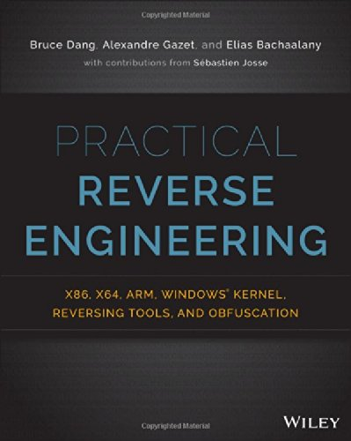
Recommended Further Reading

Slide 59
Tool References
Android Studio and SDK – https://developer.android.com/sdk/index.html
Apktool – http://ibotpeaches.github.io/Apktool/
smali/backsmali – https://bitbucket.org/JesusFreke/smali/downloads
jd-gui - http://jd.benow.ca/
APK Studio - https://apkstudio.codeplex.com/
JEB Decompiler (Commercial) – https://www.pnfsoftware.com/
Not Covered in this presentation:
Radare2 – http://www.radare.org/r/down.html
Androguard – https://github.com/androguard/androguard

Slide 60

Any Questions?
Twitter: @tkeetch
Email: tom@intrinsec.co.uk

