Slide 1
2026 Q1 Operations Review
Sample presentation for image-describer PoC

Slide 2
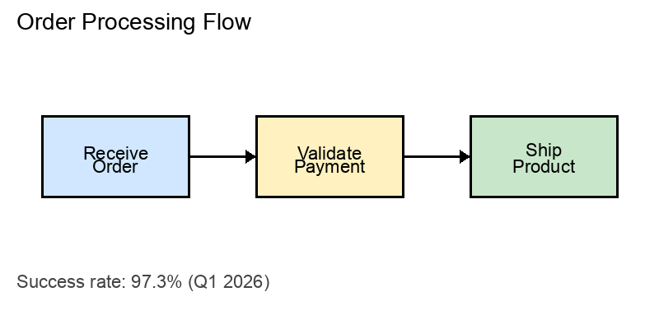
Order Processing Pipeline

Slide 3
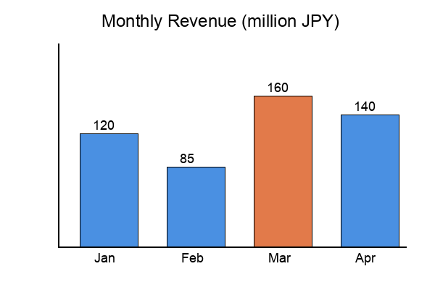
Q1 Revenue by Month

