Slide 1


TỨ ĐẠI CƠM TẤM

Slide 2

Bid Spirit
Website
Từ Xuân Thịnh (Leader)
Trần Minh Khoa
Auction Network
Nguyễn Thanh Thiện
Nguyễn Khánh

Slide 3
Who are we?
Từ Xuân Thịnh (Leader): BE, FE Admin
Trần Minh Khoa: BE, Database
Nguyễn Thanh Thiện: FE
Nguyễn Khánh: FE

Slide 4

Table of Content
Application Introduction
Technology
Database
Actors - Main Features
Highlight Function/Tech
Demo
Q & A

Slide 5
Introduction Bid Spirit
BidSpirit is the world's leading online platform for fine art, antiques and collectibles. We offer a modern, efficient alternative to manual auctions, enabling users to easily participate, search for, and acquire their favorite items. With our revolutionized technique, the entire auction process can now be carried out at your fingertips, ensuring a seamless and convenient experience for all participants while maximizing profits.

Slide 6


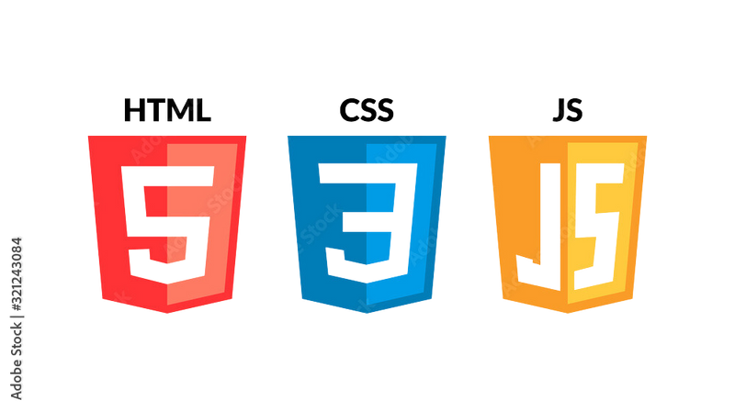





Technology
Back-End
Front-End
NodeJS
Laravel
TailwindCSS
Bootstrap

Slide 7



Database
Payment

Slide 8
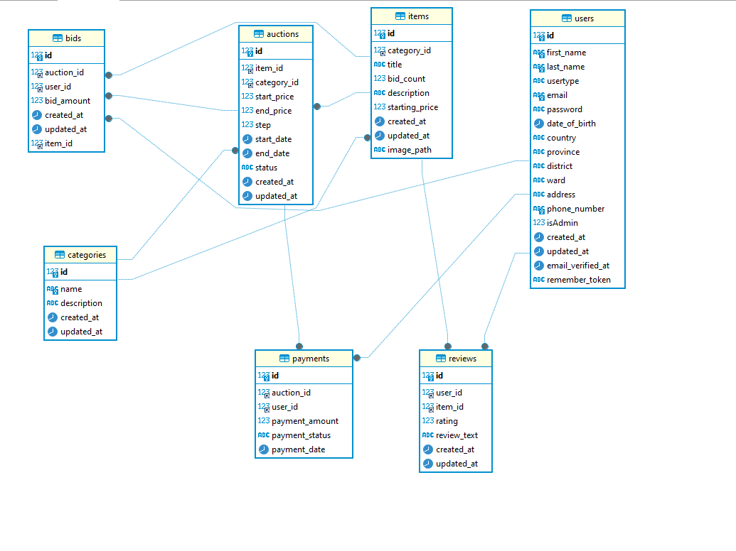
Database

Slide 9


Actors
Guest
Admin
Member
Manage user
Add user
Delete user
Edit information
Manage Categories
Manage Items
Manage Auctions
Manage Bids
View products
View categories
Sign Up
Sign In
View products
Bid product
Purchase your bidding
Edit Profile
Change password
Notes:
Chuyển list thành từng khung riêng biệt

Slide 10
Demo
Notes:
Chuyển list thành từng khung riêng biệt

Slide 11


Q & A

