Slide 1
React
1/React?

Slide 2
React
2/Cách tạo và lồng components

Slide 3
React
function MyButton() {
return (
<button>I'm a button</button>
);
}

Slide 4
React
export default function MyApp() {
return (
<div>
<h1>Welcome to my app</h1>
<MyButton />
</div>
);
}

Slide 5
React
function AboutPage() {
return (
<>
<h1>About</h1>
<p>Hello there.<br />How do you do?</p>
</>
);
}

Slide 6
React
3/Thêm đánh dấu và styles

Slide 7
React
<img className="avatar" />

Slide 8
React
4/Thể hiện dữ liệu

Slide 9
React
return (
<h1>
{user.name}
</h1>
);

Slide 10
React
return (
<img
className="avatar"
src={user.imageUrl}
/>
);

Slide 11
React
const user = {
name: 'Hedy Lamarr',
imageUrl: 'https://i.imgur.com/yXOvdOSs.jpg',
imageSize: 90,
};
export default function Profile() {
return (
<>
<h1>{user.name}</h1>
<img
className="avatar"
src={user.imageUrl}
alt={'Photo of ' + user.name}
style={{
width: user.imageSize,
height: user.imageSize
}}
/>
</>
);
}

Slide 12
React
CONDITIONAL RENDERING

Slide 13
React
let content;
if (isLoggedIn) {
content = <AdminPanel />;
} else {
content = <LoginForm />;
}
return (
<div>
{content}
</div>
);

Slide 14
React
<div>
{isLoggedIn ? (<AdminPanel />) : (<LoginForm />) }
</div>

Slide 15
React
RENDERING LIST

Slide 16
React
const products = [
{ title: ‘Cabbage’, id: 1 },
{ title: ‘Garlic’, id: 2 },
{ title: ‘Apple’, id: 3 },
];

Slide 17
React
const listItems = products.map(product =>
<li key={product.id}>
{product.title}
</li>
);
return (
<ul>{listItems}</ul>
);

Slide 18
React
const products =[
{ title: ‘Cabbage’ , isFruit: false, id: 1 },
{ title: ‘Garlic’ , isFruit: false, id: 2 },
{ title: ‘Apple’ , isFruit: true, id: 3 }
];
export default function ShopppingList() {
const listItems = products.map( product =>
<li
key={product.id}
style={{
color: product.isFruit ? ‘magenta’ : ‘darkgreen’
}}
>
{product.title}
</li>
);
return(
<ul>{listItems}</ul>
);
}

Slide 19
React
5/Phản ứng lại với các sự kiện và cập nhật lại trên màn hình

Slide 20
React
function MyButton() {
function handleClick() {
alert('You clicked me!');
}
return (
<button onClick={handleClick}>
Click me
</button>
);
}

Slide 21
React
import { useState } from 'react';
function MyButton() {
const [count, setCount] = useState(0);
function handleClick() {
setCount(count + 1);
}
return (
<button onClick={handleClick}>
Clicked {count} times
</button>
);
}

Slide 22
React
6/Cách chia sẻ data giữa các components

Slide 23
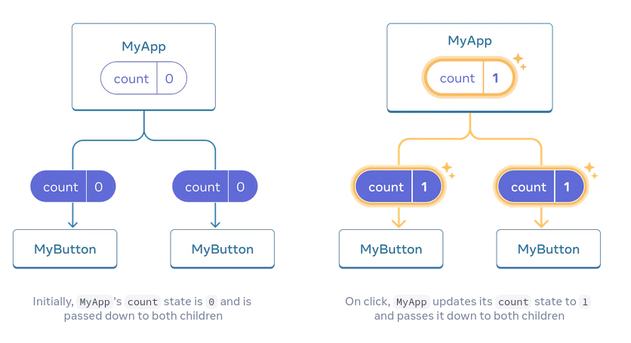
React

Slide 24
React
export default function MyApp() {
const [count, setCount] = useState(0);
function handleClick() {
setCount(count + 1);
}
return (
<div>
<h1>Counters that update together</h1>
<MyButton count={count} onClick={handleClick} />
<MyButton count={count} onClick={handleClick} />
</div>
);
}

Slide 25
React
function MyButton({ count, onClick }) {
return (
<button onClick={onClick}>
Clicked {count} times
</button>
);
}

Slide 26
React
?/TIC TAC TOE?

