Slide 1
Twitter Sentiment Analysis for 2016 Election
CIS 5200 Project 1
Toney Kim
12/3/2018

Slide 2
Data Sources
Twitter Data for 10/30/2016
https://s3.amazonaws.com/vm-election10282016-2/tweets10302016.tgz
12.5 GB uncompressed
Sentiment Dictionary
https://s3.amazonaws.com/hipicdatasets/dictionary.tsv

Slide 3
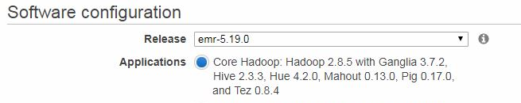
Hardware Specifications
Amazon Educate Elastic MapReduce
Cluster is m3.xlarge with 3 nodes and 15GB of ram and 300GB hard drive space with CPU 2.8 GHZ Intel Xeon E5-2670

Slide 4
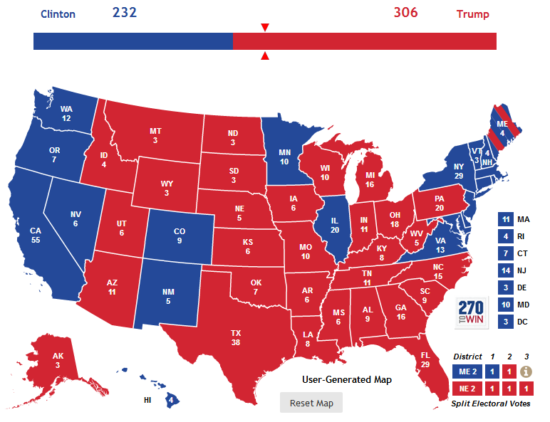
2016 Election Results
Could we have predicted this using Twitter?

Slide 5

Architecture
Amazon Elastic MapReduce with Ubuntu Linux, Hadoop, Hive, HCatalog and Pig.
Need to setup S3 and EC2 for storage and to connect to EMR master node

Slide 6
Workflow
Twitter Data is obtained
Uploaded to Linux and then put into Hadoop
Use Hive to sort messages by time zones
Separate messages for Trump and Hillary
Perform sentiment analysis for and against candidates in each time zone

Slide 7
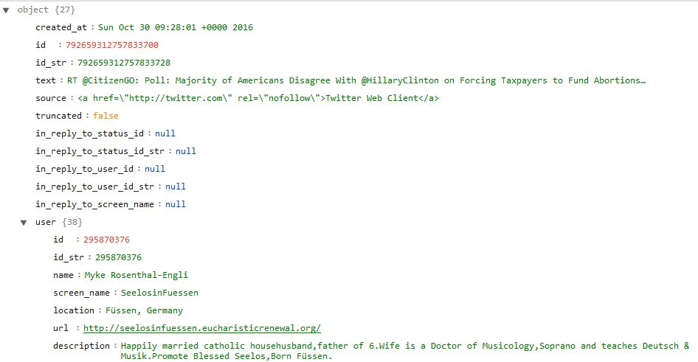
Twitter Data Structure
Delimited by pipebar |
Also contains additional nested struct datatypes

Slide 8
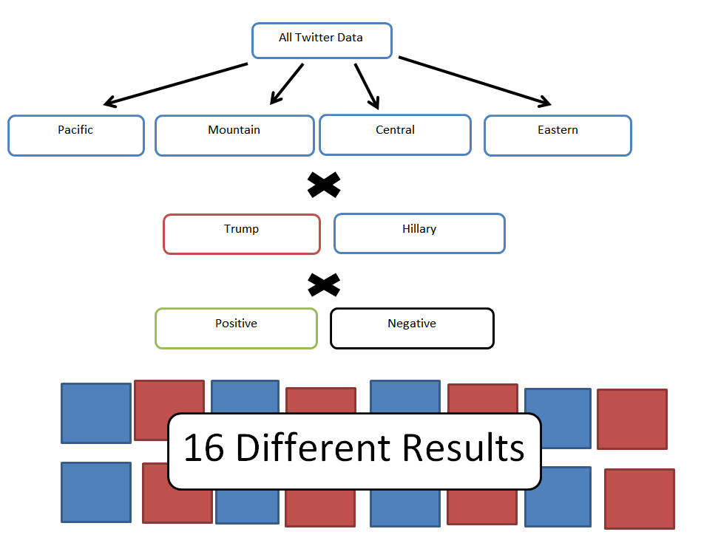

Slide 9
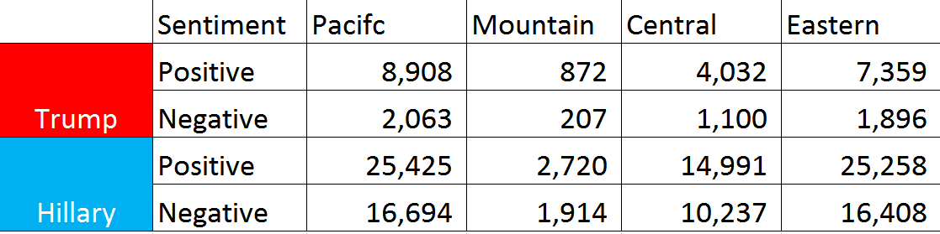
Results of Analysis
Results of Twitter messages on 10/30/2016 using binary decision tree and lexicon sentiment analysis in Hive.

Slide 10
Comparison to Actual

Slide 11

Positive Sentiment Transfer
When Negative sentiment is added to the Positive sentiment of other candidate.
Trump has more support in Central area.

Slide 12
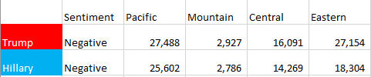
Negative Sentiment Transfer
When Positive sentiment is added to the Negative sentiment of other candidate.
Trump has larger negative sentiment overall.

Slide 13
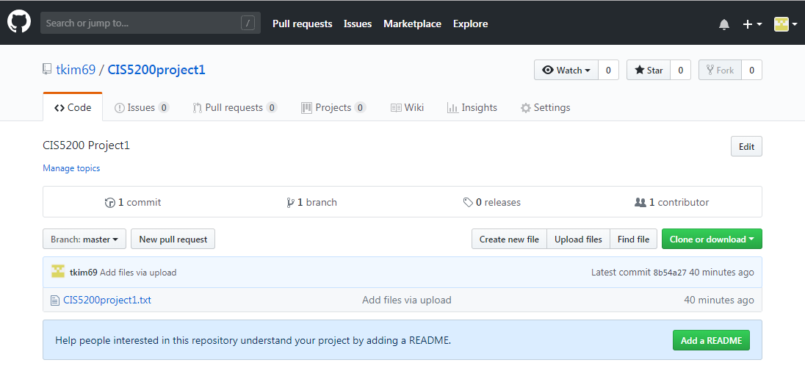
Github
Code and directions available at:
https://github.com/tkim69/CIS5200project1

Slide 14
Q&A

