Slide 1
ATTITUDES TOWARD DEBT AND STUDENT LOAN BORROWING
THOMAS KIRNBAUER - INDIANA UNIVERSITY BLOOMINGTON

Slide 2
Research Questions & Data
What is the average amount borrowed in student loan for undergraduates at IU?
To what extent does student loan borrowing differ by attitudes toward borrowing debt?
Beginning College of Student Survey (BCSSE) from 2014
IU data on student enrollment and loans as of spring 2019
2,000+ students in the sample
53% students in the sample accumulated student loan debt

Slide 3
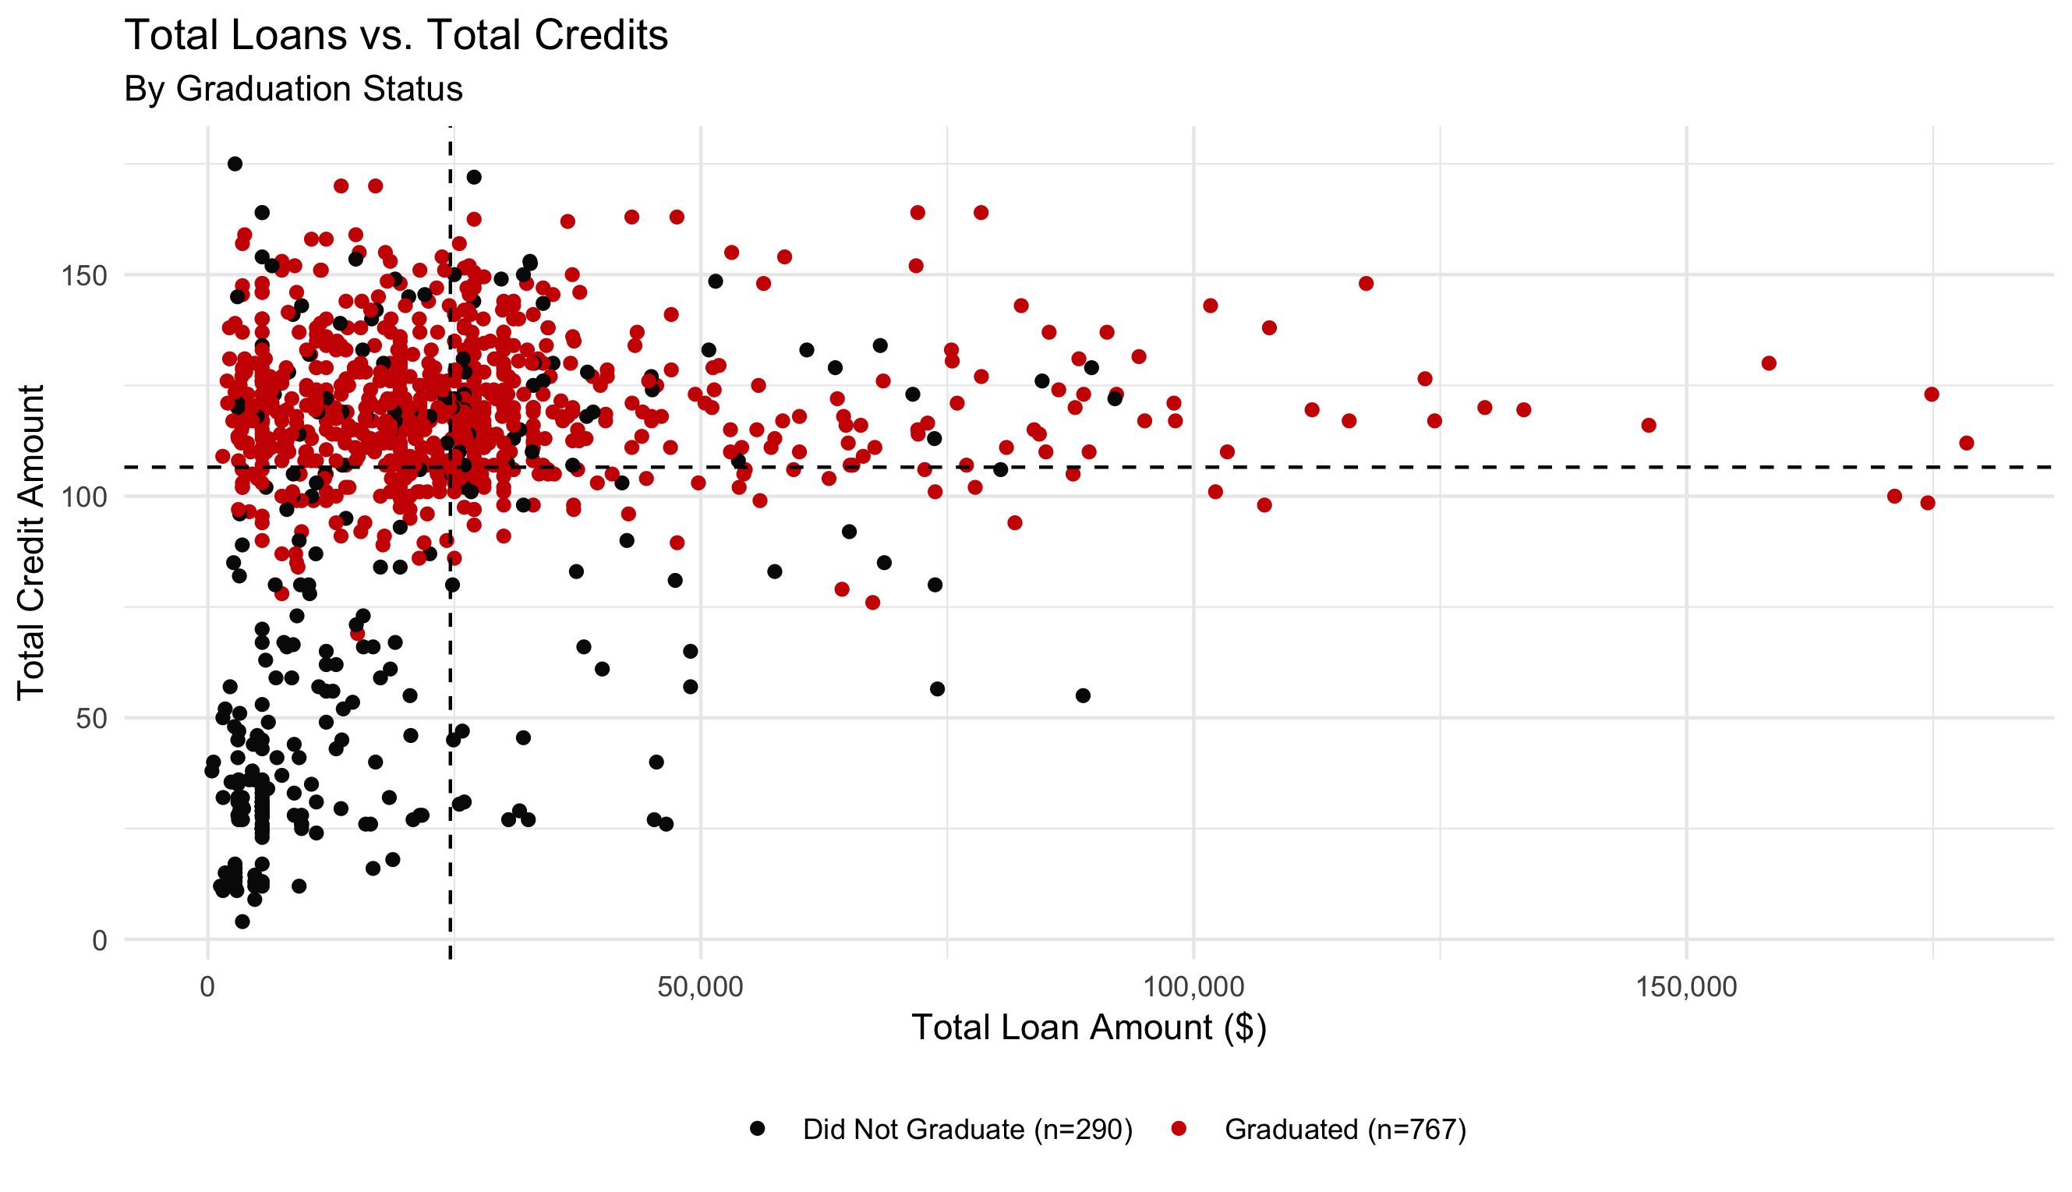
Total Loans vs. Total Credits
N = 1058
Avg Credits
= 106
Avg Loans
= $24,592
r = .06

Slide 4
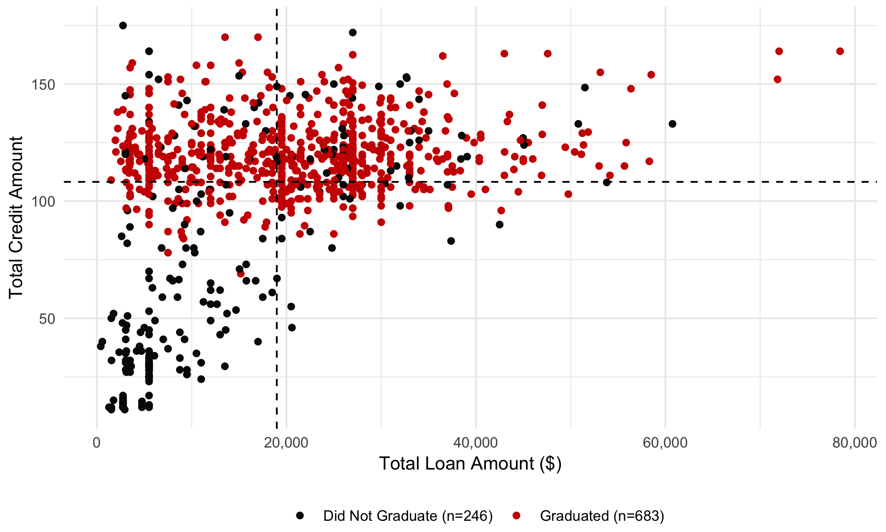
Total Loans vs. Total Credits (outliers omitted)
Revised N
= 929
Avg Credits
= 108
Avg Loans
= $18,980
r = .42

Slide 5
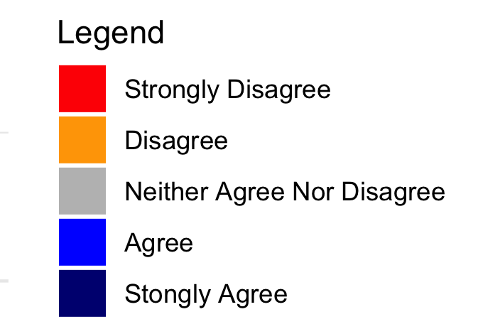
“My parents/guardians are (or would be) supportive of me taking out student loans”

Slide 6
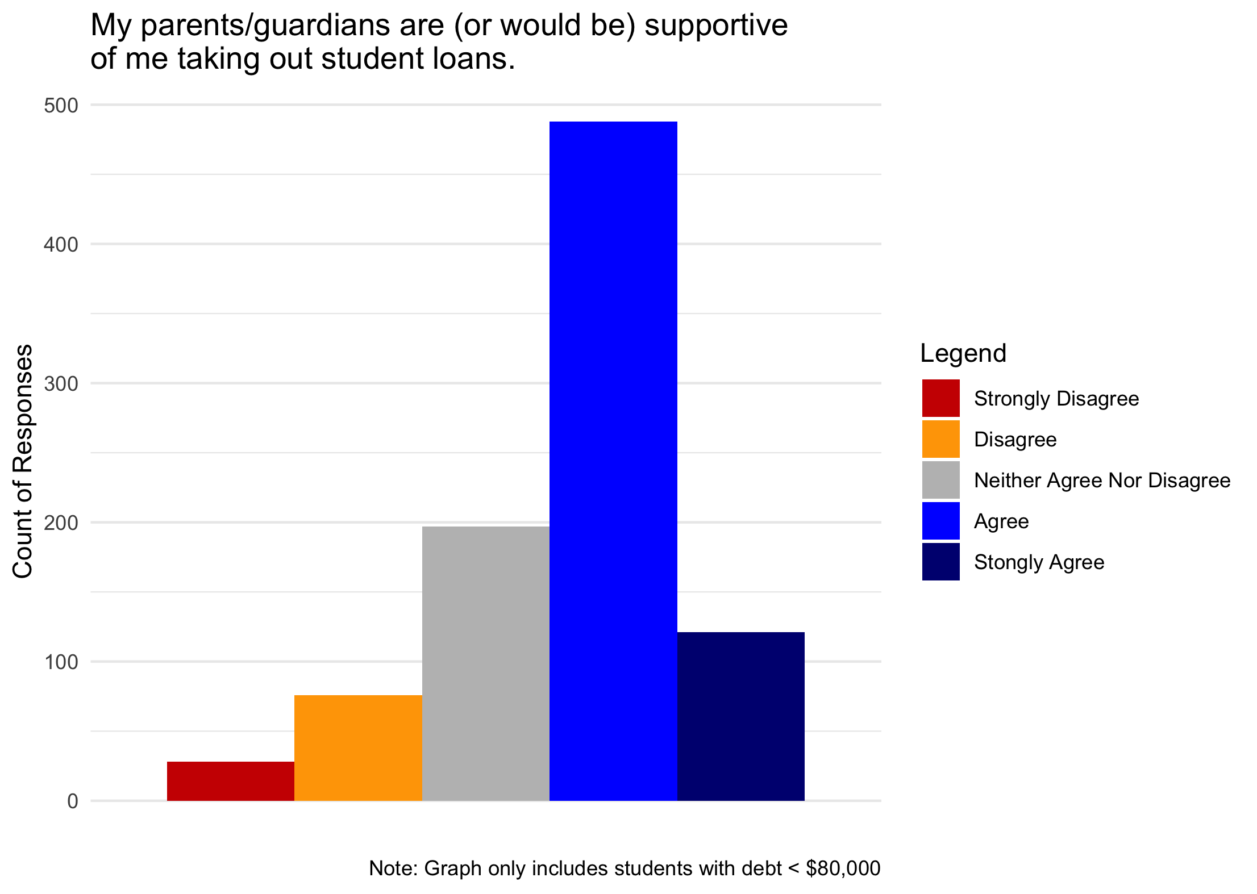
“My parents/guardians are (or would be) supportive of me taking out student loans”

Slide 7
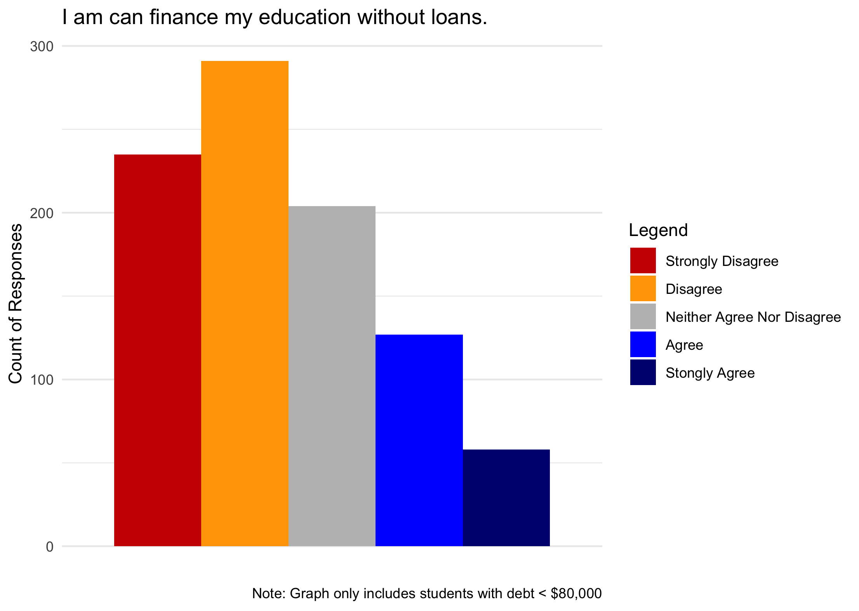
“I can finance my education without loans”

Slide 8
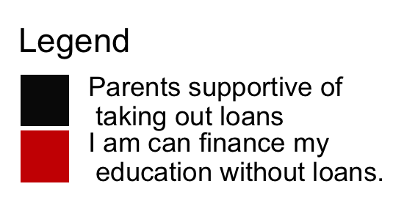

Mean Differences of Loans per Credit by Attitudes Toward Debt
Significant main effects
Probability of the differences happening by chance <5%
Total explained variance = 7%
Post-hoc test reveals specific significant differences
Strongly Disagree/Disagree vs. Agree/Strongly Agree
$175/credit

Slide 9
Conclusions & Future Research
Over half of the sample accumulated student loans
The average student loan amount ranged from $19k -> $25k
Student loan borrowing differs significantly by parental support & financial self-efficacy
Examine the outliers, debt >$80,000
- Qualitative study
How does attitudes affect the decision to take out any loans?
- Logistic regression
Create an “attitude toward debt” scale
- Structural equation modeling

Slide 10
Any Questions? Thank you!

