Slide 1
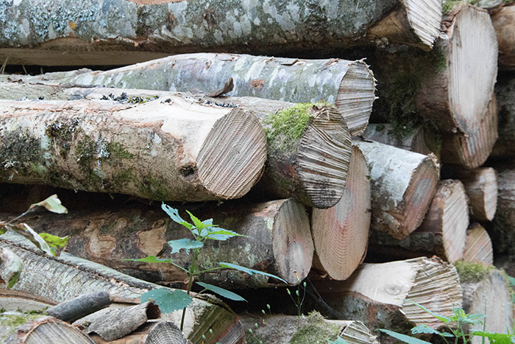
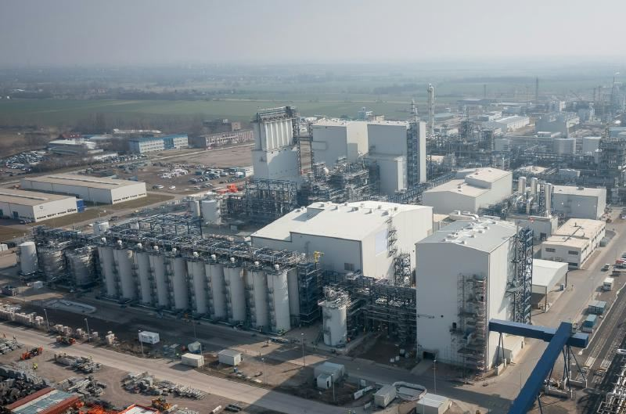
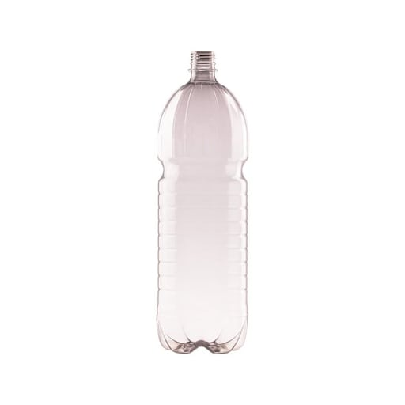
quantities
500 kt wood/a
0.18 t MEG/t wood
180 kt MEG/a
0.3 t MEG/t PET
540 kt PET/a*
Market prices
90 €/t wood
600 €/t MEG
1200 €/t PET

Slide 2
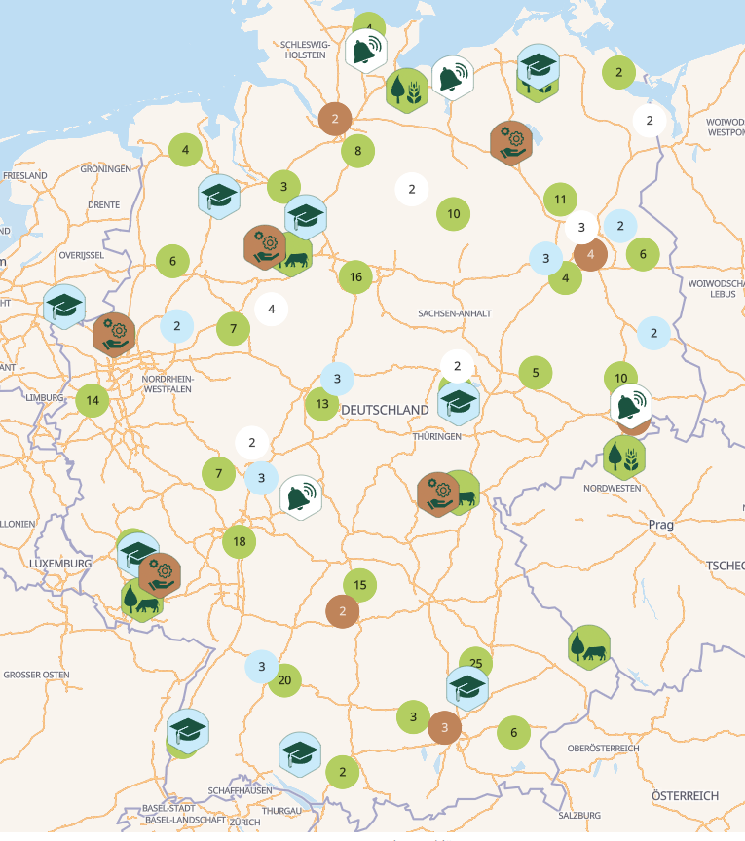

Slide 3



