Slide 1
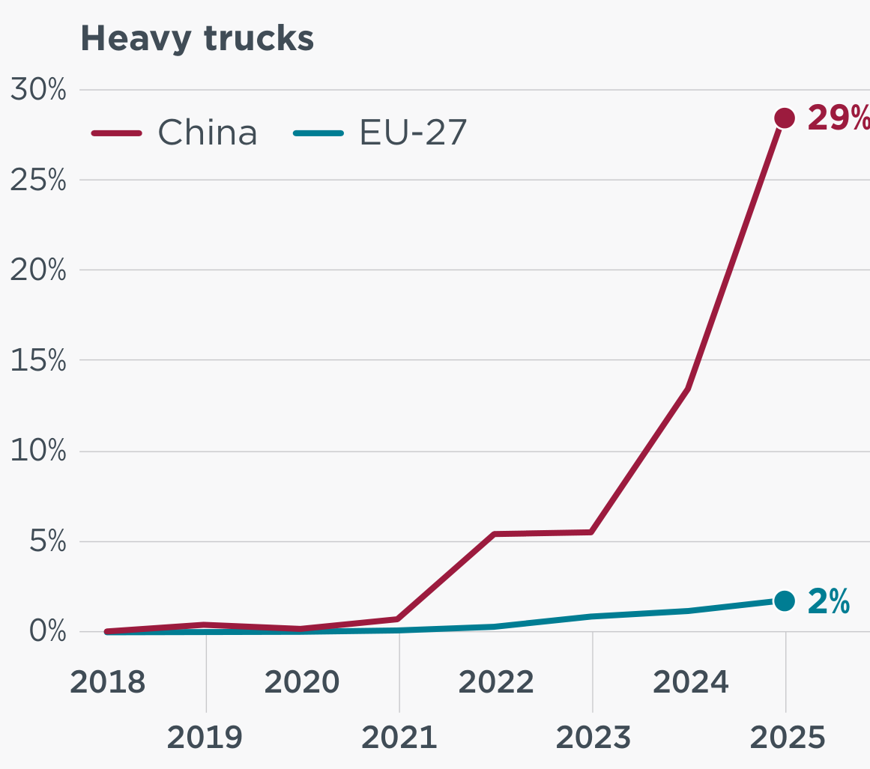
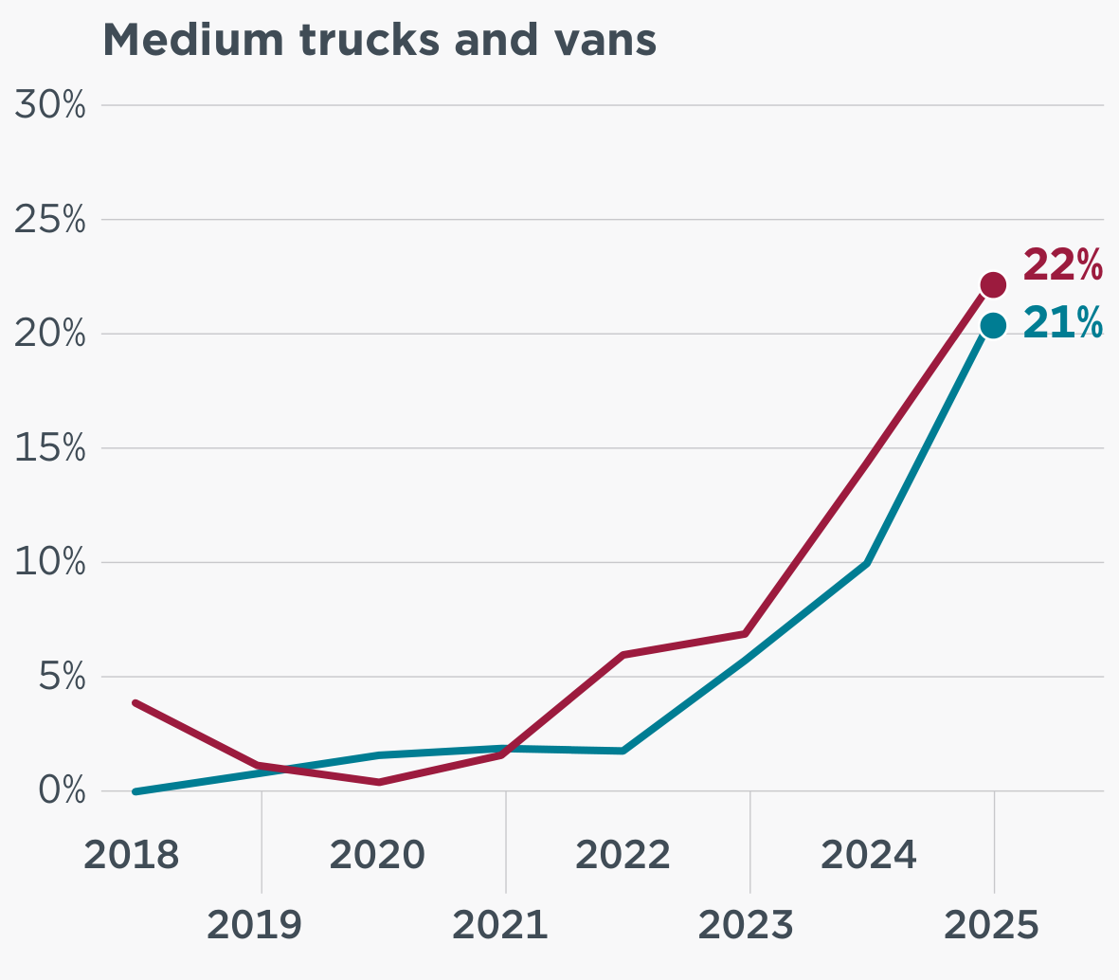
Sales share of new ZEV
Sales share of new ZEV

Slide 2
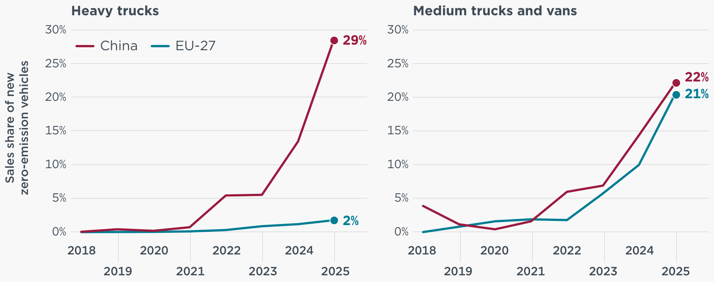

Slide 3
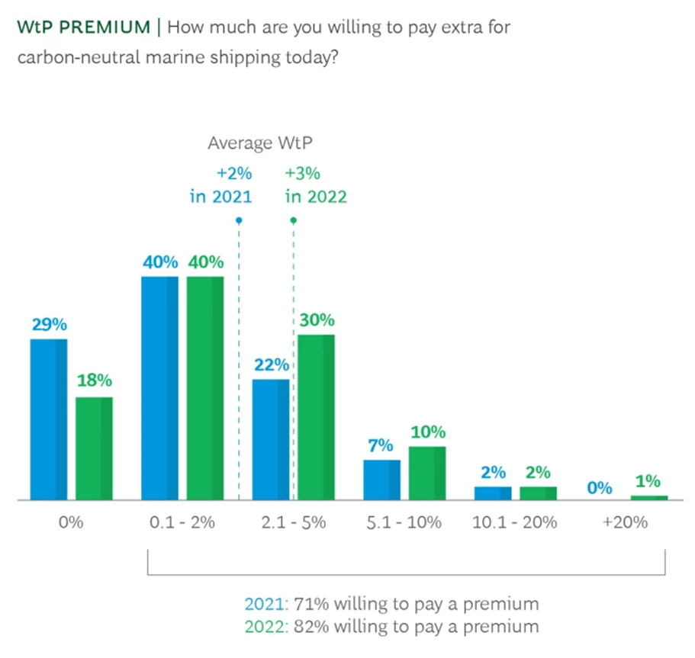

Slide 4
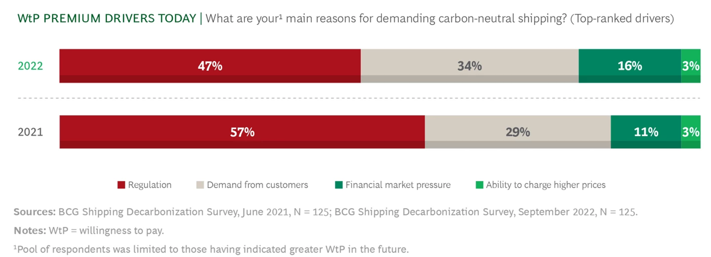

Slide 5
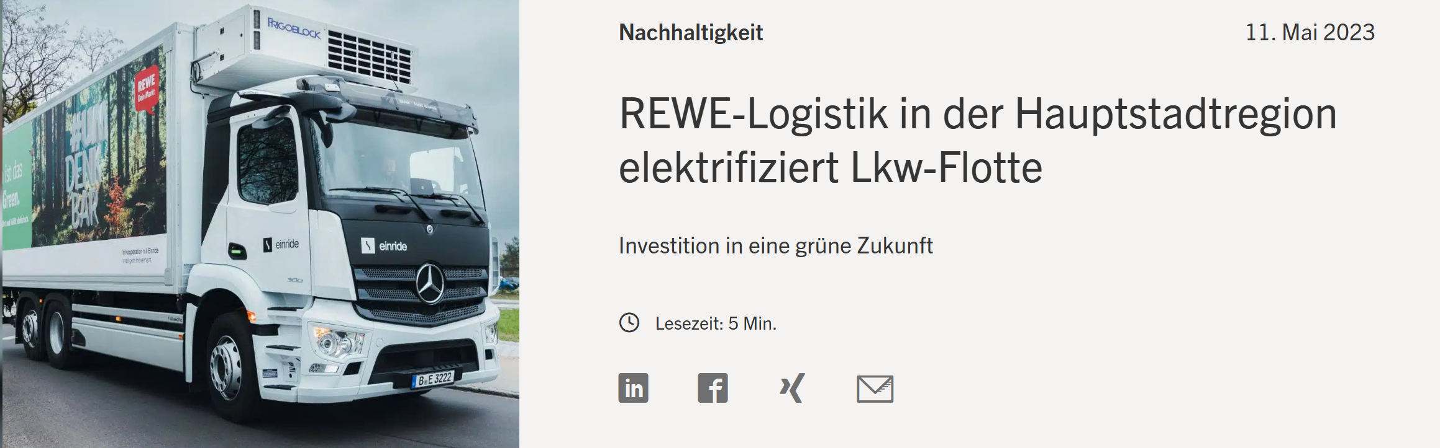

Slide 6
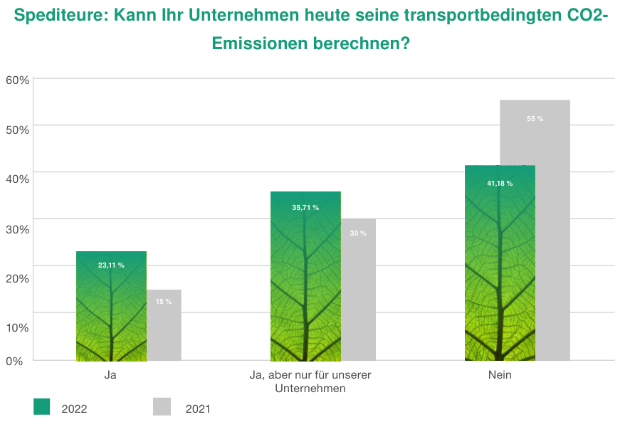

Slide 7
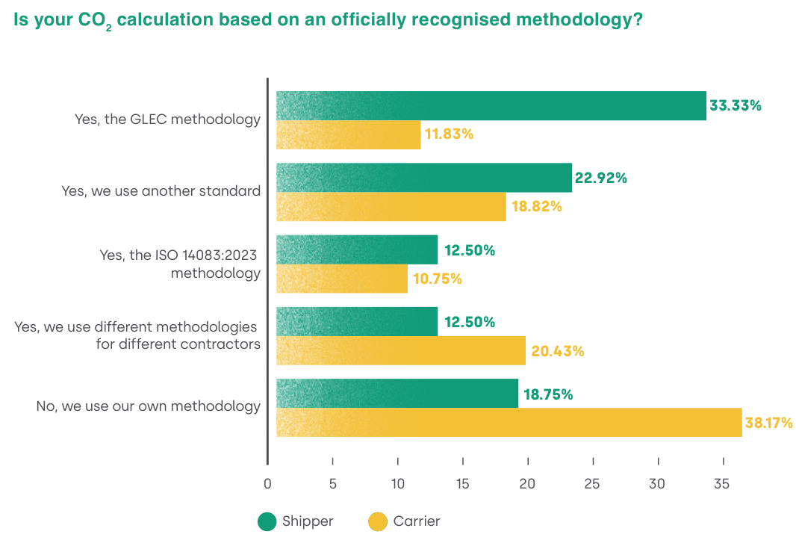

Slide 8
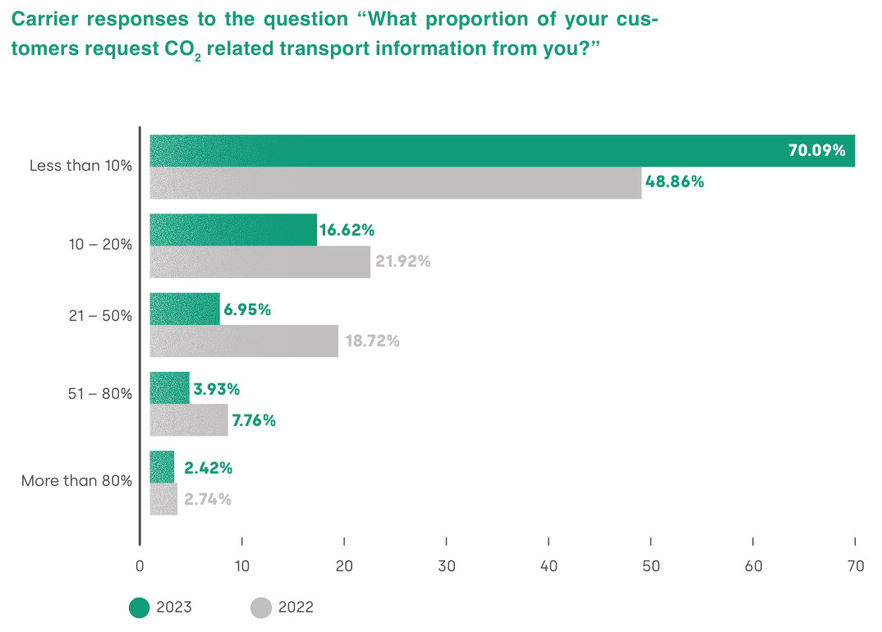

Slide 9
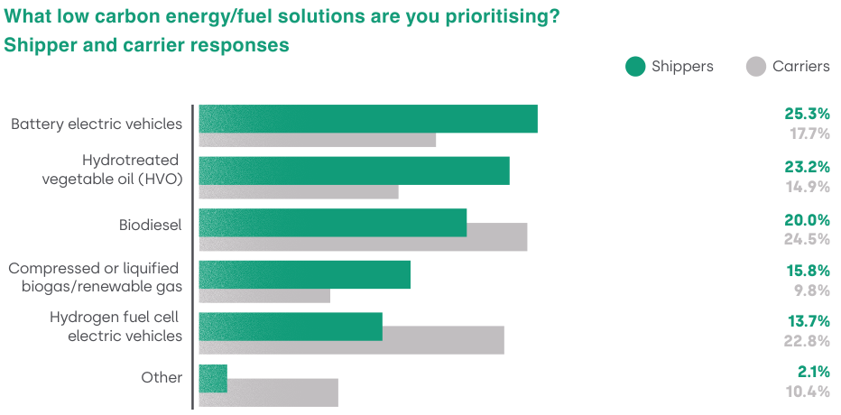

Slide 10
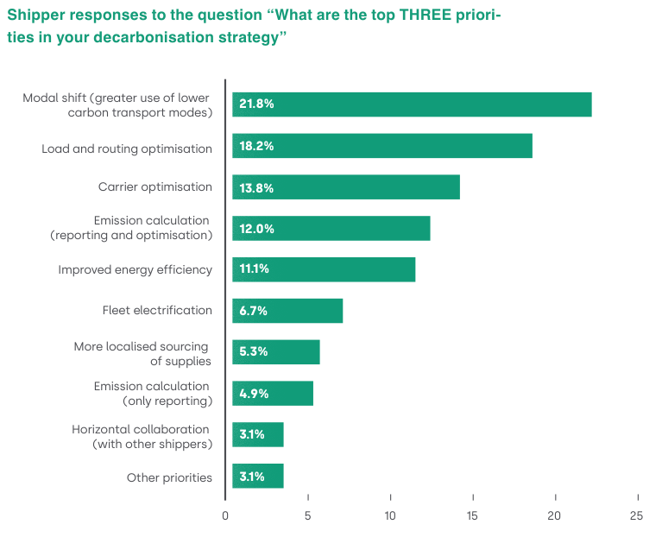

Slide 11


Allocation rules, pricing scheme
Costing tarifs & emission declaration rules
Assignment → customers to vehicles
Routing → sequence of customer visits
Declaration → cost and emission declaration per customer
Truck Fleet
number, technical/economic/
ecological specifications
Customer orders
$$€$$
Quantity/payload,
coordinates, preferences

Slide 12
Allocation rules, pricing scheme
Costing tarifs & emission declaration rules
€
10 km | 10 € | 15 kg CO2
Truck Fleet
20 km | 30 € | 5 kg CO2
number, technical/economic/
ecological specifications
€
Customer orders
$$€$$
Quantity/payload,
coordinates, preferences

Slide 13
Allocation rules, pricing scheme
Costing tarifs & emission declaration rules
€
8 km | 12 € | 2 kg CO2
Truck Fleet
8 km | 8 € | 12 kg CO2
number, technical/economic/
ecological specifications
€
Customer orders
$$€$$
Quantity/payload,
coordinates, preferences

Slide 14
Fleet size & mix
strategic
# of trucks
Customer satisfaction
Cost Tarifing & Emission Declaration
tactical
# of trucks &
Allocation rules
truck assignment &
Selected allocation rules
Preference-oriented Routing & Scheduling
operational

Slide 15




Hochschule RheinMain
Professur für Sustainable Operations Management
Fleet size & mix
strategic
Thomas
Kirschstein
Alexander
Lunin
Martin-Luther-Universität Halle-Wittenberg
Lehrstuhl für Produktion & Logistik
Cost Tarifing & Emission Declaration
tactical
Preference-oriented Routing & Scheduling
Christian
Bierwirth
Justin
Wittig
operational

Slide 16
Modellierung des kontinuierlicher Investitionsprozesse
techno-ökonomisch: TCO-Ansatz
stochastische Prognose Kundenaufkommen
Dynamische Anschaffungsentscheidungen
Fleet size & mix
strategic
Simulationsplattform
Heuristische Lösung VRPs mit zufälligen Kunden
Entwicklung techno-ökonomischer Parameter
Kundenzufriedenheitsprozesse
Cost Tarifing & Emission Declaration
tactical
Präferenz-orientierten Tourenplanungsproblemen
Entwicklung präferenzorientierter MILPs für VRPs
Heuristiken für große Probleme
Integration von Kundenzufriedenheit auf operativer Ebene
Preference-oriented Routing & Scheduling
operational

