Slide 1
Development of a Simple Near-Ground Path Loss Model Verified by Measurements
Kemal Kapetanovic, Mads Gotthardsen and Thomas Jørgensen

Slide 2
Agenda
Introduction
PL models
GWPL
FSPL
ATRPL
NSPL
Measurements
Setup
Parameters
Influence of parameters
Model fit
Proposed model
The z parameter

Slide 3
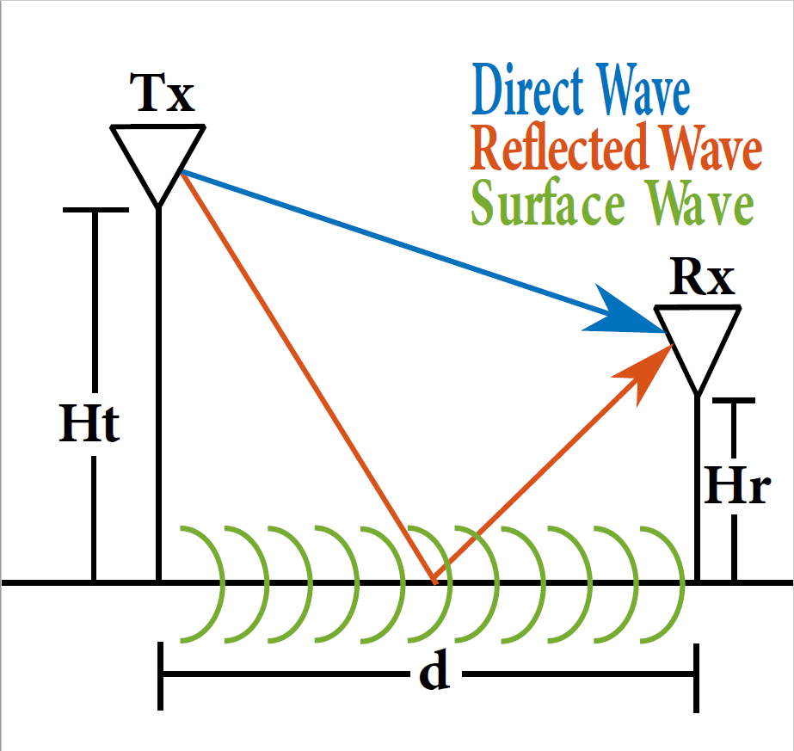
Introduction
Introduction
PL models
GWPL
FSPL
ATRPL
NSPL
Measurements
Setup
Parameters
Influence of parameters
Model fit
Proposed model
The z parameter
Relevans
Background
Focus

Slide 4
PL models
Introduction
PL models
GWPL
FSPL
ATRPL
NSPL
Measurements
Setup
Parameters
Influence of parameters
Model fit
Proposed model
The z parameter
Friss free-space PL
Only direct wave
High heights
Approximated two-ray propagation PL
Direct and reflected wave
Medium heights
Norton surface wave PL
Only surface wave
Low heights
Ground wave PL
All waves
All heights

Slide 5
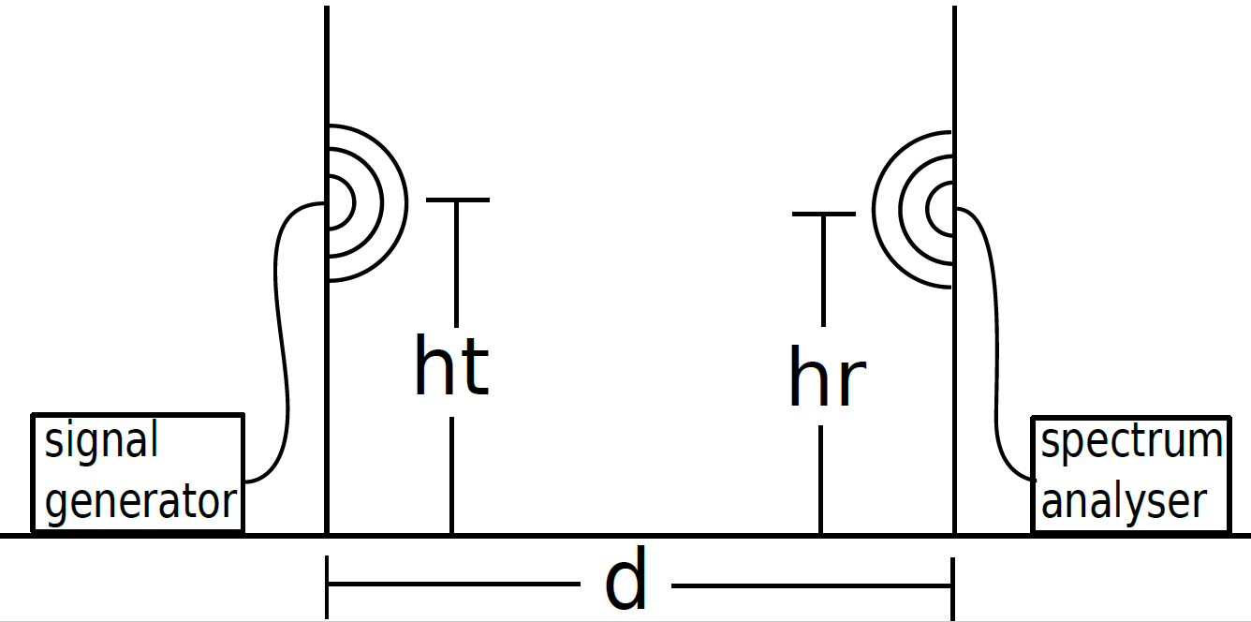
Measurements
Introduction
PL models
GWPL
FSPL
ATRPL
NSPL
Measurements
Setup
Parameters
Influence of parameters
Model fit
Proposed model
The z parameter
1 Frequency (858 MHz)
2 Antenna sets (monopole and patch)
2 Polarization (horizontal and vertical)
2 Location (outdoor and indoor)
4 Rx/Tx heights (from 0.04 to 2.02 m)
6 Distances (from 1 to 30 m)

Slide 6
Influence of parameters
Introduction
PL models
GWPL
FSPL
ATRPL
NSPL
Measurements
Setup
Parameters
Influence of parameters
Model fit
Proposed model
The z parameter
Distance | 1 m | 2 m | 4 m
PL | (34.7±1.6) dB | (41.4±1.4) dB | (49.0±1.7) dB
Distance | 8 m | 15 m | 30 m
PL | (57.3±2.1) dB | (66.1±2.5) dB | (72.3±2.3) dB
Tx \ Rx | 0.04 m | 0.14 m | 0.36 m | 2.02 m
0.04 m | (63.7±5.2) dB | (60.7±5.1) dB | (55.4±4.7) dB | (52.4±3.8) dB
0.14 m | (60.7±5.1) dB | (58.1±5.2) dB | (53.4±4.5) dB | (50.2±3.2) dB
0.36 m | (55.4±4.7) dB | (53.4±4.5) dB | (49.0±2.9) dB | (47.6±4.8) dB
2.02 m | (52.4±3.8) dB | (50.2±3.2) dB | (47.6±4.8) dB | (44.4±3.1) dB
Environment |  | Antenna type |  | Polarization
Gym | (52.4±1.8) dB | Monopole | (55.6±2.0) dB | Vertical | (51.8±1.9) dB
Parking lot | (54.6±2.2) dB | Patch | (51.4±2.0) dB | Horizontal | (55.1±2.1) dB

Slide 7
Model fit
Introduction
PL models
GWPL
FSPL
ATRPL
NSPL
Measurements
Setup
Parameters
Influence of parameters
Model fit
Proposed model
The z parameter

Slide 8
Proposed model
Introduction
PL models
GWPL
FSPL
ATRPL
NSPL
Measurements
Setup
Parameters
Influence of parameters
Model fit
Proposed model
The z parameter

Slide 9
The z parameter
Introduction
PL models
GWPL
FSPL
ATRPL
NSPL
Measurements
Setup
Parameters
Influence of parameters
Model fit
Proposed model
The z parameter

