Slide 1
Practical investigation of Rayleigh fading model in URC conditions
WCS8 Gr. 850
Andreas Vembe Jäger Mads Røgeskov Gotthardsen Markos Vourvachis Thomas Kær Juel Jørgensen

Slide 2
Agenda
Introduction
Wireless Channel
Statistical Aspect
WSSUS
Correlation
Dynamic Range
Measurement Setup
Data Processing
Results
Diversity Combining
Uncertainties
Further Work
Conclusion

Slide 3
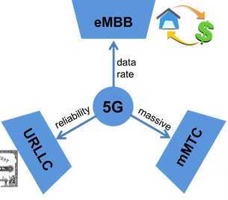
Introduction
Notes:
Probeability 10^-5 to 10^-6
Fading becoming a problem

Slide 4
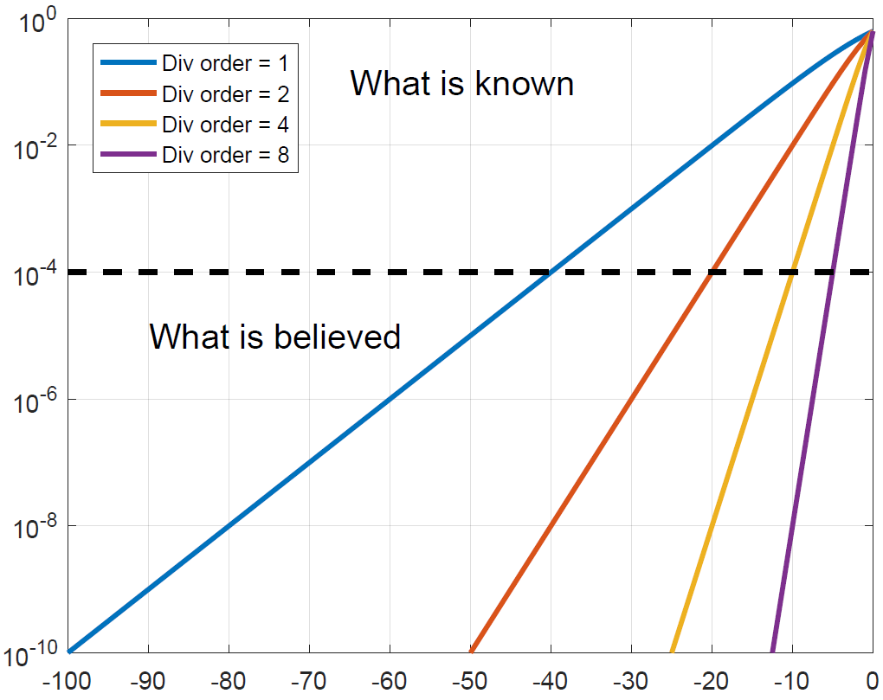
Introduction
Notes:
Tested and not tested
A hell lot of measurements

Slide 5
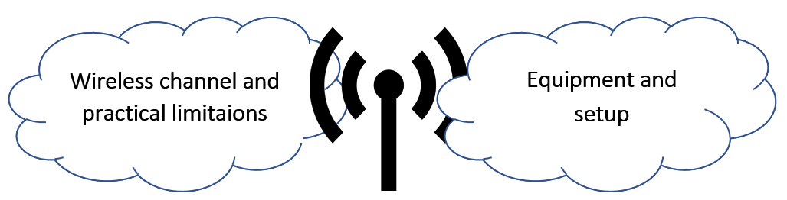
Problem statement
Design a measurement system that can handle very deep fades and a statistical method to process the data and compare to existing Rayleigh model used in URLLC channels.

Slide 6
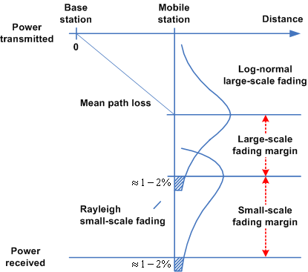
Wireless Channel
Notes:
Large scale: Pathloss for a given area
Small scale: Multipath signals that either combines construct or destructevely

Slide 7
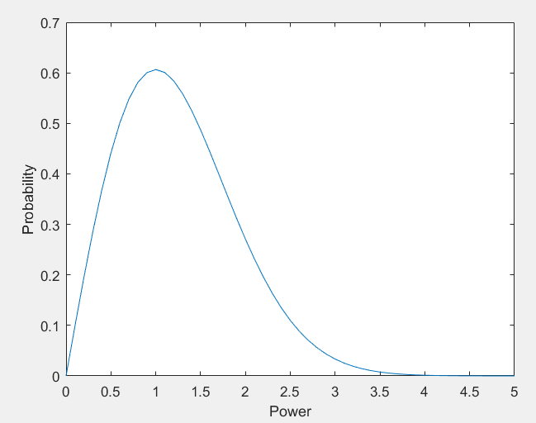
Wireless Channel
Notes:
Central limit theory. Many small gives gaussian in both domain of the complex signal. No dominant signal AKA NLOS
This is the distribution of the absolut power value

Slide 8
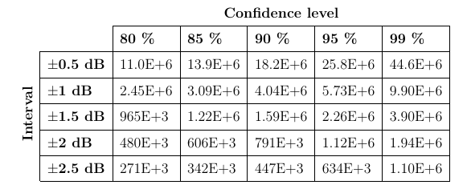
Statistical Aspect
Notes:
Wants to be confidence in our measurements
Estimation
Normal approximation of the Binomial proportion.

Slide 9
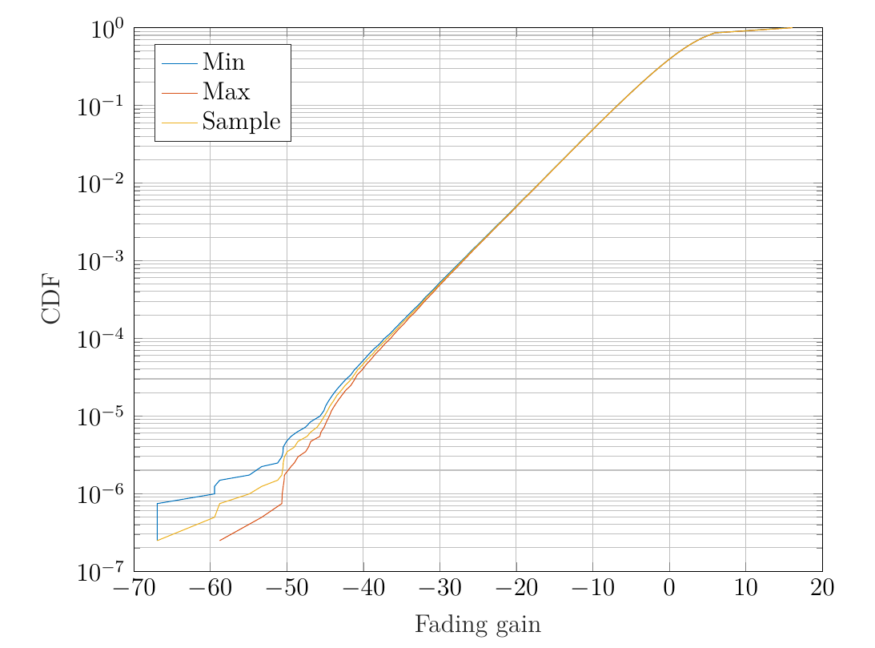
Statistical Aspect
± 0.82 dB
Notes:
Not true rayleigh (Do not need to be said)

Slide 10
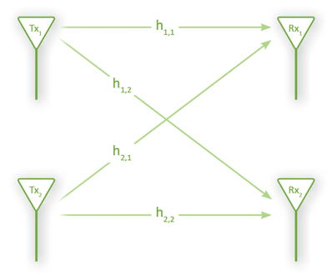

Wireless Channel
Temporal domain
Spatial domain
Notes:
Temporal: Sending multiple signal (Frequencies or retransmission)
Spatial: Sending from multiple locations (More antennas or more points)

Slide 11
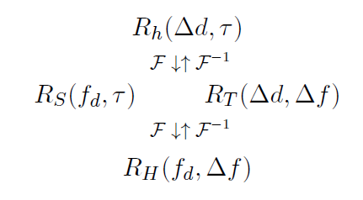
WSSUS
WSS – Temporal domain
US – Spatial domain
One parameter per domain
Independent domains

Slide 12
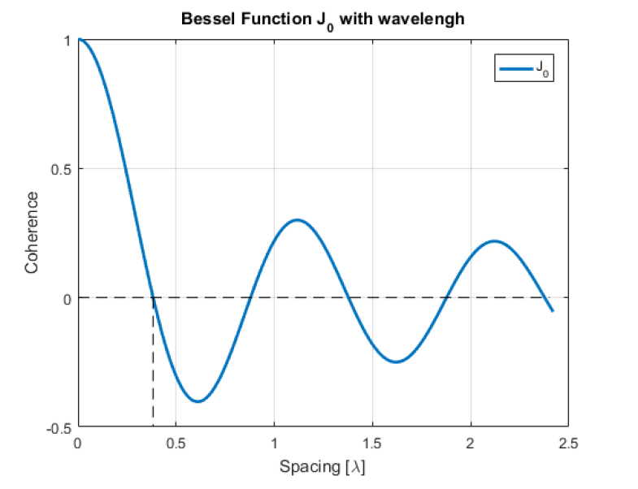

Space Correlation Function
FFT of Doppler spectrum
Assuming Rayleigh and Jakes bathtub.
Zero order bessel function
Uncorrelated samples 0.38λ

Slide 13
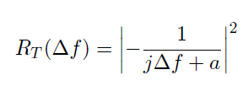
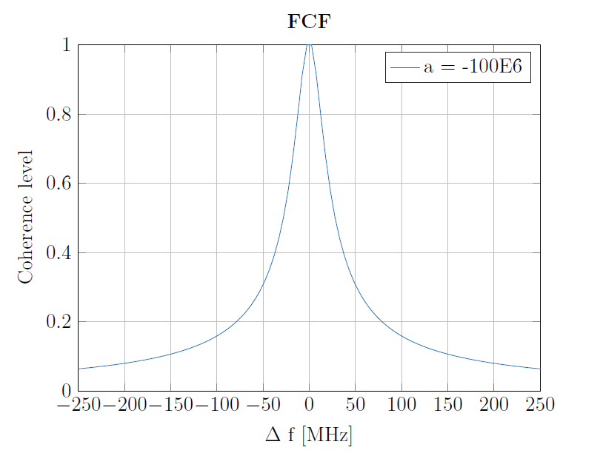

Frequency Correlation Function
FFT of Power Delay Profile(PDP)
Assuming exponential decay PDP
Small environment more Δf is needed
Approximation of coherence bandwidth
RMS delay spread inversely proportioned to coherence bandwidth

Slide 14
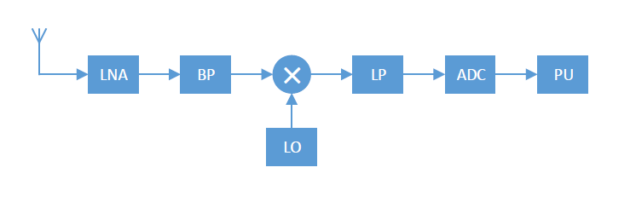
Receiver Structure
The basic receiver’s structure.
Receiver is influenced by :
Gain
Distortion
Noise
Noise is the dominant factor.
Calibration for distortion

Slide 15

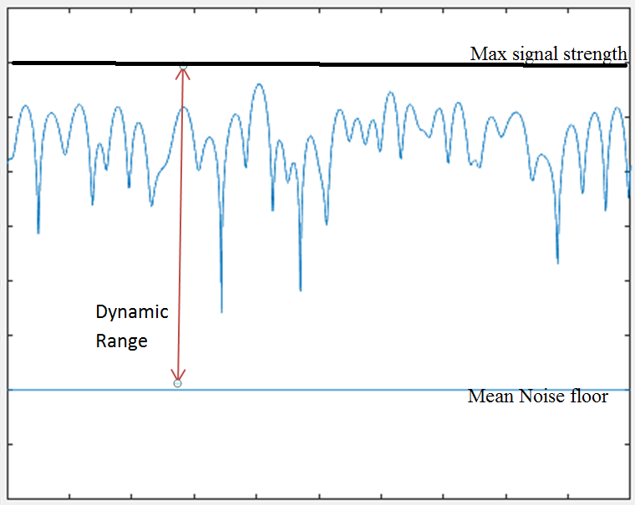
Dynamic Range
Sensitivity of the receiver to Max signal strength
Sensitivity lowest signal that meets the receiver’s criteria
In NA sensitivity=noise floor
Tradeoff between Narrowband-Wideband sample acquisition
Digital signal processing – averaging

Slide 16
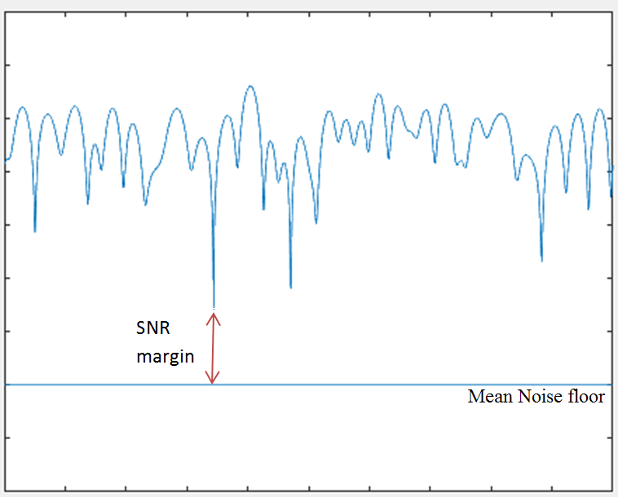
SNR Margin Estimation
Distinguish noise from deep fades
Rician distribution
K-factor is constant signal to noise
K-factor to SNR connection
For 90% confidence level and ± 1dB interval SNR margin is 14dB

Slide 17
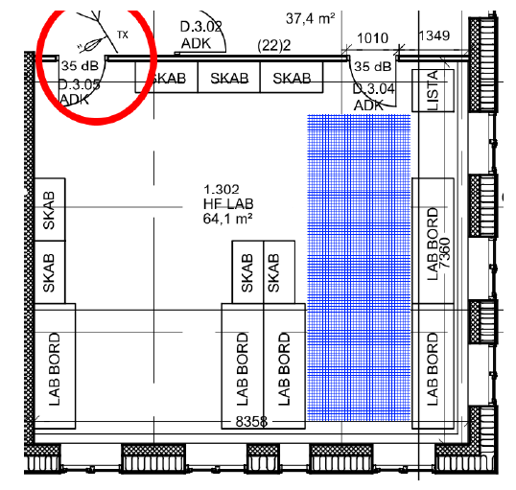
Measurement Setup
The measurements were contacted in the blue shaded space while The antenna position is circled with red.

Slide 18
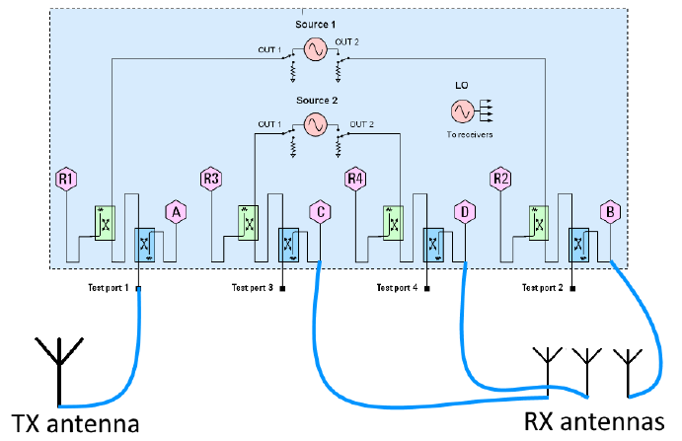
Equipment
Keysight 4-port Network Analyzer
Normalization of signal
RX omnidirectional antenna array fc 5GHz and 0.4λ spacing
Directional TX antenna 12dBi Gain and fc 5GHz

Slide 19
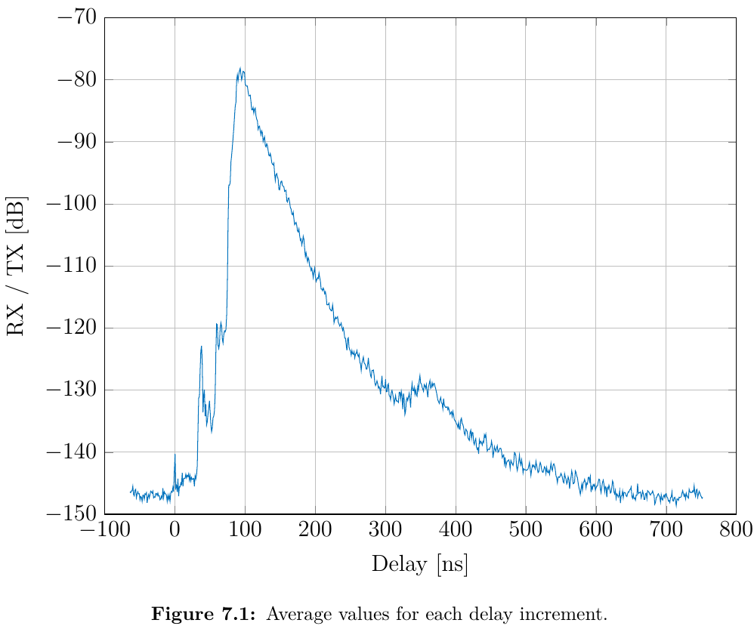
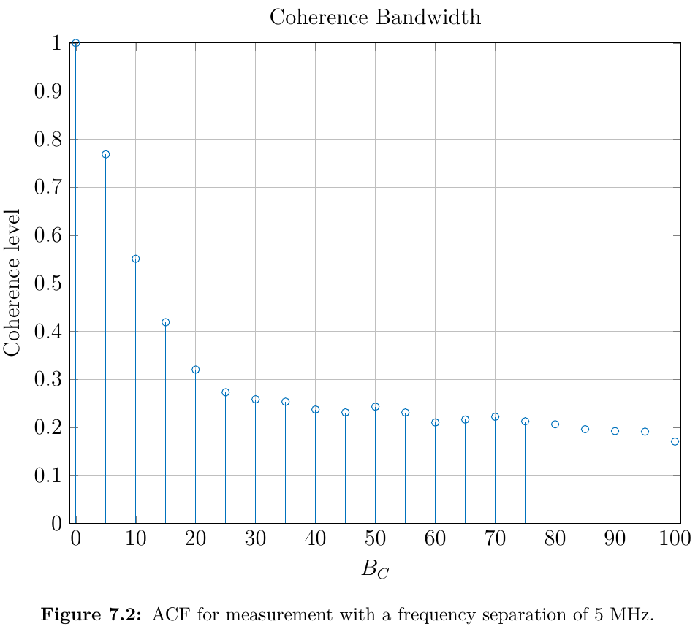
Measurement of Coherence Bandwidth
PDP measurement
20 different positions in the measurement area
RMS delay spread 14ns = 71.5MHz
New measurement with Δf 5MHz
Autocorrelation function to determine the Frequency Correlation
Correlation < 0.3 with Bc 25MHz

Slide 20
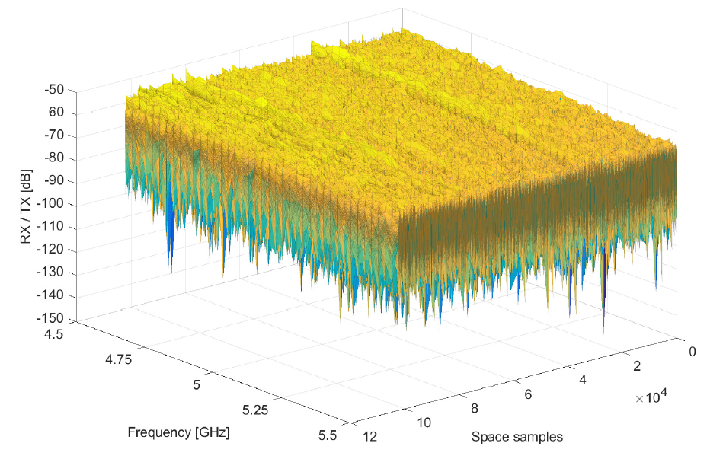
Fading Measurements-Results
162 walks for total combined length of 810 meters
41 frequency, 3 antennas and 34,020 space samples
Total 4,184,460 samples

Slide 21
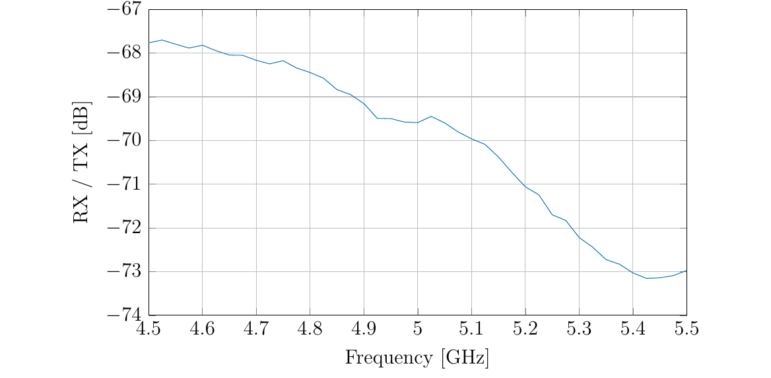
Data Processing
WSS stationarity criteria
Pathloss and Antenna gain
Normailze the data

Slide 22
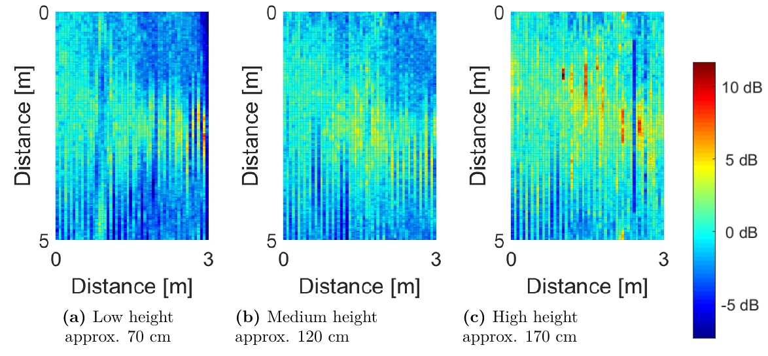
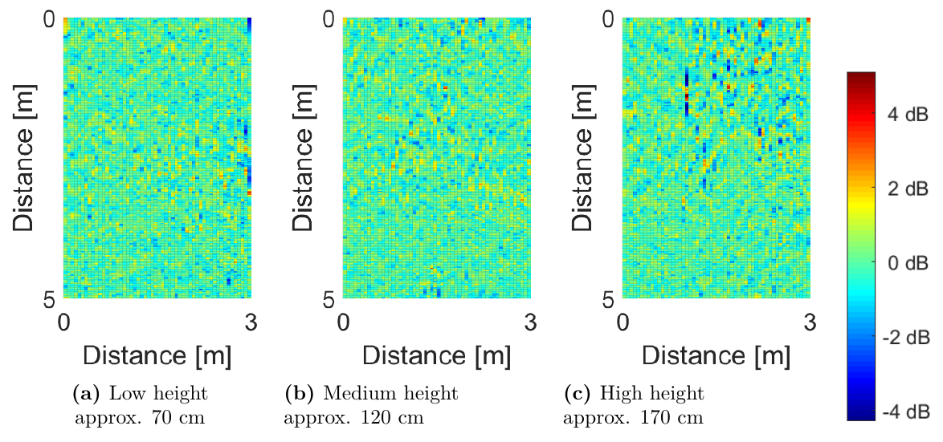
Data Processing
US stationarity criteria
Antenna domain is stationary
Main lobe reflection – not stationary
Moving average required

Slide 23
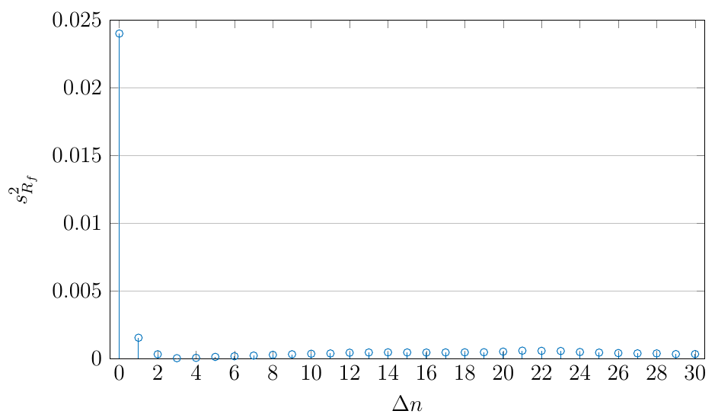
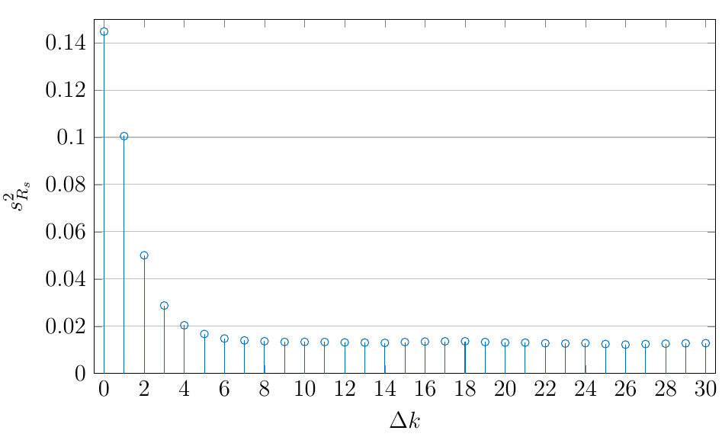
WSS and US proof
Check if auto-correlation depends only on the time lag
Sample mean and variance were found for both frequency and space
For each element the cross-covariance matrix is found
A higher diagonal variance in the spatial domain indicates a dominant component in the signal
Both domains dependent on only the delay

Slide 24
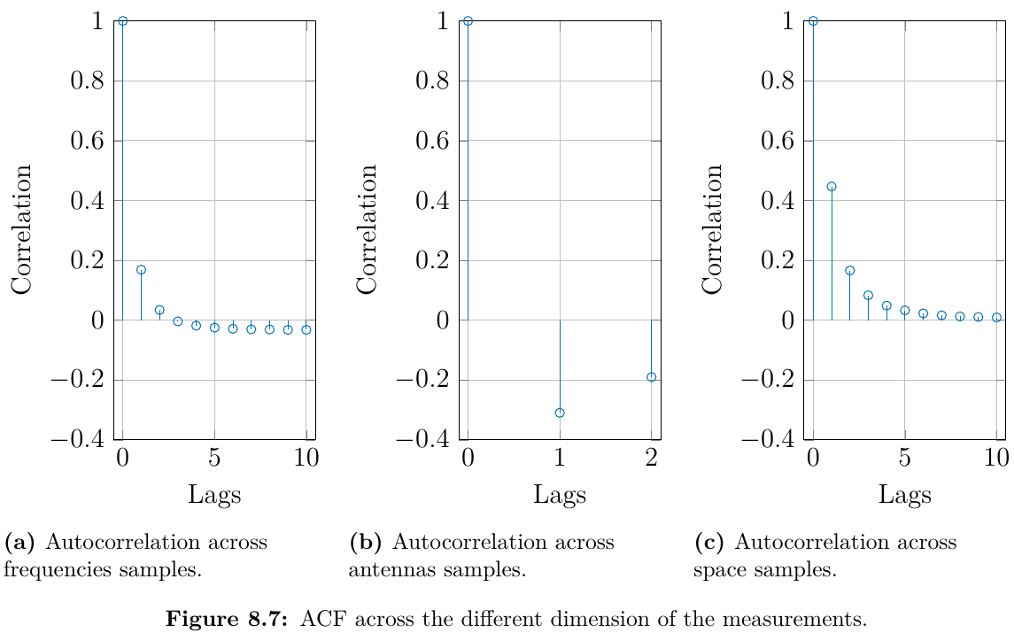
Frequency, Antenna and space correlation
Correlation < 0.3 is considered uncorrelated.
Antenna’s and frequency’s samples are uncorrelated
Space samples are too correlated with correlation of 0.45
Cause of this could be slow movement or the stationarity issue in space
The way to fix it was to remove samples from the sample pool
Every other sample was removed giving a correlation of 0.165

Slide 25
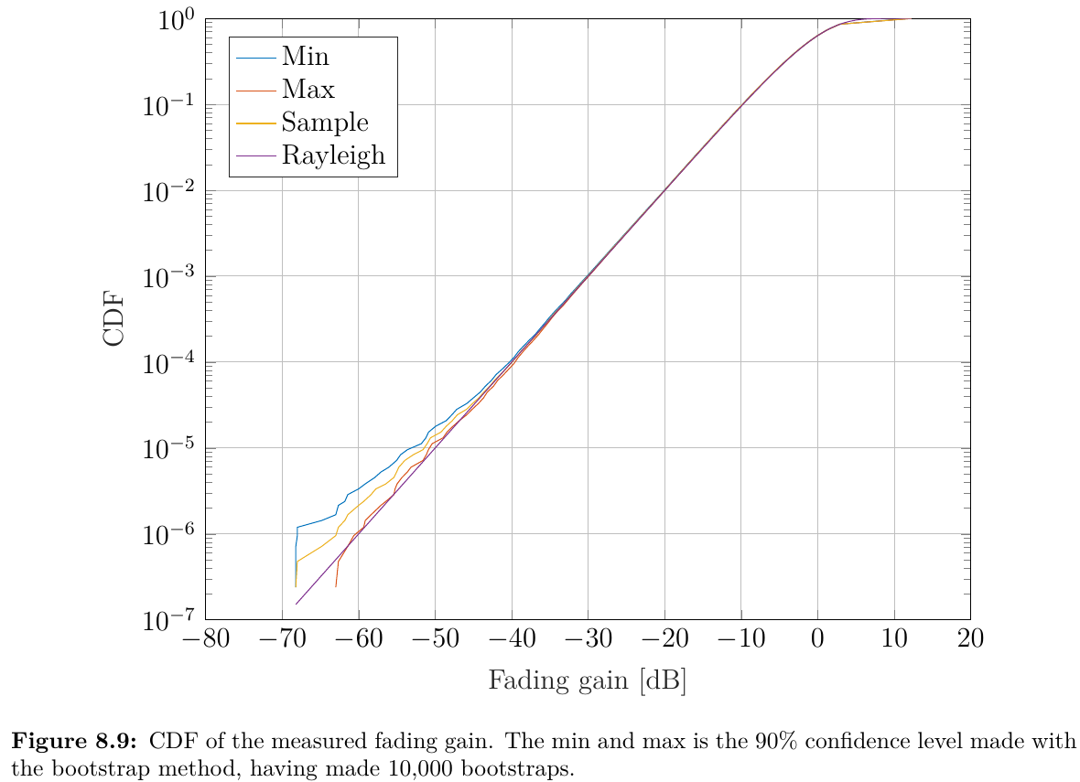
Results
Because of the lower sample size of 2,092,230 the confidence interval is increased.
10,000 bootstraps was used to find the end interval
-51.59dB fading gain with ±1.37dB interval of 90% confidence level

Slide 26
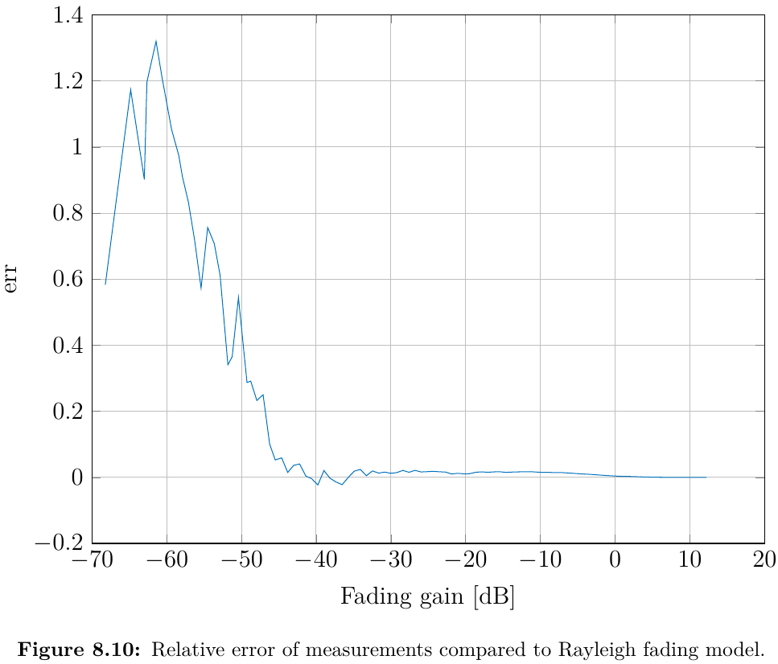
Results
Relative error of the measurements compared to the Rayleigh fading model.

Slide 27
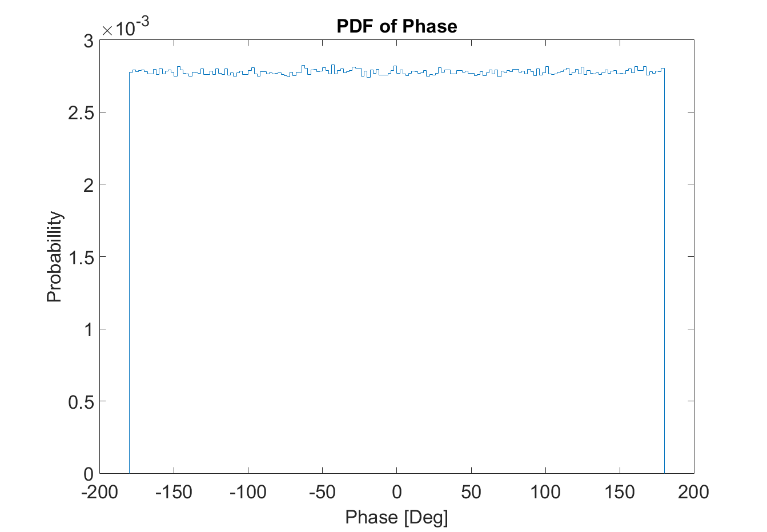
New Results

Slide 28
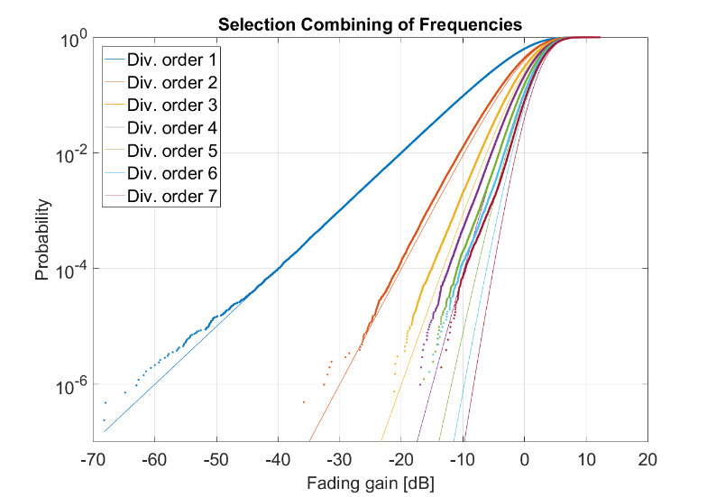
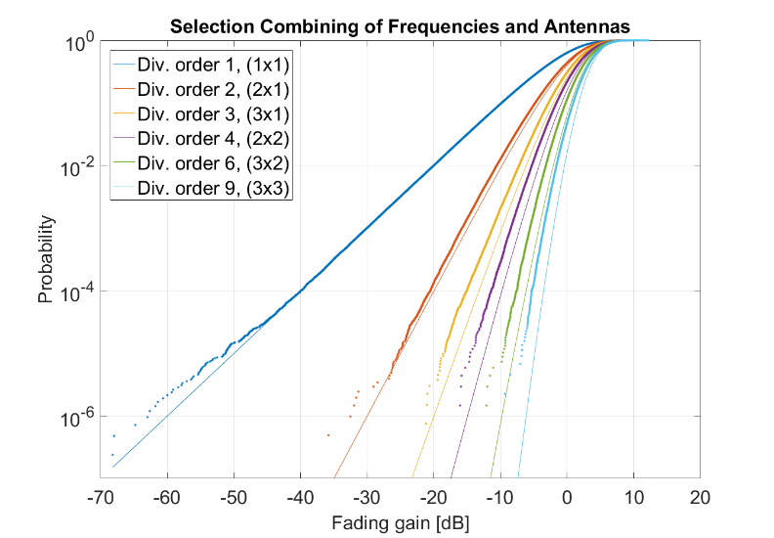
Diversity Combining

Slide 29
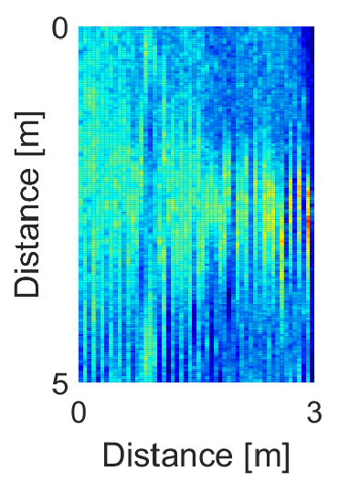
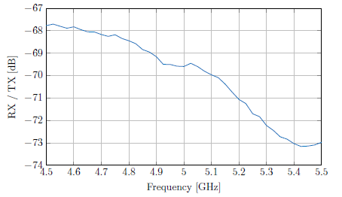
Uncertainties
WSSUS
Distance
Human error
Wide bandwidth
Phase correlation

Slide 30
Further Work
Using diversity to minimize needed SNR level
Using four antennas instead of three
Moving faster

Slide 31
Conclusion
Partly stationary
2E+6 uncorrelated samples
(1.58±1.37) dB error

Slide 32
Summary
Introduction
Wireless Channel
Statistical Aspect
WSSUS
Correlation
Dynamic Range
Measurement Setup
Data Processing
Results
Diversity Combining
Uncertainties
Further Work
Conclusion

