Slide 1

Tank Farm CT(Current Transformer) Installation (TKM101049) Work Final Report
1 / 6

Slide 2
TABLE OF CONTENTS
01
Work Final Report
02
Quotation
03
Drawing
04
Work Picture
2 / 6

Slide 3
■ 01 WORK FINAL REPORT
Work Final Report
1. Project Name: Tank Farm CT(Current Transformer) Installation
2. PO Number: TKM101049
3. Company Name: TK ELECTRIC LLC.
4. Contract Item: Electric Works
5. Work Description:
- Install CTs on the load-side feeders for each pump in the Pump Panel.
- Terminate control cables at each CT and route the cables to the PLC Panel.
- Complete control cable connections and verify proper CT installation and signal operation.
We hereby report that the above work (Tank Farm CT(Current Transformer) Installation) has been completed as described.
Completion Date: 2026-08-08
Contractor: TK ELECTRIC LLC.
3 / 6

Slide 4
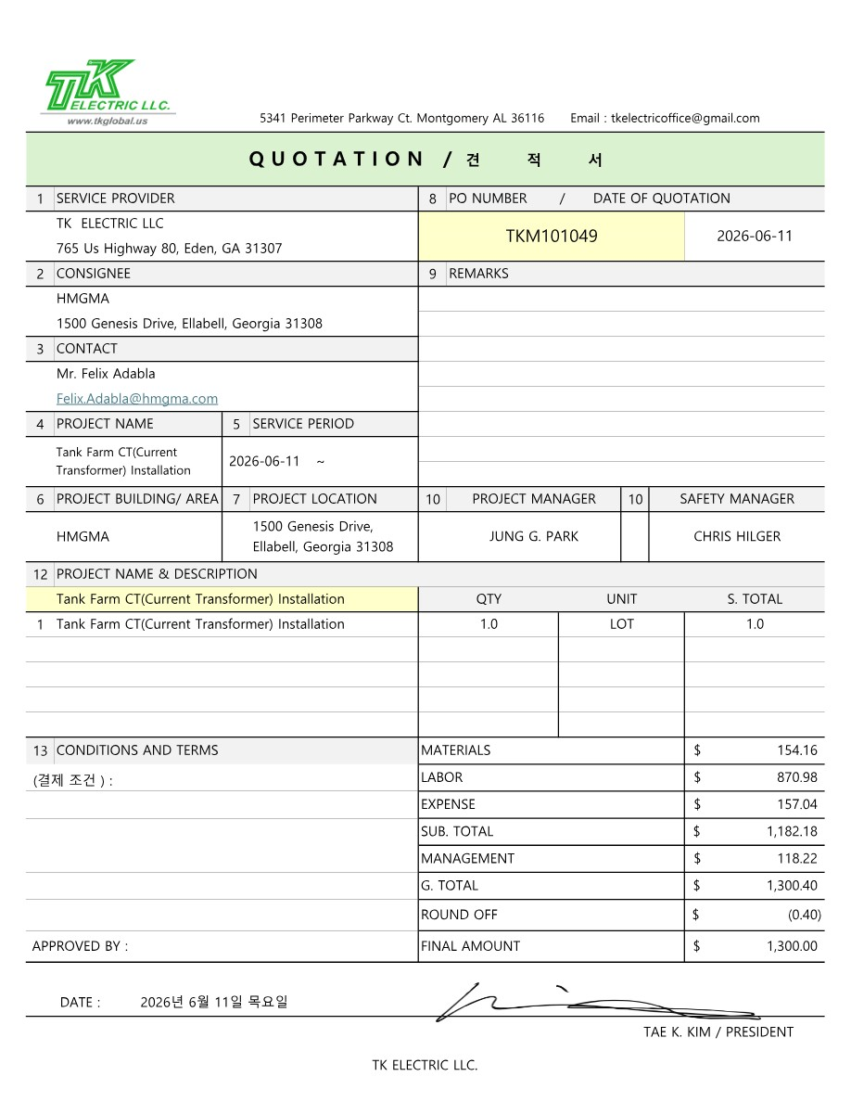
■ 02 QUOTATION
4 / 6

Slide 5
■ 03 DRAWING
Project Name | Tank Farm CT(Current Transformer) Installation | Duration | 2026-08-08
Location | Tank Farm | Contractor | TK Electric LLC
Drawing
[N/A]
5 / 6

Slide 6
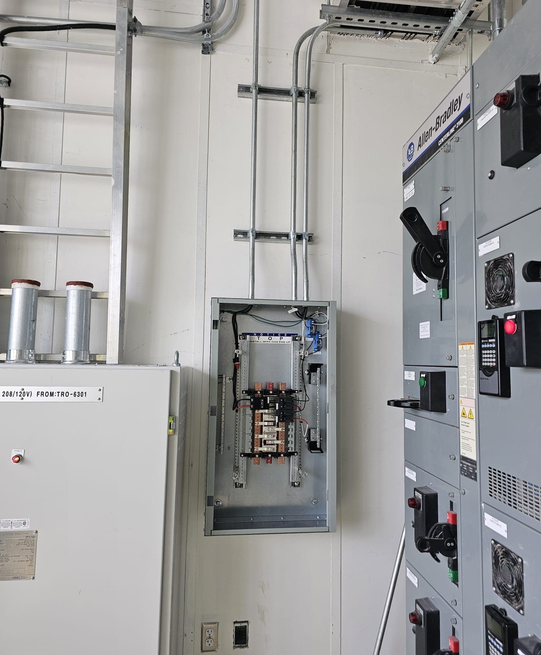
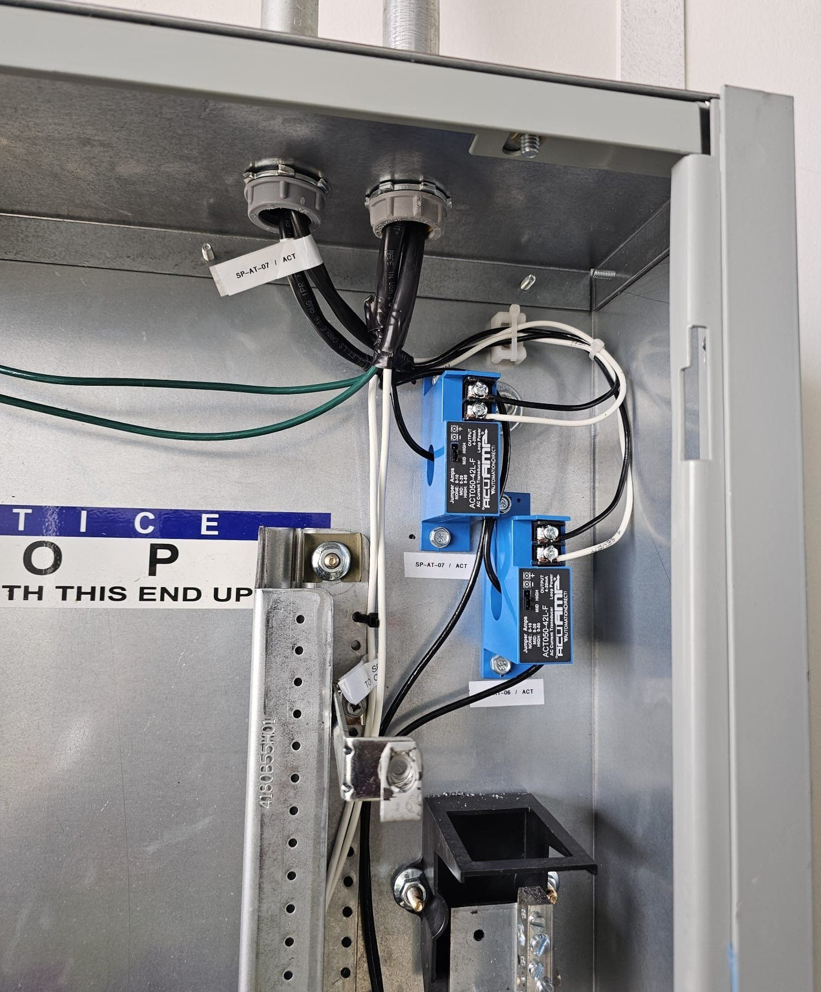
■ 04 WORK PICTURE
Project Name | Tank Farm CT(Current Transformer) Installation | Duration | 2026-08-08
Location | Tank Farm | Contractor | TK Electric LLC
Panel CT Installation 1
Panel CT Installation 2
6 / 6

