Slide 1

General Assembly Repair Area Electrical Work(TKM101012)
Work Final Report

Slide 2

■ PROJECT COMPLETION REPORT
Work Final Report
1. Project Name: General Assembly Repair Area Electrical Work
2. PO Number: TKM101012
3. Company Name: TK ELECTRIC LLC.
4. Contract Item: Electric Works
5. Work Description: General Assembly Repair Area Electrical Work
- Install 480V, 100A, 3P, 3W electrical panel with eight (8) 20A, 2P circuit breakers in the Polishing Area
- Install eight (8) L8-30R receptacles for infrared lamps in the Polishing Area
- Install two (2) quad receptacles in the Repair Area
We hereby report that the above work (General Assembly Repair Area Electrical Work)
has been completed as described.
Completion Date: Jan. 25. 2026
Contractor: TK ELECTRIC LLC.

Slide 3
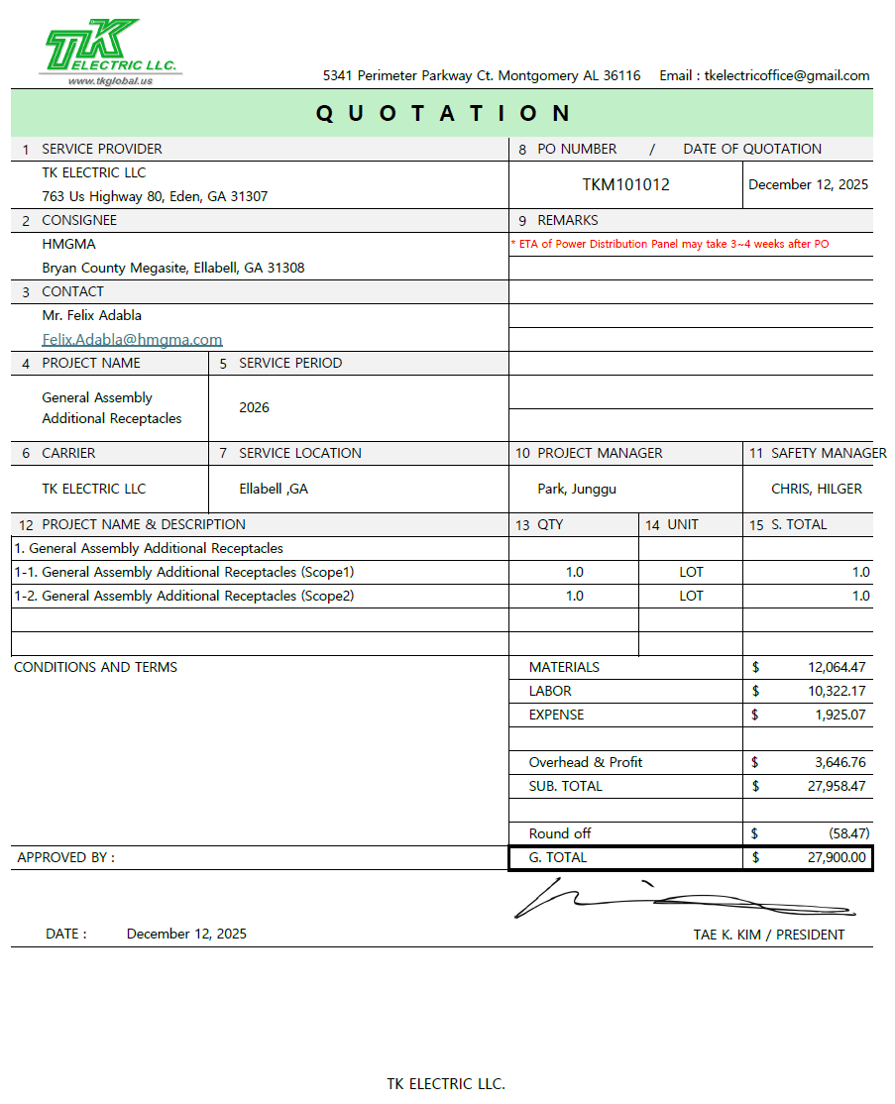
■ PROJECT COMPLETION REPORT

Slide 4
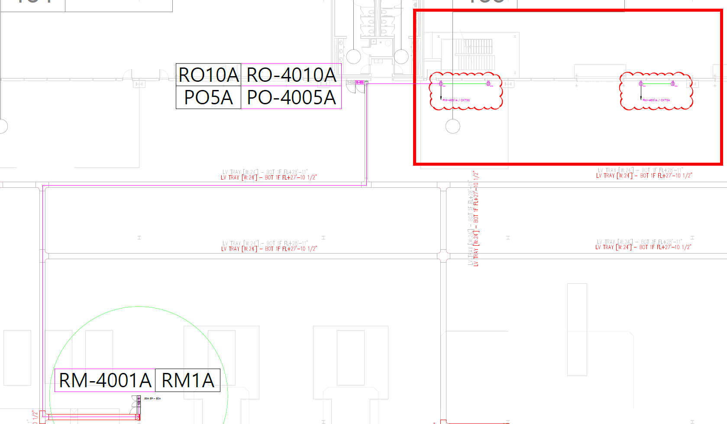
■ PROJECT COMPLETION REPORT
Project Name | General Assembly Repair Area Electrical Work | Duration | Jan. 22. 2026 ~ Jan. 25. 2026
 |  | Contractor | TK Electric LLC
Location | General Assembly(Repair Area)
Drawing

Slide 5
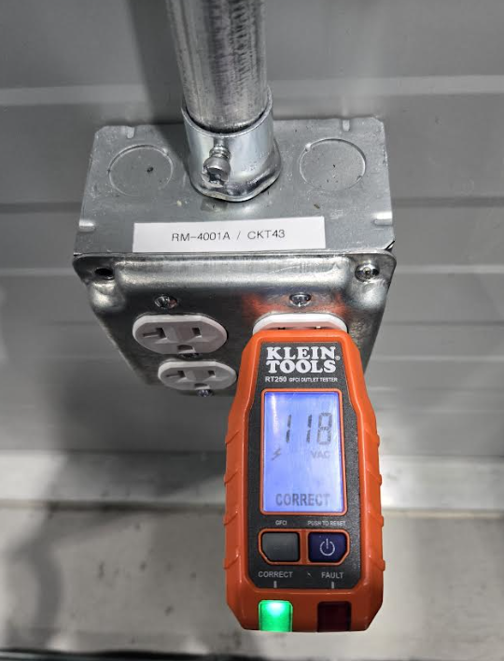
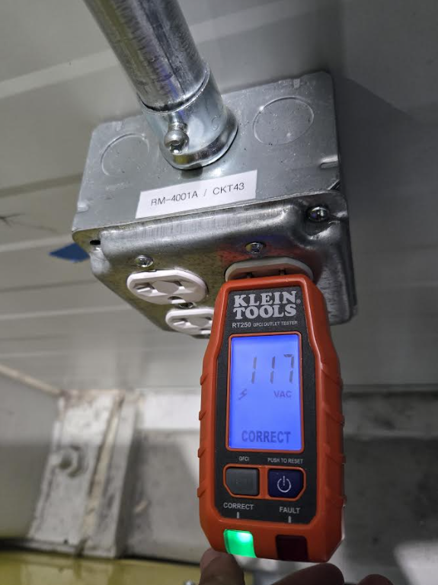
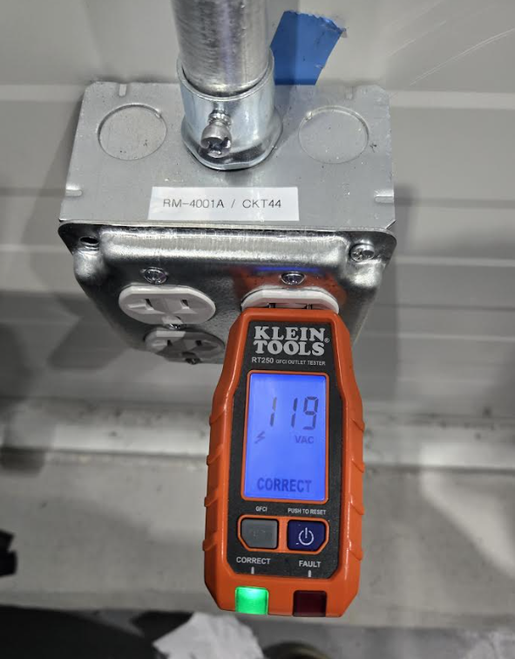
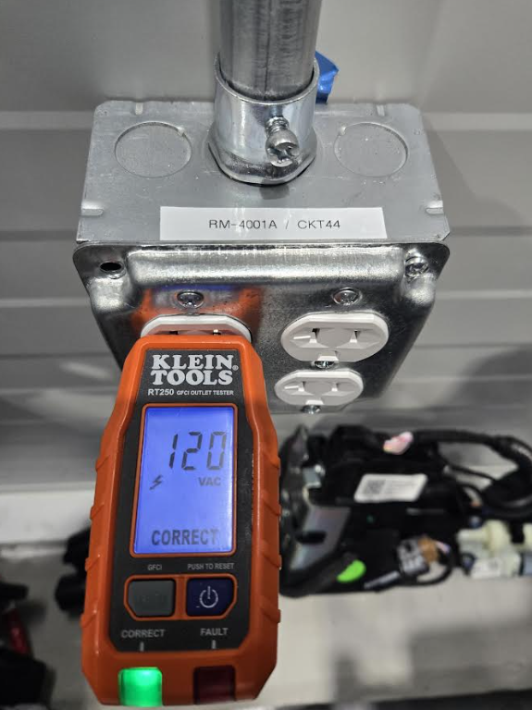
■ PROJECT COMPLETION REPORT
Project Name | General Assembly Repair Area Electrical Work | Duration |  | Jan. 22. 2026 ~ Jan. 25. 2026
 |  | Contractor |  | TK Electric LLC
Location | General Assembly(Repair Area)
Date | Jan. 25. 2026 (SUN) | Date | Jan. 25. 2026 (SUN)
Description | RM-4001A / CKT43 RECEPTACLES(QUAD) TEST | Description | RM-4001A / CKT44 RECEPTACLES(QUAD) TEST

Slide 6
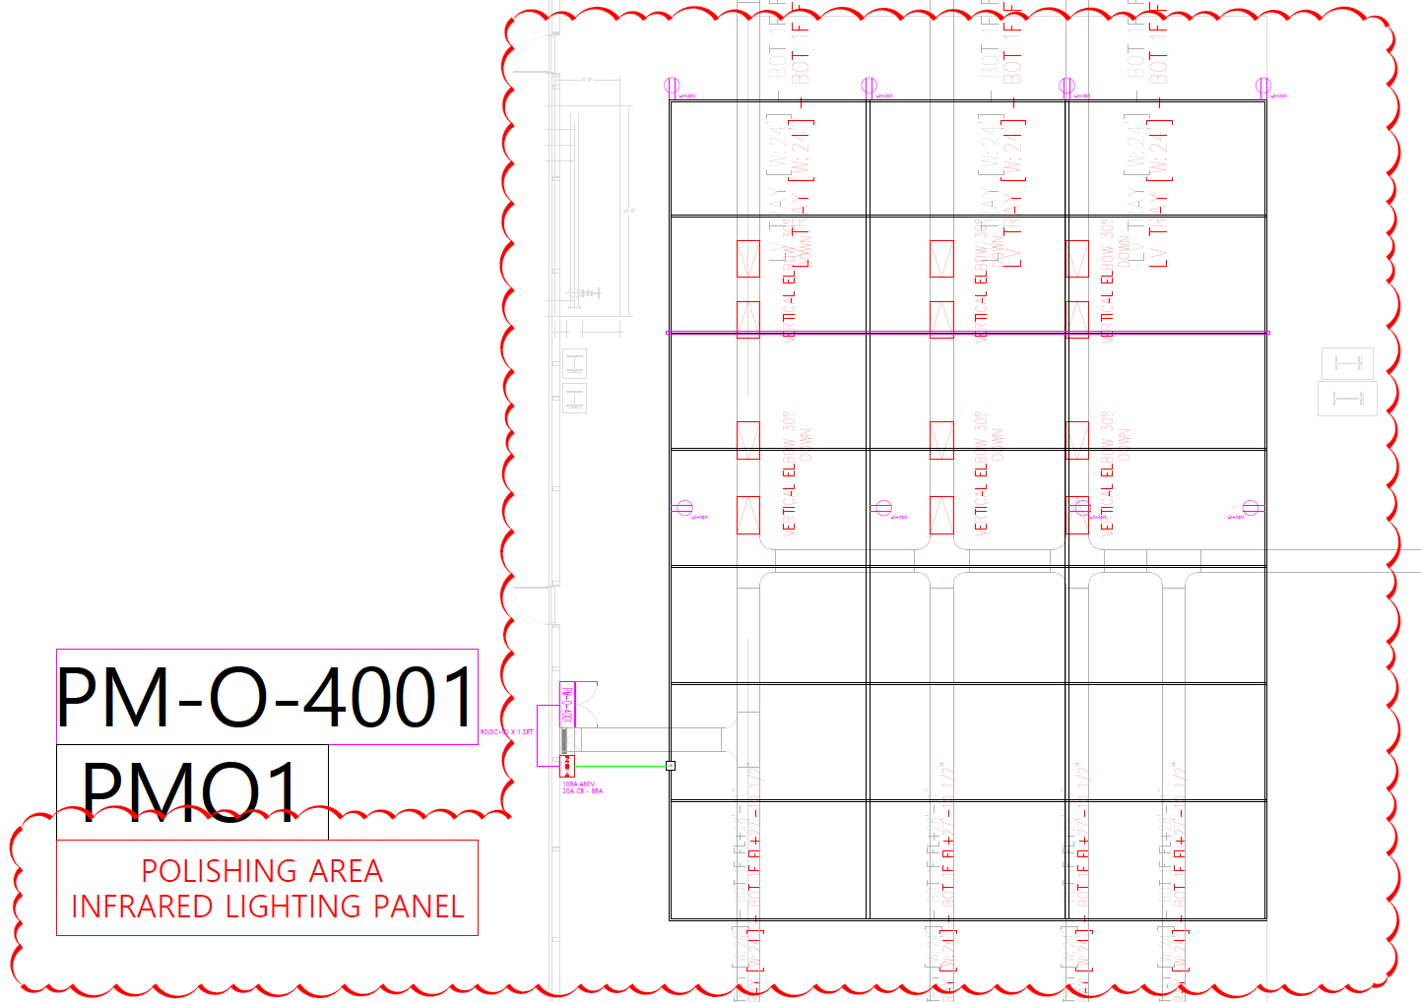
■ PROJECT COMPLETION REPORT
Project Name | General Assembly Repair Area Electrical Work | Duration | Jan. 22. 2026 ~ Jan. 25. 2026
 |  | Contractor | TK Electric LLC
Location | General Assembly(Polishing Area)
Drawing

Slide 7
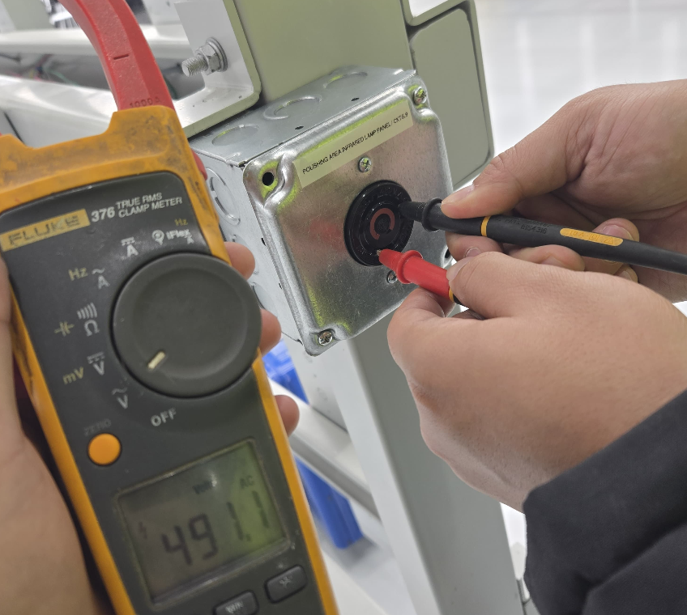
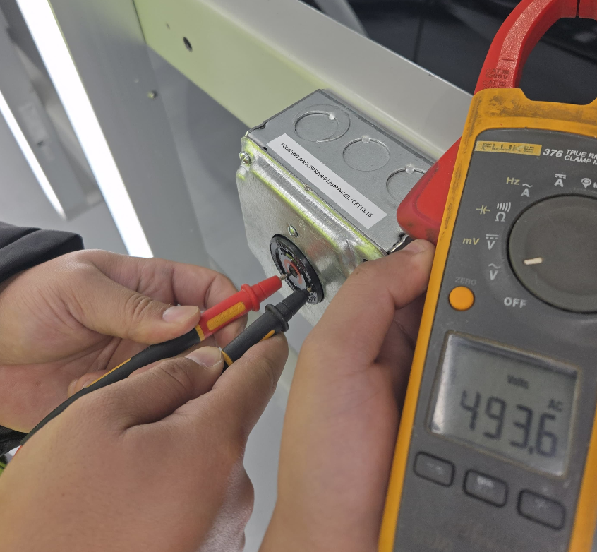
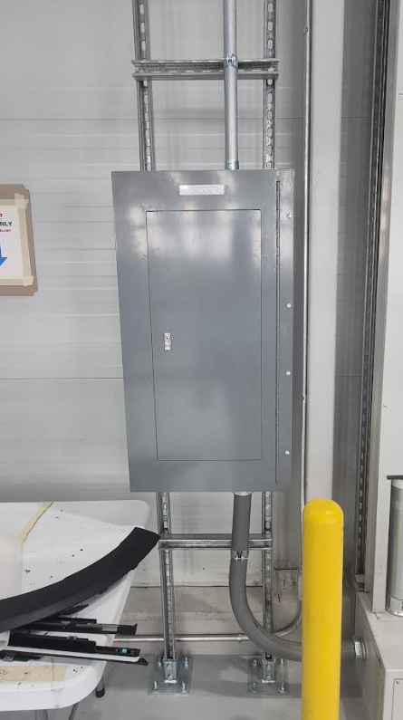
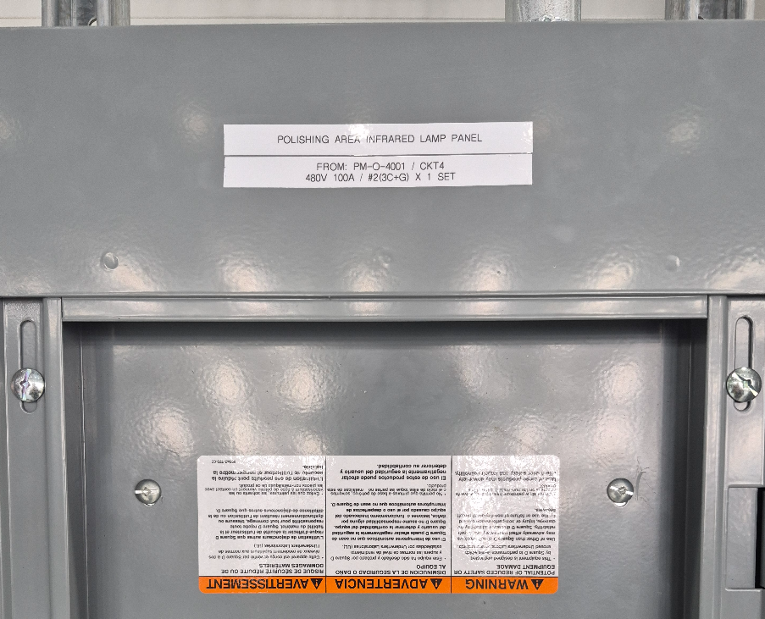
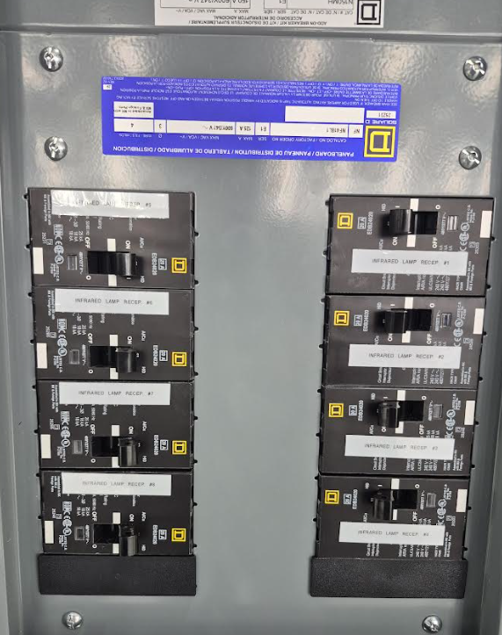
■ PROJECT COMPLETION REPORT
Project Name | General Assembly Repair Area Electrical Work | Duration |  | Jan. 22. 2026 ~ Jan. 25. 2026
 |  | Contractor |  | TK Electric LLC
Location | General Assembly(Polishing Area)
Date | Jan. 25. 2026 (SUN) | Date | Jan. 25. 2026 (SUN)
Description | RECEPTACLES(L8-30R) FOR INFARED LAMPS TEST | Description | POLISHING AREA INFARED LAMP PANEL INSTALL

Slide 8
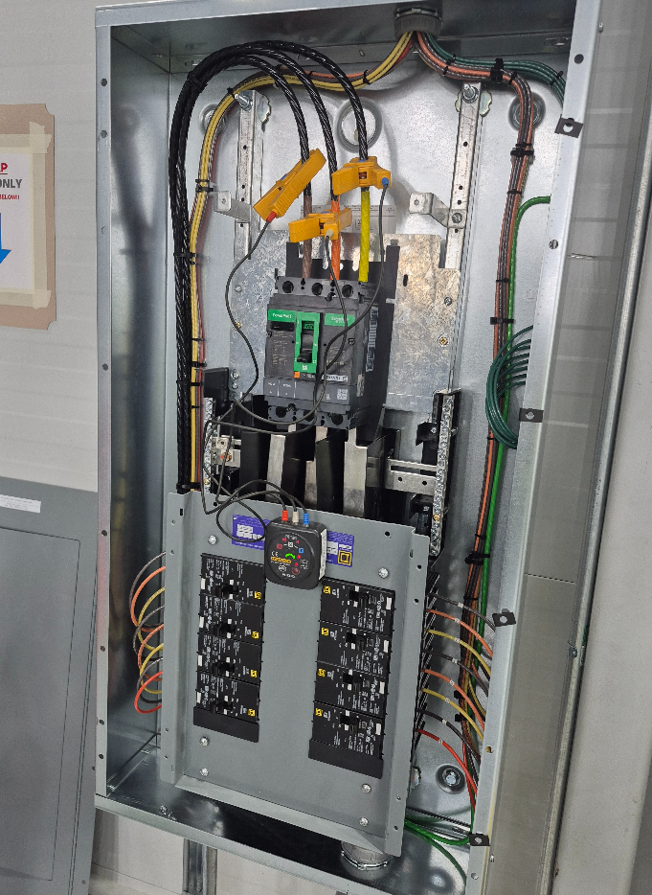
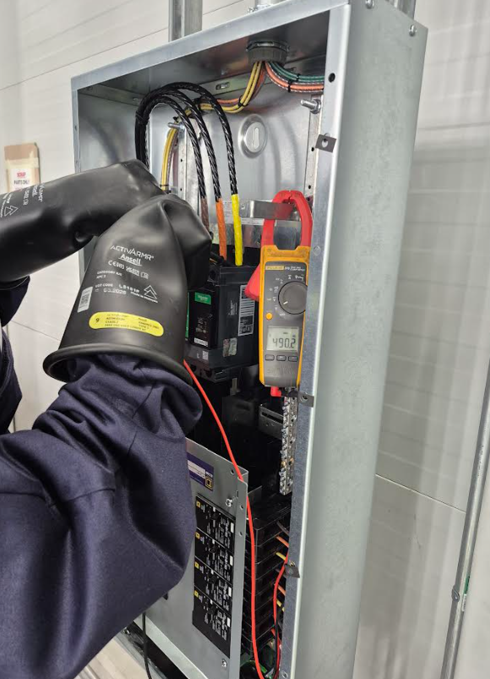
■ PROJECT COMPLETION REPORT
Project Name | General Assembly Repair Area Electrical Work | Duration |  | Jan. 22. 2026 ~ Jan. 25. 2026
 |  | Contractor |  | TK Electric LLC
Location | General Assembly(Polishing Area)
Date | Jan. 25. 2026 (SUN) | Date | Jan. 25. 2026 (SUN)
Description | POLISHING AREA INFARED LAMP PANEL ROTATION TEST | Description | POLISHING AREA INFARED LAMP PANEL VOLTAGE TEST

