Slide 1

Installation of HVLS Ceiling Fans (TK10271001) Work Final Report

Slide 2
TABLE OF CONTENTS
01
Work Final Report
02
Quotation
03
Drawing
04
Work Picture
05
Work Picture

Slide 3
■ WORK FINAL REPORT
Work Final Report
1. Project Name: Installation of HVLS Ceiling Fans
2. PO Number: TK10271001
3. Company Name: TK ELECTRIC LLC.
4. Contract Item: Electric Works
5. Work Description:
- Installed HVLS ceiling fans.
- Installed conduit and power wiring for ceiling fan power supply.
- Installed boxes, conduit, and wiring for fan controllers.
- Performed functional testing and labeling after installation.
We hereby report that the above work (Installation of HVLS Ceiling Fans) has been completed as described.
Completion Date: 2026-07-01
Contractor: TK ELECTRIC LLC.

Slide 4
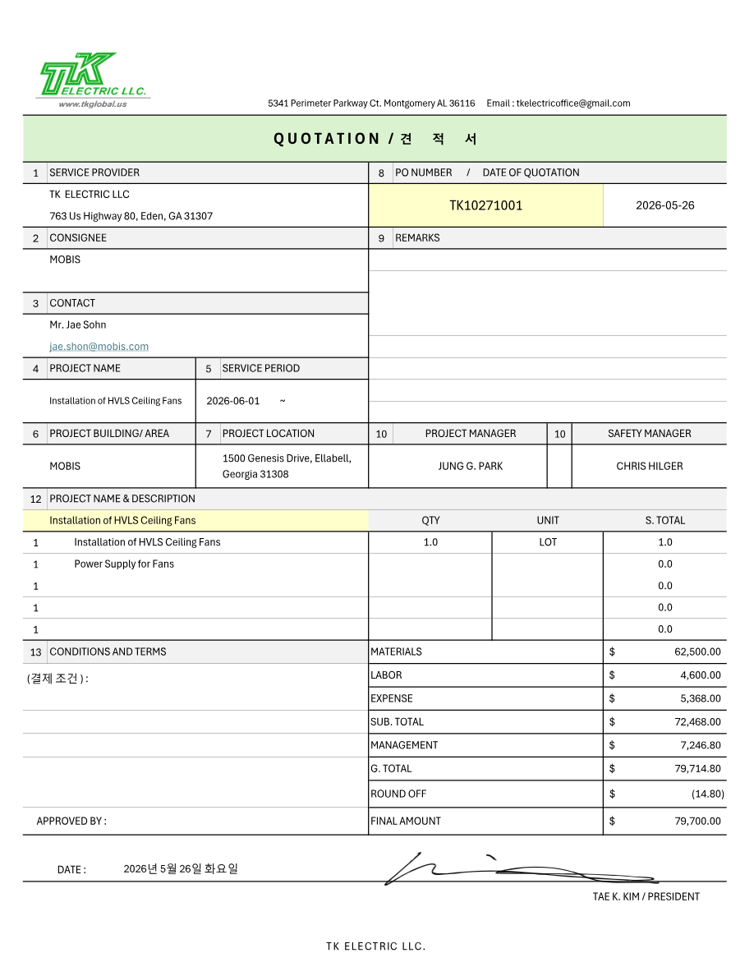
■ QUOTATION

Slide 5
■ DRAWING
Project Name | Installation of HVLS Ceiling Fans | Duration | 2026-07-01
Location | Module | Contractor | TK Electric LLC
Drawing
[ Drawing image not uploaded ]

Slide 6
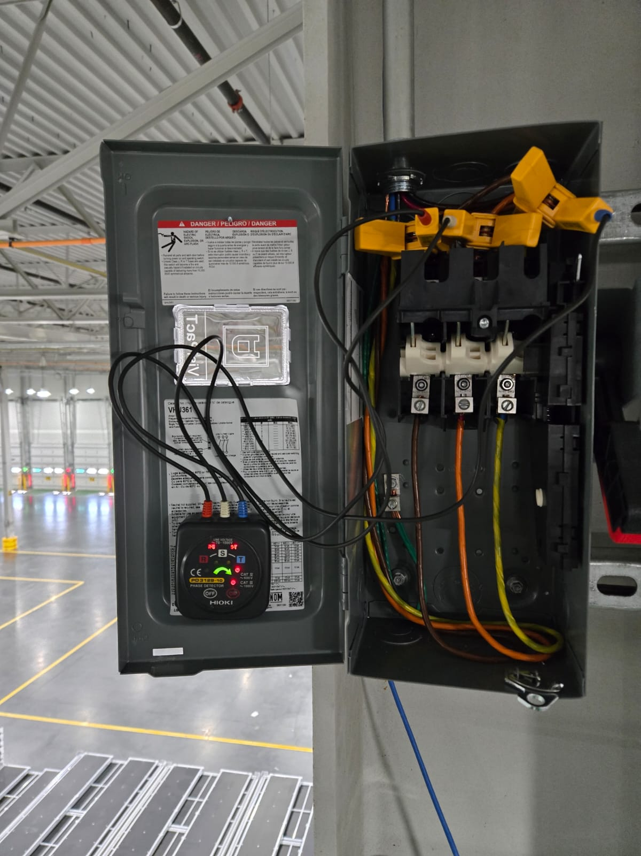
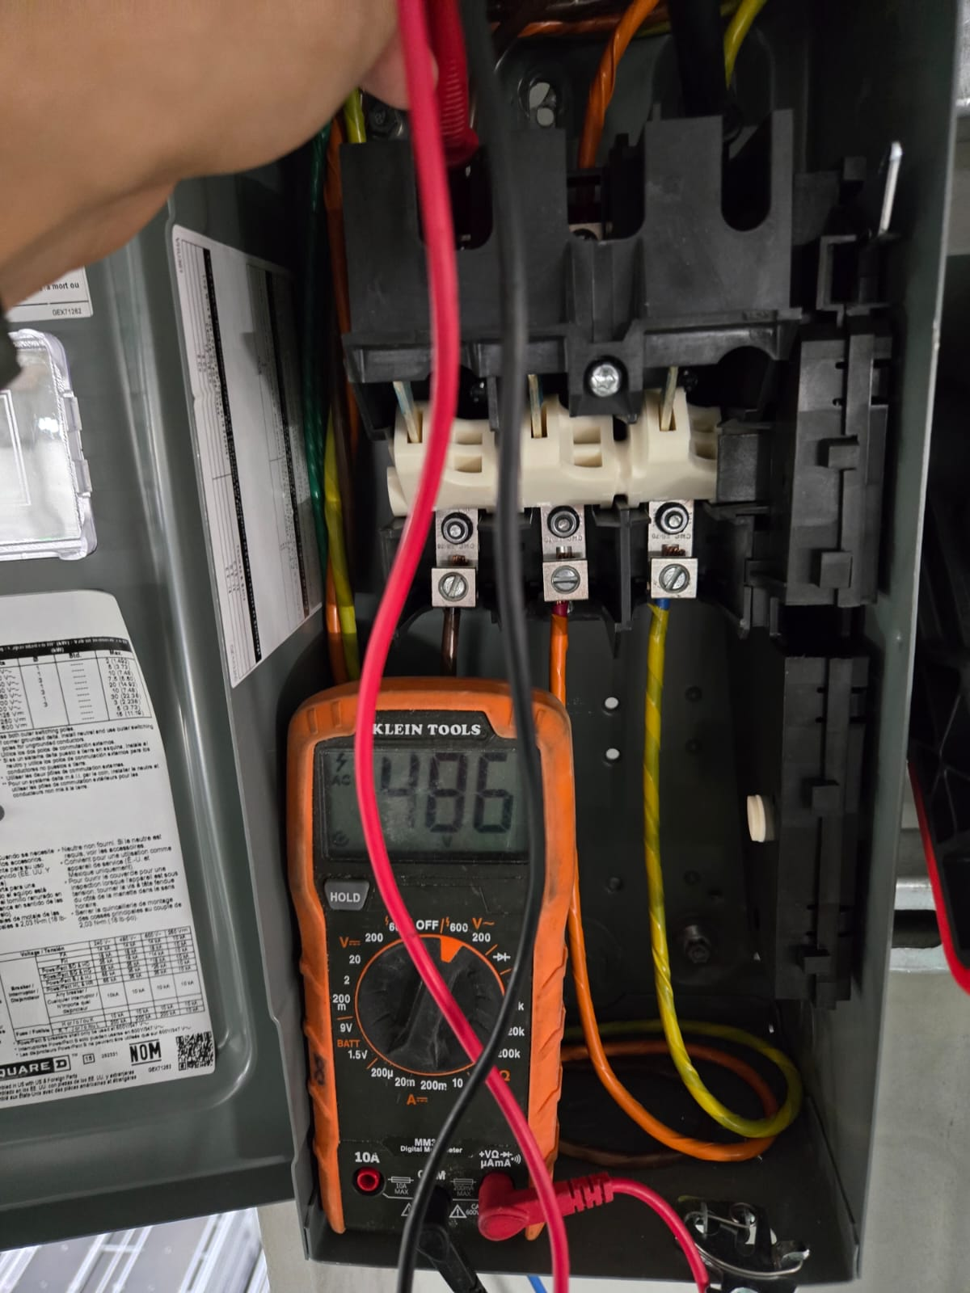
■ WORK PICTURE 1 / 3
Project Name | Installation of HVLS Ceiling Fans | Duration | 2026-07-01
Location | Module | Contractor | TK Electric LLC
—
—

Slide 7
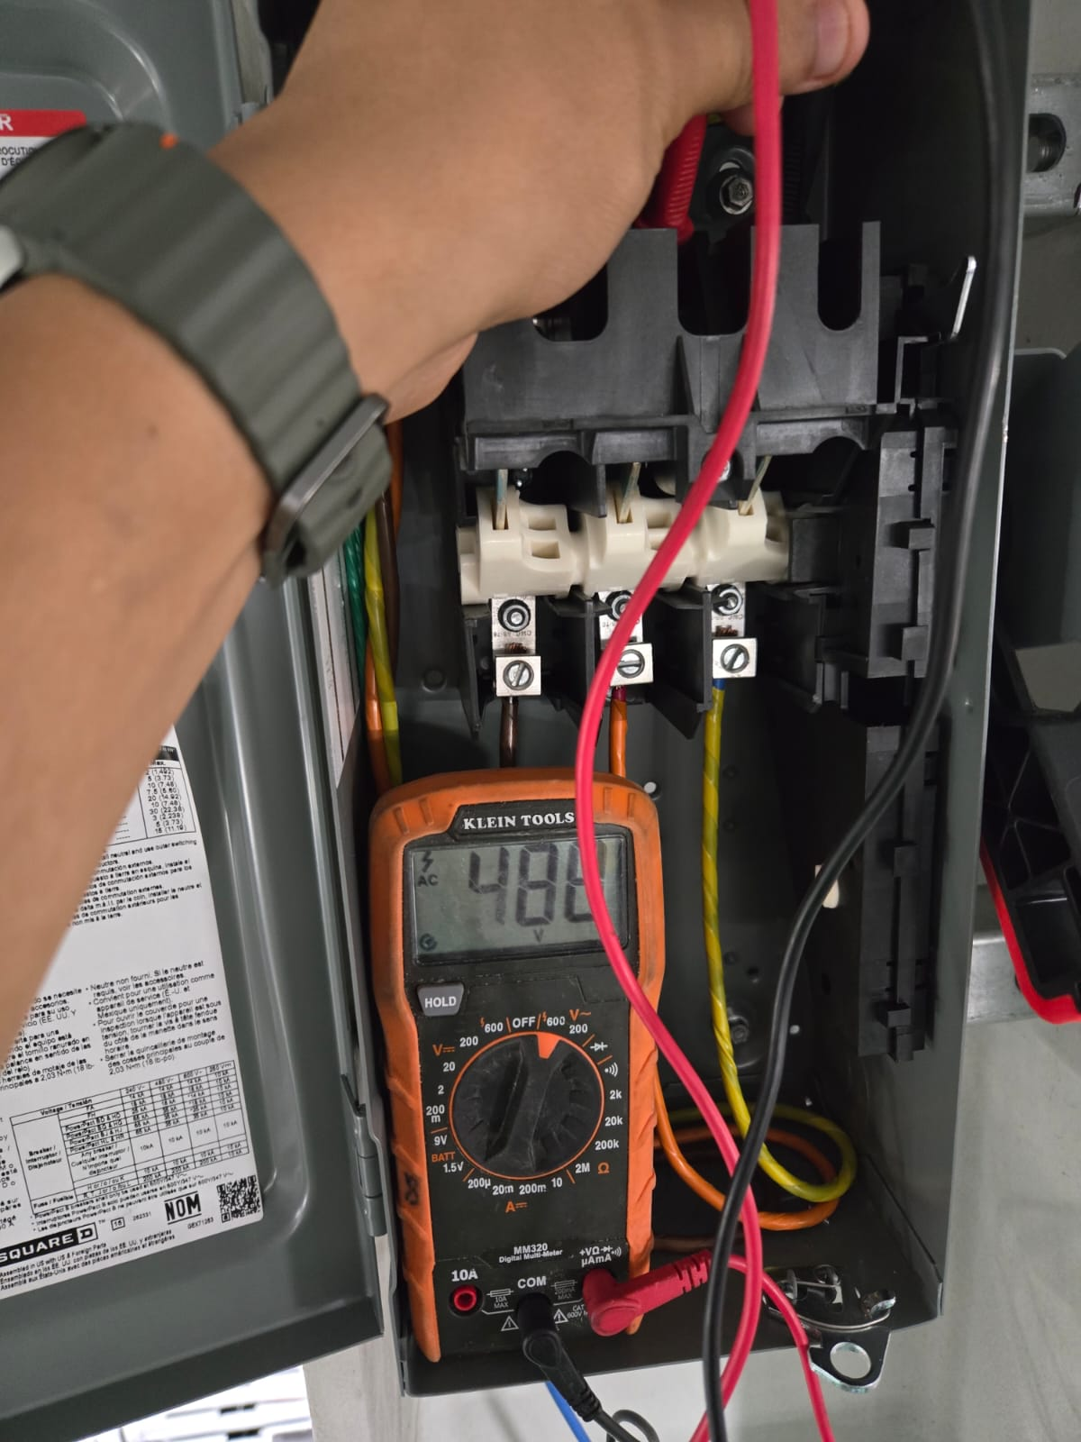
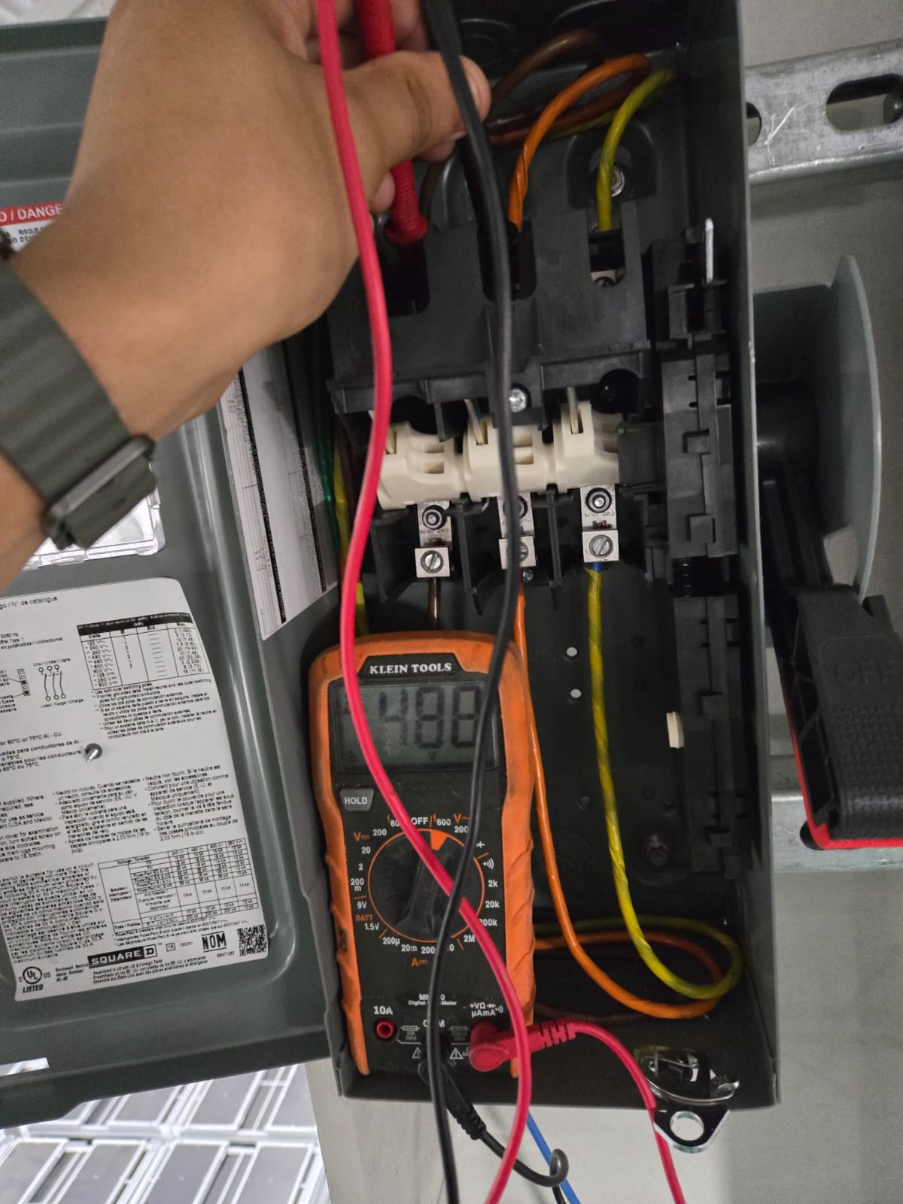
■ WORK PICTURE 2 / 3
Project Name | Installation of HVLS Ceiling Fans | Duration | 2026-07-01
Location | Module | Contractor | TK Electric LLC
—
—

Slide 8
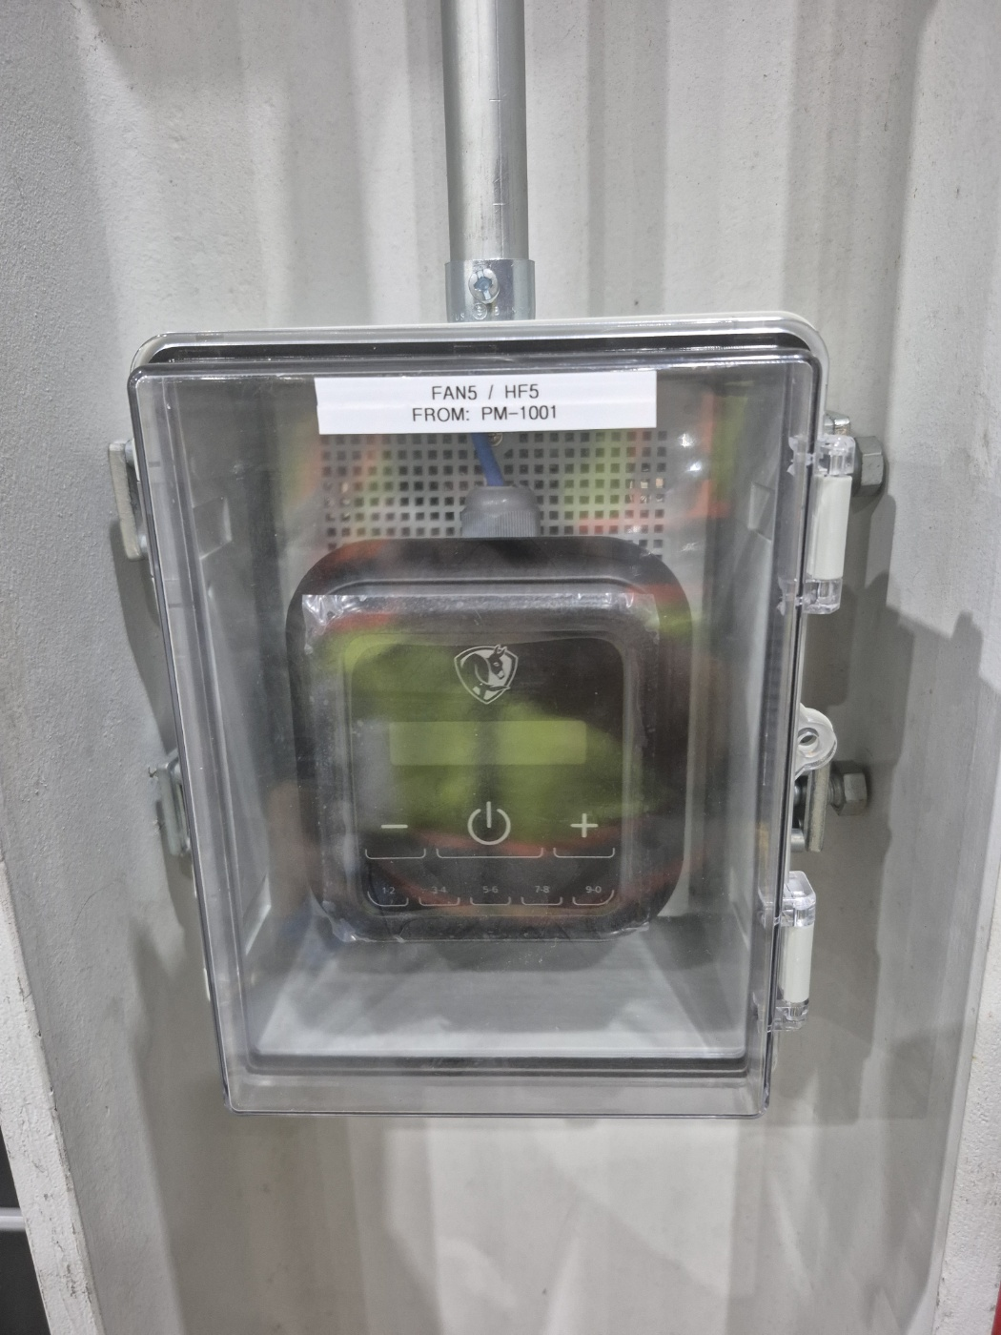
■ WORK PICTURE 3 / 3
Project Name | Installation of HVLS Ceiling Fans | Duration | 2026-07-01
Location | Module | Contractor | TK Electric LLC
—
—

Slide 9
■ WORK PICTURE 1 / 1
Project Name | Installation of HVLS Ceiling Fans | Duration | 2026-07-01
Location | Module | Contractor | TK Electric LLC
[ No photos uploaded ]

