Slide 1

Head Office Receptacle Installation / Hole Cutting (TKM101050) Work Final Report
1 / 7

Slide 2
TABLE OF CONTENTS
01
Work Final Report
02
Quotation
03
Drawing
04
Photos of Receptacle
05
Photos of Audio 6 Holes
2 / 7

Slide 3
■ 01 WORK FINAL REPORT
Work Final Report
1. Project Name: Head Office Receptacle Installation / Hole Cutting
2. PO Number: TKM101050
3. Company Name: TK ELECTRIC LLC.
4. Contract Item: Electric & General Works
5. Work Description:
- Installed 120V receptacles and performed testing to verify proper operation.
-
- Cut six (6) holes for audio system installation.
We hereby report that the above work (Head Office Receptacle Installation / Hole Cutting) has been completed as described.
Completion Date: 2026-07-08
Contractor: TK ELECTRIC LLC.
3 / 7

Slide 4
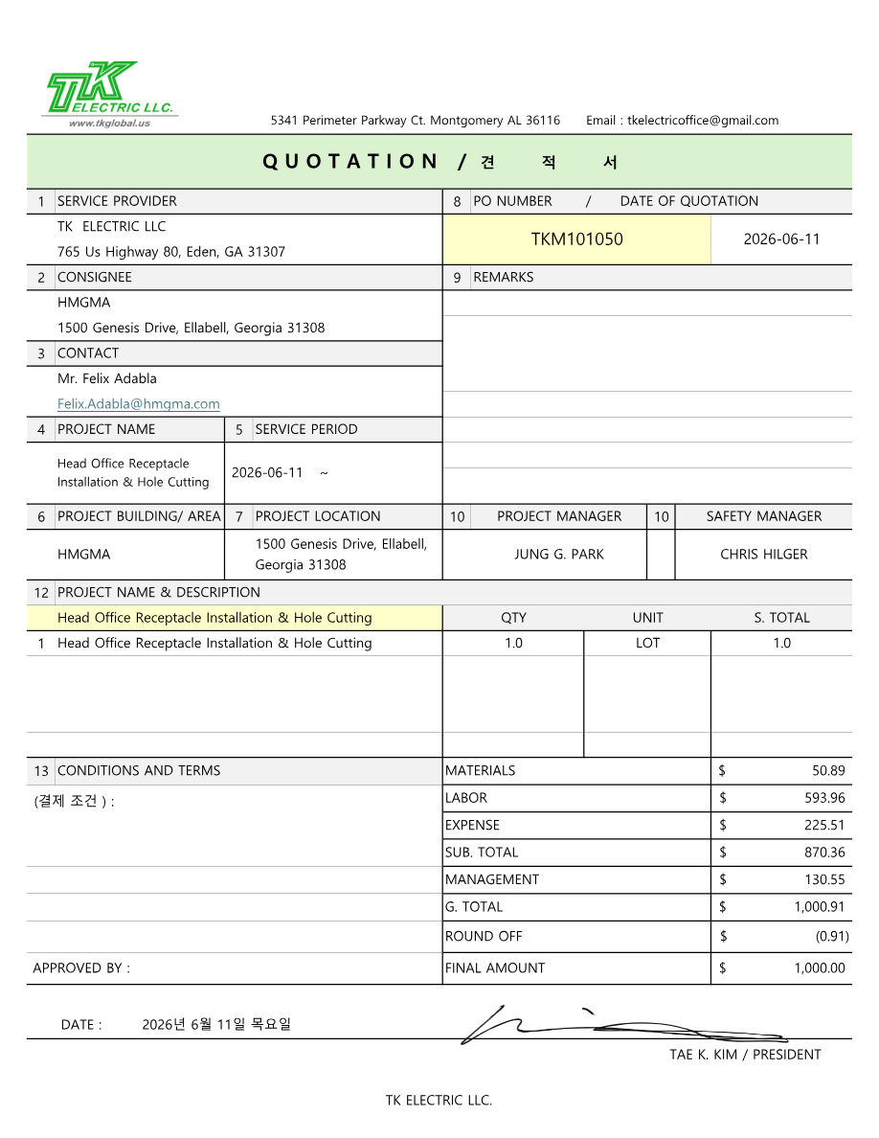
■ 02 QUOTATION
4 / 7

Slide 5
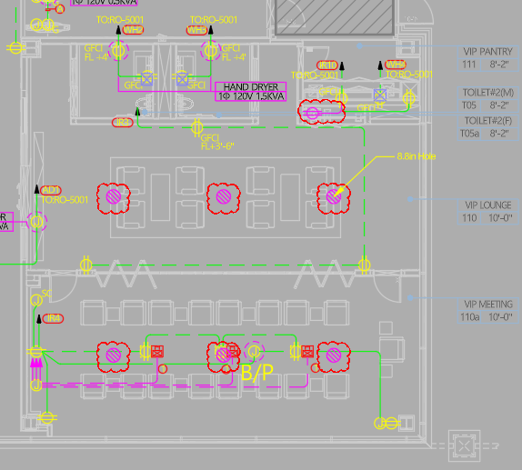
■ 03 DRAWING
Project Name | Head Office Receptacle Installation / Hole Cutting | Duration | 2026-07-08
Location | Head Office | Contractor | TK Electric LLC
Drawing
5 / 7

Slide 6
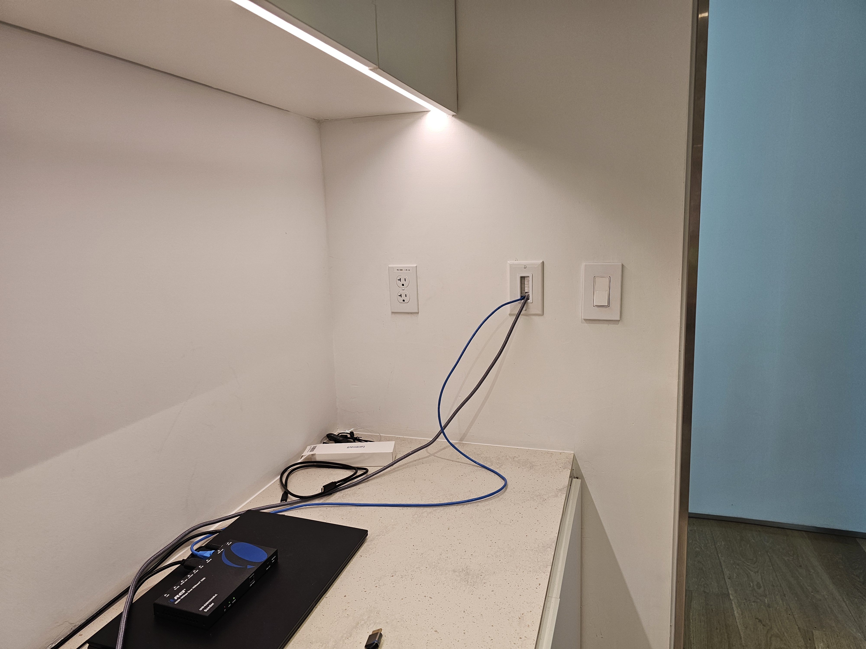
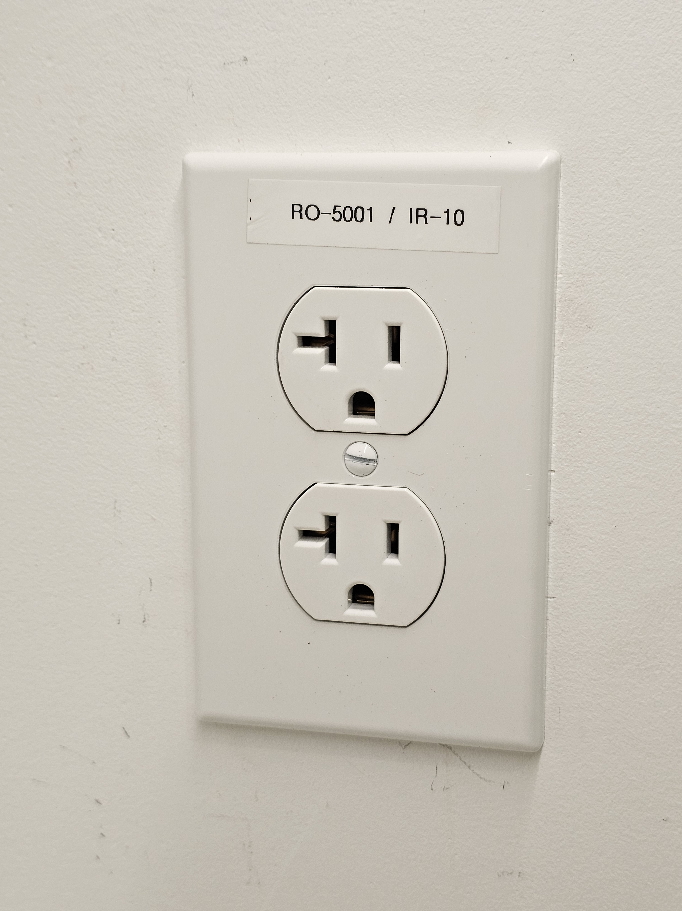
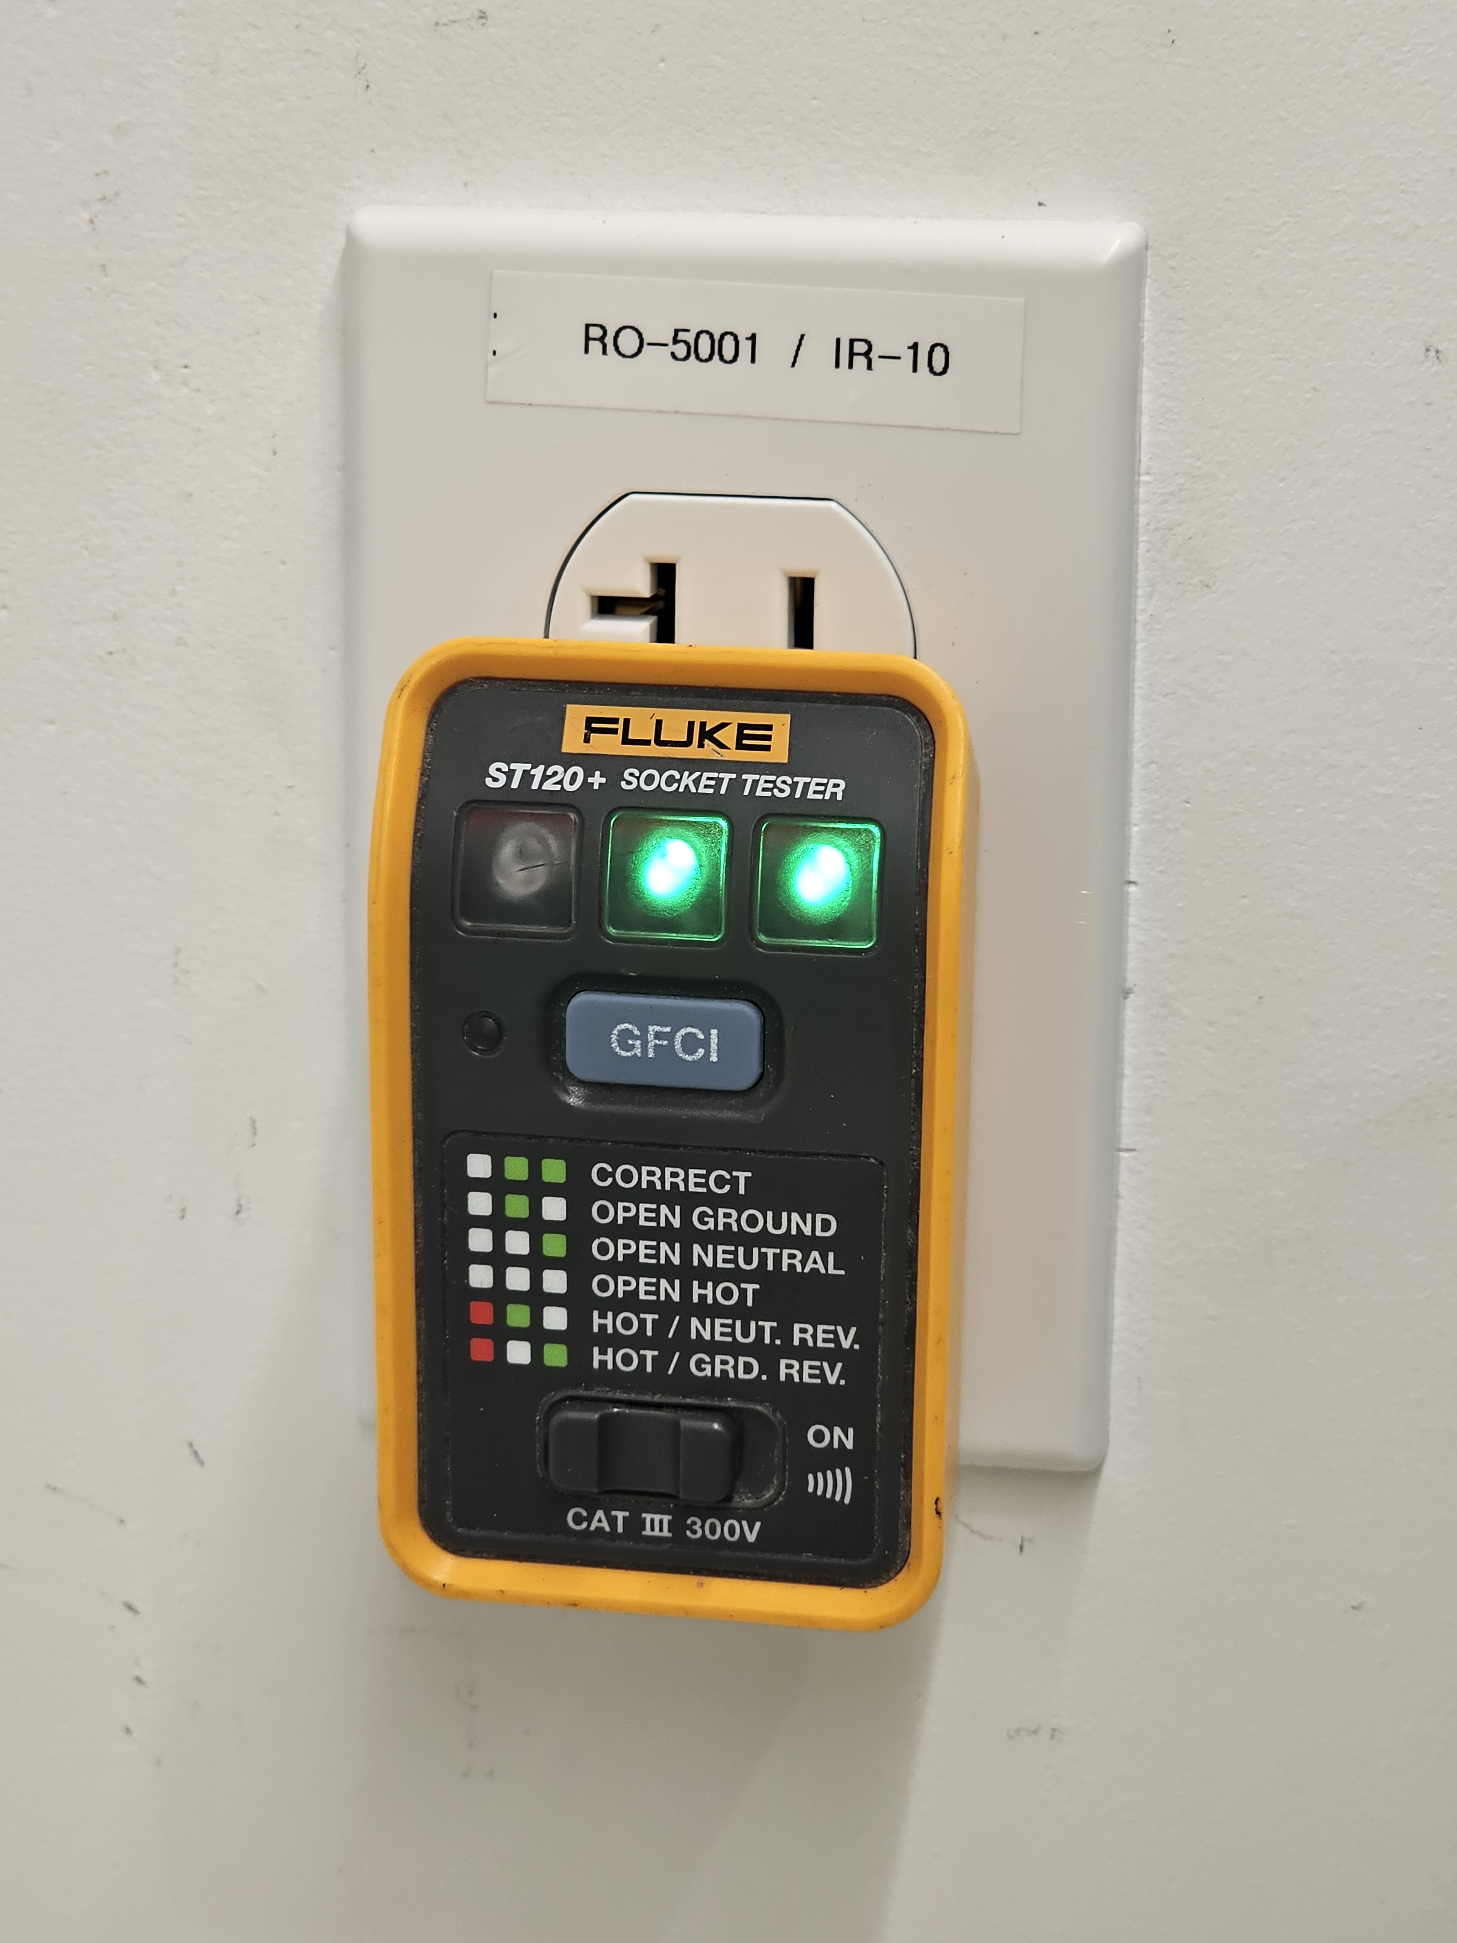
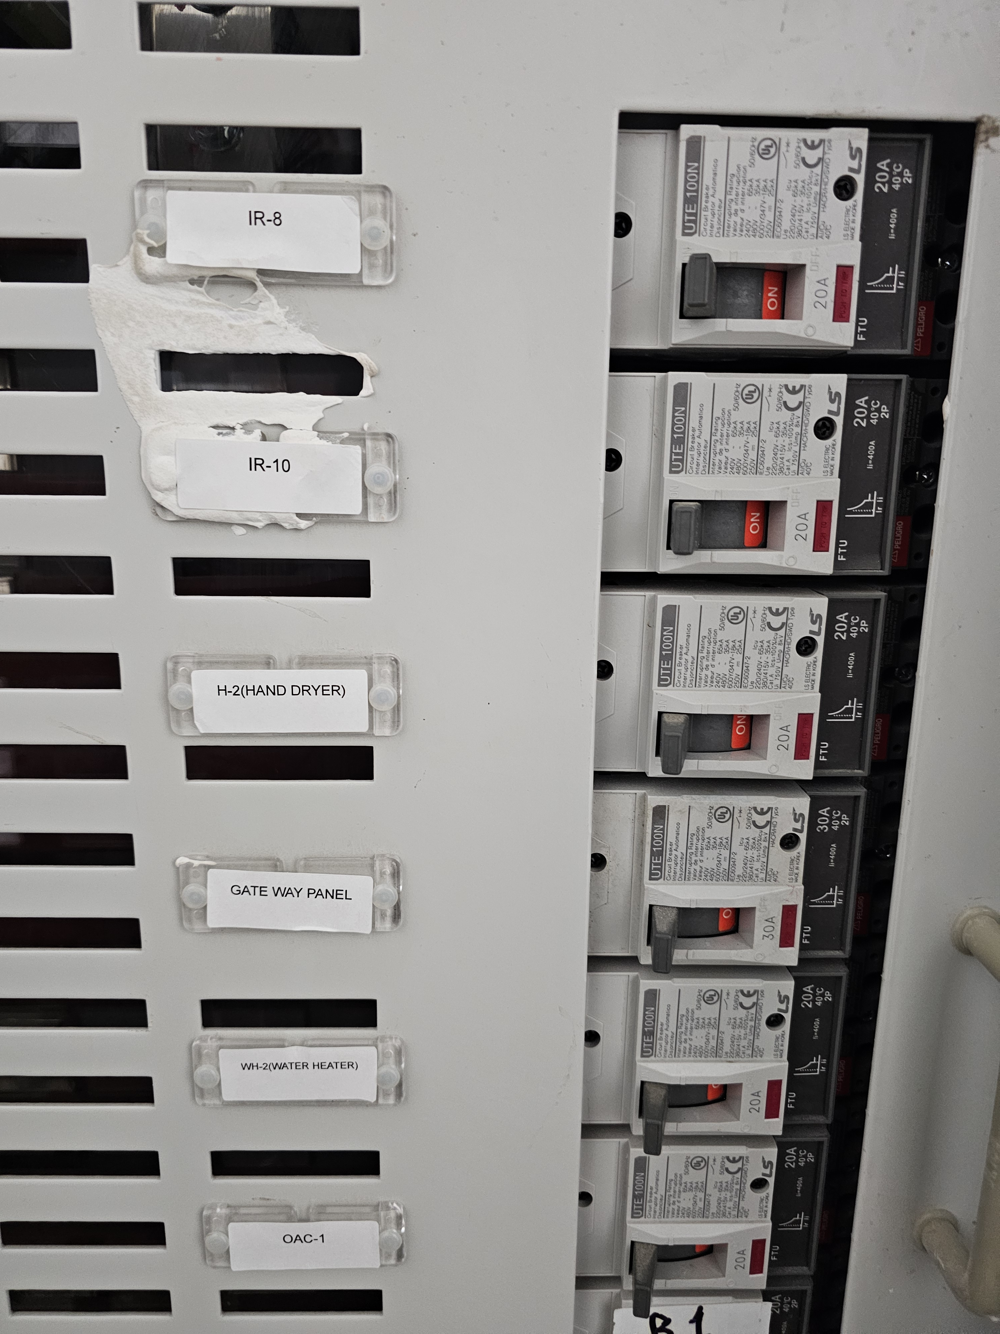
■ 04 PHOTOS OF RECEPTACLE 1 / 1
Project Name | Head Office Receptacle Installation / Hole Cutting | Duration | 2026-07-08
Location | Head Office | Contractor | TK Electric LLC
120V RECEPTACLE INSTALLATION
RECEPTACLE INSTALLATION AND LABELING
RECEPTACLE TESTING
RO-5001 PANELBOARD LABELING / IR-10
6 / 7

Slide 7
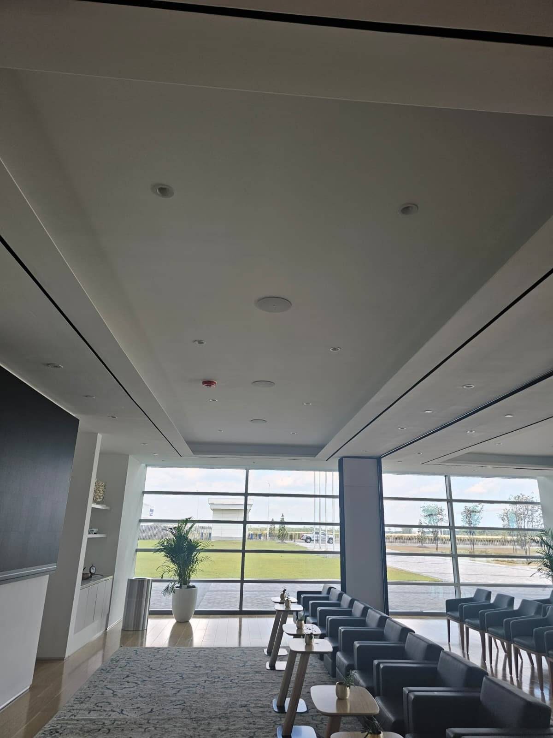
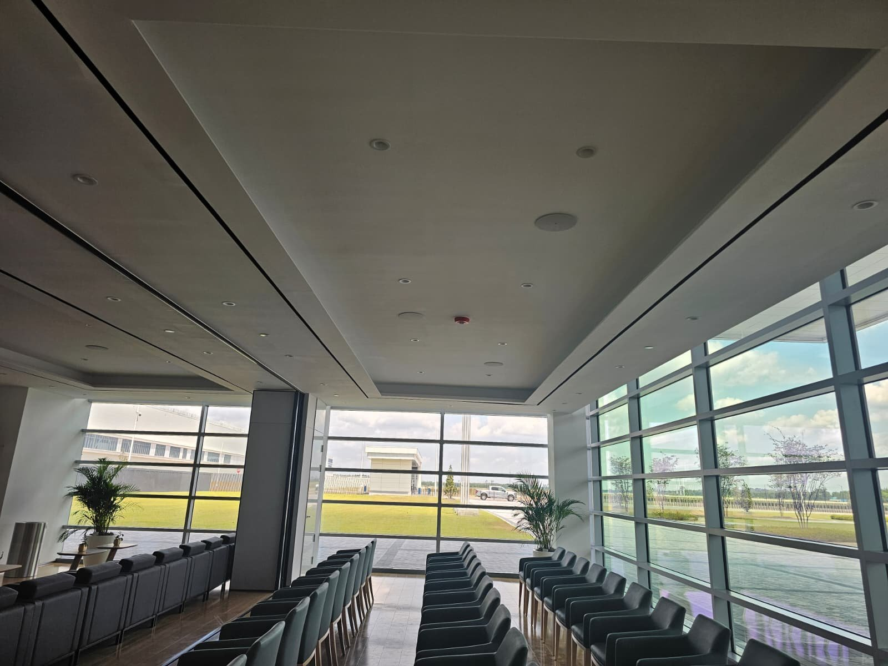
■ 05 PHOTOS OF AUDIO 6 HOLES 1 / 1
Project Name | Head Office Receptacle Installation / Hole Cutting | Duration | 2026-07-08
Location | Head Office | Contractor | TK Electric LLC
AUDIO HOLE FRONT SIDE
AUDIO HOLE BACK SIDE
7 / 7

