Slide 1
Toward Evaluating Quantum Computing Problem Scale Focusing on Operational Constraints in Transportation
82535190 Takuma Sano

Slide 2
Research Background: The Need to Prepare for Unseen Impacts
How can we identify what happens beyond technical success, use cases, and adoption?
Traditional View: Linear Progress
Emerging Perspective: Diffusive Growth
First-order
Second-order
Surrounding
A
B
A
Reframing
the perspective
We cannot fully grasp the complexity
of technological innovation.
Understanding technological innovation requires attention to
first-order, second-order, and broader surrounding effects

Slide 3
Motivation
Assess how quantum technologies can be developed and implemented in society from economic and social perspectives
Integration of quantum technology into society
This research is driven by two fundamental objectives:
1. Pathways of life changes
Explore how quantum technologies may create new forms of value in transportation, a field historically grounded in physics and continuously advanced by information engineering
2. Toward Go / No-Go evaluation
Support responsible decisions on quantum-technology applications by incorporating broader societal perspectives, including those represented by the STEEP framework

Slide 4
Initial Focus: Transport-Computation Use Cases
Integrate economic and social perspectives to assess how quantum technologies can be
developed and implemented in society.
MDR 2 Research Question
For a specific transport-computation task, how can the problem scale and quantum-resource requirements relevant to social implementation be defined and evaluated?.
Why transport?
Near-Term Applicability
Transport optimization provides a suitable application domain because problem instances and operational constraints can be explicitly defined and evaluated.
Broader Application Potential
Transportation also enables examination of how quantum computing may interact with adjacent technologies, including materials discovery, batteries, charging systems, and vehicle technologies.

Slide 5
Research Overview
This research evaluates quantum-resource requirements in relation to transport-specific problem scale, operational constraints, and social-implementation needs.
Current Research Focus
WIP Direction
• Define transport-specific problem instances and operational constraints.
• Extract reported formulations, encodings, circuit widths, and evaluation modalities from quantum-routing studies.
• Compare application requirements with the conditions represented in current quantum-routing research.
•Develop an application-oriented framework for interpreting quantum-resource requirements.
• Relate circuit width to problem-instance definition, operational constraints, formulation and encoding, and evaluation modality.

Slide 6
Survey: What Was Checked and What Was Learned
Reviewed how transport problems are translated into reported circuit widths and how those values are supported through simulation, hardware execution, or resource estimation.
What Was Reviewed
What Was Observed
・Application-oriented quantum benchmarking studies
• Transport-problem instances examined in quantum studies
• Reported circuit widths and resource estimates
• Formulations and encodings used to construct the circuits
• Evaluation modalities supporting the reported results Similar application-instance scales may lead to different circuit widths.
• Circuit width depends on problem instance, formulation, and
encoding.
• Similar problem-instance scales may lead to different circuit widths depending on formulation and encoding.
• Reported qubit counts must be interpreted together with the problem instance, formulation, encoding, and evaluation modality.
• Executing a wide circuit does not, by itself, establish quantum utility.
• Application-side requirements must be defined before resource requirements can be interpreted.

Slide 7
Adapting Application-Oriented Benchmarking to This Study
Rather than executing a standardized benchmark suite, this study reviews evidence
reported in existing transport-problem research.
Application-Oriented Benchmarking Perspectives
Analytical Dimensions Used in This Study Problem Class
Application / Algorithm
Transport Problem Class
Feasible Problem Size
Adapted for Literature-Based Application Comparison
Reported Problem-Instance Scale
Mathematical Formulation
Application-Derived Circuit
Quantum Encoding
Circuit Width and Depth
Reported Circuit Width
Solution Quality
Core Dimensions
Evaluation Modality
Execution Time and Resource Usage
Alignment with Transport Application Requirements
・This study adopts an application-oriented perspective by reviewing results reported in existing quantum-routing studies rather than executing a standardized benchmark suite.
・The analytical approach draws on the application-oriented benchmarking framework proposed by Lubinski et al. and related QED-C work.

Slide 8
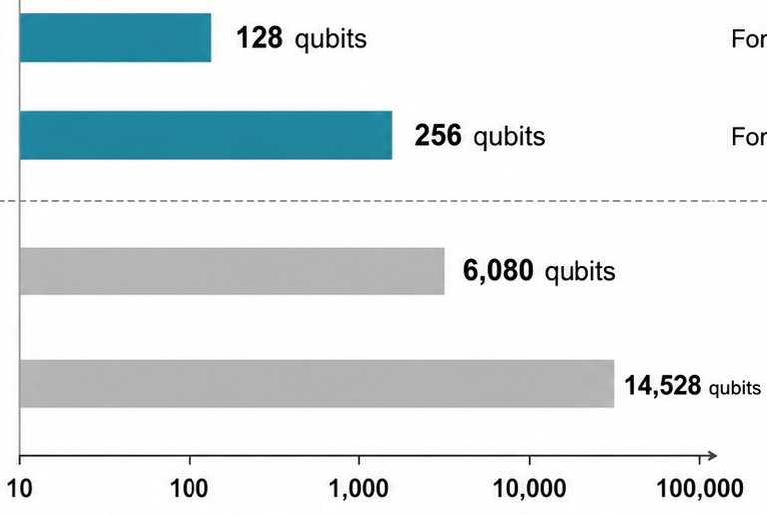
Reported Circuit Width Across Transport Problem Instances
Manually extracted the problem instance, reported qubit count, formulation, encoding, and evaluation modality from each reviewed quantum-routing study and organized them for comparison; representative cases are shown below.
※Reported circuit width depends on the problem instance, formulation, encoding, and evaluation modality; it cannot be inferred from problem scale alone.
※Reported qubit count indicates circuit width, not total computational cost. Practical execution also depends on circuit depth, gate count, connectivity, noise, and compilation overhead.
Reported Circuit Width
Evaluation Modality
Time-window routing problem for determining customer visit order Simplified formulation including only a subset of operational constraints
Simulator
Time-window routing problem for determining customer visit order Full formulation including all time-window, routing, and feasibility constraints defined in the study
Resource Estimator
Calculation using a classical benchmark for vehicle-capacitated delivery routing Capacity constraints represented directly using higher-order binary terms
Calculation using a classical benchmark for vehicle-capacitated delivery routing Capacity constraints converted into quadratic binary form using auxiliary variables

Slide 9
Survey Finding: Application-Side Definition Is Required
The survey indicated that reported circuit width cannot be interpreted without defining the application-side problem instance and required operational constraints.
Survey of quantum routing studies
Problem-instance scale
Operational Constraints
What must be represented?
What must be satisfied?
Reported circuit width
・Customers or delivery locations
・Vehicles and depots
・Route candidates
・Geographic coverage
Payload capacity
Operating time and service
time
Travel distance and usable
range
Time windows
Battery and state-of-charge conditions
Charging access and charging duration
Heterogeneous fleet or multi-depot
conditions
Insufficient without application definition
Application-side definition
Problem-instance scale × Operational constraints
Basis for Interpreting Future Resource Requirements

Slide 10
Problem Scale Alone Is Not Sufficient
. A larger problem instance is not necessarily more representative of real-world transportation operations.
Positioning Quantum-VRP Studies by Problem-Instance Scale and Operational-Constraint Coverage
Small Instance with Rich Operational Constraints
Operationally Representative Application Requirements Potential within this space
Operationally representative
conditions
SOC, and
charging conditions
Potential within this space
Constraint
coverage
Capacity and operating time
Basic routing
Toy Instance
Large Instance with Basic Constraints
Few customers
More vehicles
and customers
Larger variable or
qubit requirements
Problem scale

Slide 11
Evaluation Process for Application-Oriented Quantum-Technology Assessment
The target problem and required constraints must be defined, and the gap between application
requirements and the current technological level must be identified.
Original question
Problem scale and qubit requirements for social implementation
Evaluation Process Used to Review Quantum-Technology Application Studies
Assess Current
Quantum Coverage
Identify the Application–Technology Gap
Define Application
Requirements
Interpret Future Resource
Requirements
Problem scale
Operational constraints
Required Technology and
Validation Stages Validation content by stage
Represented scale
Included constraints
Evaluation modality and validation status
Missing scale
Missing constraints
Transpiration and hardware-related considerations
Gap between required and reported solution quality
【Prerequisites】
Target problem definition
Required-constraint definition
resource estimates become meaningful only after the target problem and required constraints have been defined.

Slide 12
Exploratory Workflow for Transport-Constraint Evaluation
Developed an exploratory workflow to examine transport-specific problem scale, operational constraints, and their representation in current quantum-VRP studies.
Application-Side Evaluation Workflow
Open-Data Inputs
Synthetic Scenario Generation
Route-Proxy Construction
Operational-Constraint Evaluation
Configuration and Parameter Checks
Comparison with Quantum-VRP Studies

Slide 13
Open Data Inputs and Their Analytical Roles
Open data were used to define the spatial and technical conditions of the scenarios, while
customer demand, route construction, and operational outcomes remained synthetic or proxied.
Open-data input | Records Used | Analytical Role | What it does not represent
e-Stat Tokyo population mesh | 5,448 mesh cells | Used as population weights for sampling synthetic customer locations and as the spatial population context | Observed customer demand or delivery records
Open Charge Map connections clipped to Tokyo | 137 charger-connection records | Used to screen charger candidates, calculate nearest-candidate distance, and evaluate geographic access and simplified charging support | Real-time availability, queues, or actual charger use
Public logistics-facility depot proxy snapshot | 440 depot candidates | Used to define candidate depot locations and select a depot proxy for route construction | Actual company depots or operational capacity
Public vehicle-specification snapshot | 10 vehicle records | Used to define battery capacity, catalog range, payload capacity, and the usable-range assumption

Slide 14
Problem Scale and Scenario Design
Category | Evaluation Dimension | Current Setting
Problem Scale | Number of customers | 25, 50, 100
 | Number of vehicles | 1, 3, 5
 | Charger-availability condition | Conservative, Balanced, Broad
Operational Assumptions | Usable driving range | 81.2 km
 | Vehicle payload capacity | 2,000 kg
 | Operating-time limit | 480 min
 | Assumed travel speed | 25 km/h
Scenario Design | Factorial scenario structure | 3 × 3 × 3
 | Total scenario configurations | 27
 | Independent random seeds | 100
 | Configurations by customer-count level | 300
Evaluation Volume | Conditional evaluations | 2,700
 | Route-condition evaluations | 8,100
 | Synthetic customer records | 17,500
 | Bootstrap iterations | 1,000

Slide 15
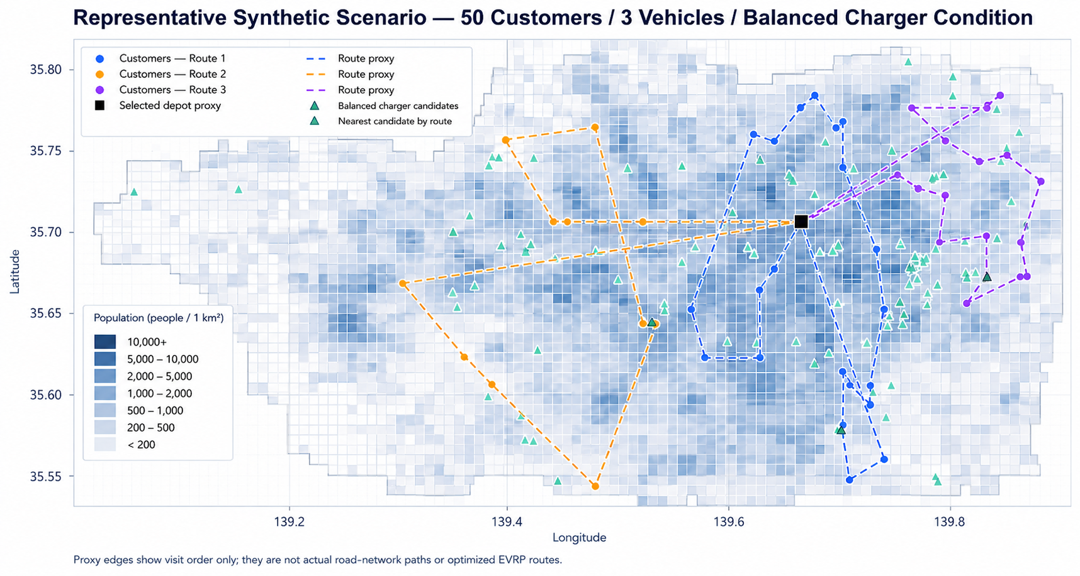
Generated Scenario Map and Route Proxy
constructed a common route proxy to compare how customer configurations and vehicle assignments affect the evaluated operational constraints
※The map is illustrative and does not represent an optimized EVRP solution, an observed delivery route, or an actual road-network route.

Slide 16
Provisional Evaluation of Operational Constraints
Under the current synthetic conditions, we summarized each operational constraint by its model-conditional unmet rate, evaluation method, and current analytical basis.
Constraint | Model-Conditional Unmet Rate | Evaluation Method | Current Basis and Limitation
Payload capacity | 0.0% | Route demand compared with vehicle capacity | Synthetic data with assumed parameters
Operating-time limit | 33.5% | Estimated travel and service duration compared with the operating-time limit | Synthetic route proxy with assumed parameters
Range feasibility | 64.4% | Route-proxy distance compared with usable vehicle range | Manufacturer range with assumed usable ratio and route proxy
SOC feasibility | Not evaluated | Sequential state-of-charge modeling required | Not evaluated
Charging-station access | 10.7% | Distance from route-proxy nodes to retained charger candidates | Public candidate geography with substantial attribute missingness
Charging-assisted range feasibility | 33.3% | Simplified charging support for range-infeasible routes | Simplified proxy with public candidate geography
Charging-duration feasibility | 15.3% | Simplified duration condition using reported charger power | Simplified duration proxy; actual charging behavior not evaluated

Slide 17
Variation Across Customer Configurations and Analytical Conditions
We examined whether the provisional constraint results vary across customer configurations and one-at-a-time parameter changes.
Constraint | Spatial Variability | Parameter Sensitivity | Main Related Conditions
Payload capacity | Low | Low | Synthetic demand and vehicle capacity; no change in the evaluated one-at-a-time range
Operating-time limit | Low | High | Vehicle count; customer count; time limit; service time; speed
Range feasibility | Medium | High | Vehicle count; customer count; usable range/SOC reserve; road-distance multiplier
SOC feasibility | Not assessable | Not assessable | Sequential SOC model required
Charging-station access | Low | Low | Charger candidate set and access threshold; no change in the balanced-reference one-at-a-time design
Charging-assisted range feasibility | Medium | High | Vehicle count; customer count; usable range/SOC reserve; road-distance multiplier
Charging-duration feasibility | Low | High | Vehicle count; duration limit; customer count

Slide 18
Application Requirements and Their Representation in Quantum-VRP Studies
distinguished whether an application requirement is represented in the reviewed quantum-VRP studies from how that requirement has been evaluated or validated.
Requirement group | Application-side check | Representation in the Reviewed Studies | Next clarification
Scale | Customers, vehicles, customers/vehicle | Varies across studies | Comparable scale indicators
Core Routing Constraints | Payload, operating time | Partially represented | Common evaluation conditions
EV-Specific Operational Constraints | Range, SOC, charging access | Limited in reviewed set | EVRP-specific formulation
Evaluation and Validation Modality | Evidence type and comparison | Varies across studies | Representation vs validation

Slide 19
Discussion: Two Directions for the Next Research Stage
The next research stage can either increase the operational realism of the optimization problem or develop a broader framework linking problem instances, quantum-technology stages, and evolving transportation requirements.
Toward Real-World Optimization
Toward an Application-Stage Framework
Problem instances and required constraints
Road-network-based distances
Expected quantum-technology stages
Calibrated or observed demand
Staged quantum utility
Time windows, SOC, and charging dynamics
Adjacent technologies: materials, batteries
Classical optimization baseline
Expert expectations and social requirements
Operational validation
A more realistic and validated transportation-optimization study
A framework for examining how application requirements evolve with quantum and transportation technologies

Slide 20
1. literatures and Open Data
Application Study
Quantum Routing Studies Reviewed for Circuit-Width Extraction
Azad et al. (2020) Solving Vehicle Routing Problem Using Quantum Approximate Optimization Algorithm. arXiv:2002.01351 https://arxiv.org/abs/2002.01351
Palackal et al. (2023) Quantum-Assisted Solution Paths for the Capacitated Vehicle Routing Problem. arXiv:2304.09629 https://arxiv.org/abs/2304.09629
Xie et al. (2023) A Feasibility-Preserved Quantum Approximate Solver for the Capacitated Vehicle Routing Problem. arXiv:2308.08785 https://arxiv.org/abs/2308.08785
Leonidas et al. (2023) Qubit-Efficient Quantum Algorithms for the Vehicle Routing Problem on NISQ Processors. arXiv:2306.08507 https://arxiv.org/abs/2306.08507
Fitzek et al. (2024) Applying Quantum Approximate Optimization to the Heterogeneous Vehicle Routing Problem. Scientific Reports, 14, 25415 https://doi.org/10.1038/s41598-024-76967-w
Azfar et al. (2025) Quantum-Assisted Vehicle Routing: Realizing a QAOA-Based Approach on a Gate-Based Quantum Computer. arXiv:2505.01614 https://arxiv.org/abs/2505.01614
Reference [7]

Slide 21
2. Literatures and Open Data
Methodology
QED-C–Related Benchmarking Methodology
Lubinski et al. (2021) Application-Oriented Performance Benchmarks for Quantum Computing. https://arxiv.org/abs/2110.03137
Lubinski et al. (2023) Optimization Applications as Quantum Performance Benchmarks. https://arxiv.org/abs/2302.02278
Lubinski et al. (2024) Quantum Algorithm Exploration Using Application-Oriented Performance Benchmarks. https://arxiv.org/abs/2402.08985
Quantum Utility and Practical Quantum Advantage
Herrmann et al. (2023) Quantum Utility—Definition and Assessment of a Practical Quantum Advantage. https://arxiv.org/abs/2303.02138
Beverland et al. (2022) Assessing Requirements to Scale to Practical Quantum Advantage. https://arxiv.org/abs/2211.07629
Application-Specific Quantum-Resource Study
Onah and Michielsen (2025) Requirements for Early Quantum Advantage and Quantum Utility in the Capacitated Vehicle Routing Problem.
https://arxiv.org/abs/2509.11469

Slide 22
3. Literatures and Open Data
Data
Used in the Current Analysis
e-Stat — 2020 Population Census: Grid Square Statistics
Open Charge Map — Open Charge Map API
Reviewed but Not Used in the Current Analysis
International Energy Agency — Global EV Data Explorer
World Bank — Logistics Performance Index
OpenStreetMap / Geofabrik — Kanto Road-Network Data
Tokyo Metropolitan Bureau of Transportation / ODPT — GTFS and Public Transportation Open Data
Japan Road Traffic Information Center — Open Traffic Information API
Tokyo Metropolitan Police Department / Tokyo Open Data Catalog — Traffic Volume Statistics
Schneider / Goeke — Public E-VRPTW Benchmark Instances
Mavrovouniotis et al. — Public E-CVRP Benchmark Instances
CVRPLIB — Public CVRP Benchmark Library

