Slide 1
Multithreading in .NET
Magesh. K

Slide 2
Agenda
Day – 1
Overview
Concurrency using Threads
Concurrency using Tasks
Parallel Programming
Day – 2
Synchronization
Async and Await in .NET 4.5
Multithreading in WPF, ASP.NET & ASP.NET MVC
Debugging Techniques

Slide 3
Process And Thread

Slide 4
Thread Overhead
Thread Kernel Object
Thread Environment Block
User-mode Stack
Kernel-mode Stack

Slide 5
Thread Kernel Object
A data structure created for each thread
Contains properties that describe the thread
Also contains the thread’s context
A block of memory that contains a set of CPU registers

Slide 6
Thread Environment Block
The TEB is a block of memory allocated and initialized in the user mode (address space that application can quickly access)
Consumes 1 page of memory (4kb)
Contains the head of the thread’s exception-handling chain
Each try block that the thread enters inserts a node in the head of this chain; the node is removed from the chain when the thread exits the try block.
Also contains the thread’s local storage data

Slide 7
User-mode stack
The user-mode stack is used for local variables and arguments passed to methods.
It also contains the address indicating what the thread should execute next when the current method returns.
By default, Windows allocates 1 MB of memory for each thread’s user-mode stack.

Slide 8
Kernel-mode Stack
The kernel-mode stack is also used when application code passes arguments to a kernel-mode function in the operating system.
For security reasons, Windows copies any arguments passed from user-mode code to the kernel from the thread’s user-mode stack to the thread’s kernel-mode stack.
12KB on 32-bit windows and 24KB on 64-bit windows

Slide 9
Stop the madness

Slide 10
CPU Trends
Multiple CPUs
Hyperthreaded Chips
Multi-core Chips

Slide 11
Multiple CPU
Some computers just have multiple CPUs in them. That is, the motherboard has multiple sockets on it, with each socket containing a CPU.
Because the motherboard must be bigger, the computer case is bigger as well
These kinds of computers have been around for a few decades, but they are not as popular today due to their increased size and cost.

Slide 12
Hyperthreaded chips
This technology (owned by Intel) allows a single chip to look like two chips.
The chip contains two sets of architectural states, such as CPU registers, but the chip has only one set of execution resources. To Windows, this looks like there are two CPUs in the
machine, so Windows schedules two threads concurrently.
However, the chip only executes one of the threads at a time.
Windows believes that both threads are running concurrently.
Windows does know about hyperthreaded CPUs, and if you have multiple hyperthreaded CPUs in a single machine, Windows will first schedule one thread on each CPU so that the threads are truly running concurrently and then schedule other threads on the already-busy CPUs.
Intel claims that a hyperthreaded CPU can improve performance by 10 percent to 30 percent.

Slide 13
Multi-core chips
Single chips containing multiple CPU cores

Slide 14
Demo
Demo creating a simple thread

Slide 15
Reasons to use Threads
Responsiveness
Performance

Slide 16
Thread Scheduling and Priority
Windows is called a preemptive multithreaded operating system because a thread can be stopped at any time and another thread can be scheduled.
The context structure of each thread reflects the current state of the thread
After a time slice, Windows looks at all the thread kernel objects currently in existence.
Of these objects, only the threads that are not waiting for something are considered schedulable.
Windows selects one of the schedulable thread kernel objects and context switches to it.

Slide 17
Demo
Spy++

Slide 18
Thread Priority
Every thread is assigned a priority level ranging from 0 (the lowest) to 31 (the highest).
When the system decides which thread to assign to a CPU, it examines the priority 31 threads first and schedules them in a round-robin fashion. If a priority 31 thread is schedulable, it is assigned to a CPU.
At the end of this thread’s time-slice, the system checks to see whether there is another priority 31 thread that can run; if so, it allows that thread to be assigned to a CPU.

Slide 19
Starvation
As long as priority 31 threads are schedulable, the system never assigns any thread with a priority of 0 through 30 to a CPU.
This condition is called starvation, and it occurs when higher-priority threads use so much CPU time that they prevent lower-priority threads from executing.

Slide 20
Higher-priority threads always preempt lower-priority threads, regardless of what the lower-priority threads are executing.
For example, if a priority 5 thread is running and the system determines that a higher-priority thread is ready to run, the system immediately suspends the lower-priority thread (even if it’s in the middle of its time-slice) and assigns the CPU to the higher-priority thread, which gets a full time-slice.

Slide 21
Process Priority
Microsoft realized that assigning priority levels to threads was going to be too hard for developers to rationalize.
To resolve this issue, Windows exposes an abstract layer over the priority level system.
When designing your application, you should decide whether your application needs to be more or less responsive than other applications that may be running on the machine.
Then you choose a process priority class to reflect your decision.
Windows supports six process priority classes:
Idle
Below Normal
Normal
Above Normal
High
Realtime.
Of course, Normal is the default and is therefore the most common priority class by far.

Slide 22
Relative Thread Priorities
Windows supports seven relative thread priorities:
Idle
Lowest
Below Normal
Normal
Above Normal
Highest
Time-Critical.
These priorities are relative to the process’s priority class.

Slide 23
In summary, your process is a member of a priority class and within that process you assign thread priorities that are relative to each other.
The system maps the process’s priority class and a thread’s relative priority to a priority level.

Slide 24
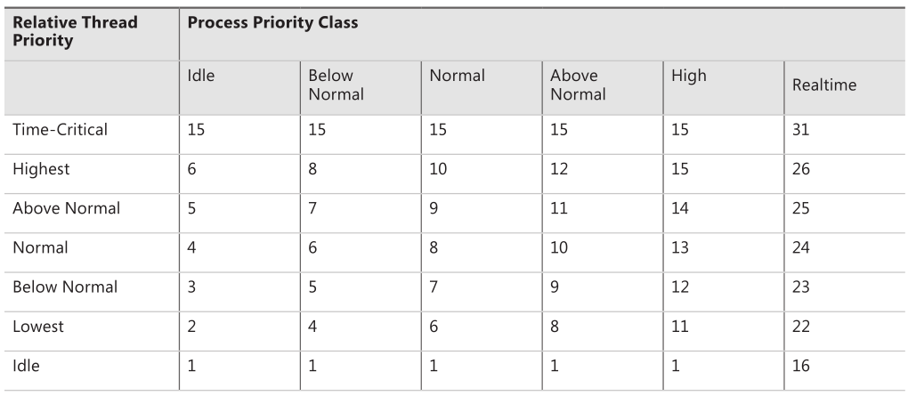
Priority Table

Slide 25
Synchronization
Coordinating the actions of threads for a predictable outcome
Particularly important when threads access the same data

Slide 26
Synchronization Construct
Categories
Simple Blocking Methods
Locking Constructs
Signaling Constructs
Non Blocking Synchronization Constructs

Slide 27
Simple Blocking
A thread is deemed blocked when its execution is paused for some reason such as sleeping or waiting or another to end via join
A blocked thread immediately yields its time slice and consumes no processor time until its blocking condition is satisfied
Unlocking happens in one of four ways
By the blocking condition being satisfied
By the operation timing out
By being interrupted via Thread.Interrupt
By being aborted via Thread.Abort

Slide 28
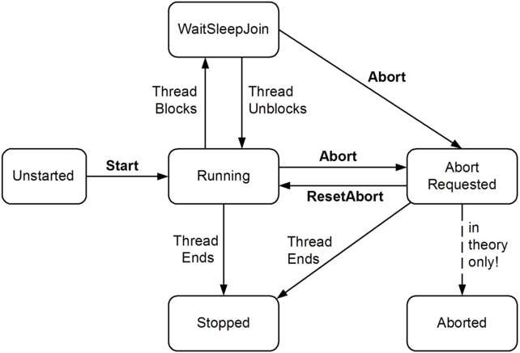
Thread State

Slide 29
Locking
Exclusive locking is used to ensure that only one thread can enter particular sections of code at a time.
Constructs
lock
More efficient
Overhead – 20ns only
Mutex
Overhead – 1000ns
Cross process possibility

Slide 30
Monitor
C#’s lock statement is a syntactic sugar over Monitor.Enter & Monitor.Exit
Monitor.Enter (_locker);
try
{
if (_val2 != 0) Console.WriteLine (_val1 / _val2);
_val2 = 0;
}
finally { Monitor.Exit (_locker); }

Slide 31
Deadlocks
A deadlock happens when two threads each wait for a resource held by the other so neither can proceed.
object locker1 = new object();
object locker2 = new object();
new Thread (() => {
lock (locker1){
Thread.Sleep (1000);
lock (locker2); // Deadlock
}
}).Start();
lock (locker2) {
Thread.Sleep (1000);
lock (locker1); // Deadlock
}

Slide 32
Mutex
A Mutex is like a C# lock, but it can work across multiple processes.
A Mutex is 50 times slower than a lock

Slide 33
Mutex Demo

Slide 34
Semaphore
A semaphore has a capacity
A limited number of threads can gain access to the locked resource
For each thread releasing the resource, a new thread gains access
Semaphores can be useful in limiting concurrency – preventing too many threads from executing a particular piece of code at once

Slide 35
Semaphores - Demo

Slide 36
Signaling
Signaling is when one thread waits until it receives notification from another.

Slide 37
Event Wait Handles
Event wait handles are used for signaling
Simple constructs
Three flavors
AutoResetEvent
ManualResetEvent
CountdownEvent

Slide 38
AutoResetEvent
Allows a thread to unblock once when it receives a signal from another
Can signal across cross process threads
Comes with a overhead of 1000ns

Slide 39
AutoResetEvent Demo

Slide 40
Producer-Consumer Queue Demo

Slide 41
ManualResetEvent
A ManualResetEvent functions like an ordinary gate. Calling “Set” opens the gate, allowing any number of threads calling “WaitOne” to be let through.
Calling “Reset” closes the gate. Threads that call WaitOne on a closed gate will block
When the gate is next opened, they will be released all at once
Apart from these differences, a ManualResetEvent functions like an AutoResetEvent

Slide 42
CountdownEvent
A CountDownEvent lets you wait on more than one thread.
To use CountDownEvent, instanciate the class with the number o threads or “counts” that you want to wait on.
Calling “Signal” decrements the “count”; calling “Wait” blocks until the cout goes down to zero.

Slide 43
CountdownEvent Demo

Slide 44
Synchronization Context
An alternative to locking manually is to lock declaratively.
By deriving from ContextBoundObject and applying the “Synchronization” attribute, you instruct the CLR to apply locking manualy

Slide 45
Synchronization Context Demo

Slide 46
Resources
Patterns in Parallel Programming
http://tinyurl.com/tpl-book
Microsoft’s main site for parallel
http://msdn.microsoft.com/concurrency
Eduasync – Jon Skeet
msmvps.com/blogs/jon_skeet/archive/tags/Eduasync/default.aspx
Parallel Programming Videos – Channel9
http://channel9.msdn.com/Tags/parallel+extensions
LINQ Videos – http://bit.ly/linqvideos
.NET Multithreading
http://www.manning.com/dennis/

