Slide 1

Group Recommendations: Handling Disagreement
Simply choosing movies with the highest average ratings may leave some group members unhappy.
To fix this, we need a way to measure disagreement between users and include it when generating group suggestions.
The goal is to find a fair balance between what most people like and what nobody hates.

Slide 2

Two approaches for generating group recommendations
Two-stage ranking: Get top n movies with a selected method first (pearson, spearman) and strategy (average, least misery). Then we apply rank_by_lowest_disagreement-function for the result, which reranks the top n movies in asceding order by std
Consensus scoring: Compute the mean and standard deviation for all movies, then calculate a consensus score for each one using the following formula:

Slide 3
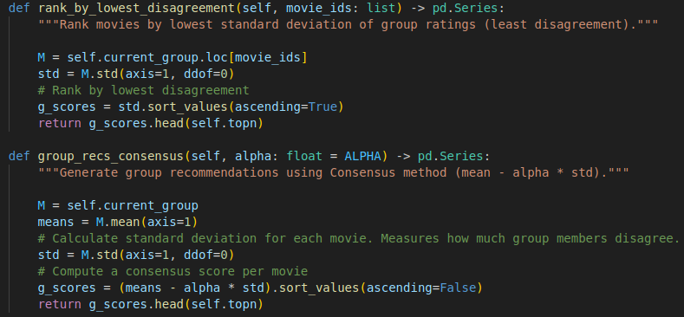
Implementation

Slide 4
Why it helps?
A very high mean from split opinions (love/hate) gets penalized.
Higher chance everyone is okay with the pick (lower risk of someone hating it).
Ff everyone likes an item more, its consensus score rises.
It’s a drop-in replacement for Average. Only parameter is α

