Slide 2
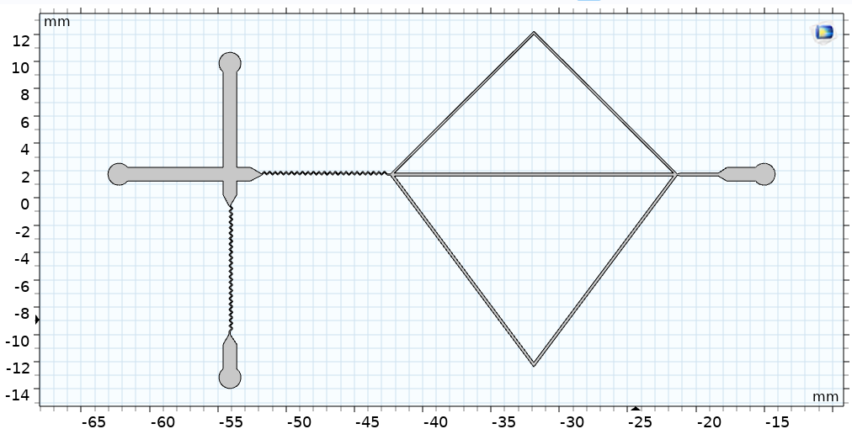
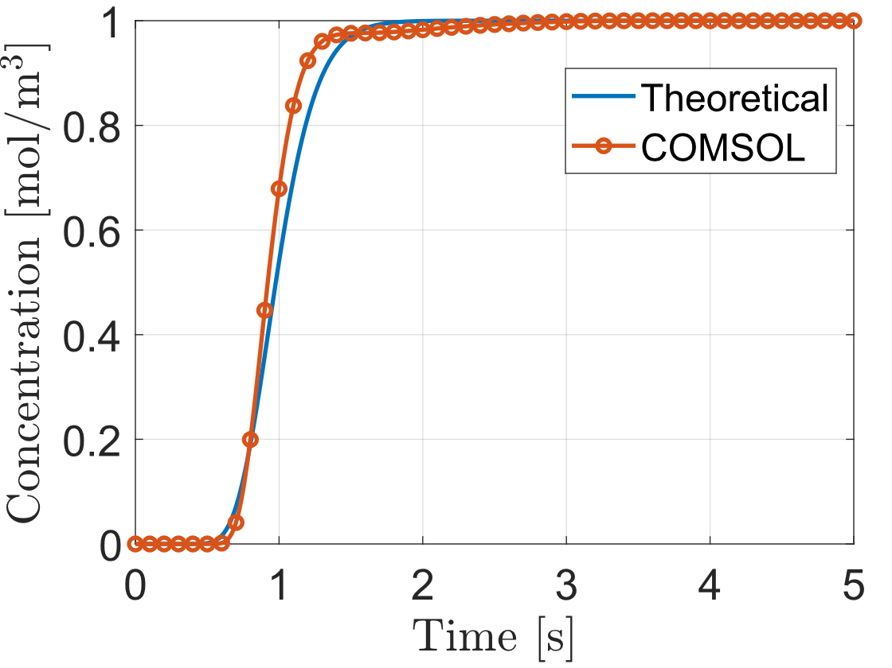
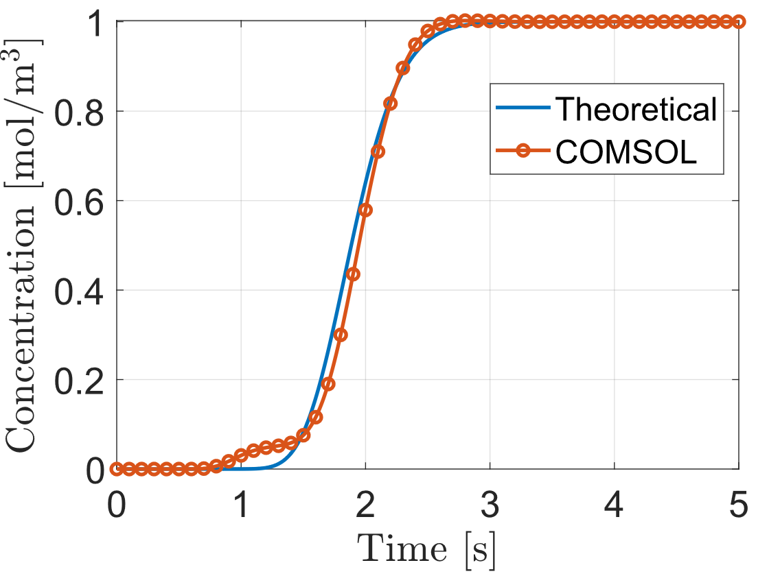
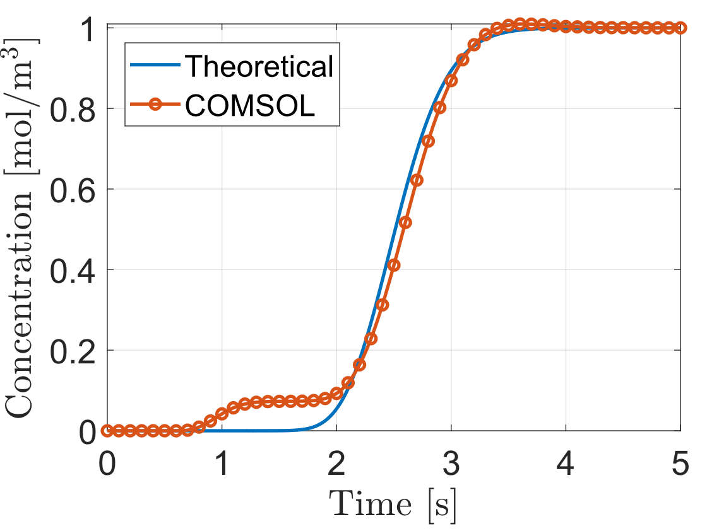
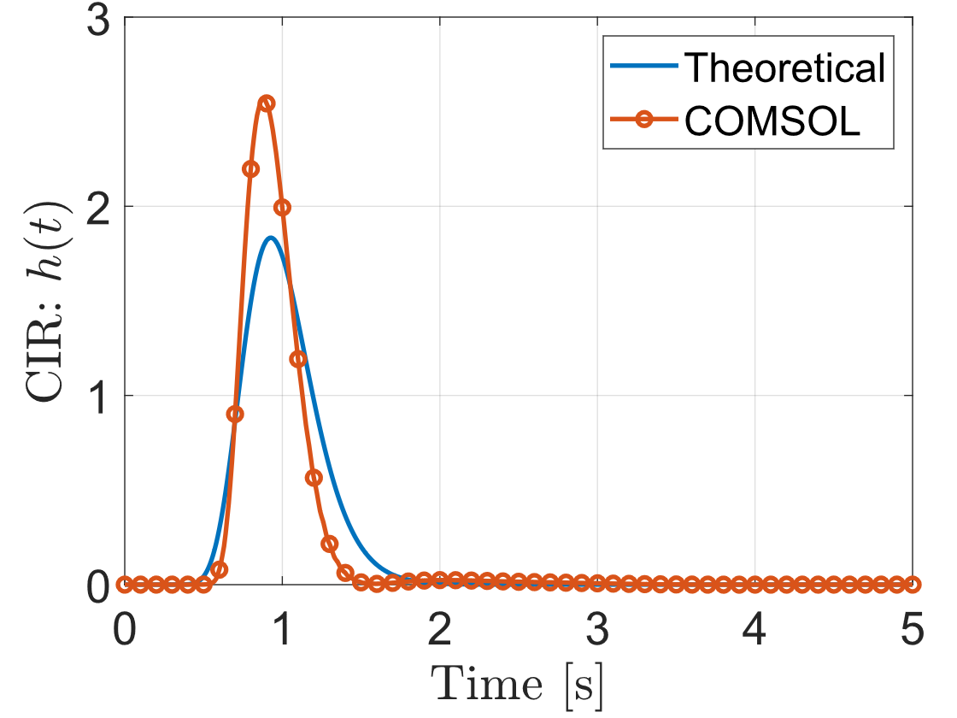
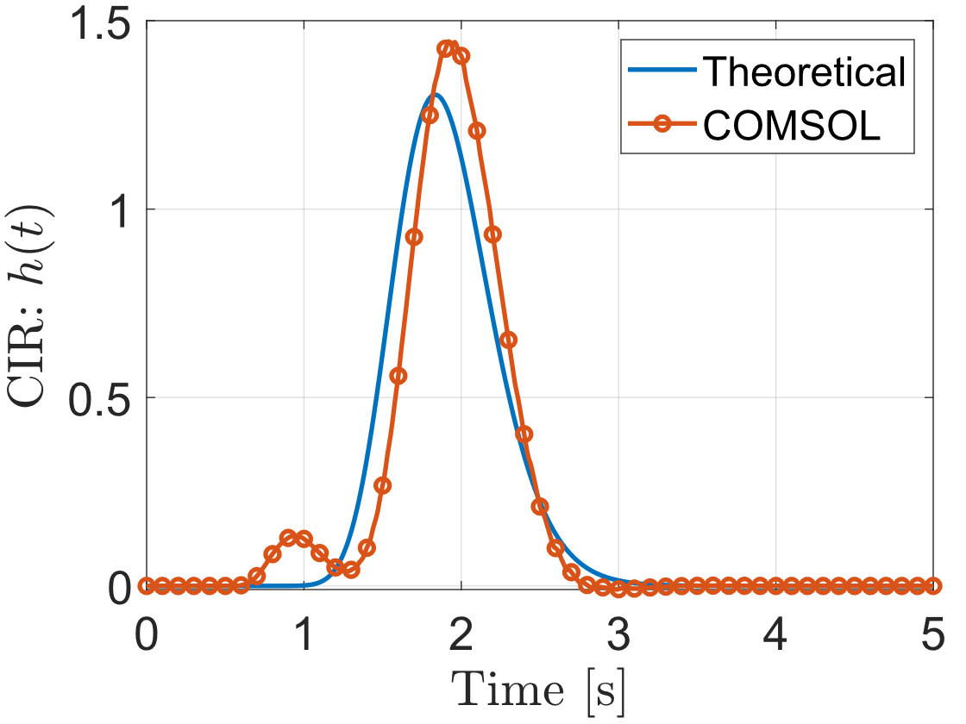
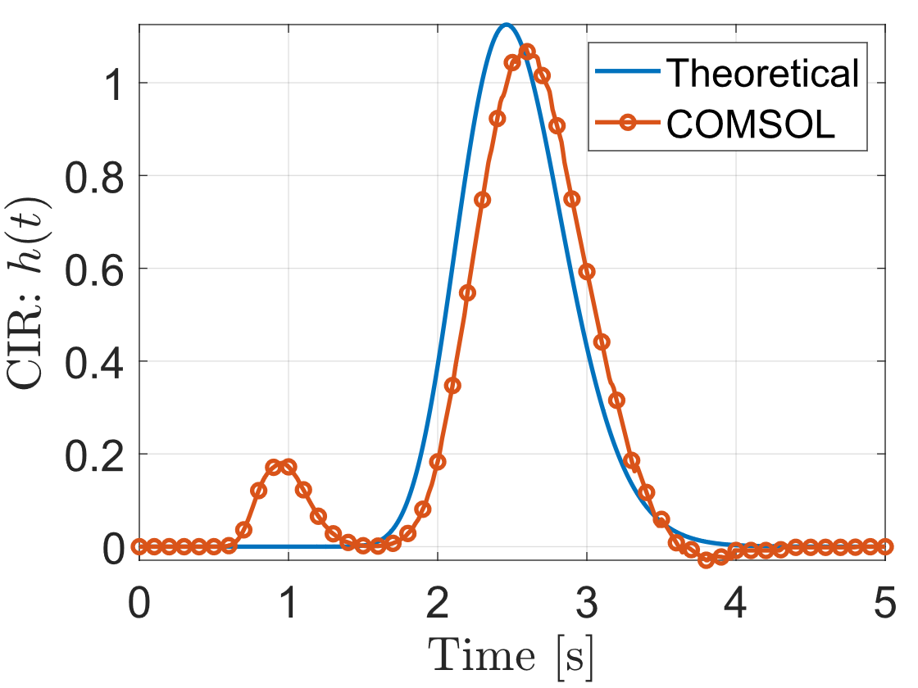
Experiment: Design 1.1
Design 1.1
Pipe 2
Pipe 1
Purpose
Validate the synchronization of pulses through the three different pipes.
Architecture
Transmitter + CNN
Dimensions
Total size: 4.8 x 2.9 cm
Chemicals
Tartrazine and H2O
Study phase
Theoretical calculations completed
Simulation in COMSOL completed
Experimental validation is missing
Pipe 3
Pipe 1
Pipe 2

Slide 3
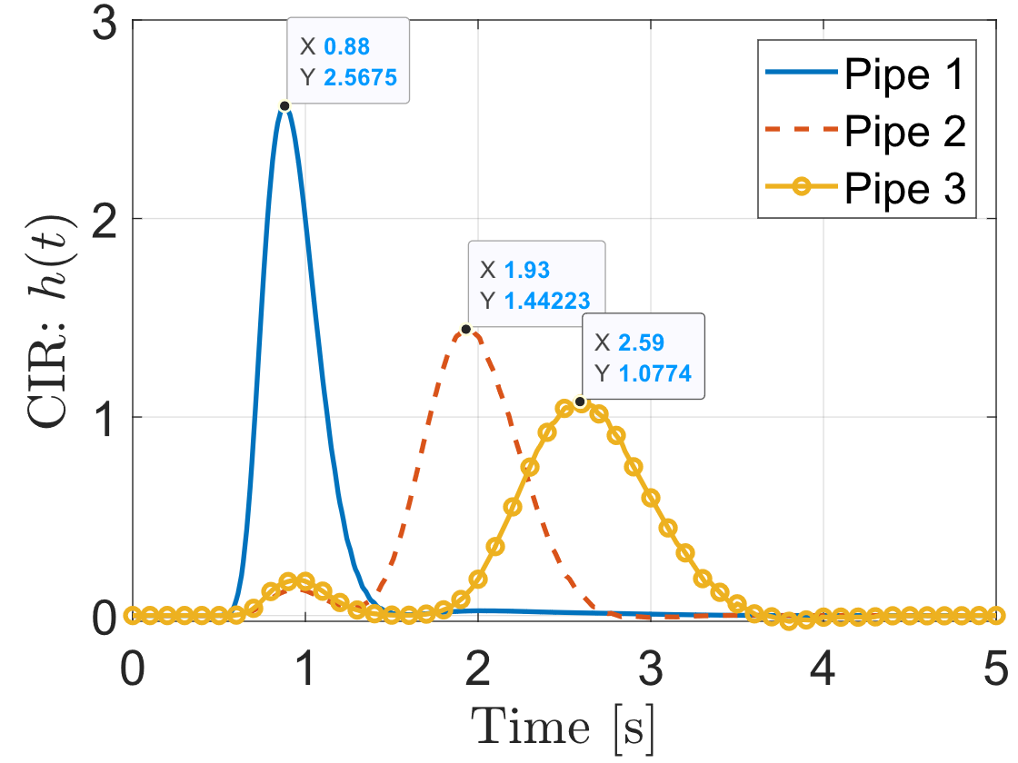
Experiment 1: Design 1.1
Design 1.1
Pipe 2
Pipe 1
Purpose
Validate the synchronization of pulses through the three different pipes.
Architecture
Transmitter + CNN
Dimensions
Total size: 4.8 x 2.9 cm
Chemicals
Tartrazine and H2O
Study phase
Theoretical calculations completed
Simulation in COMSOL completed
Experimental validation is missing
Pipe 3

