Slide 1
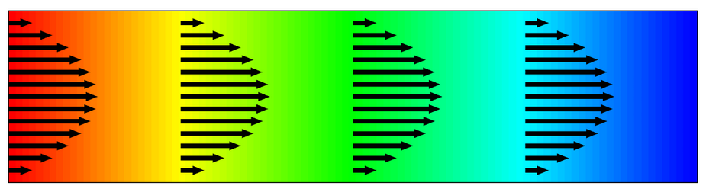

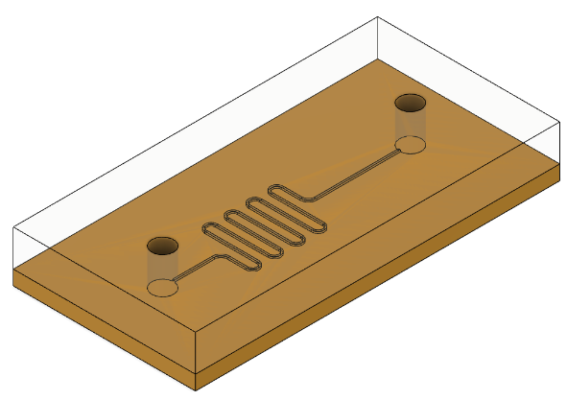












Single Neuron Scheme
$$b$$
Activation
Function
$$x_{1}$$
$$ω_{1}$$
$$y=\sum_{i}{ω_{i}x_{i}}+b$$
$$z=σ(y)$$
$$x_{2}$$
$$ω_{2}$$
$$+$$
$$⋯$$
$$⋯$$
$$x_{N}$$
$$ω_{N}$$
Transport of Diluted Species
Chemical
Reaction
Microfluidic Circuit

