Slide 1
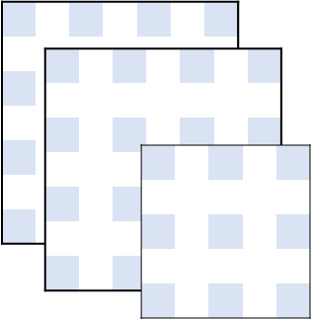





SIM 2
Neural
Network
SIM 1
$$𝕴\left(t\right)$$
$$Q_{1}$$
$$⋯$$
$$Q_{n}$$
$$Υ_{0}(ξ_{i,t})$$
Optimal
Policy

Slide 2

SIM
FPGA
Mobile
User

